Slide 1
Communicating Student Learning (CSL)
________________________________
January 24, 2022
PAC Meeting
Notes:
Kam (1-5)

Slide 2
Why the Shift from Summative to Formative Reporting?
These changes in communicating with parents are part of the Redesigned BC Curriculum.
Based on current assessment research, ongoing personal feedback, embedded in daily instruction, and examples of student work are more critical to supporting student learning than simply reporting on student results.
The communication is based on clear standards and expectations and is intended to make learning visible.
Students are encouraged to think of the questions:
Where am I now?
Where am I going?
What do I need to do to get there?
Notes:
Kam (1-5)

Slide 3
5 Required Communications with Parent(s) in a school year
One written Progress Report mid year (January)
One written Summative Report at the end of June
A minimum of three ongoing communications of student learning throughout the school year (timing at the teacher’s discretion)
Notes:
Kam (1-5)

Slide 4
What can Ongoing Communication with Parents Look Like?
Three-way conferences, Celebrations of Learning
Reflections about Concerts/Performances/Presentations
e-Portfolio reviews- MyBluePrint, Teams, etc.
Paper portfolio reviews
Student and Teacher reflections about student work
Telephone conversations, emails
Notes:
Laura 9-14

Slide 5
Understanding Your Child’s Mid-Year Report
STUDENT’S LEARNING STRENGTHS
Areas where your child is demonstrating learning goals successfully and gives examples of how they are showing these strengths.
It is personalized account of the successes your child is demonstrating at this point in the year.
May also include strength-based comments about work habits, efforts, participation, and behaviour in addition to curriculum based examples.

Slide 6
Understanding Your Child’s Mid-Year Report
AREAS FOR GROWTH
Some areas for further growth and development and for which the teacher will be providing support and guidance to your child.
These serve as learning goals for your child’s journey at their grade level between now and the end of the school year.
The areas for growth may reflect goals discussed in conferences in the fall, student’s own self-reflections or goals from an IEP.

Slide 7
Understanding Your Child’s Mid-Year Report
WAYS TO SUPPORT LEARNING
Some specific ways that teachers and families can work together at school and at home to support your child.
This learning will occur within the framework of the classroom, and support is expected at home only when communicated directly to you by your teacher.

Slide 8
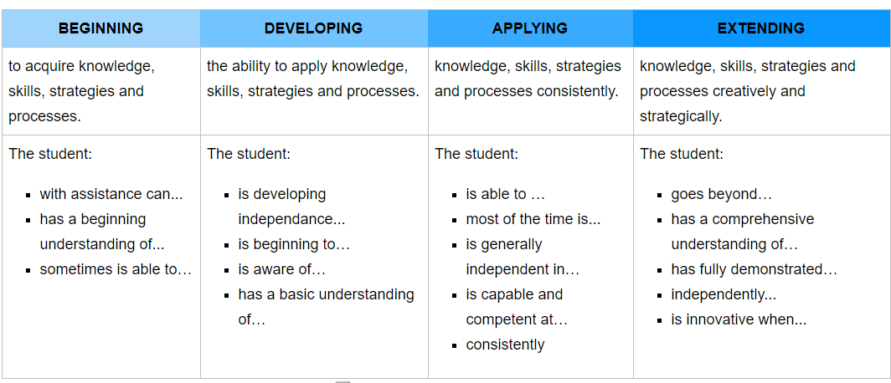
Student Competency Scale on Mid and Year End Reports
Notes:
Sandra

Slide 9
CSL REPORTS GO HOME ON
Tuesday, January 31

Slide 10
Questions

