Slide 1

Agenda
Introductions
Welcome from PAC
Who’s Who & What Do They Do?
MyEd
Grade 8 Schedules & calendars
School Cash Online (Parent HelpLine)
Getting Involved

Slide 2

KING GEORGE PAC
Raised 10K+ through various fundraisers during 2022-23 school year
  Direct Appeal (ongoing throughout the year, get yout tax receipt)
  Pizza Lunch Fundraiser (occurs every month, starting in October)
  Snowflake Holiday Fundraiser (November-December)
  KG Raffle Fundraiser (February-March)
  School Yearbook (February-May)
Assisted with raising funds for Teachers List including Grade 12 Grad, Athletics Room, Math Department, Drama Club, School Council, KG carnival and so much more

Slide 3
KING GEORGE PAC
Ways to connect with PAC, everyone is welcome:
  Join monthly PAC meetings via Zoom (second Thursday of each month, dates TBD)
  Connect with us on Facebook (search King Geo﻿rge Secondary PAC)
  Email us: KingGeorgeSecPAC@gmail.com
  Look out for monthly KG PAC Newsletters in your email inbox - sent by school
CHAIRS: Catherine Reid
TREASURER: Amber McElroy
SECRETARY: Kateryna Visotskii
MARKETING & DESIGN: Julia Kaplun
MEMBERS AT LARGE: Haseena Mecklai, Jo-Ann Dickinson, Sanjay Vyas, Ioana Liuta, Luca Schifano, Marcela Masanchez, Christina Lai, Meaghan Taylor
CALL OUT FOR PAC CO-CHAIR AND CO-TREASURER FOR 2023-24

Slide 4
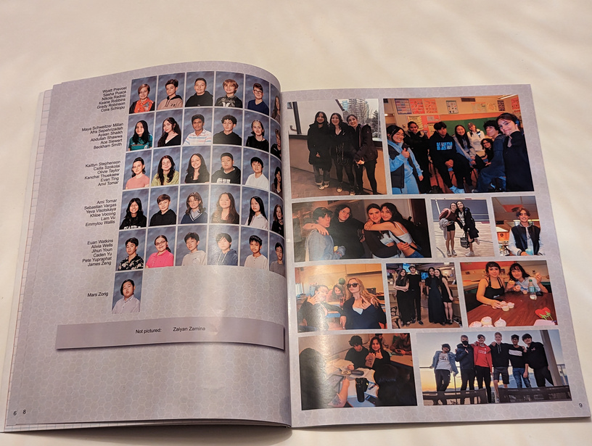
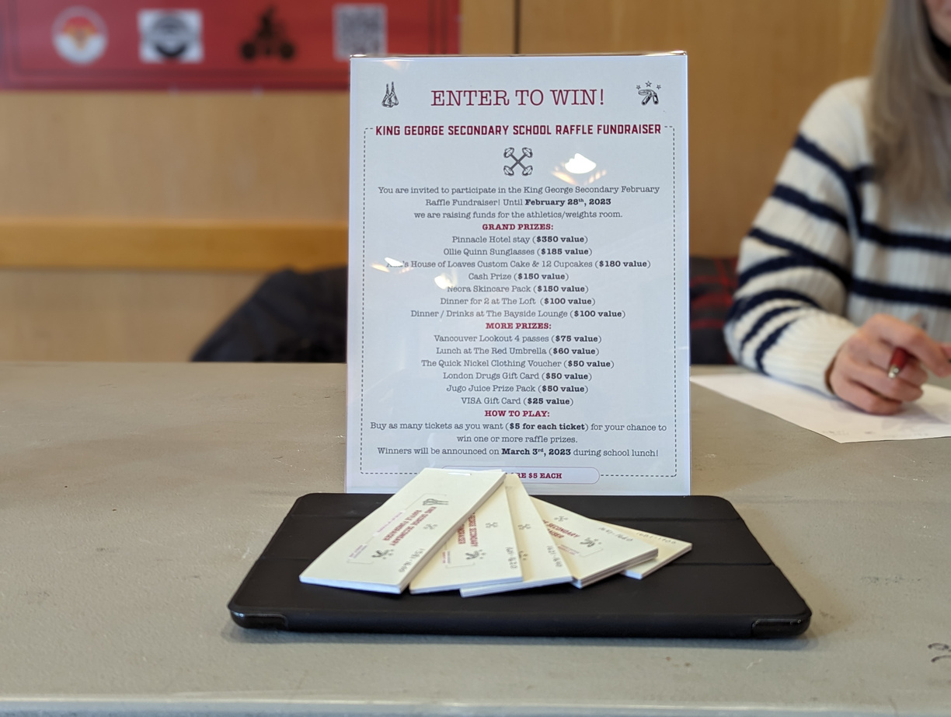
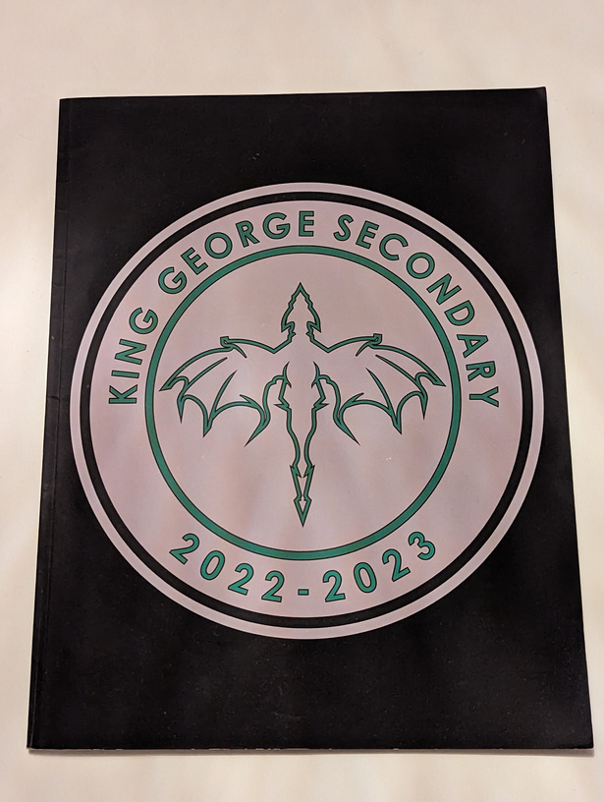
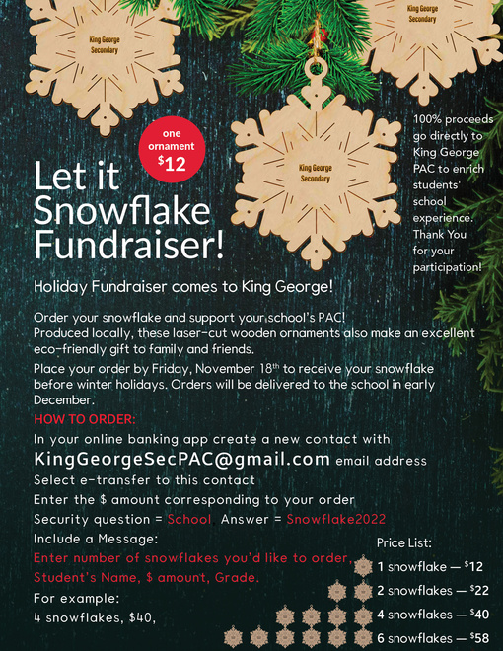

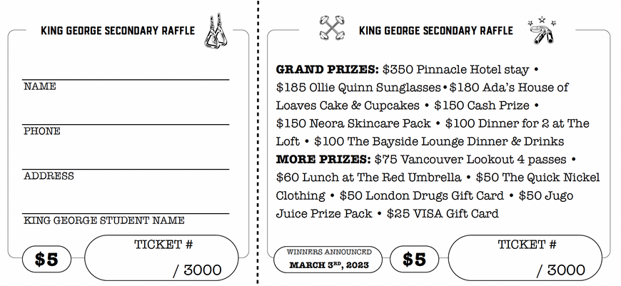
KING GEORGE PAC

Slide 5
Welcome and Introductions
Tyler Evans, Principal, Grades 10 and 12
David Nicks, Vice Principal, Grades 8, 9 and 11
Scott Derganc– Counsellor (Grades 8, 9, 11)
Emily Bekkering– Counsellor (Grades 8, 10, 12)

Slide 6

Student Services:
School Based Resource Teachers (SBRT)
-Sara Richter
-Alex Edwards
-Julianna Moore (TTOC)
Counsellors
Social
Emotional
Academic
Our counsellors share our Grade 8 student population by Alpha Surname
Emily Bekering– 8 (A-N), 10, 12
Scott Derganc– 8 (O-Z), 9, 11

Slide 7
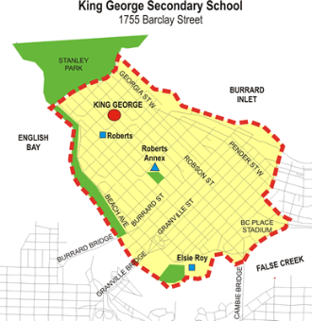
King George Family of Schools
Serving the Downtown Core
Elsie Roy
Lord Roberts
Roberts Annex
Crosstown
A few of our students
come to us from outside
our catchment

Slide 8


School Fees
You will get an email indicating course fees etc.
Link is also available by mid-week on website

Slide 9
Start of Year E-Forms
Most of the start-up paper workhttps://myforms.vsb.bc.ca
A few forms are still paper-based

Slide 10
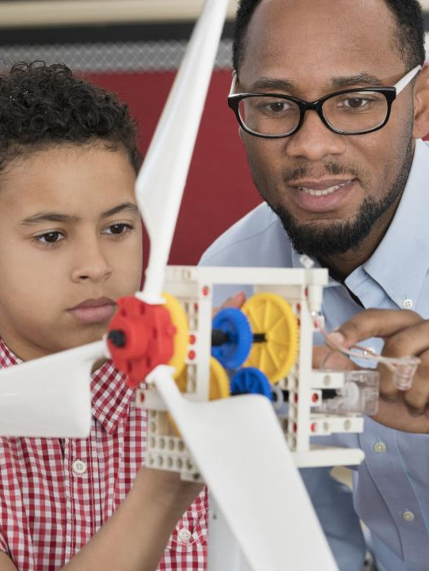
Who to Contact?
Absences – Email office at kinggeorge@vsb.bc.ca
Subject Specific - Always contact the teacher first.
Overall social or academic concerns - Counsellor
Safety, conduct, or just about anything ☺ – Grade Administrator

Slide 11

Community Schools Team
Vive Wong– Community Schools Team Coordinator
Other VSB supports -
TBD– SACY (Supporting and Connecting Youth)
Ivy Vuu-Leger – LRP (Leadership Resiliency Program)
Heather Froste– IEW (Indigenous Enhancement Worker)
Jasmin ElSayed - Youth & Family Worker
Safe and Caring Schools Support Worker
Cst. Angela Stewart - School Liaison Officer

Slide 12
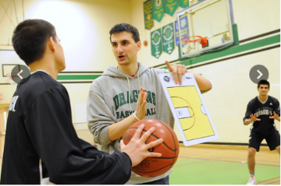
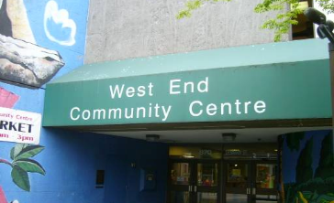
West End Community Centre
Our neighbors are an important part of our community supporting our students
We work closely with the youth community programmers for additional activities and clubs

Slide 13

Grade 8 Program
Applied Design Skills & Tech 8 - Rotation
  Technical Education
  Information Technology
  Foods
  Textiles
  Leadership
Fine Arts 8 - Rotation
  Art
  Dance
  Music
  Drama
R.I.S.E Program
(by recommendation)
Language and Literature
Individuals and Societies
Science
Mathematics
French
Physical and Health Education

Slide 14
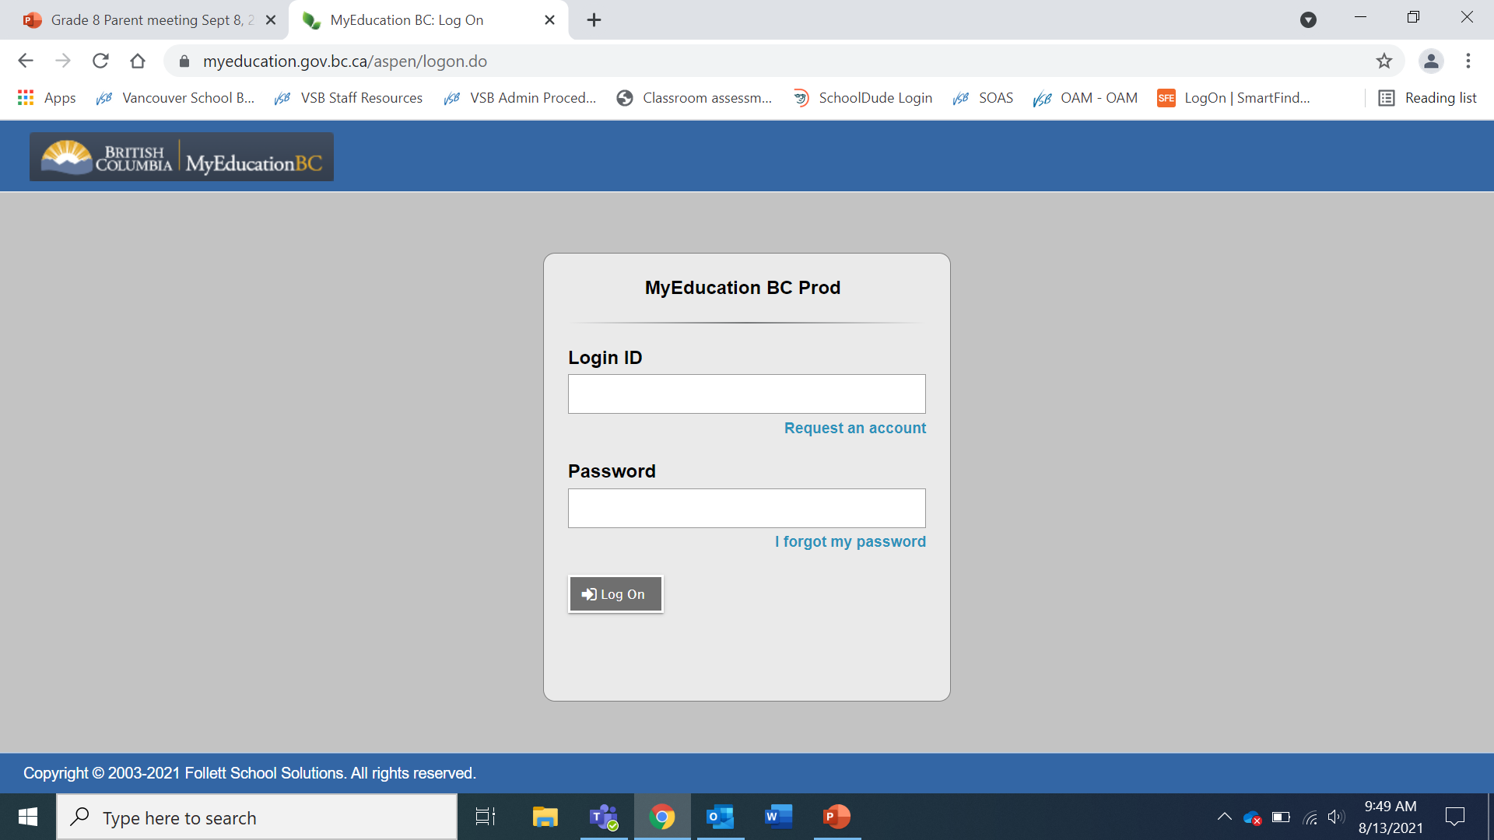
MyEdBC Student & Family Access
https://www.vsb.bc.ca/page/5038/account-management
Students and parents share access
Passwords & Log-in
See information such as:
  Attendance
  Achievement
  Report Cards
  Email addresses & Names
Default is currently set as:
User Name: Your child’s Student Number
Password: Dist$2024

Slide 15
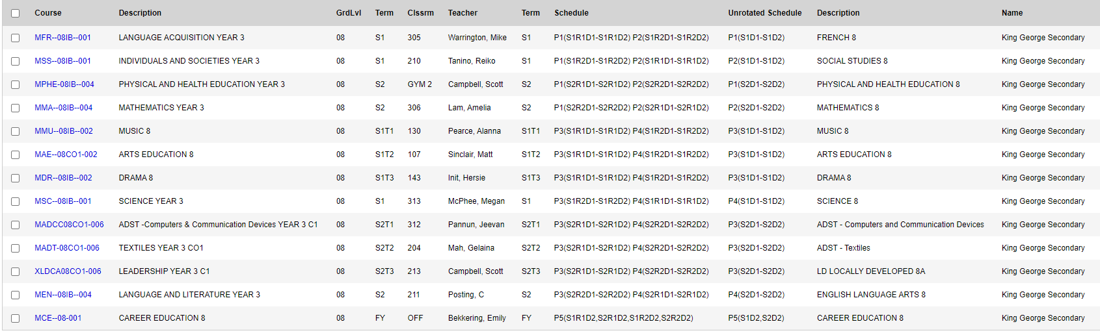
Screen Shot of Grade 8 Timetable

Slide 16

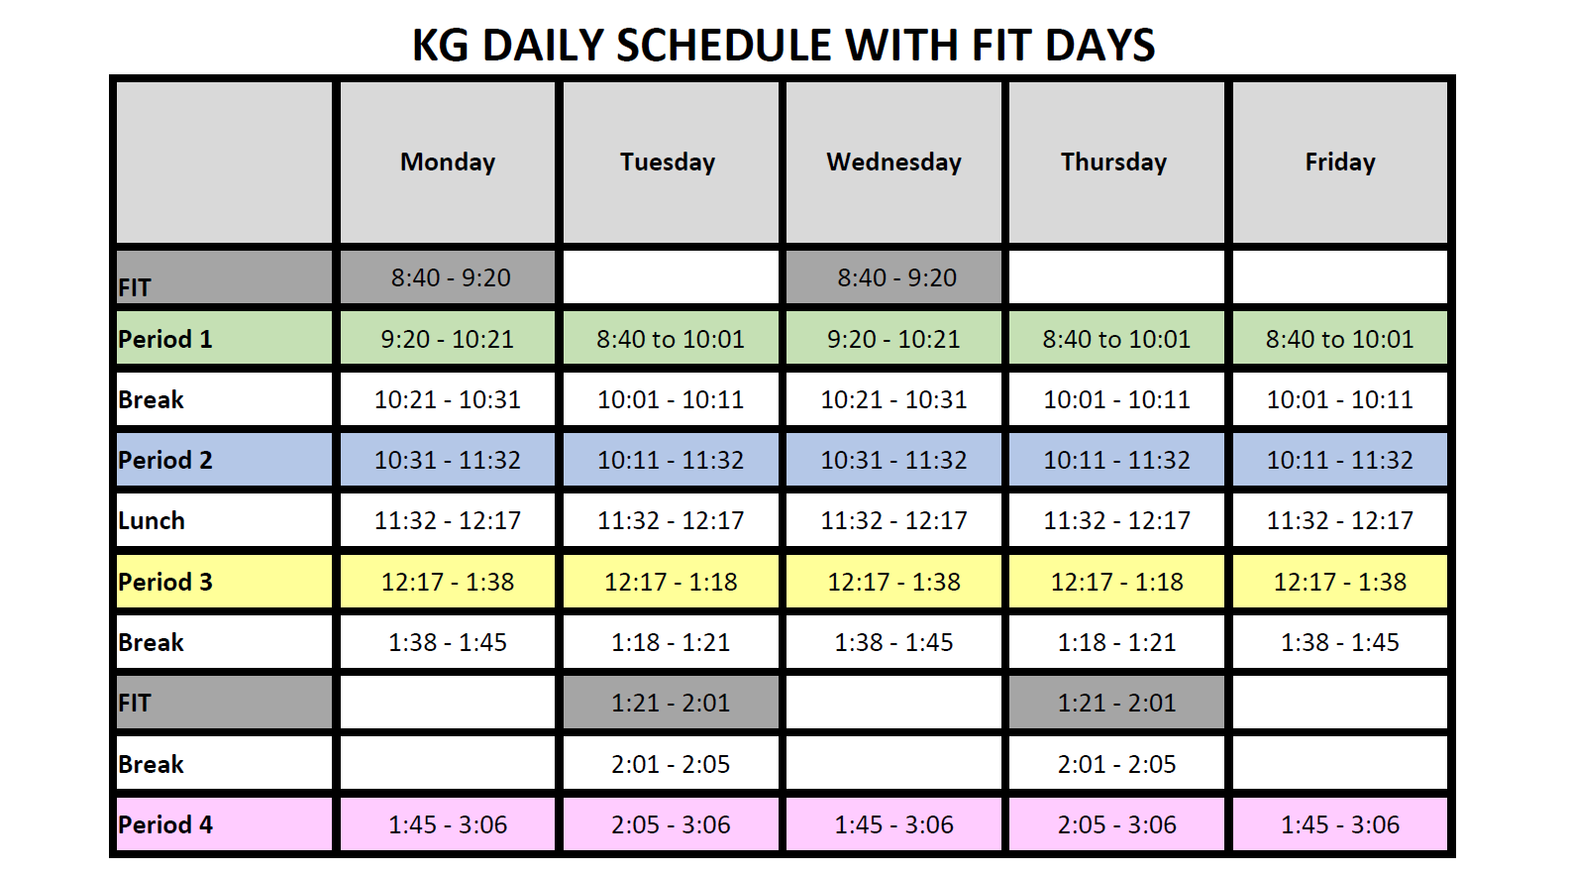
Structure of the school day

Slide 17
What is FIT time?
F.I.T (Flexible Instruction Time)
FIT time is Flexible Instruction Time and runs every Monday & Wednesday (am) and Tuesday &Thursday (pm) for 40 minutes.
During this time, students can go to any open classroom where staff will provide supervised study sessions. Students can go any to any class, providing the teachers room has space. If the door to a classroom is shut, that room is not available for FIT or the room has reached capacity and is full.
Students will be expected to work quietly in small groups or independently doing tasks such as - homework, reading, capstone/MYP Projects, groups projects etc. Students can also go to rooms where there is a specific teacher, who may be able to help them with specific work or tasks. Students will be able to use their personal technology, as long as they have headphones/earphones attached and that they are using it for educational purposes. It will be essential that students do not disrupt the learning environments for others.
Some students will be able to access the RISE room, if they have a RISE block and need additional supports.
During FIT time, the school administration will also host grade wide assemblies and other information sessions throughout the year.
If students are not required to attend a Grade wide assembly, they will be expected to attend any classroom, which is open, the school library or cafeteria that will also function as study rooms. Students will not be permitted to sit in groups in the hallways.

Slide 18
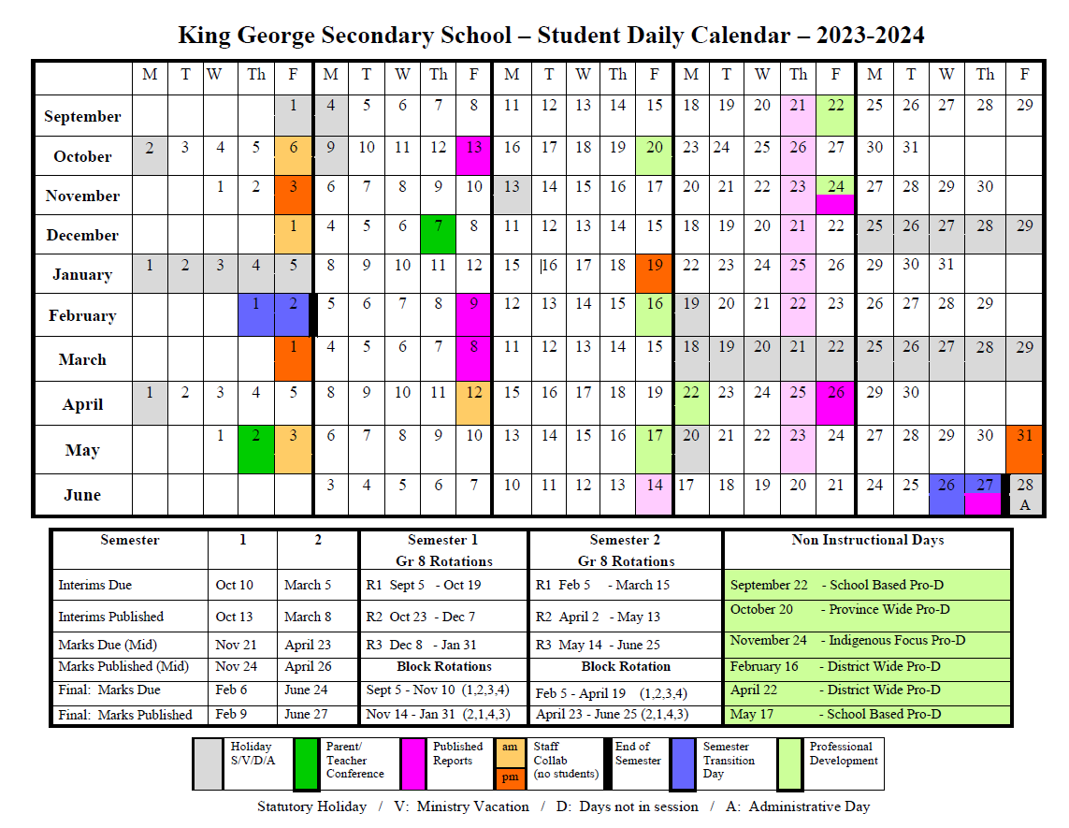

Slide 19

We expect all students in our community to
Be Involved

Slide 20










Throughout elementary, many of our grade 8s have been actively involved in…
Team Sports
Clubs
Service

Slide 21

Getting Involved at King George
The number of participants drops significantly as students enter high school.
Students involved in extracurricular activities have a better experience in high school and do better academically.
We need your support to encourage your children to participate when they arrive in high school

Slide 22

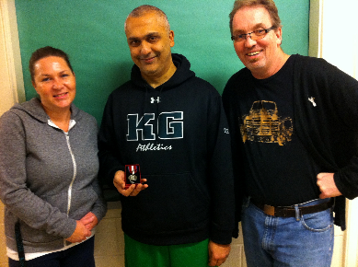
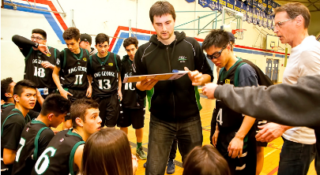
Athletics
Fall
Badminton
Basketball
Soccer
Volleyball
Spring
Badminton
Basketball
Tennis
Soccer
Volleyball
Ultimate
Winter
Badminton
Basketball
Ski/Snowboard
Soccer
Volleyball

Slide 23

King George Club Offerings
Badminton
Earth Club
Grad Council
Gay-Straight-Alliance
Interact / Leadership
Library Monitors
Weight Training
Creative Writing
Scorekeepers
Dungeons and Dragons
Chess
KG Clubs are student initiated and staff sponsored

Slide 24
We encourage
all parents and/or guardians
in our community
To be involved and engaged

Slide 25

Supporting Student Success and Family Involvement
Talk to your children and ask open ended questions about school
Be proactive and alert school of any question or concerns
Remember you are the parent and we want to work together as a team to support your child’s success
Promote healthy cellphone use

Slide 26

Questions?

