Slide 1
Magee secondary
Grade 7 Parent Information Evening
Mr. R. Mirani – Principal Mr. T. Bell – Vice Principal

Slide 2
Land Acknowledgement
With deep gratitude and respect, we are honoured to be learning and unlearning on the ancestral and unceded lands of the xʷməθkʷəy̓əm (Musqueam), Sḵwxwú7mesh Úxwumixw (Squamish Nation) & səlilwətaɬ (Tsleil-Waututh Nation).

Slide 3
Magee is committed to:
Developing
Developing capable young people,
Promoting
Promoting creative minds, healthy bodies, ethical values
Providing
Providing a rigorous academic program
Leading
Leading students to take responsibility for learning
Valuing
Valuing community and the joy of learning

Slide 4
Semester Model
PERIOD | TIME | SEMESTER 1 September to January | SEMESTER 2 February to June
1 | 8:35 – 9:55 | ENGLISH | PE
2 | 10:10 – 11:30 | MATH | SCIENCE
LUNCH
3 | 12:15 – 1:35 | SOCIAL STUDIES | APPLIED SKILLS
4 | 1:45 – 3:00 | FRENCH | FINE ART ELECTIVE

Slide 5
Grade 8 Program
Standard Program | Alternative Options
English 8 | ELL English / Writing
Science 8 | ELL Science
Mathematics 8 | ELL Math
Social Studies 8 | ELL Social Studies
Physical and Health Education 8
French 8 | Skills Development Centre
Applied Design, Skills and Technology
Fine Arts (Music, Art, Drama) | Band or Choir
Career Education 8 (Off-Timetable)

Slide 6
District Programs
Learning Assistance / Life Skills (LALS): The Learning Assistance/Life Skills class is a district program for students with special needs, who would benefit from a more supported program. There is a teacher and two support staff in the class. The focus of the program is to help students develop the following:
develop literacy and numeracy skills required for daily living
build student confidence and self- esteem
provide work experience opportunities for older students
prepare students for post- secondary options
promote the development of social skills
promote the development of independence at home, community and at school
Students exit with a school leaving certificate. Referrals come from elementary or secondary to Learning Services at the Vancouver School Board.
Life Skills: The LifeSkills class is geared toward grade 8 - 12 age level students who have intellectual disabilities. They are placed in the program through a referral to Central Screening at the District level.
The emphasis is on functional academics, socialization and commendation skills to enable students to be as independent as possible.
Work experience placements and volunteer activities are integral to the program as they provide the context for fostering a good work ethic and social skills.
All the students have an IEP, and work toward their specific educational goals.
Students exit with a school leaving certificate.

Slide 7
LSP Grade 8 Schedule
PERIOD | TIME | SEMESTER 1 | SEMESTER 2
1 | 8:40 – 10:01 | LSP SCIENCE | LSP ENGLISH
2 | 10:11 – 11:32 | LSP MATH | PE
LUNCH
3 | 12:17 – 1:38 | APPLED SKILLS | FINE ART ELECTIVE
4 | 1:45 – 3:06 | LSP SOCIAL STUDIES | LSP (Skills)
The LSP (Learning Support Program) is a small class of 15 students
that receives extra support with the fundamentals of each academic area.

Slide 8
Sparts
The Sparts program was introduced at Magee in 1985 to offer a part-time educational program to students participating in High-Performance Athletics at the provincial, national, or international levels, and to students performing in an area of the Arts at an extremely high level of excellence.
Students considering applying to the SPARTS Program:
need to be in 25 or more hours of supervised, Mon-Fri training, with certified coaches/instructors
need to be performing at an elite level (provincial/national ranking, etc.), and have evidence of performance
need to have G and E work habits
should have good academic achievement and excellent organizational skills
two years of documented performance/competition required

Slide 9
OPPORTUNITIES
CLUBS
ATHLETICS
STUDENT GOVERNMENT
VOLUNTEER
PEER SUPPORT

Slide 10
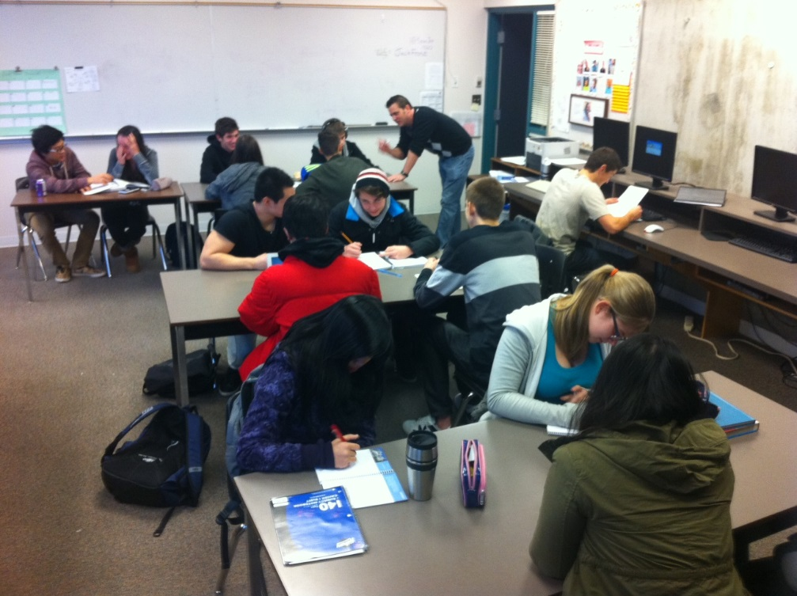
Skills Development Centre (SDC)
Students with documented learning difficulties can take a block of SDC
On an IEP (often with Ministry designation)
Teachers give 1-on-1 attention and support
Grade 12 peer tutors give additional support
Students are referred to SDC by grade 7 teachers in the spring
If your child is on an IEP, and is coming cross-boundary,
please call the grade eight counsellor in the late spring

Slide 11
Key Dates for Students
In-Boundary Return Course Selection Forms to Gr. 7 Teacher: Feb 24
Cross Boundary Application Deadline: Feb 28
Cross Boundary Offers Made: First week of March
Deadline to Accept Cross Boundary Offers: Mar 10

Slide 12
THANK YOU

