Slide 1

Grade 12 Assembly
March 2nd @ FIT

Slide 2
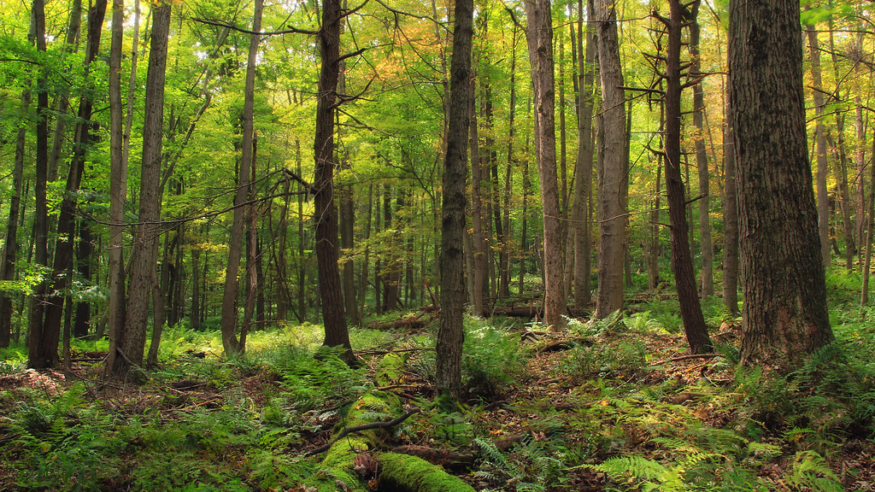
Acknowledging that we live, work and learn on the traditional, ancestral, and unceded territories of the xʷməθkʷəy̓əm (Musqueam), sḵwx̱wú7mesh (Squamish) and səlilwətaɬ (Tsleil-Waututh) Nations.

Slide 3
Agenda
Post-Grad
Ms. Boyd
Grad
Mr. MacInnes, Ms. Boyd + Grad Committee

Slide 4
Application Steps 101
Make an Eduplanner BC Account and Apply https://apply.educationplannerbc.ca/
Make your BCEID account (ALL STUDENTS)
Order a High School Transcript or Certificate as a Current Student - Province of British Columbia (Website)
How to order and or send a transcript to a Post –Secondary Institution (Video)
To access your Transcripts, Dogwood Diploma, be considered for Awards/Bursaries
Check you meet the Admission Criteria
Notes:
The information in BCEID, MyeducationBC and your legal documents should all match
Explain why all students should make and account for access to their high school information, like transcripts or their high school diplomas later on 3,5, 10 years from now.
It is YOUR / The student's responsibility that they meet the admission Criteria fully by June 30th---Post-Secondary institutions trust that you have checked that you meet the criteria for the programs you have or will meet the criteria of the programs you have applied to by June 30th---you may still receive a conditional offer calculated off Grade 11 marks, percentages already available to them, but if a program states a certain number of Grade 12 academics needed for entrance they expect you to have this complete by June 30th no matter whether you received a conditional offer or not. If you do not meet the admission requirement your conditional offer will be taken away

Slide 5
Conditional Acceptance and Admission Requirements
CONDITIONAL ACCEPTANCE = NOT GUARANTEED ACCEPTANCE
You are accepted on Condition that:
You maintain the same Average on which you received conditional acceptance (give or take 1-2%)
You meet all Admission Requirements by June 30th, 2026
It is your responsibility to know the Admission Requirements for the programs you have applied to and meet them by June 30th
When in doubt contact Admissions at the PSI where you have applied and make sure your Online classes are on your transcript
Some schools will have other Conditions, such as:
How to keep your offer of admission - UBC | Undergraduate Programs and Admissions
UBC drop below 70% in English 12---will take away offer or below 80% in extremely competitive programs
Notes:
because once you have received a conditional acceptance it is important to know the conditions that you need to maintain for the rest of the school year, to keep your offer. This can change per Post-Secondary Institution.
For example, some programs/schools the condition may be that you:
Graduate High School or
Maintain the average with which you were accepted give or take 2-3%
Maintain a similar percentage in your English 12 class as your English 11 mark last year
Make sure you know YOUR POST-SECONDARY INSTITUTION's conditions to keep your offer, as we move into Sem 2

Slide 6

After you apply
You will receive an e-mail from the Post-Secondary Institution:
Including a student number
Receipt of your Application
Log in instructions for their Student Services system,
Where you will find application updates and next steps
Such as timeline to submit any supplemental parts to your application (Profile, Assessments, Interview..ect..)
Notes:
If you do not complete these follow up steps by the dates specified your application will be revoked

Slide 7
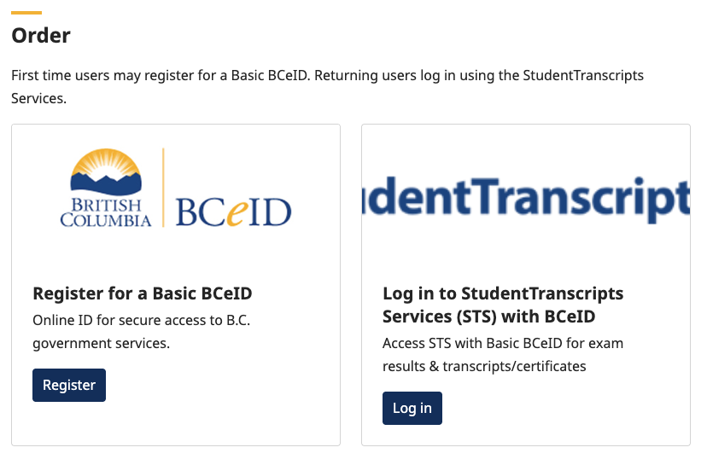
Student Transcripts Service
ALL students whether applying for a post-secondary school or not should make an account on the BC government's Student Transcripts BC site.
You'll need your Personal Education Number (PEN), which is in Myed and on any report card
Link to site here.
This site is the hub where students share their transcripts and course progress to post-secondaries across BC and Canada.
Some PSI will ask for a one-time transcript share. Many others will ask for ongoing access for one year, which includes midterm marks in November and April.
Information in MyedBC needs to match the STS Government site!!
If your family has moved, Gladstone NEEDS you to come in and update your address
Notes:
Explain why all students should make and account for access to their high school information and update their addresses, like transcripts or their high school diplomas later on 3,5, 10 years from now.
Also due to automatic Scholarships---Such as the BC Achievement Scholarship
*** Remind them that some schools have set deadlines for them to make their marks available through STS (I believe UBCs as already passed), SFU end of March and interim grades they'd like to use for SFU need to be in by the end of March this includes any online classes they to count for Post-Secondary

Slide 8
BC Achievement Scholarship
Another reason to sign up for BCEID/STS account, some scholarships are calculated automatically
Top 8000 academic averages in the Province based on Grade 10-12 grad requirement course grades will automatically receive a $1250 scholarship voucher from the Province that can be used within 5 years of graduation.
-Meaning you do not need to be going to Post-Secondary right away
-Will be reimbursed by designated post-secondary institution or B.C. authorized trades training provider.
-Minimum 73% in English 12 to be in consideration for these vouchers
Paper scholarship vouchers are mailed to recipients to the last home addresses reported by schools. Notifications are also posted to the Student Transcripts Service. Students can login to their account to find out if they are a recipient of the BC Achievement scholarship.
Notes:
Explain why all students should make and account for access to their high school information, like transcripts or their high school diplomas later on 3,5, 10 years from now.

Slide 9
A REMINDER: Online Classes
If you decide to take Online learning courses to meet your application degree requirements, during your Grade 12 year please arrange for interim (50% complete) grades to be sent by March 15, meaning you want to have at least 50% of course done by Feb 15th.
Recommended that you finish your online courses by June 1st of your graduation year, because the final marks for these courses need to be on your transcript by June 30th
Ensure that your online provider sends your final grade to the Ministry of Education so that it appears on your final transcript.
DON’T cut this too close – it takes some time for courses to be uploaded by Ministry of Education
Courses like CLE 10 are not used for admissions, but you need them to graduate high school to get into certain PSI programs and CLE 10 is a high school grad requirement, so the same rules apply for taking any grad requirement courses online.
Notes:
I will be trying to contact parents of any student who is enrolled in a necessary Grad Requirement Course online and less than 50% complete between now and Spring Break

Slide 10
Online Learning (info from VLN)
Regarding interim marks:
Students must meet the 50% course completion threshold (which may include writing a midterm, if applicable).
Once they reach 50%, students must contact their teachers directly to request an interim mark.
If students want to use interim marks (excluding CLE and CLC) for admission purposes, then they should request those interim marks once they meet the requirements.
VLN posts interim mark deadlines to help students stay on track, but teachers can submit interim marks at any time once requirements are met.
These deadlines mainly ensure that post‑secondary institutions can view marks during their admissions review period, which typically begins in late March through May.
Notes:
**Mention that if they are taking a course through a provider other than VLN they need to be in communication with this online provider and take responsibility for their marks being uploaded onto their Ministry transcripts. **I have seen situations where students had a high-grade point average and were waiting and waiting for a response from a PSI and they never got a spot due to an online class being added late to their ministry transcript
*My understanding too is that VLN is one of the only online schools that runs all 12 months through the summer, so for other online providers you may only have till the end of June, check with them.

Slide 11
VSB Summer Learning
It is still possible to complete up to 2 courses through VSB summer school the summer after Grade 12: Summer Learning
This is primarily for students missing 1 or 2 Grad Requirement courses that they need to receive their Dogwood Diploma: Registration Opens April 29th 2026
Counsellor can put Grade 12s needing courses towards their Dogwood Diploma on a priority registration list
**Communicate with me, if you might need this option, just in case
Courses completed in Summer School 2026 will not count towards Post Sec applications for Sept 2026

Slide 12
Scholarship Updates
Reminder for UBC Applicants:
Submit Veazey Scholarship Applications by Friday March 6th – Counselling Suite
Check Grade 12 Team---Scholarship Channel for Application information
-This scholarship can only be used at UBC campuses (Vancouver or Okanagan)
-2 nominees selected per school (Each nominee receives $1000 dollars)
--No references required,
Nominees will submit their application to Veazey by April 15th
--Veazey will interview Nominees, before selecting overall winner from all school nominations

Slide 13
Scholarship Updates
There are a lot of smaller denomination Scholarship Applications
In March, April and May
See the newly finalized Gladstone Scholarship Document:
Gladstone Scholarship Document 2026 Students
***Stay especially aware of the Gladstone only Scholarship Application and all VSB only Applications (Competition Pool less)

Slide 14
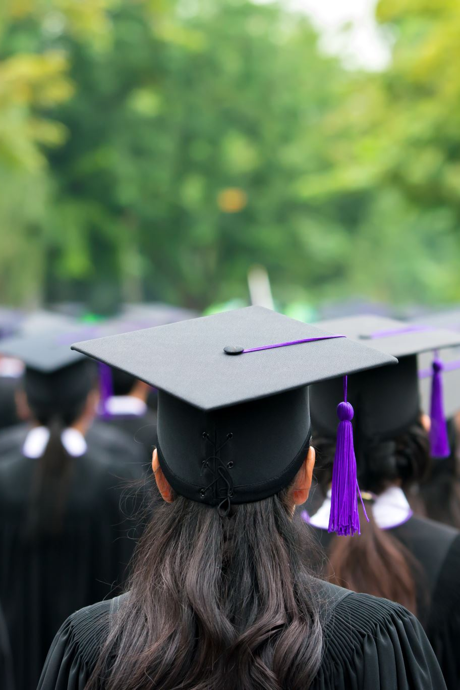
Gladstone and District Scholarships
Due Friday April 10 - Gladstone and District Scholarship applications
Gladstone Scholarships Application Form – Fill out form
District Scholarship Applications –COMING SOON! *watch the Scholarship Channel
Notes:
**Remember to mention that there are 50 + scholarships through one application, not all are grade related, every year one of their teaching team puts a student's name forward for an award and then discover that that student never filled in the application and cannot get the award

Slide 15
District Scholarships
Area of interest | Examples
Applied Design, Skills, and Technologies | Business, Home Economics, Media Arts, Technology, Tourism
Community Service (Volunteer Activity) | Includes awareness of local, global, and cultural issues
Fine Arts | Dance, Drama, Music, Visual Arts
Indigenous Languages and Culture | Demonstrated at school or in the community
Languages | External Assessments or Languages Curriculum, including AP and IB courses
Physical Activity (and Health) | Athletics, Dance, Gymnastics
Technical and Trades Training | Coding, Culinary Arts, Mechanics, Robotics, Woodwork
$1250 dollars each
Decided by School Staff and Awarded at Grad
Awarded to students who show Excellence in a particular Area
Students can apply to more than one category

Slide 16
If you plan to apply for Student Aid BC:
Get a BC services card (or your Drivers license) + Make sure you have a SIN number: https://sin-nas.canada.ca/en/Sin/
Get the BC services App and Make your account (helps you apply for certain Grants too!)
https://studentaidbc.ca/apply/how-to-apply
Make sure your family has done their income taxes from the previous year, this information is used to assess financial need
You are considered a dependent (application based on your parents' income) until 48 months after graduating high school or after having been in the full-time work force for 24 consecutive months (information from the 2021/2022 guide)
Helpful Eduplanner Financial Resources:
Financial resources | EducationPlannerBC

Slide 17
Grad – Mr. MacInnes
Grad Citations + Valedictorian
Grad Ceremony + Tickets
Grad Rehearsal + Gowns
Grad Photos + Yearbook
Dinner & Dance
Grad Committee

Slide 18


Grad Citations Submit on Teams: April 8th-24th
Survey includes Grad Ceremony Confirmation.

Slide 19
Grad Citations Submit on Teams: April 8th-24th
Each Graduate is responsible for drafting a SHORT message (25 words or less) that will be read as they cross the stage. Must be written in the third person:
"Bob is excited to be taking a gap year.."
Some examples of what you may want to include are:
What you will fondly remember
Your future plans
Regards to people you may wish to thank
A reflective statement

Slide 20

Valedictorian
The valedictorian for the Gladstone Secondary class of 2026 should be the student who best represents the graduating class.
The valedictorian writes and gives a speech, at the end of the graduation ceremony, that captures the spirit of the class, acknowledges the achievements and contributions of the students, staff and parents.
The speech should be serious, inspirational, entertaining and look ahead to life beyond high school.
Notes:
Mention that there is also a Scholarship attached

Slide 21
Valedictorian
Friday, April 17 – Valedictorian Applications open
Wednesday, April 29 – Valedictorian Applications due.
Wednesday, May 6 – Valedictorian Announced

Slide 22
Grad Ceremony
Location: Chan Centre for the Performing Arts at UBC
Date and Time:: 6:00 pm on Tuesday, June 2.
Timeline:
Grads arrive: 5:00 pm.
Doors open: 5:30 pm
Ceremony will start promptly at 6:00 pm.

Slide 23
Grad Ceremony Tickets
Grad Fee: $120 includes 2 complimentary tickets
Additional Tickets: May be purchased through Chan Centre for $12 each May 1 to 22
Grads do not need a ticket (if wearing Gowns)
All tickets, complimentary and additional must be obtained through the Chan Centre Website
Tickets - Chan Centre

Slide 24
Grad Ceremony Rehearsal
Grad Rehearsal at 8:40 am Tuesday, June 2 (periods 1 and FIT) in the Auditorium
All grads will be excused from their first period as attendance at rehearsal is mandatory!

Slide 25
Grad Ceremony Rehearsal
Students MUST attend the rehearsal and arrive on time at 8:40 am if they wish to cross the stage.
Grad gown package distribution following the Grad Rehearsal
** Your Gown is your ticket to Grad

Slide 26
Grad Citation
Remember that this will be read out loud by a teacher/administrator as you cross the graduation stage so it must be written in the third person
(e.g. “Emily is excited to be taking a year in the fall and traveling around the world. She will miss her friends and family in Vancouver”).
Your message must be appropriate for a formal occasion, be under 25 words and be submitted electronically.

Slide 27
Grad Citation
Survey/Form link on the Grade 12 Teams opens Wednesday, April 8 to enter your Graduation Citation Message.
The Citation is due on Friday, April 24.

Slide 28
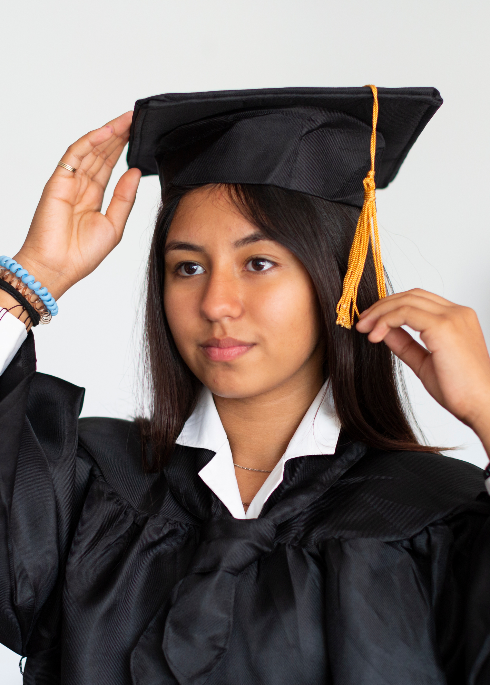
Grad Gowns
All students taking part in the Gladstone Graduation Ceremony must wear a gown, grad cap/tassel and a sash.
Gowns are ordered by height measurement, and these grad items are included in the Graduation Fees.
Grad Gown measurements are done when graduates have their grad photo taken at the Artona studios.
Notes:
Purchase or Rental of Gowns?
Mention that if they plan to walk the stage on June 2nd, please go to Artona and get your Grad Photos done and Measurements for your gown done.

Slide 29
Grad Gowns
The grad gowns will be distributed after the Grade 12 Assembly/Grad Rehearsal on Tuesday, June 2
Students will be keeping their gown, sash and caps as keepsakes of their graduation ceremony.

Slide 30

Grad Photos
Graduation Photos Session Dates were in October 2025 and Grade 12 students should have booked their 30-minute appointment at Artona Studios
If you missed the October photo session dates, you are still able to book an appointment until March 31st https://artona.com
Select the Chat feature or Call Artona 604-872-7272 and make an appointment as soon as possible.
Your picture may now not be in the Grad composite

Slide 31
Yearbook
-Everything should already have been given to Ms. Montroy for Yearbook
--Too late to send in now
--If you still want to ORDER a yearbook this year ORDER ONE THIS WEEK
SchoolCashOnline.com: Welcome
--

Slide 32
Grad Photos
If you have any questions in regard to the graduation photos, please contact Artona directly - click on “contact us” on their website https://artona.com/ or call 604-872-7272.

Slide 33
Grad Committee Announcements
Notes:
Winning Design -Heather grey hoodie -$45-$50

Slide 34
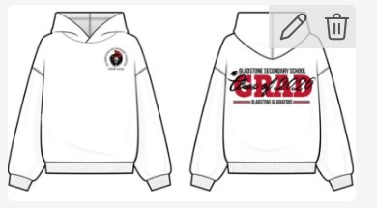
Grad Wear
Winning Design is:
Will be a heather grey hoodie
Will cost approximately $45-$50 dollars
Purchase through School Cash Online starting end of this week: SchoolCashOnline.com: Welcome
Notes:
Winning Design -Heather grey hoodie -$45-$50

Slide 35
Grad Olympics
March 30th to April 2nd after School
16 Teams of 5 (First to sign up get the spots)
$25 dollars a Team to take part ($5 dollars each)
Team Sign up link will be posted later this week on Teams and Instagram
There will be Team challenges and Individual challenges
Prizes for the top 3 individuals!!
Notes:
Winning Design -Heather grey hoodie -$45-$50

Slide 36

Grad Dinner/Dance
The Dinner/Dance will be held at the Fraserview Banquet Hall on Wednesday, June 17th at 6:00 pm. More event details to follow.
The Dinner / Dance fee is approx. $75 and will be payable on School Cash on-line prior to the event.

Slide 37
Prom Fundraiser
Neufeld Farms Frozen Foods Sale
Fundraiser runs from:
April 24th – May 13th
Deliveries are on:
May 19th
Top Seller gets their prom ticket for free!
Notes:
Winning Design -Heather grey hoodie -$45-$50

Slide 38
Grad Events Review
June 2nd @ 8:40 am: Grad Assembly, Auditorium
All Grads MUST arrive by 8:40am
June 2nd @ 6pm: Grad Ceremony UBC Chan Centre
All Grads MUST arrive by 5:00pm
June 17th @ 6pm: Grad Dinner/Dance Fraserview Banquet Hall

Slide 39


