Slide 1
Course Planning 2024-25
One Last Time!

Slide 2
LAND ACKNOWLEDGEMENT
Acknowledging…​
With deep gratitude and respect, we are honoured to be learning and unlearning on the ancestral and unceded lands of the xʷməθkʷəy̓əm (Musqueam), Sḵwxwú7mesh Úxwumixw (Squamish Nation) & səlilwətaɬ (Tsleil-Waututh Nation).

Slide 3
Two main things to consider Apples Vs Oranges
1. Graduating from high school
2. Post-secondary admissions

Slide 4
ELL Students
Course Planning
All ELL students will be course planning in English class, face to face with Mr. Pratt, in the coming weeks.

Slide 5
Grad requirements
SUBJECT AREA | MINIMUM CREDITS
Language Arts 10 | 4
Language Arts 11 | 4
English 12 or English BC First Peoples 12 | 4
a Mathematics 10 | 4
a Mathematics 11 or 12 | 4
Fine Arts or Applied Skills 10, 11 or 12 | 4
Social Studies 10 | 4
Social Studies 11 or 12 | 4
Science 10 | 4
a Science 11 or 12 | 4
Physical Education 10 | 4
CLE/CLC Supercourse | 6
Capstone | 2
Indigenous Focused course
TOTAL | 52 credits
ELECTIVE COURSES
Students must earn at least 28 elective credits over Grade 10-12 | 28 credits
OVERALL TOTAL | 80 credits
Note: Of the 80 credits for graduation, at least 16 must be at the Grade 12 level, including English 12 or English BC First Peoples and 4 must be Indigenous Focused.

Slide 6
French immersion dual diploma

Slide 7
Diploma Verification Report
Document that tracks your progress towards graduation.
Top box tracks the grad requirements that you have completed AND the ones you are presently taking.
Main box lists all the courses you have completed (Earned Credits), the ones you have in progress (Potential Credits) and any marks that have been posted for these courses, both final and interim.
The final box shows your scores on any of the 3 Provincial Assessments
Last box shows your credit totals: Earned, Potential and Grade 12 (16 Grade 12 credits needed to graduate)

Slide 8
This box is very important. When you look at your DVR, if any of the grade 10 or 11 boxes are NOT checked, you must come see me immediately!

Slide 9
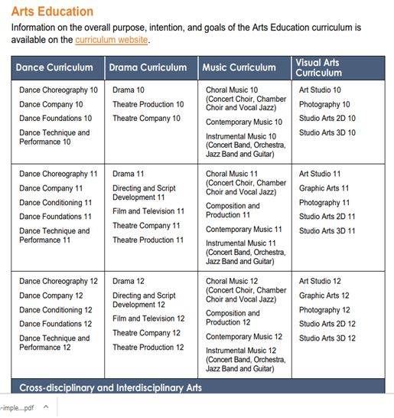
ONE Arts Education and/or an Applied Design, Skills and Technologies course at grade 10, 11, or 12 level

Slide 10
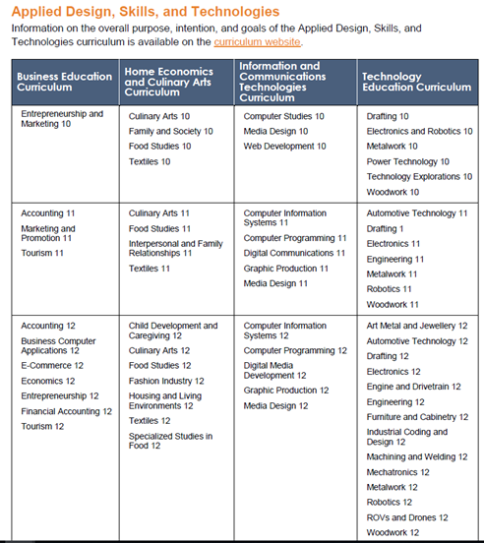

Slide 11
INDIGENOUS STUDIES
The BC First Peoples 12 Course counts towards your Social Studies 11 or 12 requirement for graduation
The English First Peoples 12 course counts towards your English Language Arts requirement for graduation (ie. English Studies 12)

Slide 12
Capstone 12
a 10-week / half semester course
Guides you through a passion project
A Graduation requirement

Slide 13
Languages
You do NOT need a second language to graduate
UBC & SFU require a grade 11 language credit for admissions
French Immersion students already meet this requirement by the nature of the program
Churchill offers French, Introductory Spanish, Introductory Japanese, Spanish 11, & Japanese 11
Other ways:
Challenge Exams
Online (VLN)
The latter two options are NOT for beginners and are for students who are quite good or proficient in the language already (learning a new language online is very difficult)

Slide 14
language CHALLENGE EXAMS & UNIVERSITY ADMISSIONs
If you are fluent (can read, write and speak) in the following languages: French, Farsi, Japanese, Korean, Mandarin, Punjabi or Spanish you can apply to take the Language Challenge exam through the Delta school district to meet the 2nd language requirement for UBC and SFU. (Applications DUE November 2024)
Can you use a language challenge exam 11 or 12 to meet the language admission requirement ?- YES
BUT some universities (UBC) do NOT use the language challenge exams for calculating grade point (ADMISSION) average -
Notes:
Because some universities do not use Challenge Exam marks to calculate GPA – sometimes it may be more beneficial to take the Course online or at school (if we offer the course_ so that you can the grade to boost your GPA

Slide 15
Community Service and Peer Tutoring
Many Grade 12 students take Community Service 11 or Peer Tutoring 12. These courses are an excellent opportunity to give back to the school.
Peer Tutoring is a vital part of our Student Support Services. Many students who enroll in this class say that having to be the teacher has resulted in them becoming better students. Students who successfully complete Peer Tutoring receive a letter of recommendation.

Slide 16
ONLINE CLASSES & SUMMER SCHOOL
Online classes count for credit
you must have any online class 50% completed by march 1, 2025 if you wish to use the course for university admissions
Information about summer school comes out in May – Register immediately once portal opens
Please indicate any schooling planned over the summer on your course planning sheet

Slide 17
TIPS TO TAKING ONLINE COURSES
Online classes provide a lot of flexibility and can seem easy
BUT experience has taught the following:
Taking an online class in a subject where you struggle often doesn’t work out (due to a lack of in-person instructions; students are teaching themselves the material)
Successful completion of an online course requires A LOT of self discipline. If you choose to take a course online, but change your mind and want to take it at Churchill there may not be space for you here
For the overwhelming majority of students, in class instruction provides a better understanding of the course material

Slide 18
Work Experience coordinator ms. Yee wyee@vsb.bc.ca

Slide 19
VSB CAREER PROGRAMS

Slide 20
How to apply
Applications and submission dates are found within each program.
Students will be interviewed for suitability and acceptance into a program.
Deadline to apply for most programs is March 1st of grade 11 year
https://www.vsb.bc.ca/career-programs/page/11417/programs

Slide 21
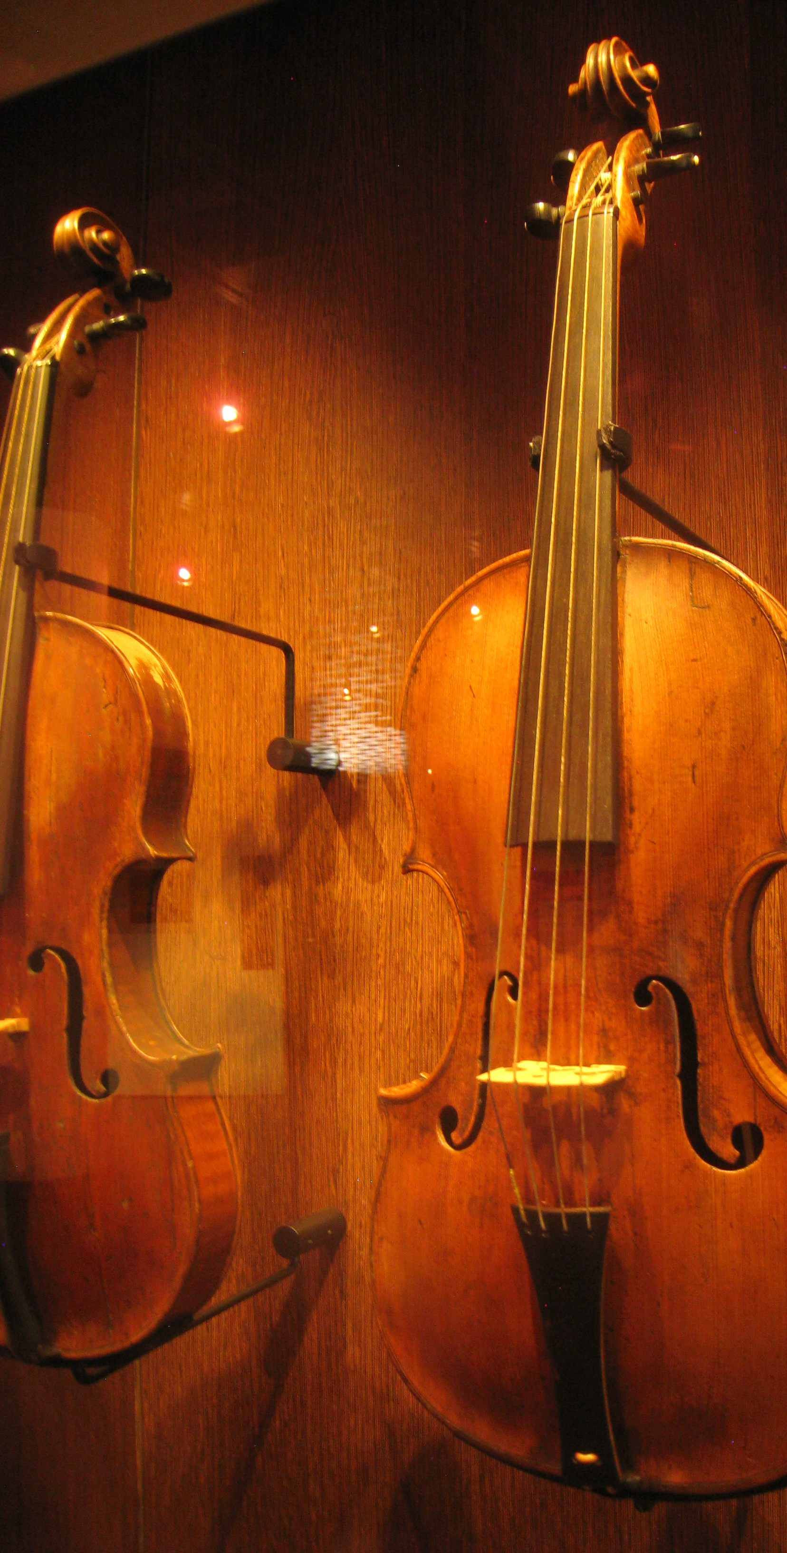
External credits
Remember you may be able to gain extra credits towards your graduation for extracurricular activities. For example:
Royal Conservatory of Music – Certificates level 6 or above
Provincial level sports
Red Cross/Life Society Certificates – Instructor level
For more information: https://www2.gov.bc.ca/gov/content/education-training/k-12/support/graduation/getting-credit-to-graduate/external-credentials
This Photo by Unknown Author is licensed under CC BY-SA

Slide 22
Grade 12 Course Planning Basics

Slide 23
Grade 12 Course Planning Basics
Selections should be based on graduation requirements AND meeting admission requirements for post-secondary programs of choice.
Also choose non-academic classes: Music classes, Arts classes, Tech classes, PE classes etc… Having a balance of academic and non-academic classes can be important in having a fun, enjoyable grad year.
Do not course plan for 80 credits. Course plan for a minimum of 92.
All students must take English Studies 12 or English First Peoples 12
If you are not taking an Indigenous studies focused course this year, you must take either English First Peoples 12 (Language Arts course) or BC First Peoples 12 (Socials course)

Slide 24
WHAT ABOUT AFTER HIGH SCHOOL?
Notes:
4 year college/university degree – 2 year college certificate program – trades or apprenticeship, go straight into the workforce, travel, take a gap year? Choose a path that you are genuinely passionate about
You can always take a gap year to discover yourself, work or travel
Take risks and explore other careers and interests
Do not stress or worry, this process can be nerve-racking, but life will unfold and it always works out
What determines your success is your attitude
If you have questions, ask family, friends or seniors for mentorship

Slide 25
Starting to Think about Post-Secondary
Community Colleges (Langara, Douglas, VCC, etc.) generally only require high school graduation to enter. This is also true of the teaching universities (Kwantlen, Capilano, etc..)
BUT, they will have program specific requirements. Important to check their websites.
Technical schools like BCIT also have program specific entrance requirements. Please look these up yourself if you are interested.
Universities (UBC, SFU etc.) have specific language, Math, Science, and English requirements that often include grade 11 courses.

Slide 26
- POST SECONDARY- The education that follows the successful completion of high school. Includes universities, colleges, trade &vocational schools. - UNDERGRAduATE -After high school, you are considered an undergraduate when applying to a university or college – DEGREE (Bachelors)- an undergraduate degree is awarded by a college or university upon completion of a course of study lasting 3 to 6 yEARS (4-5 YEARS AVERAGE) - ASSOCIATE DEGREE- Associate degrees are awarded to students who complete at least 60 credits of university program courses (Potentially first 2 years of a 4 -year degree) - DIPLOMA/Certificate programs - Diploma programs are commonly 30 to 72 credits and can usually be completed in less than 2 years, which is the normal time it takes to complete an associate's degree program. Certificate programs can typically be completed in months instead of years and may only require somewhere between 9 and 30 credits.
What does this mean?
Notes:
For example, someone interested in being an educator or working with kids could – a) Go to a community college

Slide 27
Levels of education

Slide 28
Post Secondary APPLICATION PROCESS
The post-secondary application process begins in the Fall of grade 12 and runs all the way through till June 2025.
You start the process when you apply. This begins a conversation between you and the institution you are applying to about your application and what you need to do.
Both the institution and I will support you in this process. It happens every year and every grad class gets through it. So will you!
University websites are generally easy to navigate for admission requirements. If you can’t find what you need, come and see me and I will help you.
Have a 1st choice, 2nd choice and then a back up school. For example:
1st choice: U of T ; 2nd choice: UBC; 3rd choice: Langara

Slide 29
General Recommendations
UBC recommends 6 Grade 12 courses. These do not have to all be academic, but they do have to meet any faculty specific admissions requirements. Taking 6 courses (plus Capstone)next year is probably a good general rule as taking 6 will meet the base number of courses required for most universities.
Different universities want different things. Once you have narrowed down where you want to study, get to know what your school is really looking for.
There are also other options than attending post-secondary right away. Take a gap year, work, if you can travel, get some experiences. This can possibly help you find a direction going forward.

Slide 30
University admission criteria
Each Post secondary institution has different criteria for admitting students
There are general admission requirements as well as Program specific requirements
Some universities base admissions on grades (UofT) alone, while others take a more holistic approach (UBC)
Do your homework! Start looking at various post secondary options

Slide 31
 |  | UBC | SFU | UVic
SCIENCES
English Language Requirement | English Studies 12 or English First Peoples 12 | 70% or higher English 11 or 12 Score “Proficiency” on Literacy 12 Provincial Assessment | 70% or higher English 11 or 2 | 67% or higher English 12
# of Grade 12 courses |  | 6 Academic/non-academic courses recommended | 5 Approved grade 12 courses | Top 4 Academic grade 12 courses
Language 11 |  | Required | Required | Not Required
Math |  | Precalculus 12 | Precalculus 12 | Precalculus 12 (min 67%)
Sciences |  | Chemistry 11 and Physics 11 and 1 Science 12 ie: Anatomy & Physiology 12, Chemistry12 or Physics12 | Chemistry11 and Physics 11 and 2 Science 12 or 1 Science 12 and 1 Calculus 12 | Chemistry 11 and Physics 11 and 2 Science 12 approved courses
Evaluation based on |  | Grades & Personal Profile | Grades | Grades -

Slide 32
Ubc ADMISSIONS – hOLISTIC APPROACH (COURSEWORK + PERSONAL PROFILE
ASSESSMENT BASED ON GRADE 11 & 12 COURSES WITH PARTICULAR ATTENTION TO THOSE SUBJECTS RELEVANT TO INTENED AREA OF STUDY
RECOGNIZES STUDENTS WHO CHALLENGE THEMSELVES
BREADTH, DEPTH, RIGOR & RELEVANCE
RECOMMENDED TO TAKE 6 ACADEMIC/NON-ACADEMIC COURSES (RELATED TO FIELD OF STUDY) IN GRADE 12 YEAR

Slide 33
Ubc – The Personal profile – what is it?
Short answer questions where you are encouraged to share some of your significant achievements, personal experiences & challenges and how you have overcome, persevered, grown and learned from those experiences. It provides an opportunity for you to show more of who you uniquely are.
https://www.youtube.com/watch?v=IRolpNKomRo
This Photo by Unknown Author is licensed under CC BY-SA

Slide 34
Scholarships
Types of scholarships:
Academic
Athletic
Community Service
Financial Need
Notes:
It is important to work on improving your resume over the summer. Look for summer volunteer, educational or work opportunities. You can find work and volunteer opportunities on the WEX teams channel.

Slide 35
Scholarships
To be eligible for a Board AUTHORITY DISTRICT SCHOLARSHIP YOU MUST BE TAKING A MINIMUM OF 5 GRADE 12 COURSES IN YOUR GRADE 12 YEAR AT CHURCHILL
Ms. Yee , our scholarship guru will be posting scholarship information in THE grade 12 TEAM so start getting in the habit of checking teams for important information!
Spend your summer doing things to bolster your resume – VOLUNTEER, WORK,, EDUCATIONAL ENRICHMENT ACTIVITIES, ACTIVISM ETC
Most scholarship applications want three things: a transcript, a resume, and a cover letter outlining why you should get the scholarship. create a resume & write a stock letter outlining who you are. As you start applying to specific scholarships you edit the letter to meet the specific requirements on each scholarship

Slide 36
Course selection
Schools are staffed and time-tabled according to course selection in February. The number of sections offered per course is based on course sign-up now. Please consider your choices carefully!
To help students make informed decisions:
Review graduation requirement
Review post-secondary admission requirements
Review Grade 12 course requirements (February course planning slides – will be posted 24 hours after the assembly)
Review Course Selection Guide (SWC website → Teaching & Learning → Courses)
Talk to subject teachers if descriptions are unclear
Self-reflection, discussions with family, & report card grades will help determine areas of strengths and interests – pick courses based on this information

Slide 37
The Process – hOW TO INPUT COURSES IN MYED
Myed Demonstration

Slide 39
Feb 21

Slide 41
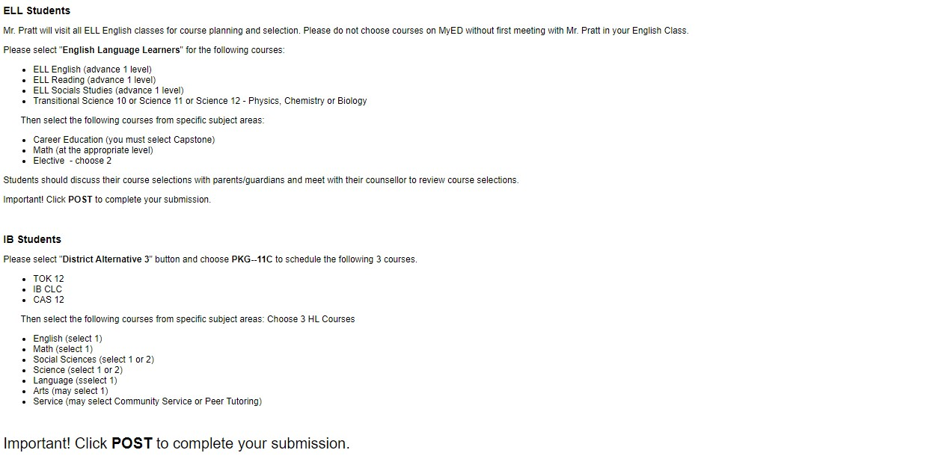

Slide 42
Helpful Websites
Information on the Graduation Program
https://www2.gov.bc.ca/gov/content/education-training/k-12/support/graduation
BC Education Planner – very helpful in providing links to post secondary institutions
https://www.educationplannerbc.ca/
External Credits - https://www.bced.gov.bc.ca/datacollections/course_registry_web_search/search-home.en.php
Career Programs/Youth Train in Trades
https://www.vsb.bc.ca/career-programs/page/11417/programs

Slide 43
Deadline to get Courses into MyEd is
FEBRUARY 21st, 2024
This deadline is a VSB deadline. Failure to get your requests in by this date could result in you not getting the courses you want/need.

Slide 44
STEPS TO COURSE SELECTION
1
3
2
4
Organize your options and discuss with your parent(s), or guardians
Input your course selection on MYED at home.
Hand in Fully completed course planning sheet (parent/guardian signature required) to Ms. Salter’s office By february 21
Do research on post-secondary requirements and ensure you have the prerequisites you need

Slide 45
Extra help sessions
FEB 14 & FEB 15
AT LUNCH
ROOM 216A (MAC LAB)

