Slide 1
Grade 10- 11
Course Planning

Slide 2
LAND ACKNOWLEDGEMENT
Acknowledging…​
that we work, play, and learn today on the traditional, ancestral, and unceded territory of the xʷməθkʷəy̓əm (Musqueam), sel̓íl̓witulh (Tsleil Waututh), and sḵwx̱wú7mesh (Squamish) peoples

Slide 3
ELL STUDENTS
Course Planning 2022-23
In the coming weeks ELL students will be course planning face to face with Mr. Pratt in your English classes

Slide 4
Requirements
Requirements for high school graduation are different than the requirements for University admissions
It is important to be clear when picking courses that you have the courses needed to graduate as well as the courses required for post-secondary program admissions

Slide 5
DOGWOOD DIPLOMA REQUIREMENTS
You need 80 credits to graduate
At least 16 credits must be at the grade 12 level, including a required Language Arts 12
At least 28 credits must be elective course credits
At least 4 credits must have an Indigenous focus

Slide 6
52 CREDITS REQUIRED FROM:
Career Life Education (4 credits) & Career Life Connections (2 credits) + Capstone 12 (2 credits)
Physical & Health Education 10 (4 credits)
Science 10 (4 credits) & a Science 11 or 12 (4 credits)
A Social Studies 10 (4 credits & a Socials 11 or 12 (4 credits)
A Math 10 (4 credits) & Math 11 or 12 (4 credits)
A Language Arts 10, 11 & a required Language Arts 12 (12 credits total)
An Arts Education 10, 11, or 12 and/or an Applied Design, Skills and Technologies 10, 11 or 12 (4 credits total)

Slide 7
GRADUATION ASSESSMENTS
Grade 10 Numeracy Assessment
Grade 10 Literacy Assessment
Grade 12 Literacy Assessment
You need three assessments required to graduate
Assessments are not connected to any course
Scores on the grade 10 assessments are presently not considered by any post-secondary institution for admission purposes, however, some post-secondary institutions do consider grade 12 literacy assessment scores.

Slide 8
INDIGENOUS STUDIES
The BC First Peoples 12 Course counts towards your Social Studies 11 or 12 requirement for graduation
The English First Peoples 12 course counts towards your English Language Arts requirement for graduation (ie. English Studies 12)

Slide 9
CLE, CLC & CAPSTONE
CAREER LIFE EDUCATION
CAREER LIFE CONNECTIONS
CAPSTONE
Continuation of Career Life 9 and broadens career life awareness and options.
(4 Credits)
Personal exploration. The two are taken as a super course.
(2 Credits)
A project that allows students to demonstrate their learning in their area(s) of interest. Students will design, assemble, and present this project. The course is taken over half a semester.
(2 Credits)

Slide 10
LANGUAGE ARTS
New Media
Journalism, Podcasting, Audio Storytelling 11
Film, Media & Literature Studies 11
Literary Studies
Psychology of Self 11
Creative Writing
Creative Writing 11
You must take and pass one of these to graduate. In grade 12, you either take English Studies 12 or English First Peoples 12.

Slide 11
SOCIAL STUDIES
You must take and pass one Social Studies course at either the grade 11 or 12 level to graduate.
BC First Peoples 12
Comparative Cultures 12
20th Century World History 12
Human Geography 12
Philosophy 12
Law Studies 12
Social Justice 12

Slide 12
SCIENCES
Students are encouraged to challenge themselves in regard to course selections, but be realistic! If you received a 50% in Science 10, you may have a tough time in Chemistry 11, Biology 11 or Physics 11. I recommend those students to take Science for Citizens 11.
We don’t recommend taking all three sciences at once!
Most Faculties of Science require Physics 11 and Chemistry 11
Those interested in medicine are recommended to take one of the sciences at summer school
Failing is not a reason to withdraw from a course! Dropping a class does not get you a study block

Slide 13
MATHEMATICS
There are three options of Math 11 that meet graduation requirements
Pre-Calculus Math 11
Foundations Math 11
Workplace Math 11

Slide 14
PRE-CALCULUS 11
Meets graduation requirements
Meets admission requirements for the Faculty of Arts
This course alongside Pre-Calculus 12 meets university admission requirements for Faculties of Science and Business/Commerce
Calculus 12
Required for some university Engineering and Science programs out of province

Slide 15
FOUNDATIONS 11
WORKPLACE MATH 11
Foundations 11 alone meets graduation requirements
Foundations 11 and Foundations 12 meets university requirements for Faculty of Arts
Meets graduation requirements
This course also meets requirements for admissions to community colleges however generally does not meet requirements for university admissions

Slide 16
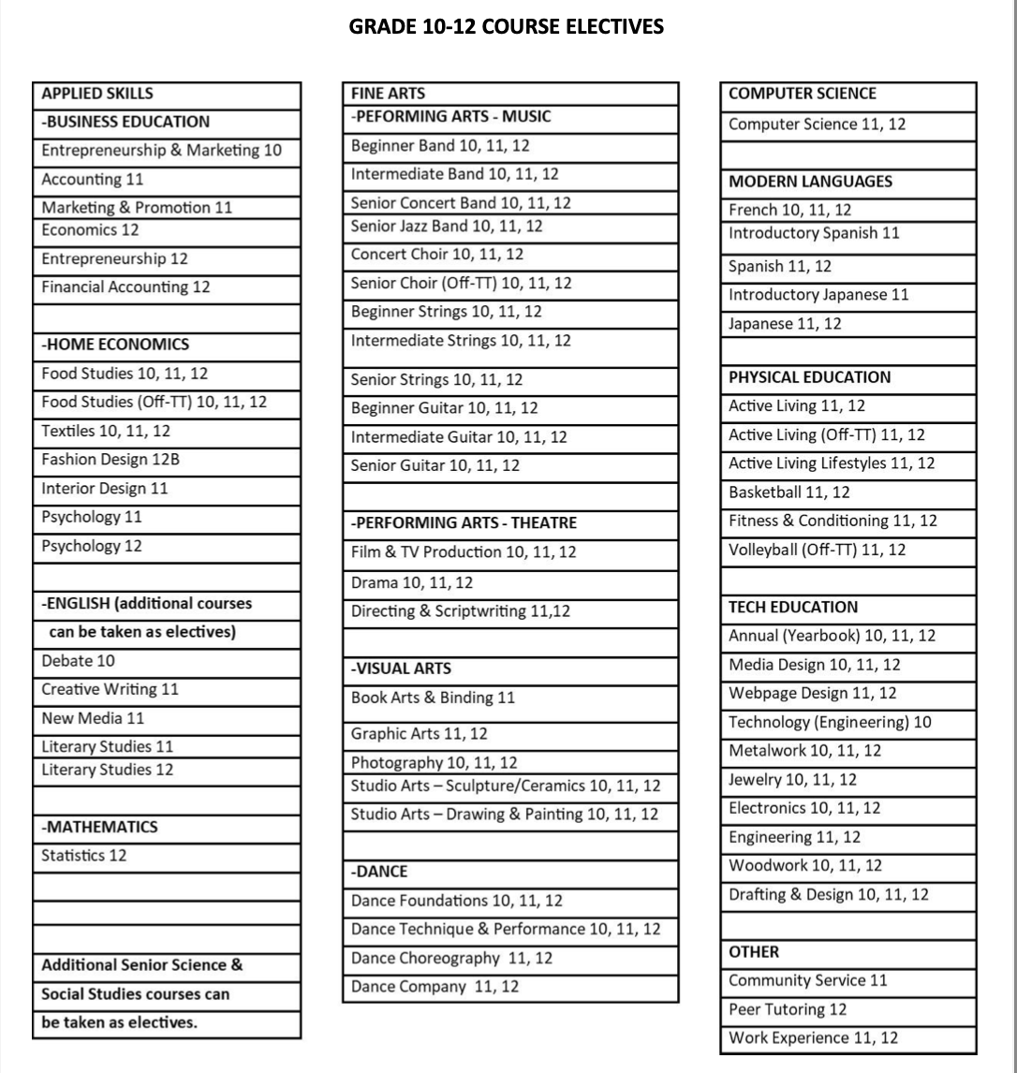
Find course booklet on Churchill website

Slide 17
GRADE 11 GRAD REQUIREMENTS
All students require a Math 11, a Language Arts (English) 11, and Science 11 or 12, and a Socials 11 or 12
French Immersion students are required to have EFLS11 (Etudes litt et art prod ecrite) and Sciences Humaines et Explorations 11 for their FI Diploma
YOU DO NOT NEED A SECOND LANGUAGE TO GRADUATE, however UBC & SFU do require one. SFU only requires an Intro 11 course (ex. Intro Japanese, Intro Spanish, etc…) while UBC requires a full grade 11 language course (ex. Japanese 11, French 11, etc…)
If you are fluent (can read, write and speak) in the following languages: Japanese, French, Korean, Punjabi, Spanish or Mandarin you can apply to take the Language Challenge exam through the Delta school district to meet the 2nd language requirement for UBC and SFU

Slide 18
ONLINE CLASSES & SUMMER SCHOOL
If you fail any of the 5 grade 10 graduation requirements: Math 10, Socials 10, Science 10, English 10 or PE10, take them at remedial summer school
Information about summer school, both completion (moving ahead a grade) and remedial (take if you failed a course) comes out in May
Please indicate any schooling planned over the summer on your course planning sheet

Slide 19
TIPS TO TAKING ONLINE COURSES
Online classes provide a lot of flexibility and can seem easy
BUT experience has taught the following:
Taking an online class in a subject where you struggle often doesn’t work out
Successful completion of an online course requires A LOT of self discipline
If you choose to take a course online, but change your mind and want to take it at Churchill there may not be space for you here
For the overwhelming majority of students, in class instruction provides a better understanding of the course material

Slide 20
THOUGHTS ABOUT ADVANCING YOURSELF IN A SUBJECT AREA
Getting too far ahead in a
subject area often does not pay off in the long
run. Students often end up retaking the grade
12 level course they advanced themselves into
because their mark is uncompetitive on their
university applications. The reason this is the
case is because they took the course before
they were cognitively and emotionally ready
enough to be successful. I would suggest that
you’ll be better off taking an elective.
Notes:
Don’t advance yourself over two semesters - don’t take precalc 11 sem 1 and precalc 12 sem 2

Slide 21
IB CERTIFICATE COURSES
Part-time IB (certificate) is available to regular students ONLY in Film studies, Art, Dance and Theatre. Please see Ms. Puzio in the IB office (Rm 202A) for an application.
Universities count certificate courses as academic courses for admission purposes because they have increased academic requirements

Slide 22
COMMUNITY SERVICE & PEER TUTORING
Many Grade 11 students take Community Service 11 or Peer Tutoring 12. These courses allow students to give back to their school community!
Peer tutoring is a vital part of our Student Support Services. Here, you can support students in subjects/areas in which you are confident and strong

Slide 25
EXTERNAL CREDITS
Remember you may be able to gain extra credits towards your graduation for extracurricular activities. For example:
Royal Conservatory of Music
Provincial level sports
Youth Development: Cadets, First Aid, etc.
For more information: https://www2.gov.bc.ca/gov/content/education-training/k-12/support/graduation/getting-credit-to-graduate/external-credentials

Slide 26
WHAT ABOUT AFTER HIGH SCHOOL?
Notes:
Choose a career that you are genuinely passionate about
You can always take a gap year to discover yourself, work or travel
Take risks and explore other careers and interests
Do not stress or worry, this process can be nerve-racking, but life will unfold and it always works out
What determines your success is your attitude
If you have questions, ask family, friends or seniors for mentorship

Slide 27
STARTING TO THINK ABOUT POST-SECONDARY
Community Colleges (Langara, Douglas, VCC, etc.) generally only require high school graduation to enter. This is also true of the teaching universities (Kwantlen, Capilano, Etc.) BUT, they will have program specific requirements so please check their websites.
Technical schools like BCIT also have program specific entrance requirements. Please look this up!
Universities (UBC, SFU, etc.) have specific language, Math, Science and English requirements that often include Grade 11 courses

Slide 28
STEPS TO COURSE SELECTION
1
3
2
4
Organize your options and discuss with your parent(s), or guardians
Fully complete the course planning sheet. Input your course selection on MYED at home.
Do research on post-secondary requirements and ensure you have the prerequisites you need in the coming years of highschool
Hand in your course planning sheet to Ms. Salter’s office fully completed and with your parent(s) or guardian's signature.

Slide 29
INPUT Courses into MyEd & HAND IN Course Planning Sheets by THURSDAY, February 16th

Slide 30
STUDENT CHECKLIST
Do my research
Peruse the course booklet online
Discuss course planning with parent(s) or guardian
Confirm summer school/online courses
Complete the course planning sheet
Input courses for next year on MYED (IB applications please register for regular classes for now and indicate that you have applied to IB)
Hand in your paper copy of the course planning sheet to Ms. Salter before the deadline Thursday, February 16th

Slide 33
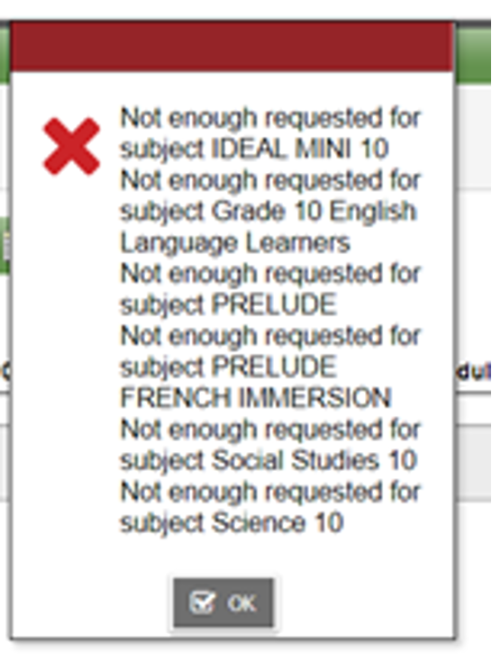
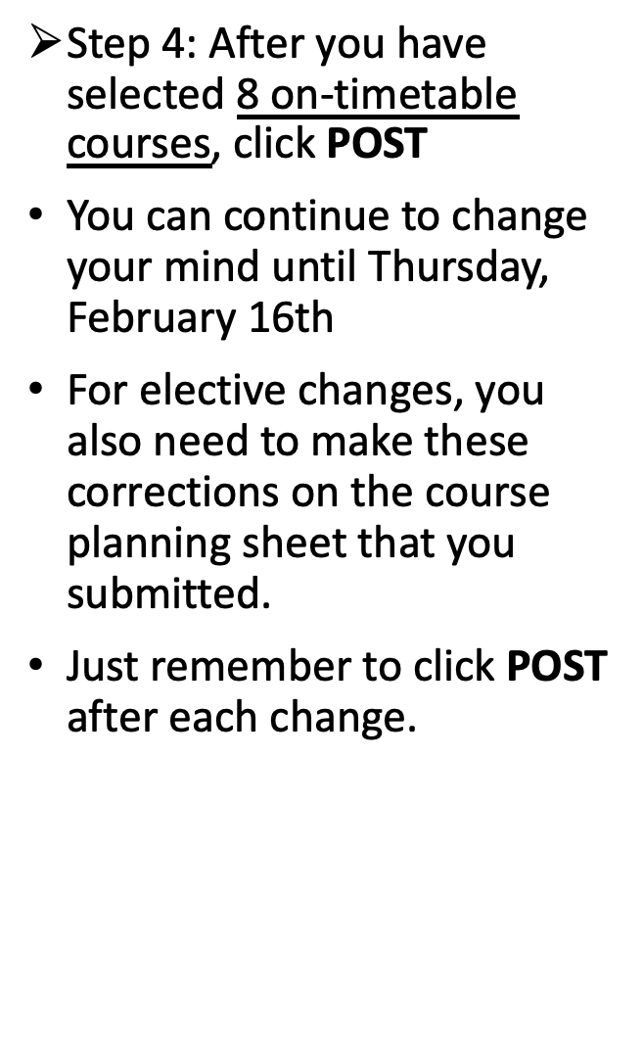

Slide 34
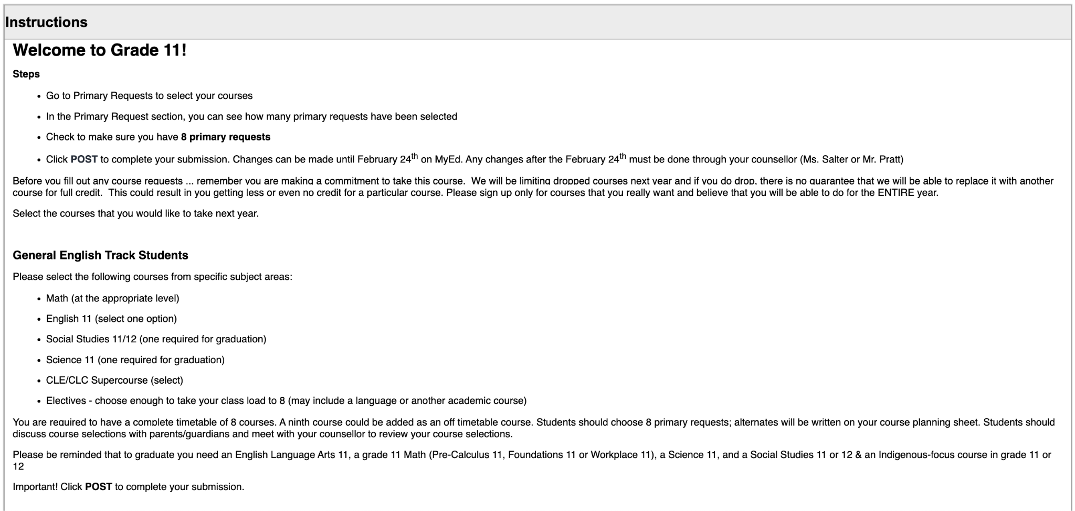

Slide 36
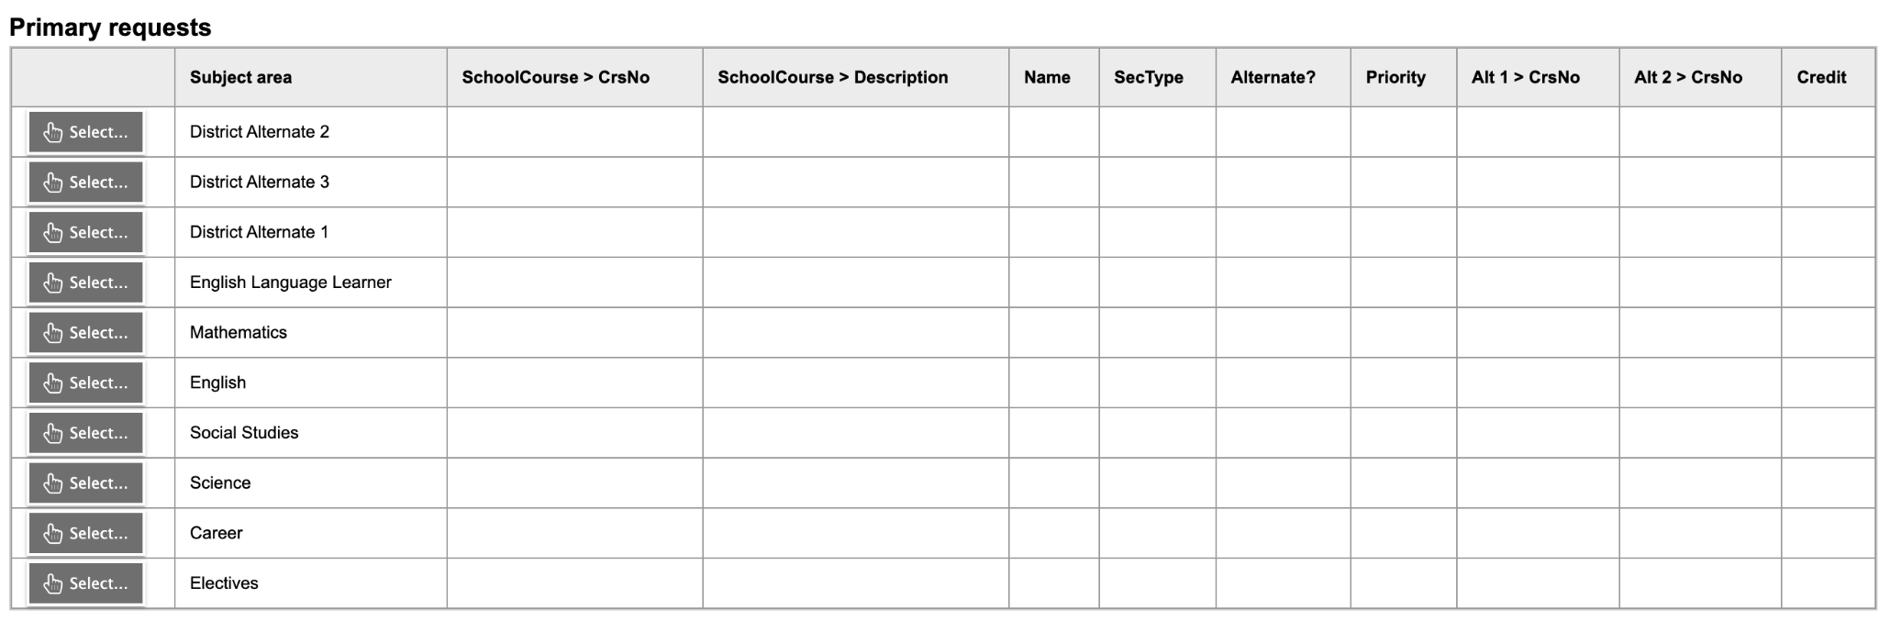

Slide 37
QUESTIONS?

