Slide 1

Course Selection
For Grade 11 and 12’s

Slide 2
INTRO
Ms. Rebane (covering the Class of 2027)
Ms Higenbottam (Class of 2026)
Special guest: Mr. Hamilton (Tupper Tech)

Slide 3
Counsellor’s role in Course planning
Counsellors help students with their course selections and make timetables, but we are fairly neutral when it comes to recommending courses. It is better to talk to teachers, read the course planning book on our website and make an informed
choice by doing research
Counsellors will take all course requests either in the lab or on a MS Form
Students will get all REQUIRED courses needed for graduation

Slide 4
STUDENT’s role in Course planning
Talk to your caregivers, consult whether this course is necessary for your post secondary planning (looking at post secondary websites). Talk to the teachers who teach the course if it’s an elective gathering information from the course planning book and decide if it could be a good fit.
Try new learning experiences, try courses you haven’t had a chance to try. Attend a course planning assembly, attend a smaller FIT session, come visit your counsellor to chat more.
Students will get all REQUIRED courses needed for graduation.

Slide 5
COURSE PLANNING 11 & 12
4 Feb 2025: FIT Time
Course Planning Presentation to all Grade 11 INTO 12, auditorium
4-20 Feb 2024
Counsellors available at FIT for group course advising/ LIBRARY
28 Jan 2025
Course Planning Night
27 Jan 2025
Course Planning Powerpoint available on MS Teams
6 Feb 2025
Course Planning Presentation to all Grade 10 into 11s in the Auditorium
1 MAR 2025
Career Program Applications Due
18 FEB 25
Course Requests Due

Slide 6
COURSE PLANNING
We will review the REQUIRED courses
We will talk about the ELECTIVE options
We will touch on POST SECONDARY pathways and SCHOLARSHIPS
We will answer FAQS and be available for questions and conversations at the end of this presentation and can follow up individually as needed.

Slide 7

GRADUATION REQUIREMENTS
80 credits (most courses are 4 credits each)
Hint: You need to pass the course to get the credits!
52 credits from the required grade 10-12 academic classes you will take, as well as CLE 10, CLC 11/12, and PHE 10.
28 credits from all your electives
4 credits of Indigenous-focused coursework, we will explain
electives, or vice versa
** at least 16 credits must be at the grade 12 level (which includes your required English 12 class)

Slide 8

FAQS
Volunteer hours are no longer REQUIRED to graduate
A second Language is not required to graduate
CLC (Career Life Connections 12) is required to graduate, currently for class of 2026 this is online and off timetable.

Slide 9

ADULT DIPLOMA
The adult graduation diploma is an option for students who are 18 years old
This is a good option for students who are coming from ELL, or who have had some difficulty obtaining their graduation credits.
If you are not sure if you are a good candidate for the adult diploma, please talk to your counsellor about it or your ELL teacher

Slide 10
WHAT DO I NEED TO GRADUATE?
INDIGENOUS GRADUATION REQUIREMENT
All Students must take 4 credits of Indigenous-focused coursework during their high school studies in order to qualify for graduation.
All students in mainstream English at Tupper did this in English 10
Any new students after grade 10 need to ensure they get the credit: BCFP 12 or English FP 12 (which also counts as an English 12)

Slide 11
Graduation Requirements for Grade 12 – English and Social Studies
English First Peoples 10
Literary Studies 11 or New Media 11
English Studies 12 or English First Peoples 12
Social Studies 10
Social Studies 11 OR any Social Studies 12 (BC First Peoples 12 Law 12, History 12, Geography 12 or Economics 12)
LITERARY ASSESSMENT EXAM 10 & 12

Slide 12

ASSESSMENT EXAMS REQUIRED
LITERARY STUDIES 10
LITERARY STUDIES 12
NUMERACY 10

Slide 13
Graduation Requirements for Grade 12 – Math and Science
Any Math 10: Foundation of Math and Pre-Calculus 10 OR Workplace Math 10
Any Math 11: Pre-Calculus 11 🌶️ 🌶️ /Foundations of Math 🌶️ 🌶️ 11/ Workplace Math 11 🌶️
Science 10
At least 1 Science 11 or12: Life Science 11/Chem 11/Physics 11/Environmental Science 12/Science for Citizens 11
NUMERACY 10 ASSESSMENT

Slide 14
Graduation Requirements for Grade 12 – OTHER COURSES
You need a minimum of 4 Grade 12 level classes to graduate
PHE 10 and Career Life Education 10 must be complete
Career Life Connections12 with a Capstone project must be complete by graduation
One Fine Arts 10, 11 or 12 or Applied Design, Skills & Technologies 10, 11 or 12 course
A total number of credits equaling 80 or more (each full year course is worth 4 credits once passed)

Slide 15
What other courses do I take?
All students must have at least 3 additional Grade 12 courses ( you can have more!) in order to graduate
Select courses based upon your post-secondary plans whether you want to attend trades schools, college, or university
Grade 10-12’s need a total of 7 elective courses (28) credits to graduate, one must be fine arts or applied skills

Slide 16
TYPES OF COURSES
REQUIRED COURSES
students are scheduled according to grade
To meet graduation requirements
Teacher and social requests not possible
We do everything possible to ensure students get REQUIRED courses
ELECTIVE COURSES
Courses are run according to demand/ student requests
Students often will choose a course because they want to work with a teacher
Certain electives may be required for post secondary
7 Elective courses are required to graduate
They enhance your education/ personal growth

Slide 17
Before choosing courses:
Read the full description in the Course Planning Book (online, Tupper website)
Talk to the teachers who teach in the departments
Talk to people who have taken the course
Check post secondary requirements and talk to parents

Slide 18
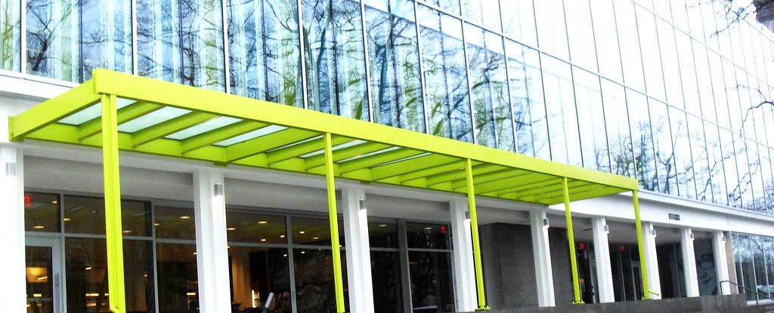
ELECTIVE Areas: Computer Science, Business, Applied sciences
ACCOUNTING 11, 12
MARKETING AND PROMOTION 11
ENTREPRENEURSHIP 12
MEDIA DESIGN 11
APPLICATIONS OF AI 12
COMPUTER PROGRAMMING 11, 12
This Photo by Unknown Author is licensed under CC BY-SA-NC

Slide 19
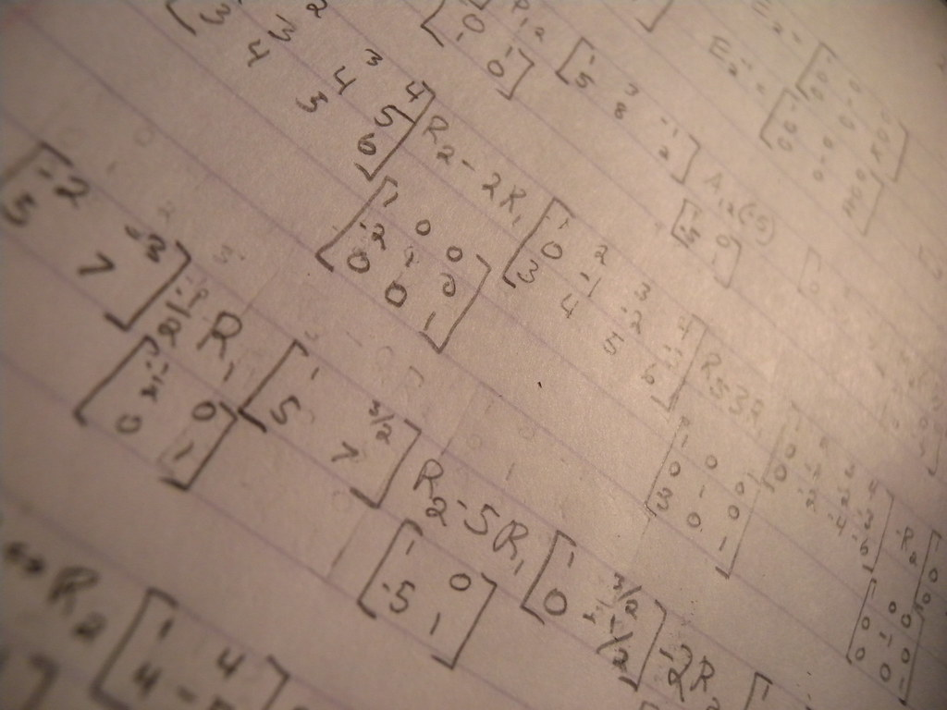
ELECTIVE areas: STEM/ MATH/ APPLIED SCIENCES one math required
🌶️= .5 HOUR OF HOMEWORK APPROX/ * prereq
PRECALCULUS 11 *🌶️ 🌶️ 12* 🌶️ 🌶️ 🌶️
FOUNDATIONS OF MATH 11* 🌶️, 12 *🌶️🌶️
WORKPLACE MATH 11 🌶️
CALCULUS 12*
This Photo by Unknown Author is licensed under CC BY

Slide 20
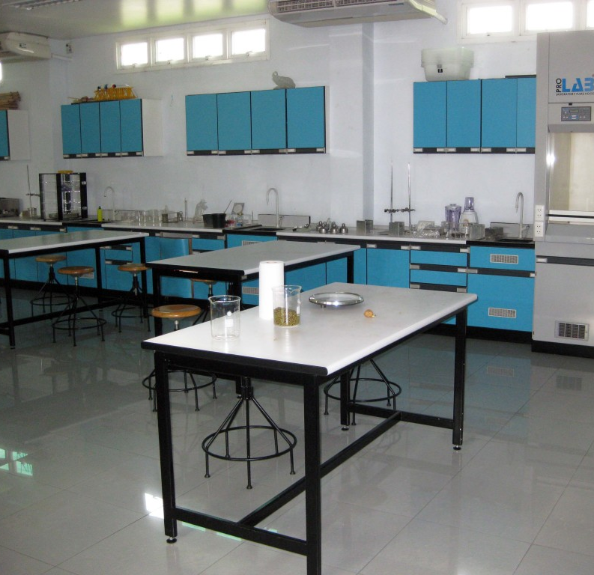
ELECTIVE areas: STEM/ SCIENCES/ APPLIED SCIENCES/ health sciences one science required
CHEMISTRY 11 🌶️ 🌶️, 12* 🌶️ 🌶️ 🌶️
LIFE SCIENCES 11🌶️
SCIENCE FOR CITIZENS 11🌶️
ENVIRONMENTAL SCIENCES 12🌶️
ANATOMY AND PHYSIOLOGY 12* 🌶️ 🌶️ 🌶️
PHYSICS 11 🌶️ 🌶️, 12 * 🌶️ 🌶️ 🌶️
This Photo by Unknown Author is licensed under CC BY-SA

Slide 21
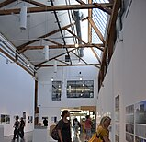
ELECTIVE areas: VISUAL ARTS
ART (DRAWING AND PAINTING) 11, 12
CERAMICS AND SCUPLTURE 11, 12
GRAPHIC DESIGN 11, 12
PHOTOGRAPHY 11, 12
YEARBOOK/ ANNUAL 11, 12
FILM & TV 11, 12
This Photo by Unknown Author is licensed under CC BY-SA

Slide 22
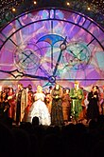
ELECTIVE areas: performing arts
*PRE-REQ
THEATRE COMPANY 11, 12
TECHNICAL THEATRE 11, 12
DIRECTING/ SCRIPTWRITING 11, 12
DRAMA LEADERSHIP 11 *
DANCE 11, 12
DANCE COMPANY 11, 12 *
This Photo by Unknown Author is licensed under CC BY-SA

Slide 23

ELECTIVE areas: MUSIC
*PRE-REQ
GUITAR 11,12
BEGINNING BAND 11, 12
INTERMEDIATE BAND 11, 12*
ADVANCED BAND 11, 12 *
CHOIR 11, 12 (OFF TIMETABLE /LINEAR)
JAZZ BAND 11, 12 * (OFF TIMETABLE/ LINEAR)

Slide 24
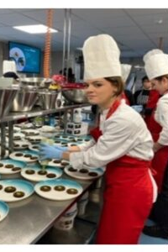
ELECTIVE areas: SKILLED TRADES
FOODS 11, 12
CULINARY ARTS (CAFETERIA) 11, 12
DRAFTING AND DESIGN 11, 12
WOODWORK 11, 12
TEXTILES 11, 12
COMPUTER PROGRAMMING 11, 12
This Photo by Unknown Author is licensed under CC BY-SA

Slide 25
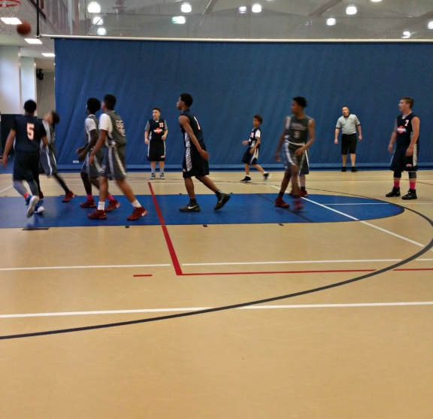
ELECTIVE AREAS: HEALTH
ACTIVE LIVING 11,12
FITNESS & CONDITIONING 11, 12
PHE LEADERSHIP 11, 12*
SOCIAL PSYCHOLOGY/ FAMILY STUDIES 11
PSYCHOLOGY 12
This Photo by Unknown Author is licensed under CC BY-NC-ND

Slide 26

ELECTIVE AREA: ARTS, HUMANITIES, SOCIAL SCIENCES, COMMUNICATIONS, POLITICAL SCIENCE, CULTURAL STUDIES
NEW MEDIA 11 or LITERARY STUDIES 11 (ONE IS REQUIRED)
ENGLISH STUDIES 12 or ENGLISH FIRST PEOPLES 12
LITERATURE 12 (elective in addition to English 12)
CREATIVE WRITING 12

Slide 27
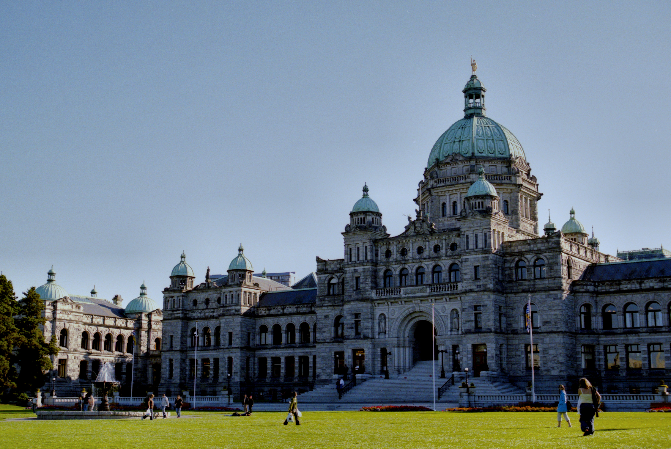
ELECTIVE AREA: ARTS, HUMANITIES, SOCIAL SCIENCES, COMMUNICATIONS, POLITICAL SCIENCE, CULTURAL STUDIES (ONE IS REQUIRED FOR GRAD)
EXPLORATIONS OF SOCIAL STUDIES 11
SOCIAL JUSTICE 12
PHYSICAL GEOGRAPHY 12
ECONOMIC THEORY 12
BC FIRST PEOPLES 12
20TH CENTURY HISTORY 12
LAW 12
Social Studies Honours Certificate (Social Studies 11 plus two Grade 12 Social Studies courses)
This Photo by Unknown Author is licensed under CC BY-SA

Slide 28
DISTRICT COURSES: ARTS/ SOCIAL SCIENCES/ CULTURAL STUDIES
Queer & Trans History 12
History of African Descent 12
Why Take Them?​
Unique curriculum with field trips, guest speakers, and project-based learning​
Meet students from across the district​
Focus on important cultural and historical topics​
​
Who Can Enroll?​
Grades 11 & 12 students from all VSB high schools ​
OFF TIMETABLE COURSES w/ FIELD TRIP and some ONLINE work
NOT SOCIAL STUDIES GRADUATION CREDITS

Slide 29
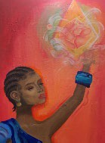


History of African Descent in BC 12
History of African Descent in BC 12 (Course Code YSSC-2A)
Course Highlights:
Explore Black culture, history, resilience, and achievements
Focus on African empires, West Indian dialects, Black art, and more
Dive into popular culture influences like Beyoncé, Maya Angelou, and AfroFuturism
What You’ll Do:
Field trips, guest speakers, and project-based learning
Online discussions and seminars
Why Take It?
Centering Black Joy and Resilience
Engage in important conversations about history and culture
AD 12 Artwork by Lily Hayes
(Grad 2023, Vancouver Technical Secondary)
Hear more from students!
Round Table Discussion with Wayde Compton (youtube.com)
https://youtu.be/Xsx4hZPmq5A?si=N Tc_UiRDD_ssdxOu

Slide 30

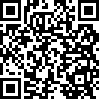
Queer & Trans History of BC 12
Queer & Trans History of BC 12 (Course Code YSSC-2B)
Course Highlights:
  Learn about the diverse history of 2SLGBTQIAP+ communities in BC
  Explore language, music, dance, and movements
  Focus on Queer and Trans joy, resilience, and achievements
What You’ll Do:
  Participate in field trips, guest speakers, and project-based learning
  Engage in online dialoguing and seminars
Why Take It?
  Centering Trans and Queer Joy
  Gain a deeper understanding of historical movements and personal stories
More Information:
https://www.youtube.com/watch?v=OL_EJY- CmEg

Slide 31
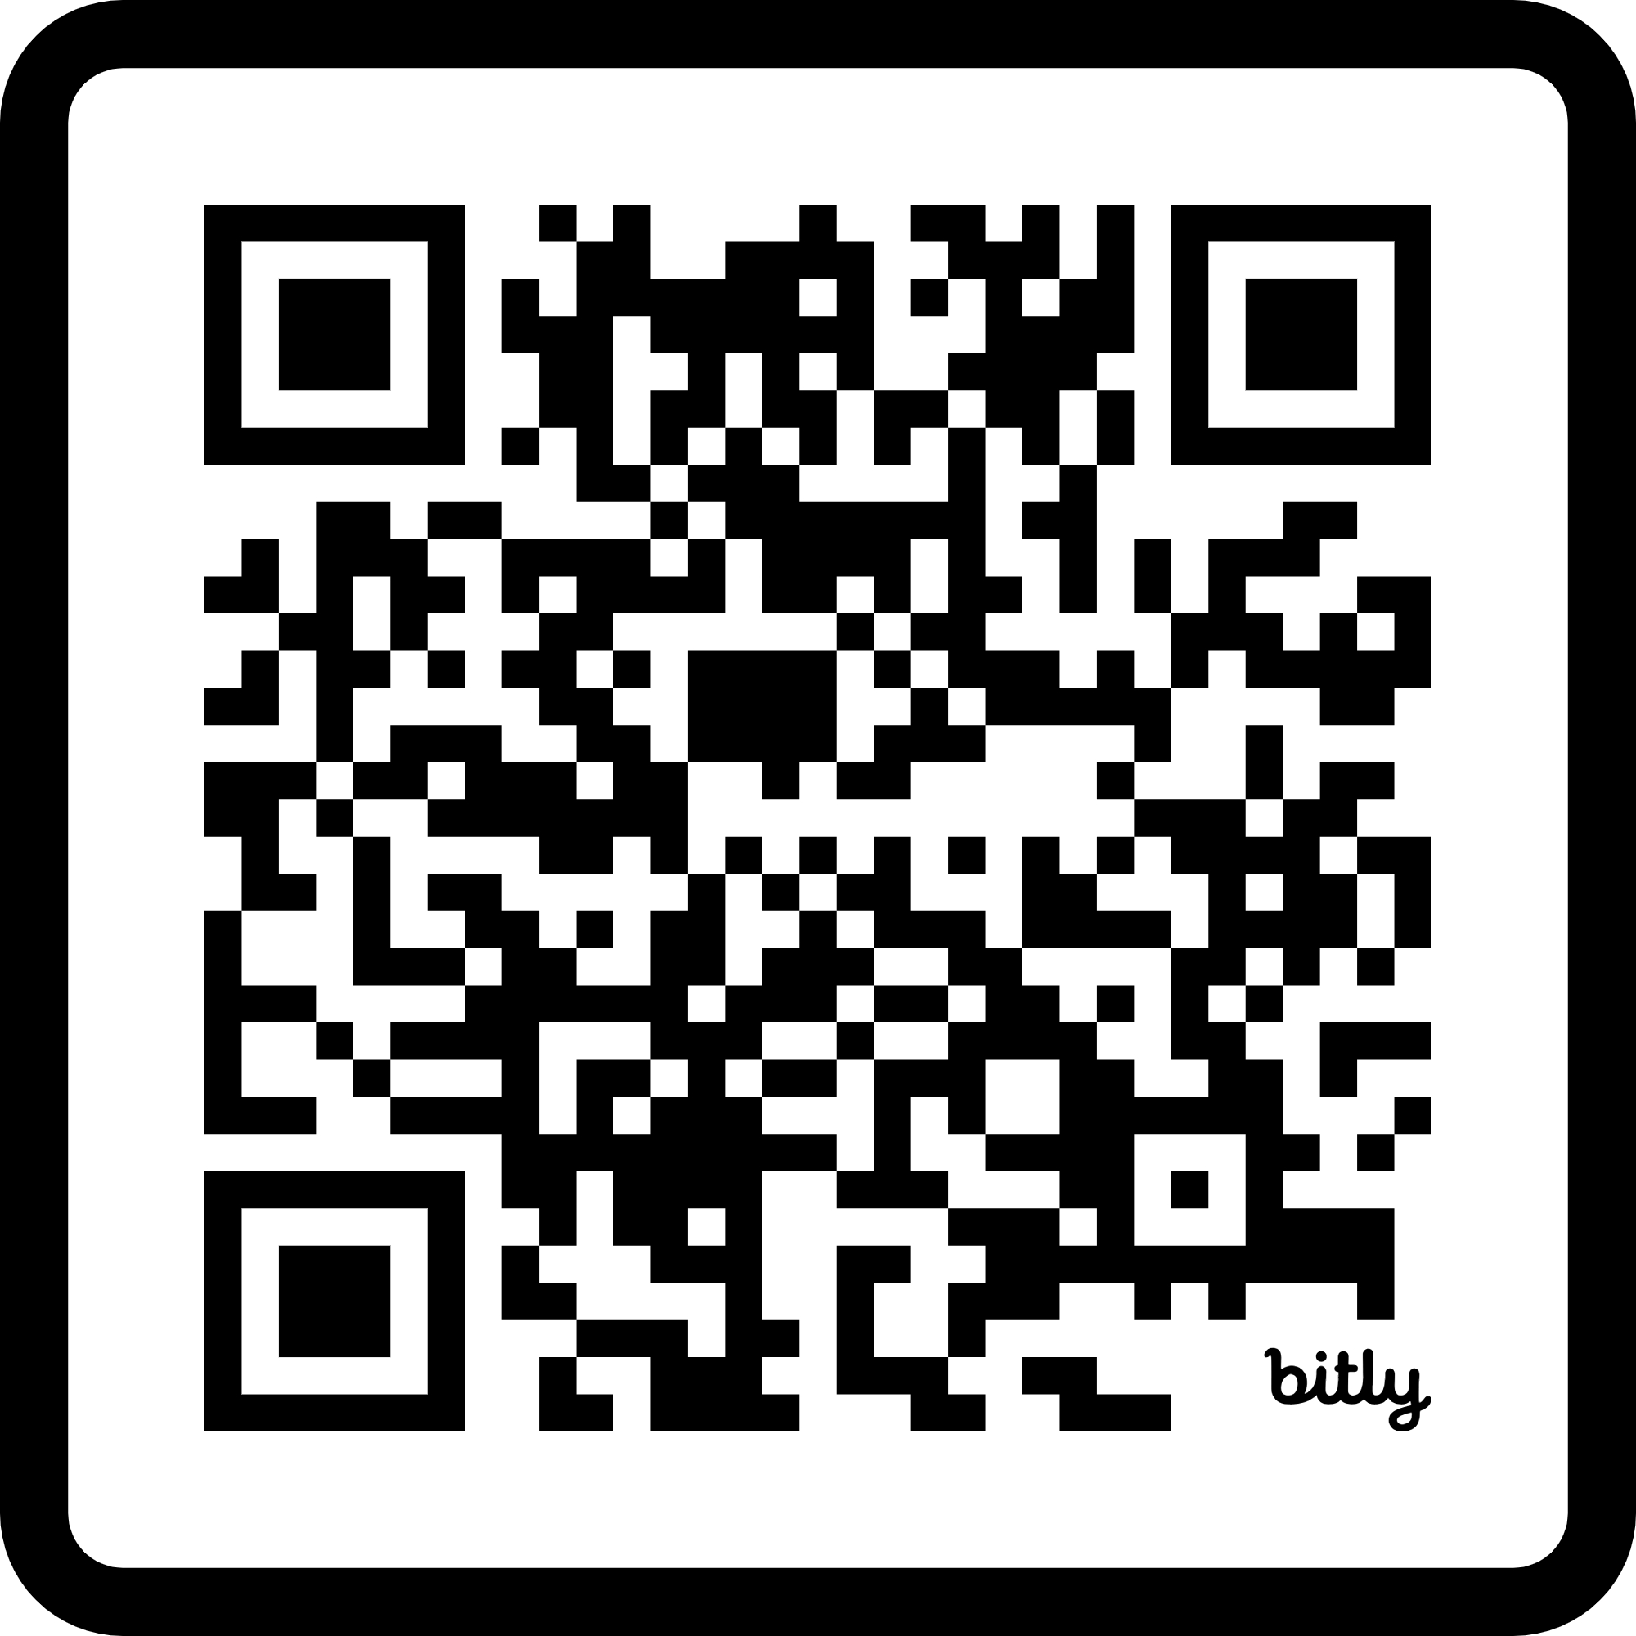

INFORMATIONAL SESSION
Register for the Informational Session on February 26, 2025 @ 5:30 PM (virtual) for more details!
bit.ly/3DoNNBo

Slide 32
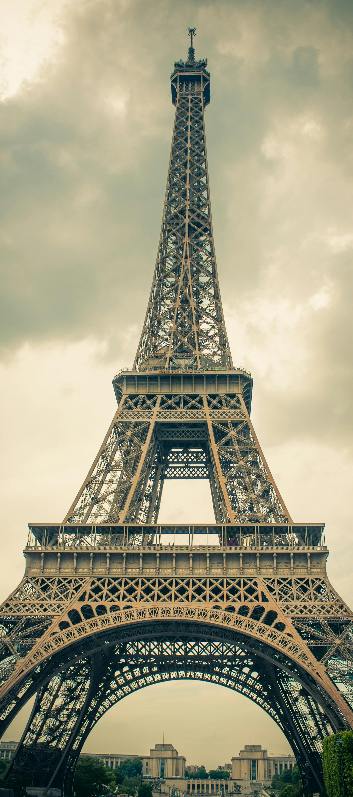
ELECTIVE AREA: ARTS, HUMANITIES, SOCIAL SCIENCES, MODERN LANGUAGES
*PREREQ
FRENCH 11, 12*
SPANISH 11, 12*
FILIPINO LANGUAGE AND CULTURE 11

Slide 33

ELECTIVE AREA: STUDENT SUPPORT SERVICES & CAREER EDUCATION
LEARNING STRATEGIES 11, 12*
LINK LEADERSHIP 11, 12 (LINEAR/ OFF TIMETABLE)
WORK EXPERIENCE 11,12 (OFF TIMETABLE)
DISTRICT WORK EXPERIENCE 12 (MS. RENTZ)
This Photo by Unknown Author is licensed under CC BY-NC-ND

Slide 34
WATCH VIDEO ON VSB CAREER PROGRAMS
CAREER PROGRAMS

Slide 35
CAREER PROGRAMS/ TRADES
If you think you may be interested in trying out a trade or career program, or simply want to learn more, check out their website to view programs
https://www.vsb.bc.ca/career-programs/page/11419/program-offerings
Then, speak with your grade counsellor (generally)
Book office hours with district teachers Mark Reid and Allison Newton or
Talk to Mr Hamilton (Tupper Tech)
*Application deadlines for next years’ programs due on March 1 of the Grade 11 year. Please see Career Programs VSB for more details

Slide 36
Various Youth Train in Trades and Career Programs offered by the VSB
Aircraft Maintenance Engineer
Automotive Collision and Refinishing Technician
Automotive Service Technician
Baking and Pastry Arts
Carpentry
Cisco and IT Networking
Early Childhood Educator
Electrical
Hairstylist
Health Care Assistant
Heavy Mechanical Trades
Job Training
Metal Fabricator
Millwright
Motorcycle Technician
Painting and Decorating
Plumbing and Sprinklerfitting
Professional Cook 1
Trades Discovery
Tupper Tech Explore Trades Sampler

Slide 37
Career Life Connections 11/12
This is an Off timetable course that will be delivered in 2 parts. 1st portion in Grade 11 and the other in Grade 12.
Both CLC 11 and 12 are worth 2 credits each
These courses will be delivered during the school year with 6-10 assignments throughout the year
Students will be assigned to a teacher, to which they will submit their assignments

Slide 38
HOW SHOULD I DECIDE WHAT COURSES TO TAKE NOW TO GET INTO POST-SECONDARY LATER?
Look at the admissions requirements for the various post-secondary spots where you’re interested in going.
See what courses they require you to have, and which ones are suggested, but optional.

Slide 39
SOME POST SECONDARY PATHWAYS
COLLEGE / TRANSFER
PROFESSIONAL TRAINING
UNIVERSITY
LANGARA/ DOUGLAS
BCIT/ VCC
UBC/ SFU/ UVIC
Lower barrier for open enrolment programs
Classes are typically smaller and tuition fee is less
Transfer to university to complete degrees
Usually offer continuous enrolment
May offer paid apprenticeship opportunities
Competitive admission
Deadlines
Usually, a minimum of an A/ high B average in Grade 12 courses
Often requires specific Grade 12 courses and sometimes admission, essays or supplemental applications

Slide 40
What if I don’t know what I want to do ?!
Don’t worry, it’s ok if you don’t have it all figured out.
Think about the things you don’t want to do and use that as a starting point.
People change their mind/ career path all the time---open yourself to new ideas/ opportunities, take some general classes to help you figure out a focus.
Get a part time job
Volunteer
Enrich your experiences

Slide 41

What now?
Read the planners online
Talk to your parents/guardians
Make individual appts with your counsellor if necessary
Talk to your teachers--especially Youth Train in Trades and Tupper Tech hopefuls---research the courses and make informed choices.
Research Career Programs
If you have questions, I want to HEAR FROM YOU !!

Slide 42
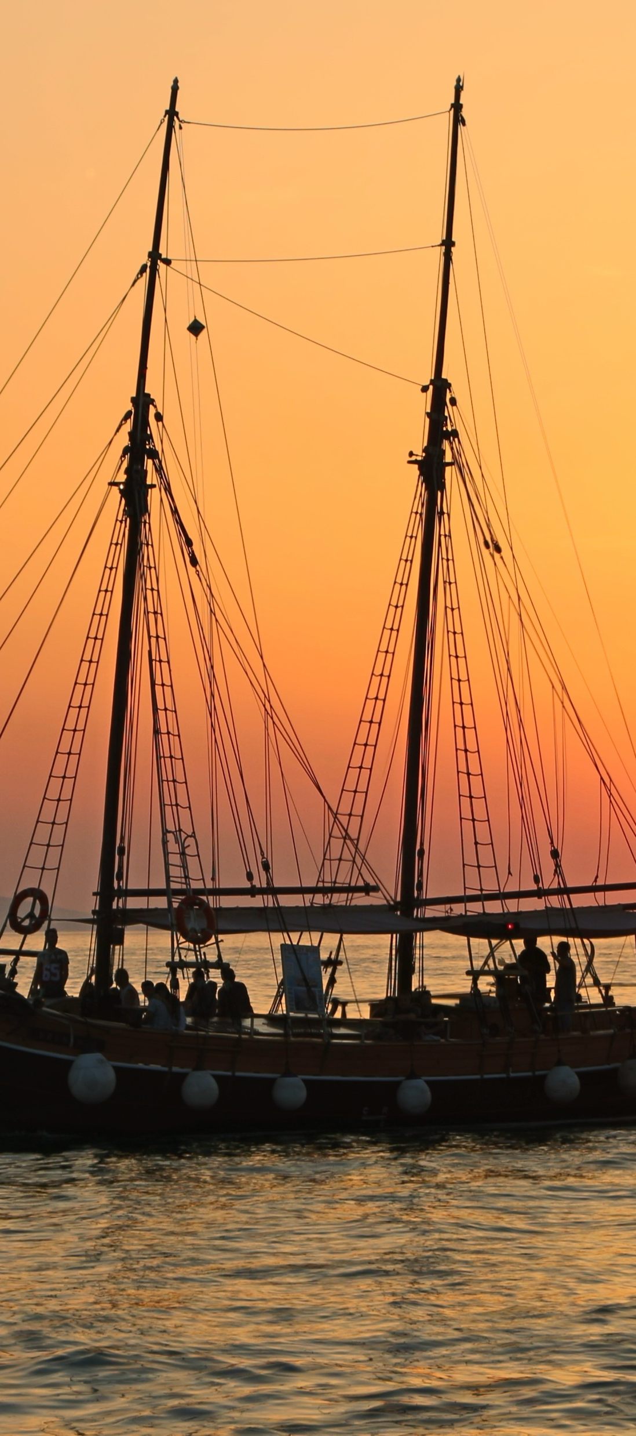
EXCHANGES AND SEMESTER AWAY
If you are planning on attending an educational or athletic program away from Tupper on an exchange or in a different country, please notify the school and counsellor as soon as possible so you can discuss the potential impact to your graduation credits.

Slide 43
Course Planning book 2025-2026
Can be found on the Tupper Website under Course Planning, go to:
Tupper Website → Guidance and Support (top tab) → Course Planning → Course Planning Book 2023-2024

Slide 44
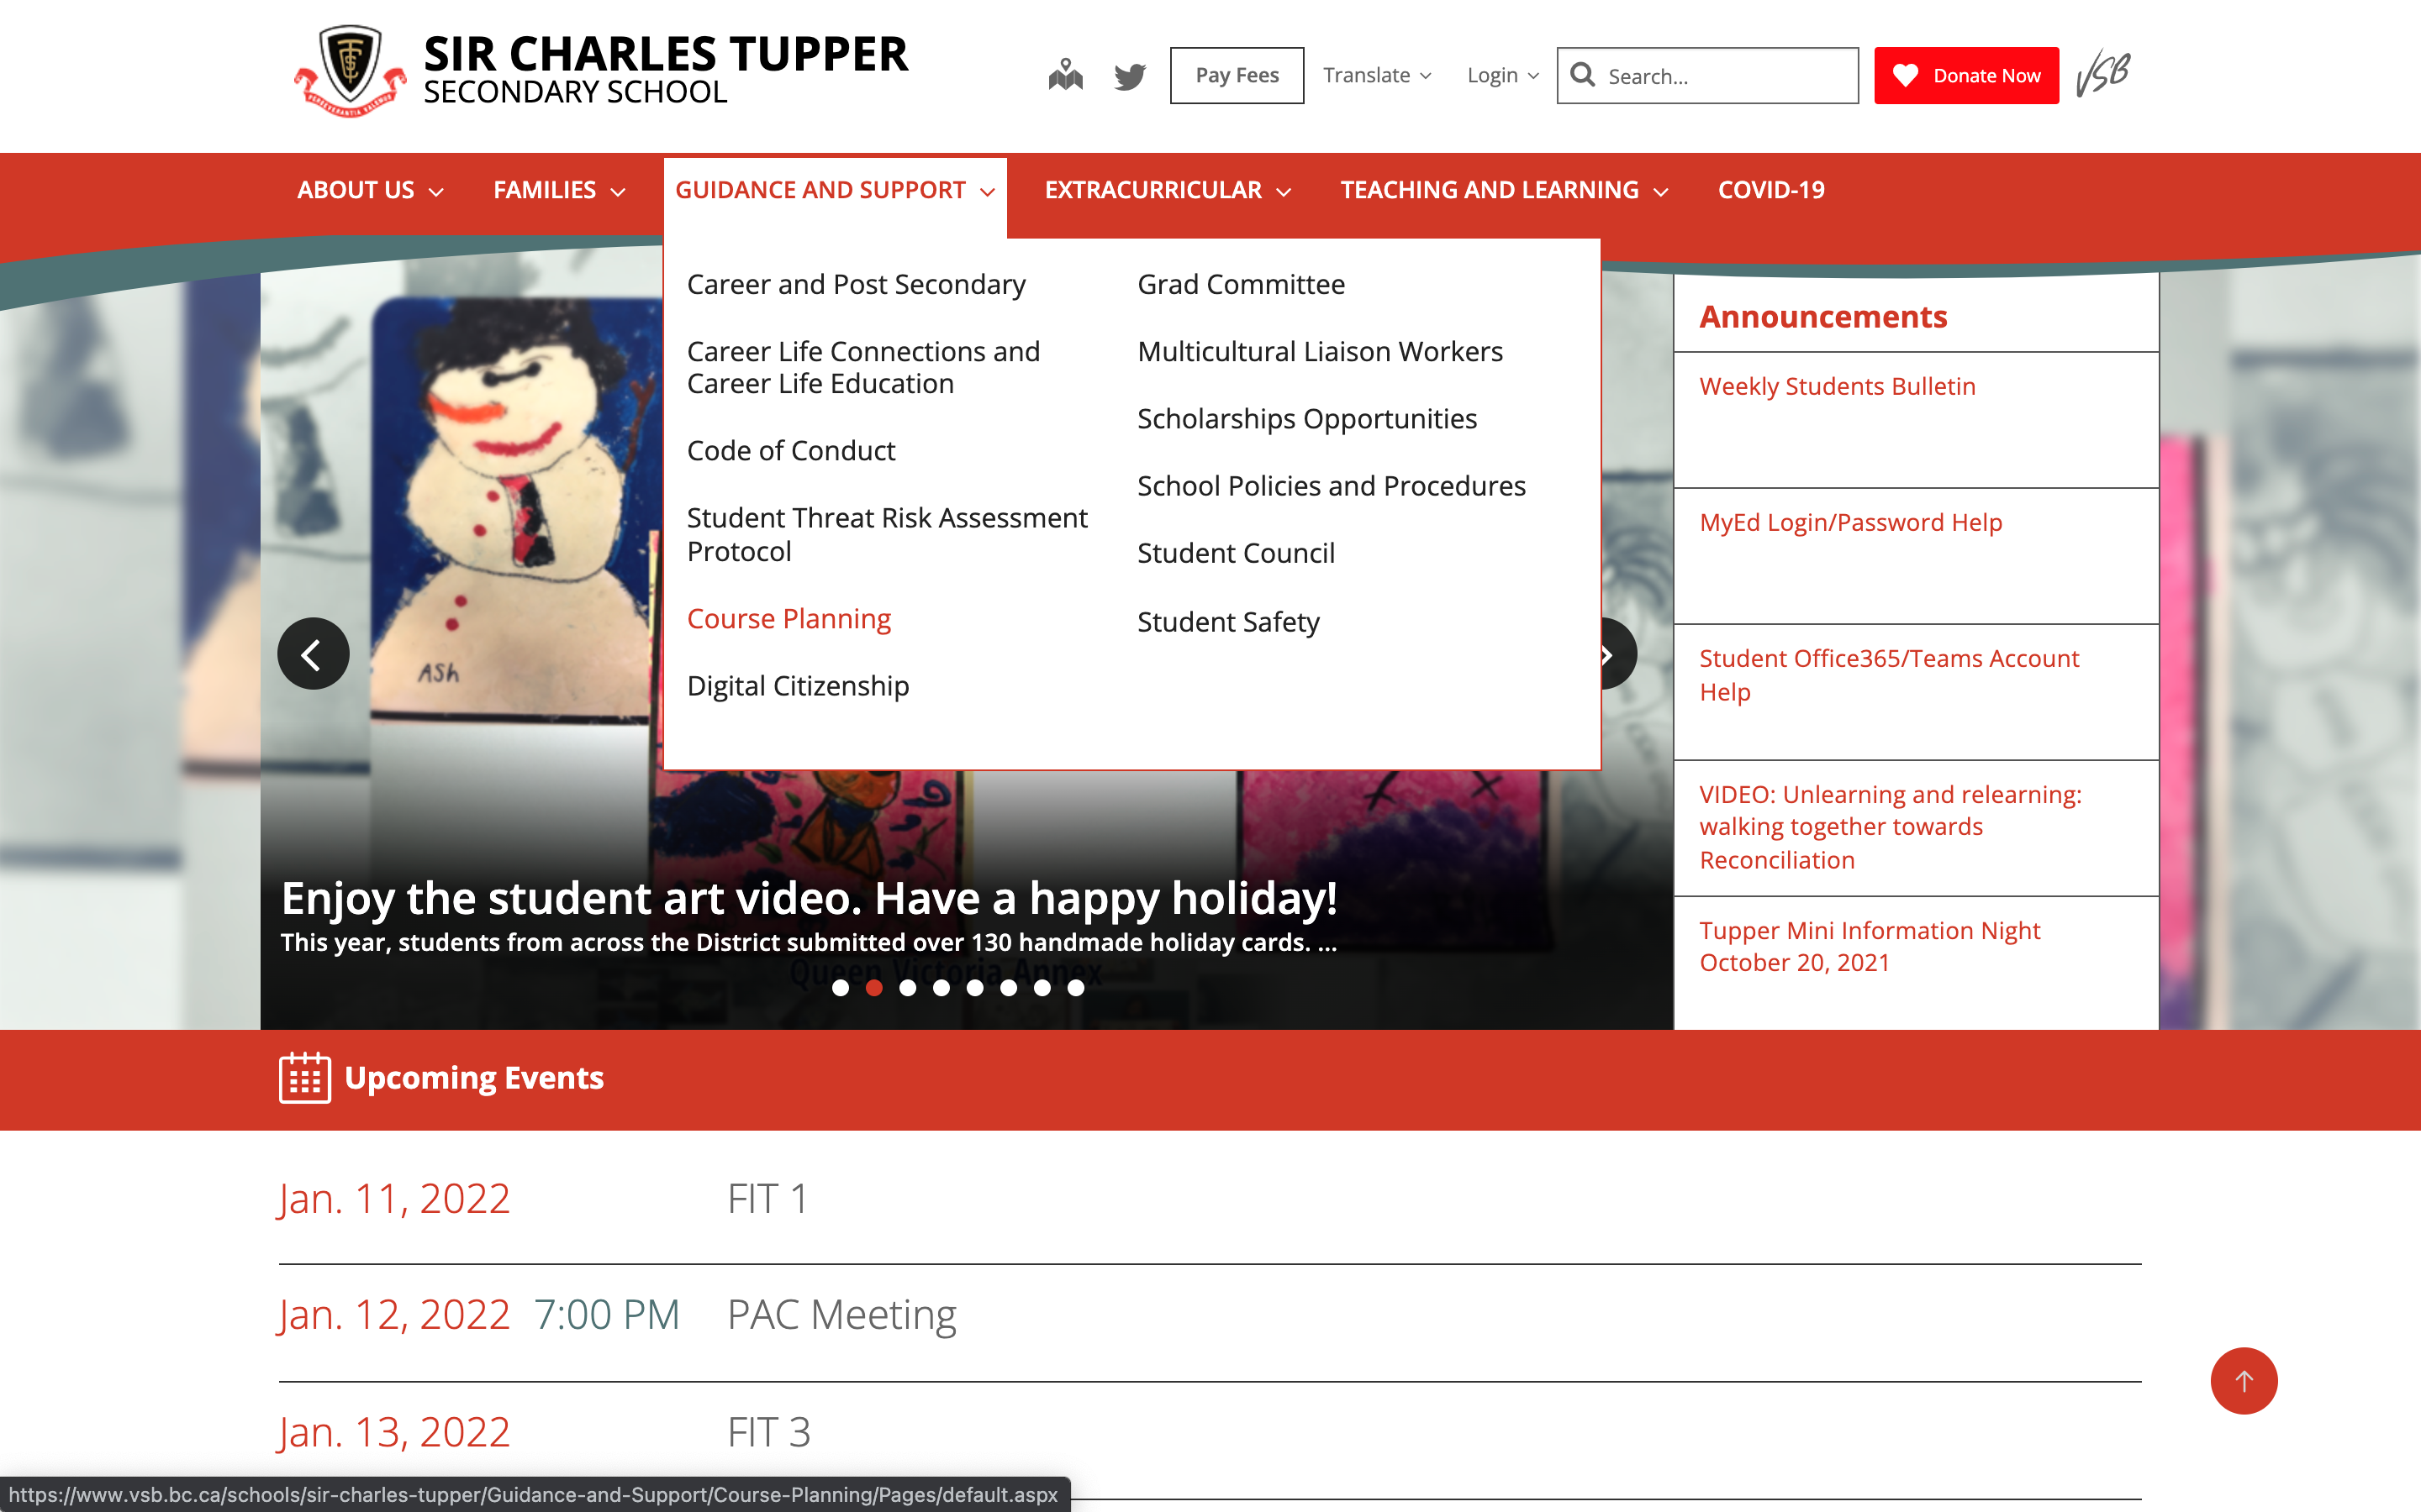
Where to find course planning materials?
1. Tupper Website

Slide 45
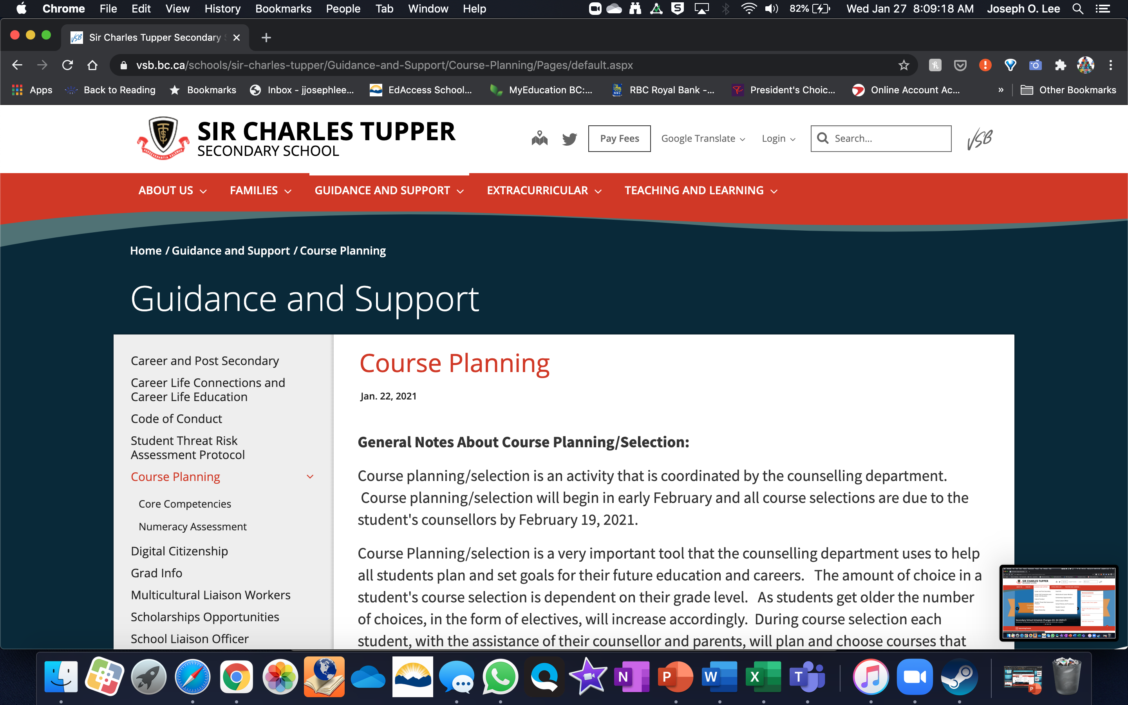
Course planning Page on Tupper Website

Slide 46
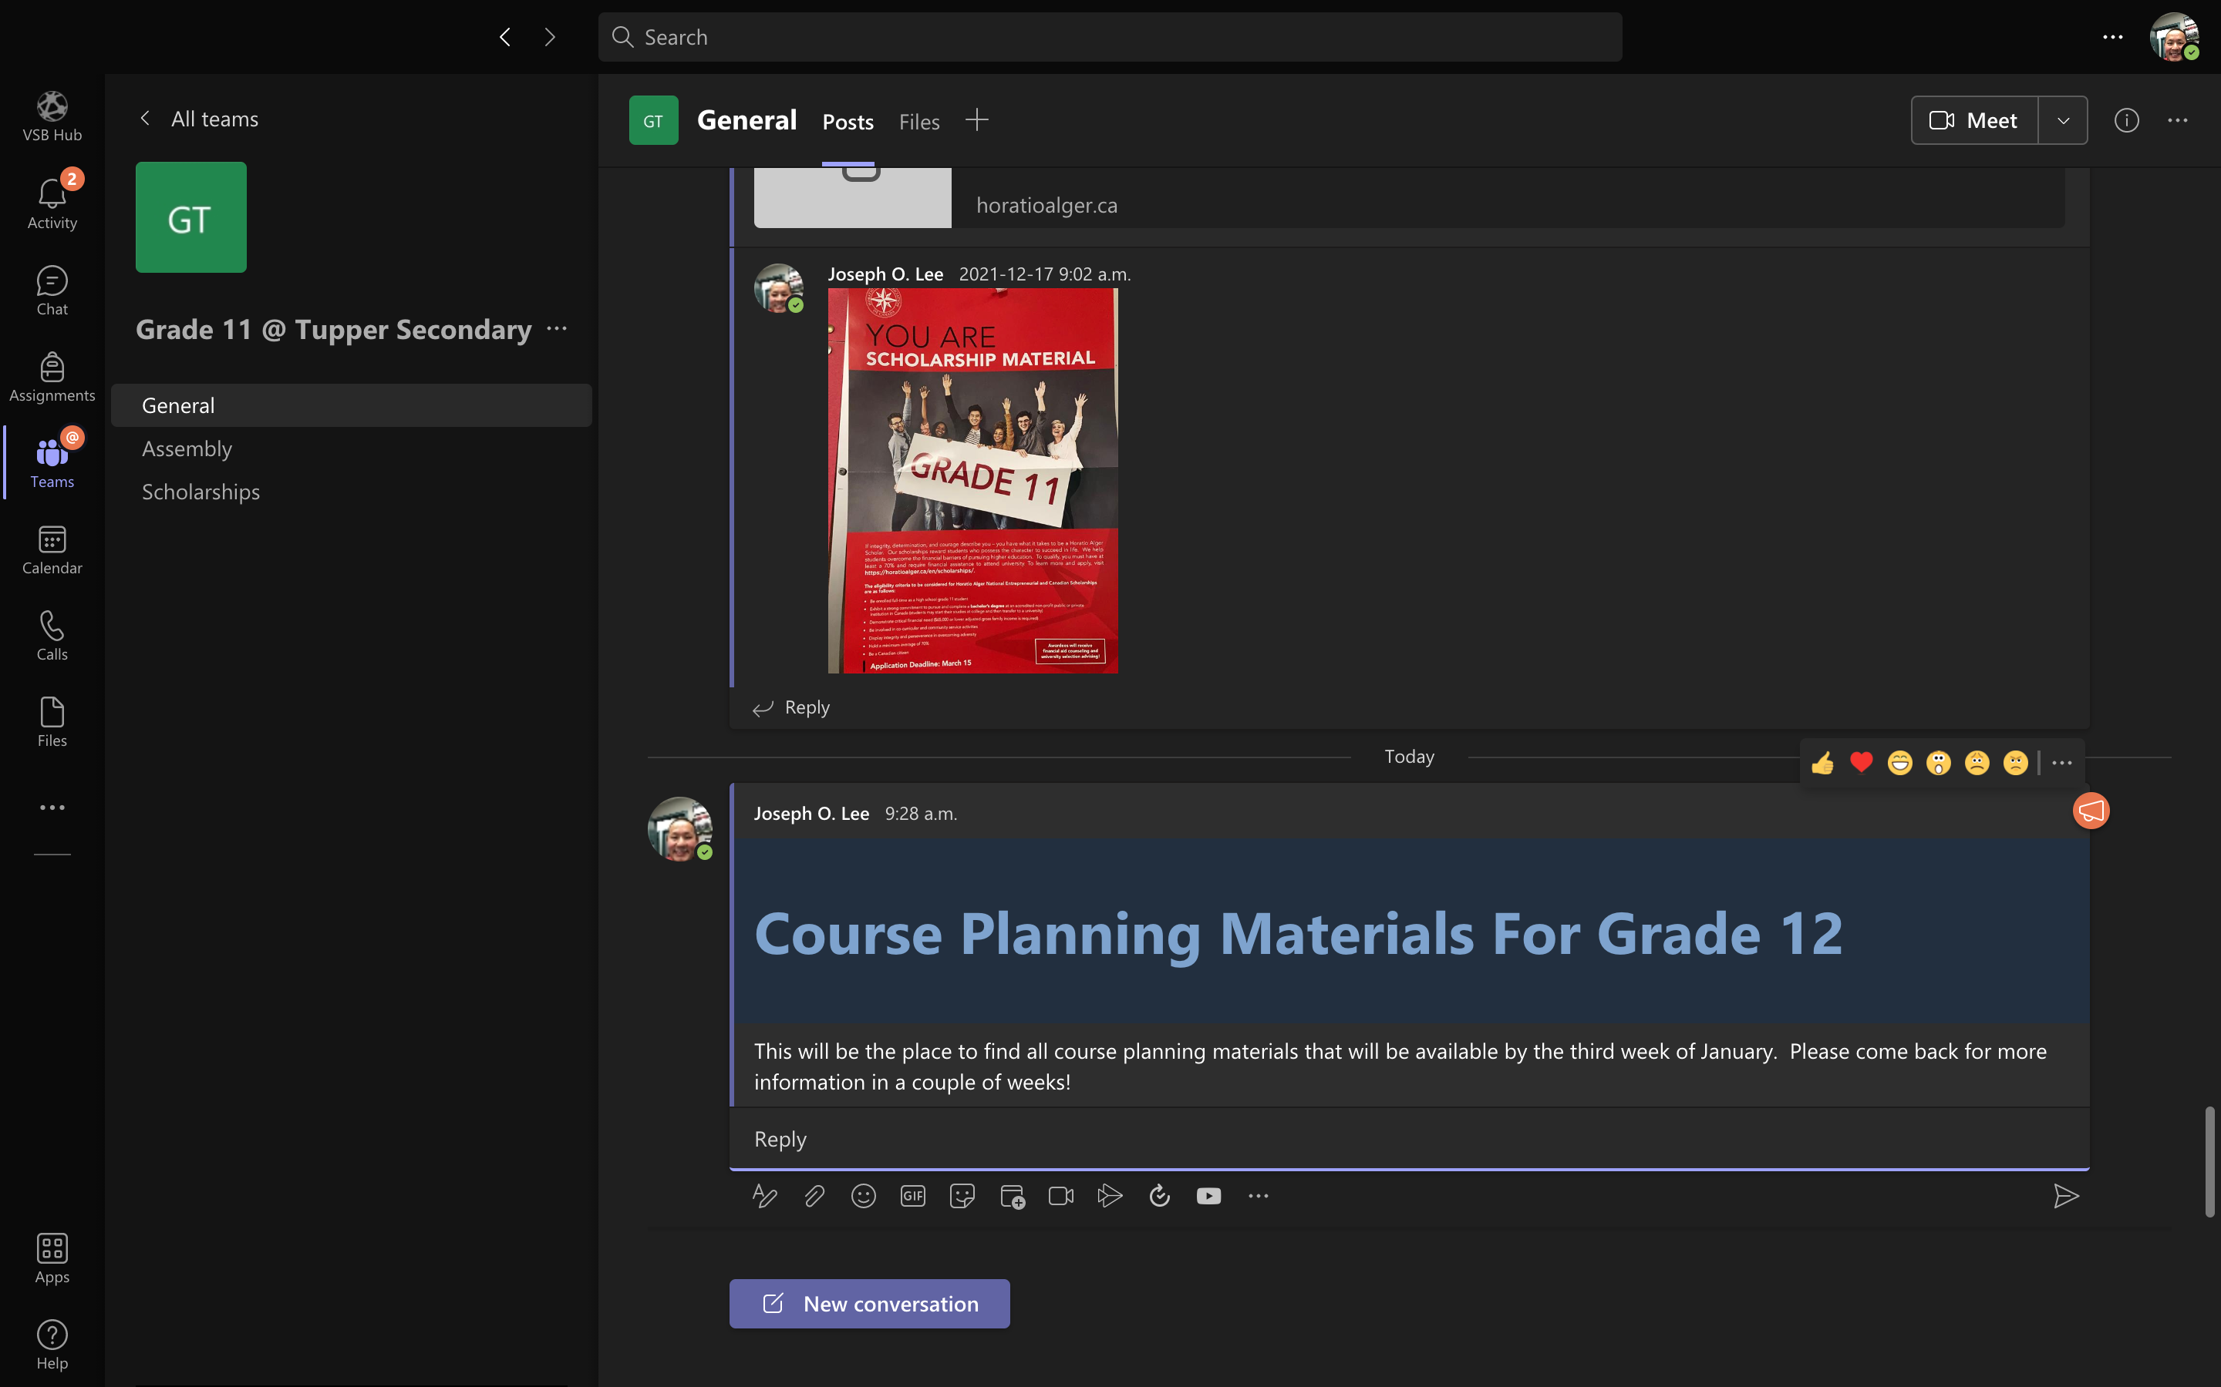
All information will also be available on MS Teams Grade channel

Slide 47
How do I submit my course Selections?
GRADE 10
Complete the PAPER course planning form, get it signed and return to Ms. Rebane in Counselling
GRADE 11
Once you’ve made your decisions and after consulting with your parents, you MUST complete the Course Selection Form on the Grade 11 MS Teams Channel

Slide 48

How Your Schedule is Made
Once everyone’s courses are requested, we spend months building the timetable
Factors that impact how the timetable is made: number of people requesting a course, teacher’s work schedules, room availability, student support needs, and overall operating budget/staffing.

Slide 49
I’m In grade 12, I get priority in all classes right???
Yes…kind of.
Grade 12s will get priority to classes based upon their initial course selection requests that are made in February
However, if you change your mind in September, then you will not be able to “bump” another student out of a class at that point and will go on to a waitlist
We do not allow students to retake courses for a higher mark at Tupper

Slide 50
SCHOLARSHIPS
EXTERNAL
SCHOOL NOMINATED EXTERNAL
ENTRANCE
An external scholarship is a scholarship that is donated and might have specific criteria.
if the scholarship is promoted to Tupper then we will post about it in the scholarship teams channel
scholarshipscanada.com is another good resource for looking at external scholarships.
Organizations ask us to nominate a student, and this will go through the school scholarship committee.
The candidate for these scholarships is usually a student who is in the top percentile of student marks, leadership, and roars and athletics
Loran/ BC EXCELLENCE/ TD Book / Veazy/ SCHULICH etc
Many post secondary institutions will offer an entrance scholarship to entice students to go there
These are usually based on your marks or overall scholarship/leadership profile or Financial need

Slide 51
School based Scholarships
The Tupper scholarship committee awards scholarships at the graduation ceremony every year. Students apply for these scholarships in the spring.
The donors of the scholarships give the Tupper scholarship community the authority to determine the best candidates based on the criteria for each award.
Students wanting to apply to SCHOOL BASED scholarships must be registered in a minimum of 7 classes at Tupper (online classes do not count, nor does CLC 11/12)
All decisions on school based award winners are made through the Tupper Scholarship Committee

Slide 52
Information for other scholarships
All information on scholarship opportunities will be presented on the Scholarship Channel in the Grade 12 MS Teams group
Please have a look at this channel approximately once per week to see any and all scholarship opportunities

Slide 53
Common Grade 12 faqS
Can I have a study block? Yes, all Grade 12 students that have enough credits to graduate are allowed to have one unsupervised study block.
Who is in charge of getting me into a post-secondary program? Students and their families are ultimately responsible for any and all post-secondary programs applications (including scholarships)
Can I get a reference letter from the counsellor? Yes, your counsellor is able to write reference letters for most students. They’ll need at least 2 weeks before your first reference letter and at least one week for any subsequent reference letters

Slide 54
FAQS
Do I need volunteer hours to graduate?
What happens if I don’t complete one of my graduation requirements?
I’m waiting to find out if I’m getting into Tupper Tech or a career program what do I do with my courses?
What if I change my mind about my selections?

Slide 55
What about US or international applications?
Students applying to the US for college and university should be fully aware of the actual true cost of going to school in the US
The application and admission process is widely different than Canada and requires the counsellor to do quite a bit of paperwork. They typically will want to look at your marks from grade 9 up.
If there is a realistic chance that you will be going to school in the US or abroad, please see your counsellor as soon as possible

Slide 56
More questions?
Please attend one of the course planning assemblies on February 4 or sixth
1
Please attend a follow up smaller group session in the library during fit from February 4 to the 21st
2
See your counsellor for more help
3

Slide 57
What to expect in grade 11 and 12 for post secondary guidance
PSI DAY & VISITS
TEAMS
graduation
We will continue to bring in the local universities and colleges at our post secondary day, which is typically held in November
We will continue to host representatives from universities and colleges at FIT time
We encourage students to check their grade wide teams channel every week and the post secondary in scholarship channel weekly
The Tupper graduation committee runs several social events and social media sites to share information about graduation to students.
Early next fall, Artona will reach out about graduation photos

Slide 58
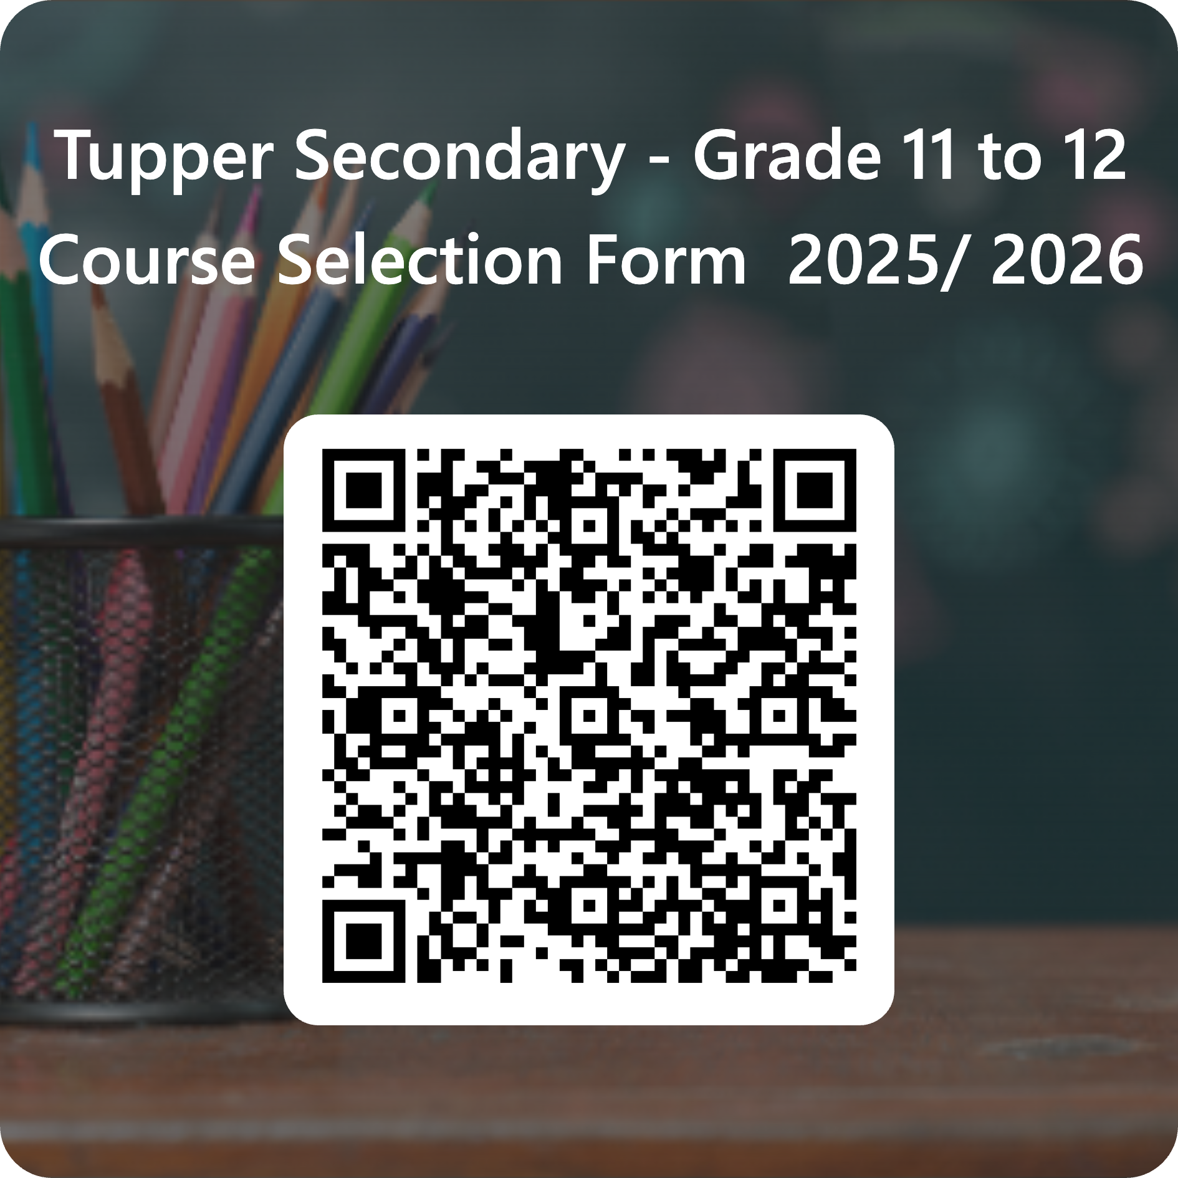
Course PLANNING DEADLINE
Feb 18, 2025

Slide 59
GRADE 10 INTO 11
Submit your course selection sheet by February 18 to the counselling suite Ms Rebane will collect them there

