Slide 1
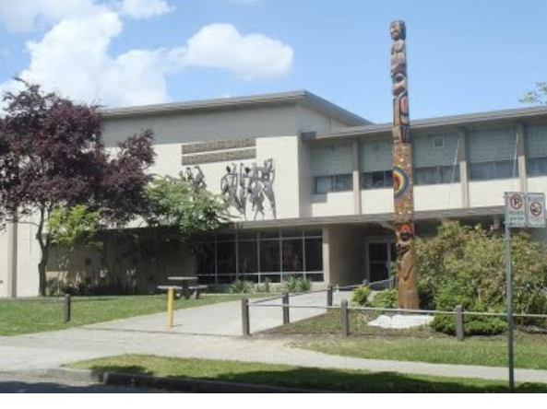
Future Grads of 2028
Course Planning for Grade 9s going into Grade 10

Slide 2
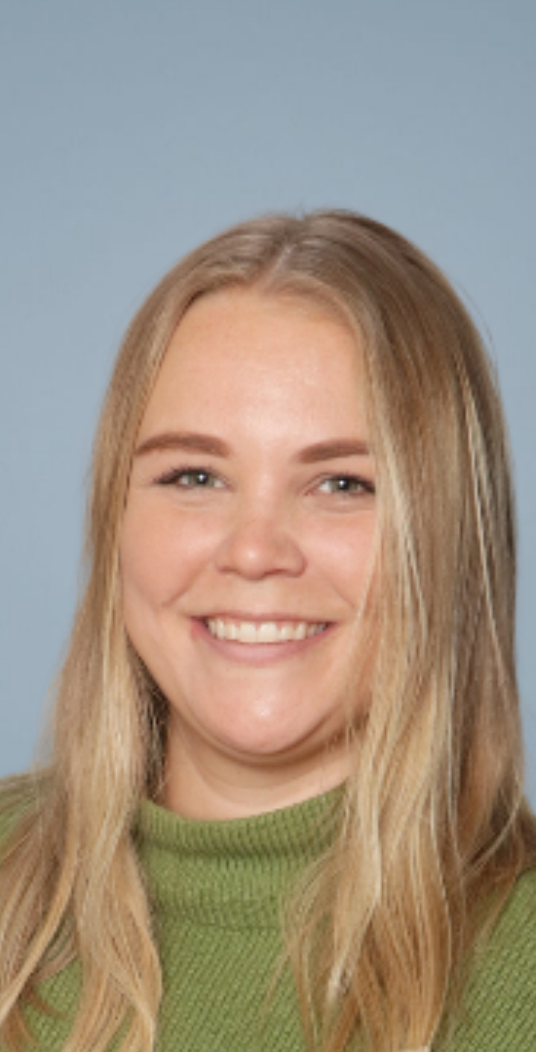
Ms. Jackie Wall
M.Ed., B.Ed., B.A.
Grade 9 Counsellor
Grade 8 Counsellor (K-R)
jbwall@vsb.bc.ca
604-713-8233 extension 7605
Please email me, call me, or come find me in my office if you have questions about course planning!

Slide 3
COURSE PLANNING:
COUNSELLOR’S ROLE
Counsellor’s Role
To help students with their course selection and make timetables, but we are neutral when it comes to recommending courses. It is better to talk to teachers, read the course planning book on our website and make an informed choice by doing research.
Support for Course Selection
Jan. 28 at 3:00pm on TEAMS for guardians and students.
There will be an assembly for Grade 9s on February 11, in the auditorium during FIT to give more information.
Counsellors will be in the library to help students during every FIT from February 4th to 20th
Requests are DUE on FEBRUARY 18, 2025
I encourage students to drop-in and see me. My policy is to come in whenever the door is open or email me and I will see you when it is most convenient for you. Communication is essential. All education related information or changes must include parents.

Slide 4
Terminology to Know
Required Courses are necessary from the Ministry of Education for graduation.
There is a difference between graduation and Admissions to a
Post-Secondary Course or Program.
If a required course has not been completed, then you have to repeat the course through taking it again at Tupper or through summer school.
Grade 10 courses start accumulating CREDITS toward your graduation diploma.
To graduate from high school you must have:
80 credits total (most courses are 4 credits each)
52 Ministry of Education Required Credits
28 Elective credits – considered any class after the required courses
Numeracy and Literacy Assessments

Slide 5
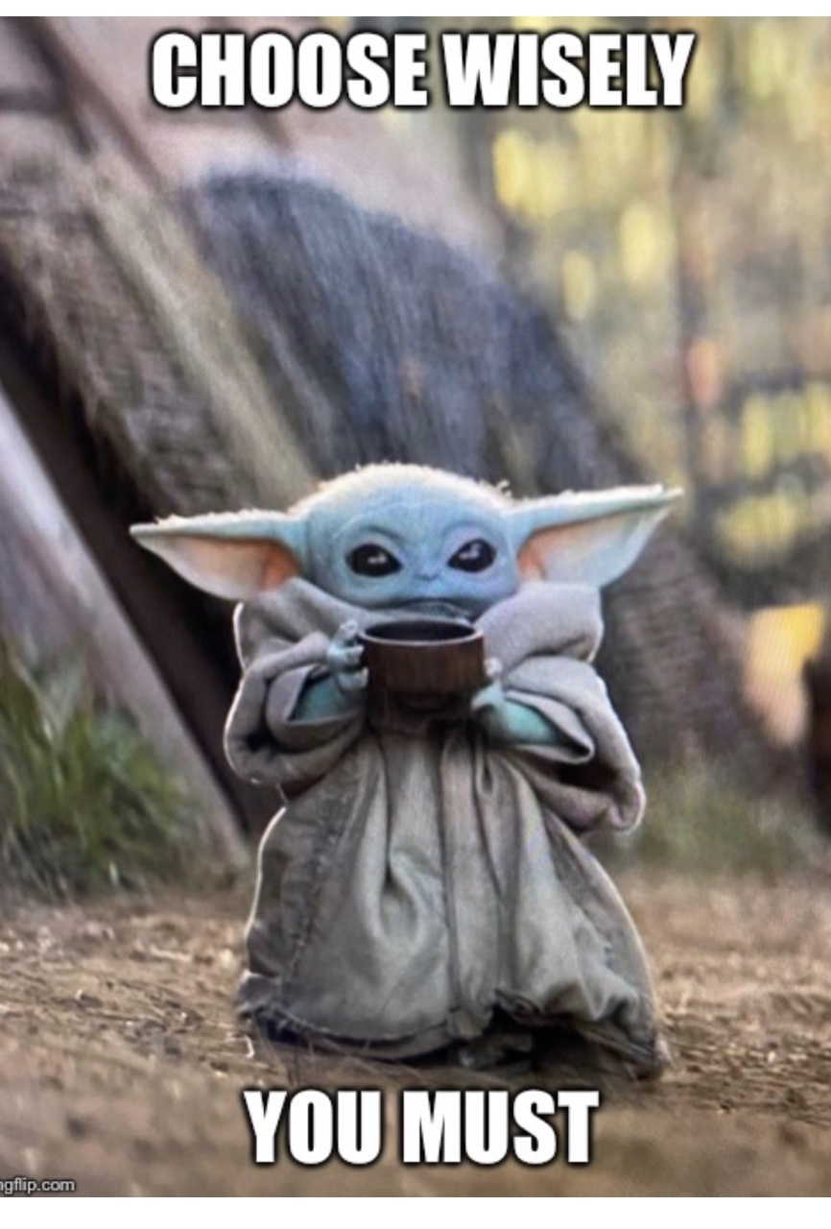
CREATING THE TUPPER TIMETABLE
Once all the course requests are submitted, MANY months are spent by a committee of Teachers and Administration to evaluate student selections and to determine which classes will CONTINUE and which classes will be CANCELLED. Your selection makes a difference.
Factors to consider are:
Number of people enrolled in a class
Room Availability
Student Support Requirements
Operating School Budget/Staffing
MAKING AN ACCURATE SCHOOL TIMETABLE is so IMPORTANT! Please demonstrate your ROARS approach and think carefully about what courses really interest you next September!

Slide 6

Ok, so let’s review your options for Grade 10

Slide 7

I applied to TREK….
Please do course selection, even if you have applied to TREK
TREK will notify all successful applicants and I can drop your courses at that time.

Slide 8
Ministry Required
GRADE 10 COURSES
₊
2 Electives = 8
₊
Ministry Required Assessments
Numeracy and Literacy
ENGLISH FIRST PEOPLES 10
SOCIAL STUDIES 10
PHYSICAL HEALTH EDUCATION 10
CAREER LIFE EDUCATION 10
SCIENCE 10
A MATH 10 (BY TEACHER RECOMMENDATION)

Slide 9
Mini
GRADE 10 COURSES
₊
2 Electives = 8
₊
Ministry Required Assessments
Numeracy and Literacy
Mini ENGLISH FIRST PEOPLES 10
Mini SOCIAL STUDIES 10
PHYSICAL HEALTH EDUCATION 10
CAREER LIFE EDUCATION 10
AT LEAST ONE SCIENCE 11 COURSE
PRE-CALCULUS MATH 11 (or Foundations of Math 11)
**Important note: Grade 11 courses prioritize senior students, so make sure you select back-up choices! Mini students often don’t get their first choices due to scheduling constraints

Slide 10
A Learning Skills Block is an Elective
If you are a student with an IEP, or a parent of a student with an IEP please feel free to consult with your case manager (resource teacher or Program teacher) about course planning as they will be able to help with next year’s courses.
If you had a Skills learning support block in Grade 9 and would like it again, please select on the course selection form.
If you would like a Skills block in each semester, please let Ms. Wall know
If you do not want Skills, please come see Ms. Wall or your Resource teacher to discuss further, and don’t select that option on your Course Selection Form

Slide 11
Coming from ELL/
TAP/LSP?
If you are leaving or continuing in a VSB district program, you will do your Grade 10 course planning with your program teacher and myself.
Please ask Ms. Baron, Ms. Cumaual, Ms. Kwan, or Mr. Glen for more details

Slide 12
Math
Pathway From Grade 9
MATH 9
Workplace Math10
Workplace Math 11
Found of Math/
Pre-Calc 10
Found of Math 11
Pre-Calc 11
Found of Math 12
Pre-Calc 12

Slide 13

SCIENCES
ENVIRONMENTAL SCIENCES
11
CHEMISTRY 11
(Pre-calc Math 10 strongly recommended)
REQUIRED FOR MOST STEM UNIVERSITY PROGRAMS
Physics 11
(Precalc Math is not an absolute pre-requisite, but is it recommended)
REQUIRED FOR MOST STEM UNIVERSITY PROGRAMS
Science for Citizens
11
(formerly know as Science & Tech 11)
Life Sciences 11
(formerly known as Biology 11)
SCIENCE 10 >>>>

Slide 14
Managing Elective Expectations
Every effort will be made to give you your first-choice electives, however, as mentioned earlier everything will depend upon the finished timetable.
Please indicated in the Alternate Elective section of the Course Selection Form what other electives interest you.
If you are unable to get your elective choice, I will schedule in your alternate elective choices
IMPORTANT –Priority in given to the older students as they may need to meet post-secondary requirements.
This Photo by Unknown Author is licensed under CC BY-NC-ND

Slide 15

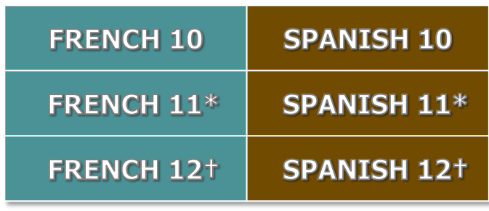
Second Language Question….
Do I need to have an Elective Language course to graduate?
You do not need a language to graduate high school, however, some universities may require a second language for direct admissions. If you choose to take college first, and then transfer to a university, a language is not required.
GRADE 8 ⁰
GRADE
TUPPER LANGUAGE Options
Language Pathway At
Tupper
No Prerequisites Required
Satisfies Language for Direct Entrance to University
Satisfies Language 11 post-secondary admission requirement.
⁰ Skills students unable to take French 8 may choose to enter the language program in Grade 9
by enrolling in French 8. Or, they may enter in Grade 10 by enrolling in Spanish 10

Slide 16





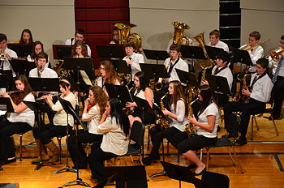
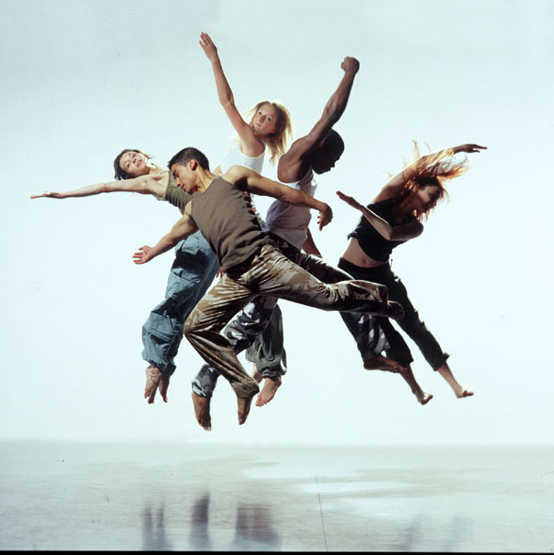
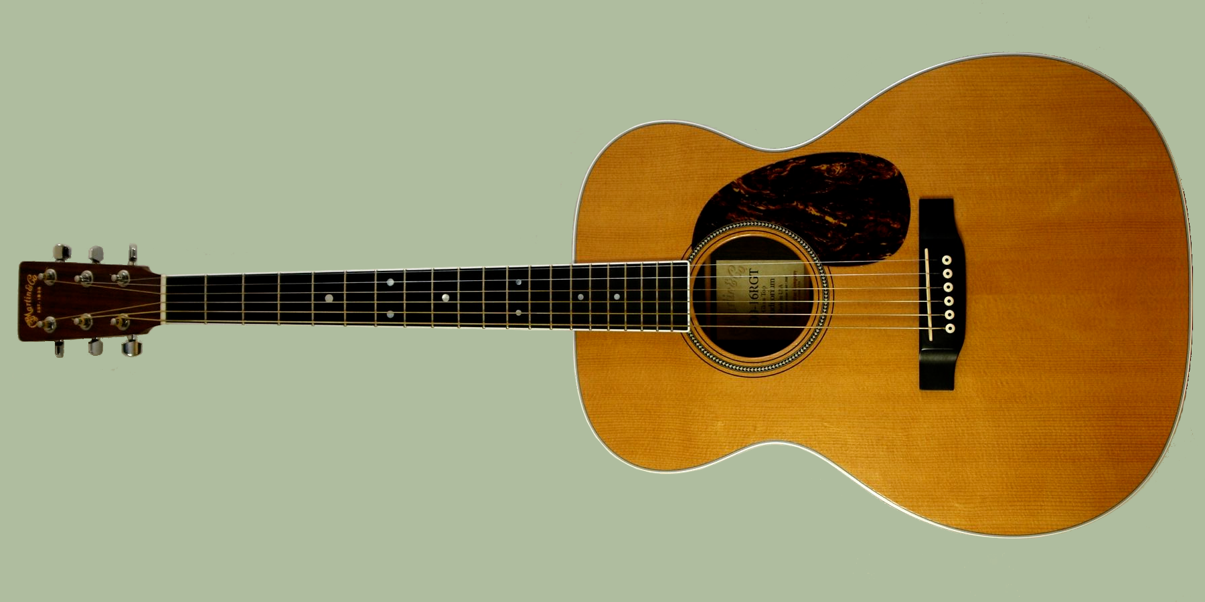
FINE ARTS ELECTIVES
ART
CERAMICS
GRAPHIC ARTS
PHOTOGRAPHY
BEGINNER BAND/ INTERMEDIATE BAND
ADVANCED BAND (OFF TIMETABLE)
JAZZ BAND (OFF TIMETABLE)
CHOIR (OFF TIMETABLE)
GUITAR
DRAMA
DANCE
YEARBOOK
FILM AND TV

Slide 17

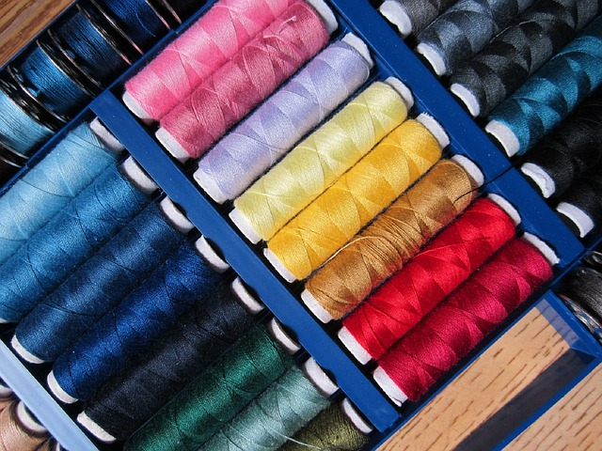


APPLIED SKILLS ELECTIVES
Foods
Textiles
Woodworking
Drafting
Computer Studies
Marketing and Entrepreneurship
This
is licensed under CC BY-NC-D

Slide 18


Download the COURSE PLANNING BOOK 2025-2026 to your computer:
  Department Heads about specific questions
  English – Ms. Braun (Room 422)
  Science – Mr. Florio (Room 405)
  Social Studies – Mr. Lum (Room 401)
  Applied Skills – Ms. Koyanagi (Room 202)
  Fine Arts - Ms. Read (Auditorium)

Slide 19

Frequently asked Questions
Q = Can I choose my teachers or have a class with my friend?
A = No, we cannot accommodate requests to move classes based on teacher preference or friends. This is a great opportunity to learn about new people, make new friends, and experience your strength to push through uncomfortable situations.
Q = Will there be older kids in my class?
A = Depending on our final timetable, some elective classes may be multi-level classes 9/10 split or combined 9-12 classes.
Q = Can I have a free block in Grade 10?
A = For safety reasons students are not given a study block, even if they are taking extra off timetable courses.
Q = Can I take online courses?
A = Yes, but my warning is that it can be very challenging to complete, and it is not my recommendation

Slide 20

Frequently Asked questions…continued
Q = I do lots of sports/ dance/ gymnastics outside of school, can I be exempt from PE?
A = Sorry, the Ministry of Education does not grant PE credit for outside high level sports.
Some sport activities could earn you more credits if they’re accredited by the Ministry of Education and qualify as Athlete 10. Please check with your organization and get a letter from them to verify your participation.

Slide 21

What is Online School?
Vancouver Learning Network (VLN) is a SEPARATE school that offers online classes for VSB students
Online courses are possible for Grade 10 and above but should not be taken without consideration.
Sadly, every year students do not complete online courses and this can affect graduation—particularly CLE 10 online.
Only a few students will do well in online courses. Talk to me about it!

Slide 22




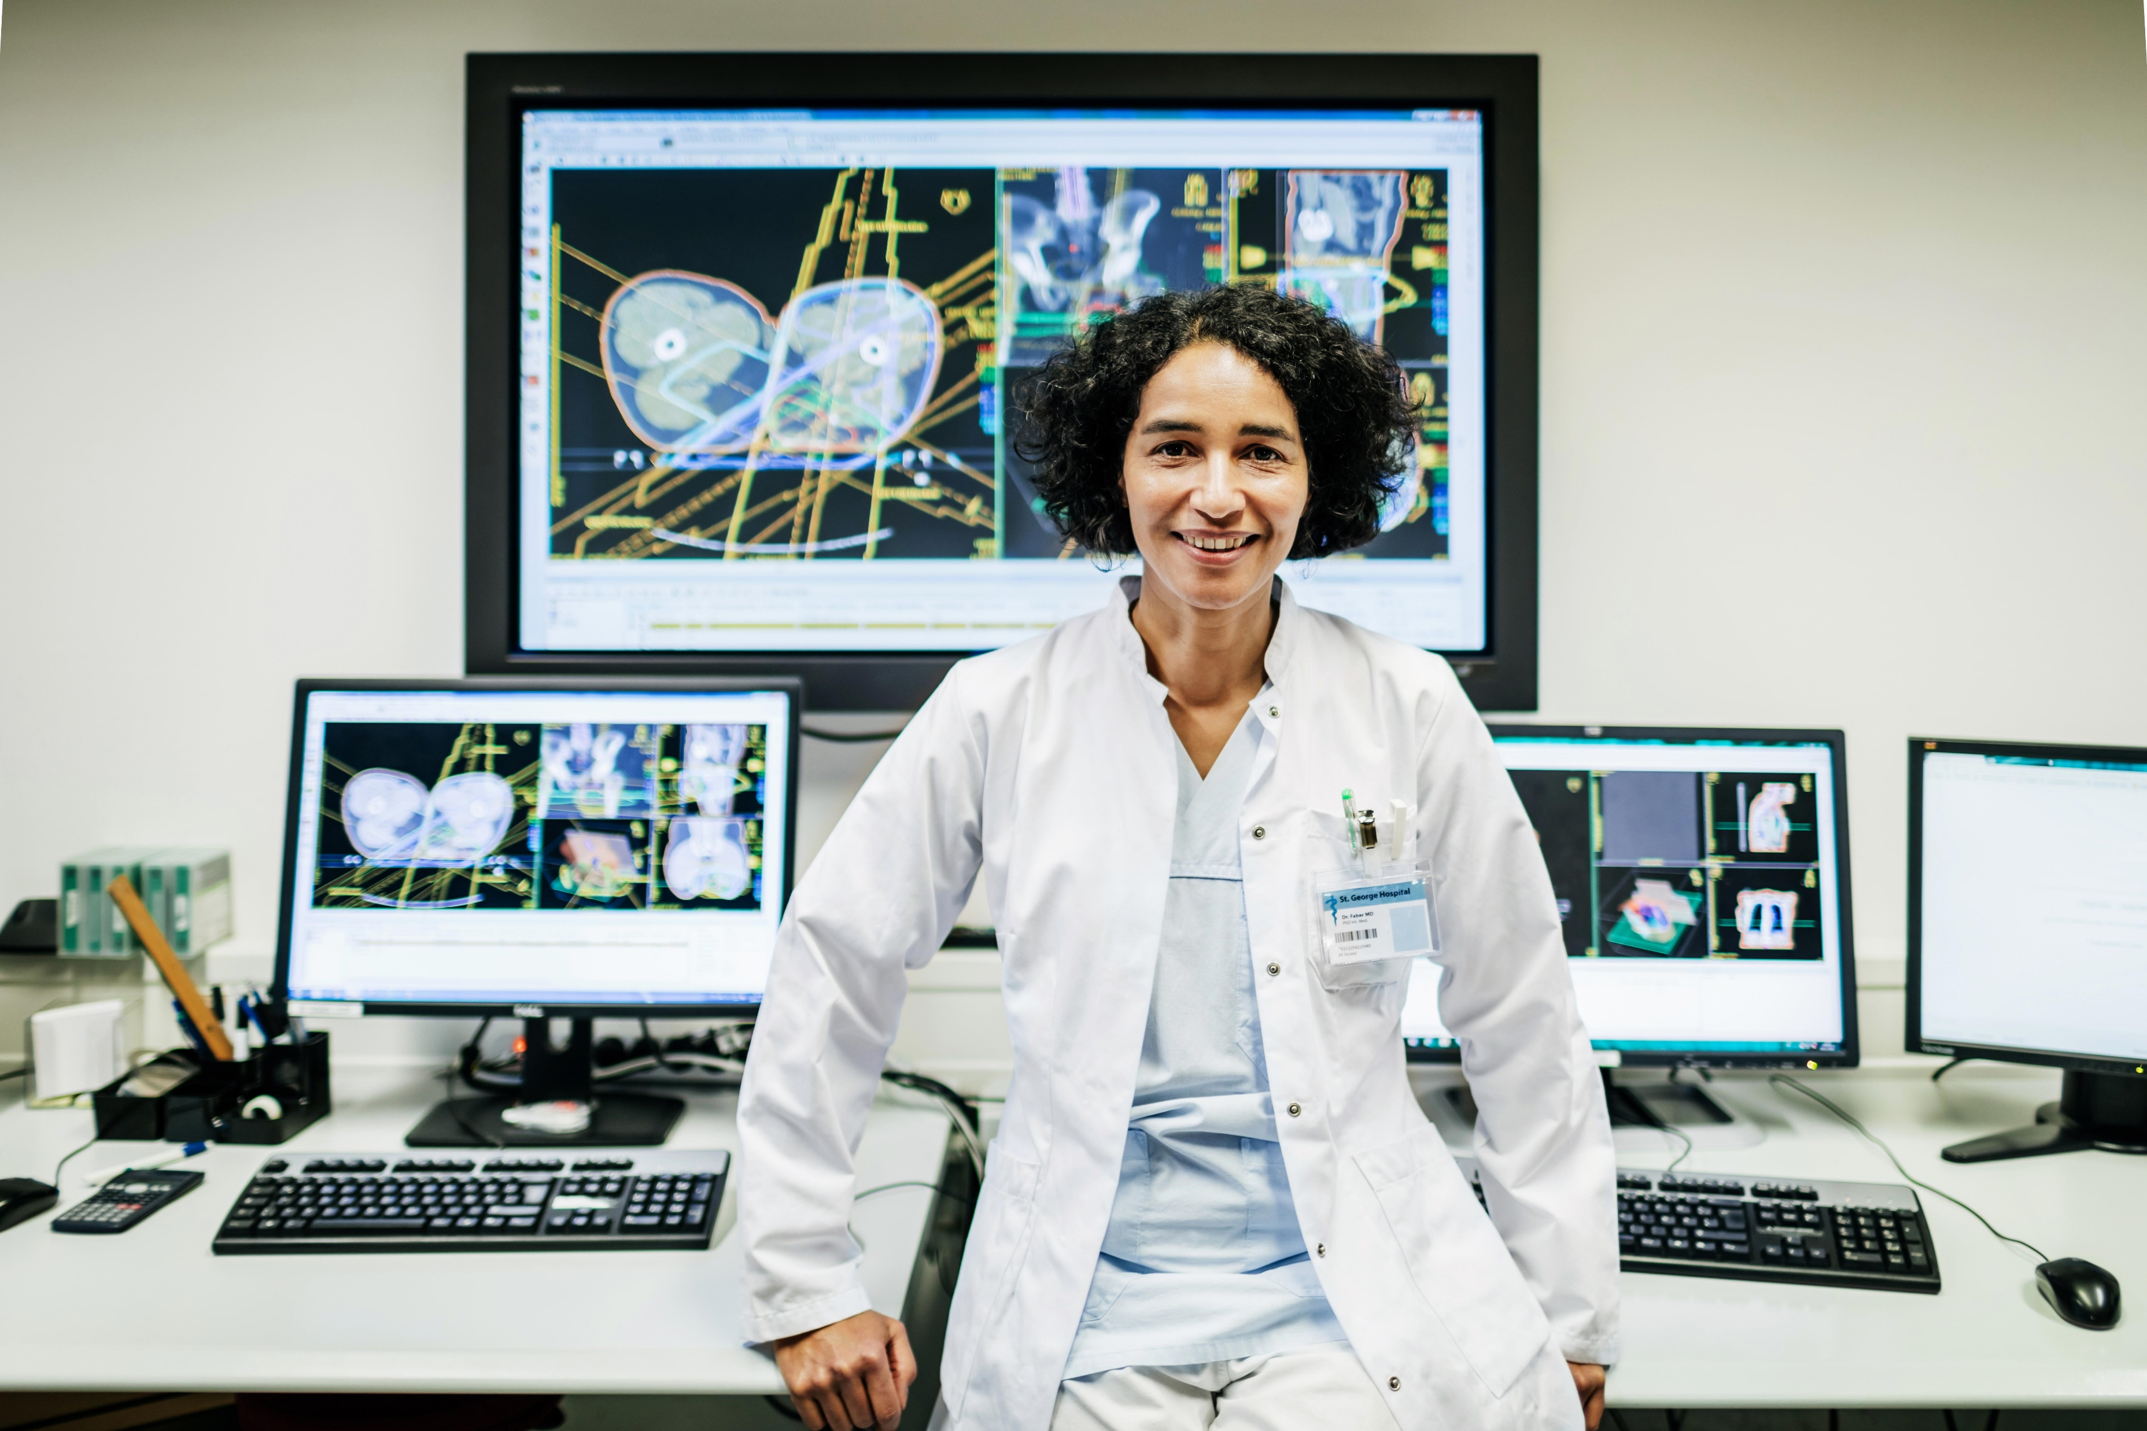
THINKING AHEAD
Students wishing to pursue university studies in STEM will usually need to demonstrate high grades in: PreCalculus Math 11, PreCalculus Math 12, Calculus 12, Chemistry 11, Physics 11, and at least two Grade 12 sciences (Anatomy and Physiology, Chem or Physics 12)

Slide 23
Additional Websites
Ctrl+Click on the links
Education Planner - Plan Your Future and Apply to Post-Secondary Institutions
https://www.vsb.bc.ca/Career-Programs

Slide 24

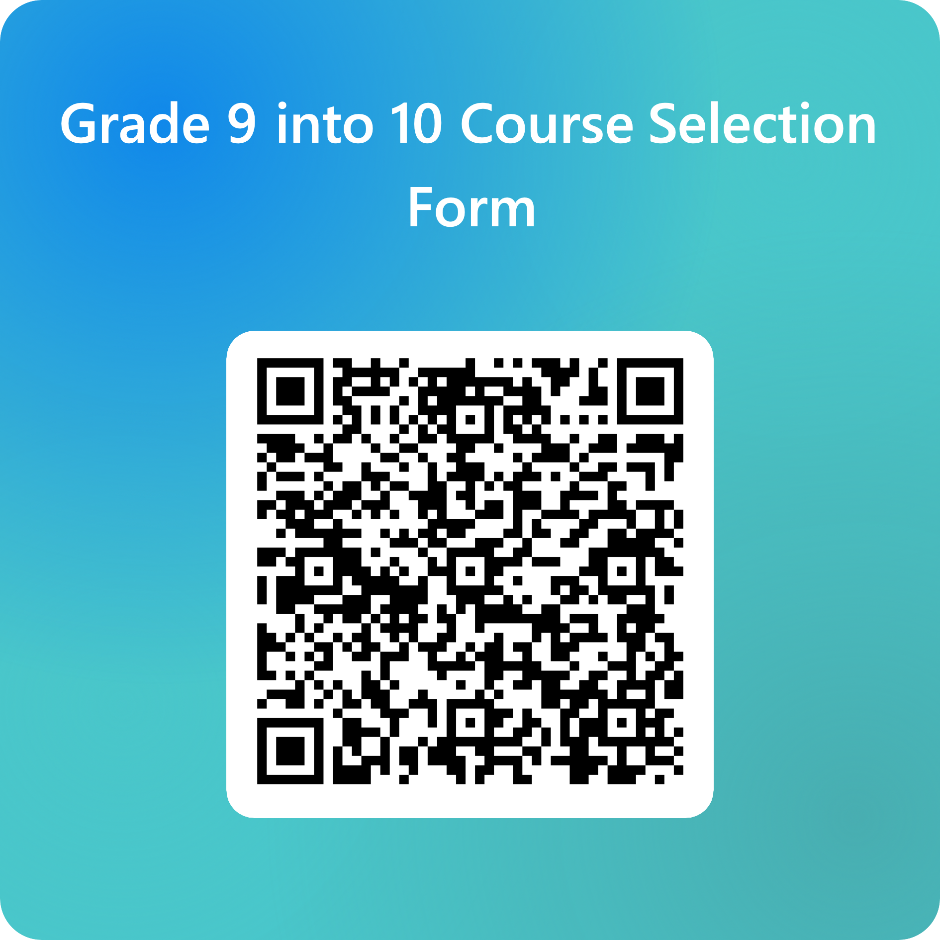
It’s Time to Make Your Selection
If you make a selection and then want to change your mind, you can submit a Another Form. I will take the last form that I receive.
If you are planning to take a summer course or online course, choose the future course for September, then we will have more accurate information.
If I have made a mistake on the form or missed a course, please let me know. Good luck and please come see me if you need any help.
Grade 9 to Grade 10 Course Selection Form 2025-2026 (office.com)

