Slide 1

Flex Humanities District Program
Alia Ut Centrum
Others as Center

Slide 2

Flex Humanities
What is Flex Humanities?
Liberal Arts critical thinking program
Grades 8 - 12
Components: Philosophy, World Literature, History, Fine Arts, Film and Media Studies, and Interactive Arts and Design Technology

Slide 3

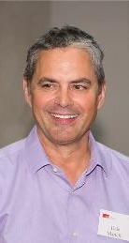

The Classics:
Dr. Martelli
Philosophy & World Literature
Philosophy 12

Slide 4
Class Outline
Classics/ Dr. Martelli
Grade 8 | Grade 9 | Grade 10
Classics 8 Ancient to 16th century Philosophy and Literature | Classics 9 Late Renaissance, to 19th century Philosophy and Literature | Classics 10 Late 19th to early 21st century Philosophy and Literature

Slide 5
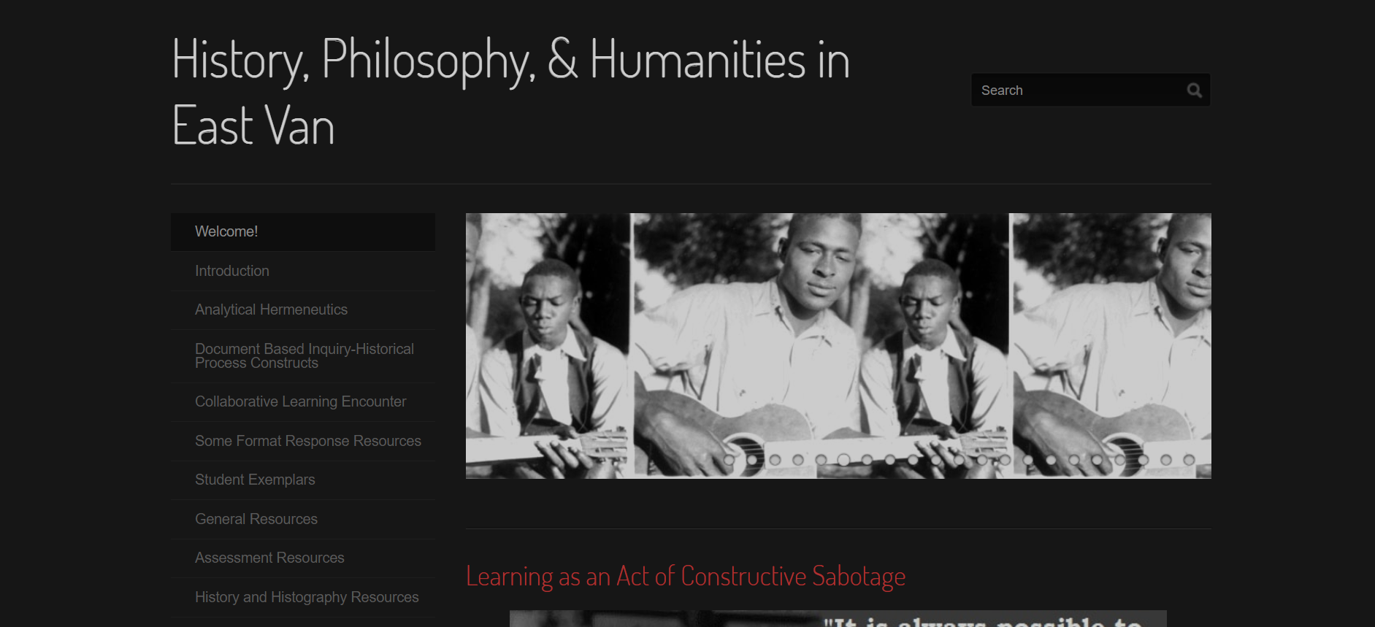
Dr. Martelli's resource site
https://martellisocialsciences.weebly.com/

Slide 6
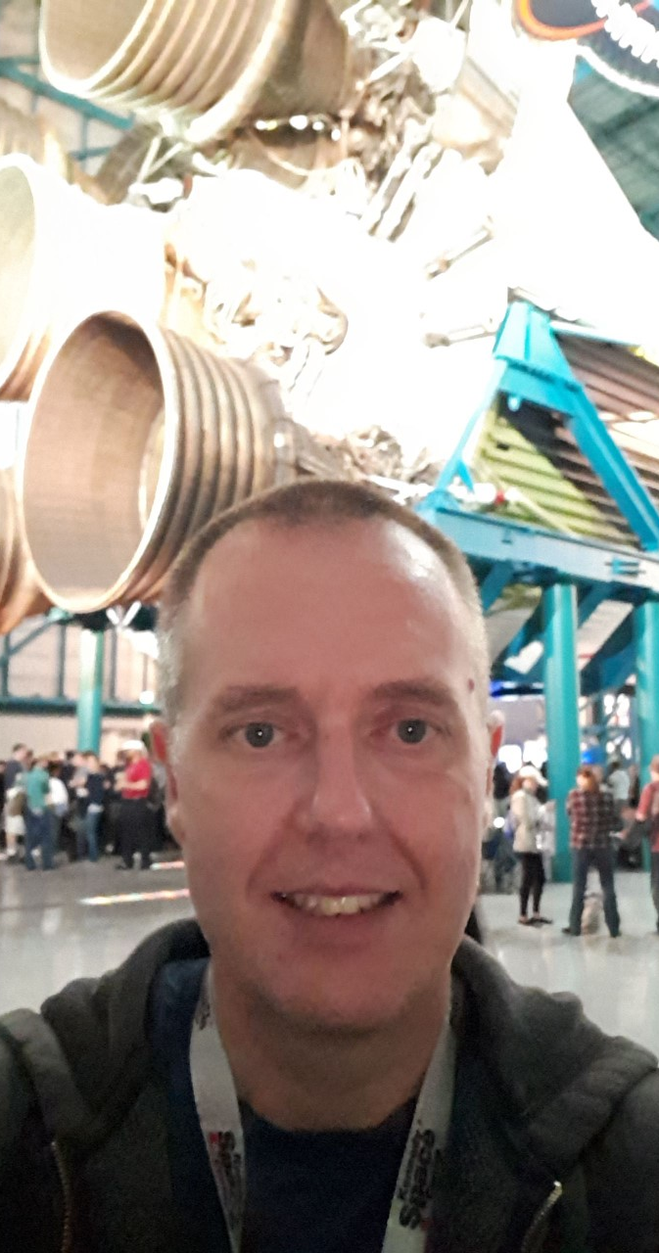
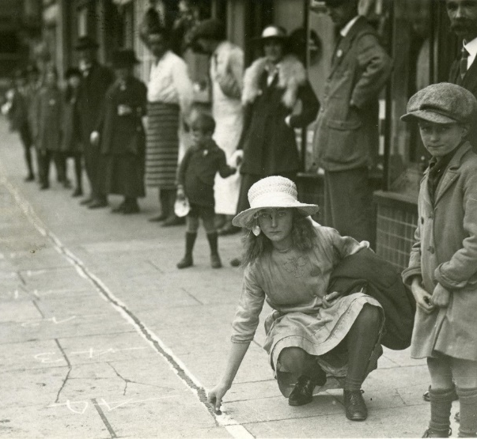
History & Social Sciences:
Mr. Moon
Flex Humanities History 8, 9 & 10
20th Century World History 12
Economic Theory 12

Slide 7
Class Outline
History/ Mr. Moon
Grade 8 | Grade 9 | Grade 10
History 8 Ancient to 16th century history Comparative World Cultures | History 9 18th to early 20th century history Colonization & resistance Nation States & Empires Revolutions and political movements | History 10 Early 20th to early 21st century history Canadian & World History Political Studies Human Geography and Economics

Slide 8


Film Studies:
Mr. Derreth
FH Film Studies 10
FH English 11 Media Studies

Slide 9
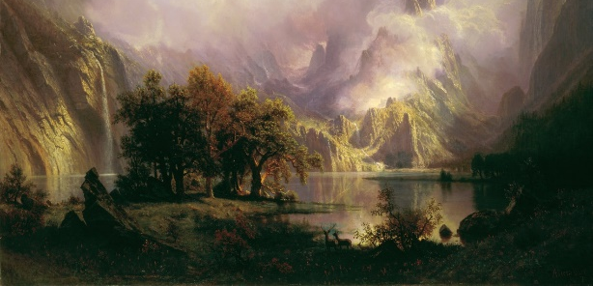
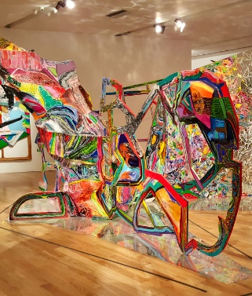
Fine Arts:
Ms. Rudolph
  Visual Arts
  Drama
  Art History

Slide 10
Class Outline
Fine Arts / Film Studies
Grade 8 | Grade 9 | Grade 10
Fine Arts/Drama 8 Mixed media Art and Drama. | Visual Arts 9 Mixed media arts, painting, sculpture and drawing | Film Studies 10 Historical Journey of film. Studying film and its correlation to culture through the 20th and 21st century.

Slide 11
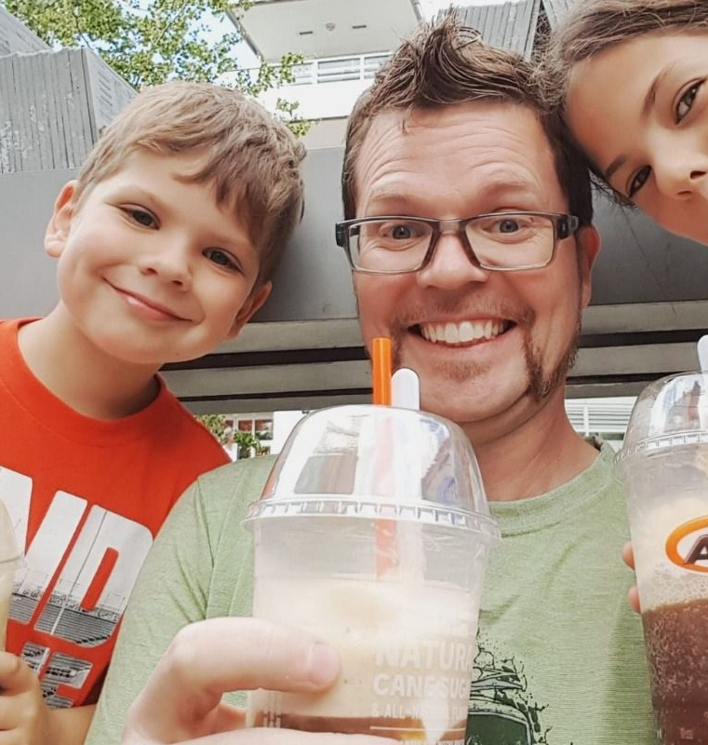
Interactive Arts and Technology (8-10)
Mr. Reedman &
Ms. Donaldson
Innovative and Cutting Edge
Inspired by Simon Fraser University’s School of Interactive Arts and Technology
http://www.sfu.ca/siat.html

Slide 12
Class Outline
Interactive Arts/ Mr. Reedman & Ms. Donaldson
Grade 8 | Grade 9 | Grade 10
Interactive Arts and Technology 8 the science of human experience the analysis of media and culture | Interactive Arts and Design Technology 9 The creation of original and experimental works of art | Interactive Arts and Design Technology 10 Design and the implementation of new technologies

Slide 13
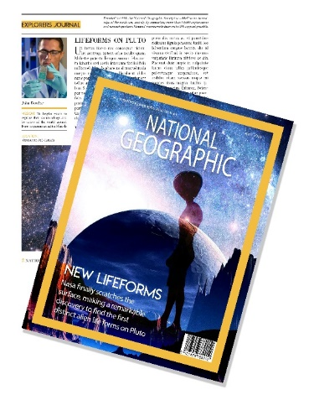
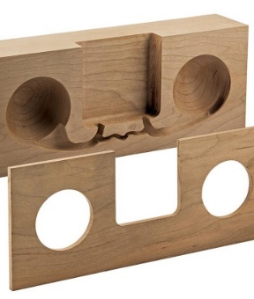
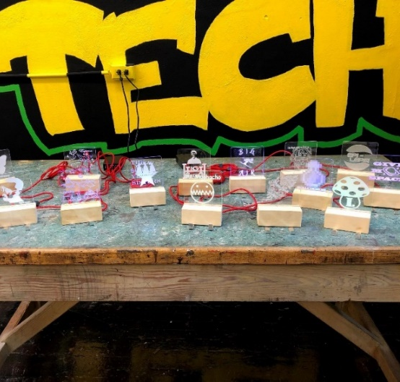
Interactive Arts and Design Technology
This course combines the science of human experience, the analysis of media and culture, the creation of original and experimental works of art, and the implementation of new technologies.
Students bring these resources to bear on the most vital and innovative sectors of the economy, building the technologies and experiences that increasingly shape our lives

Slide 14
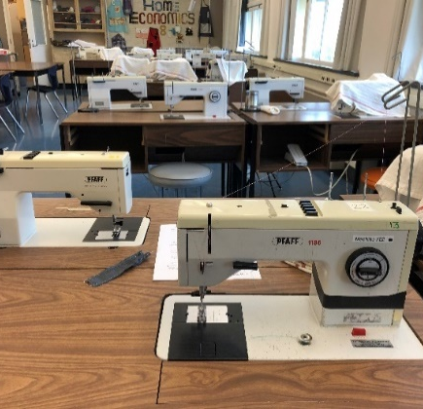
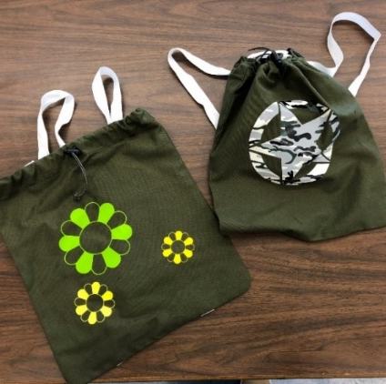
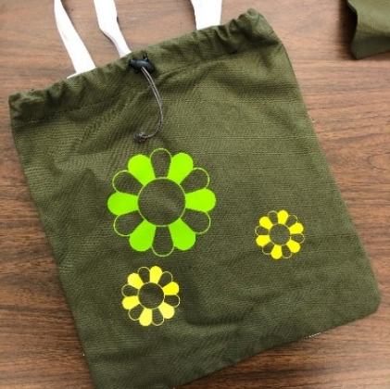
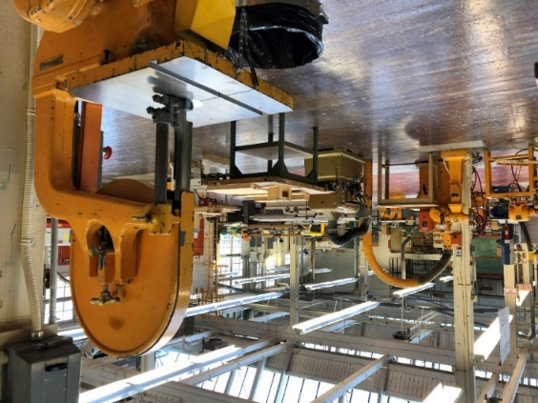
Interactive Arts and Technology
The course will involve cross-functional teams collaboratively work with new media and interactive applications, and the study of the human experience of technology that helps to generate creative design theories and approaches.
As part of the Flex Humanities program, Interactive Arts and Technology will expand student career options

Slide 15
Class Outline
Grades 11/ 12
Grade 11 | Grade 12
FH English 11 and Media Studies | FH Philosophy 12

Slide 16

Program Culture
Notes:
Grade 10s

Slide 17
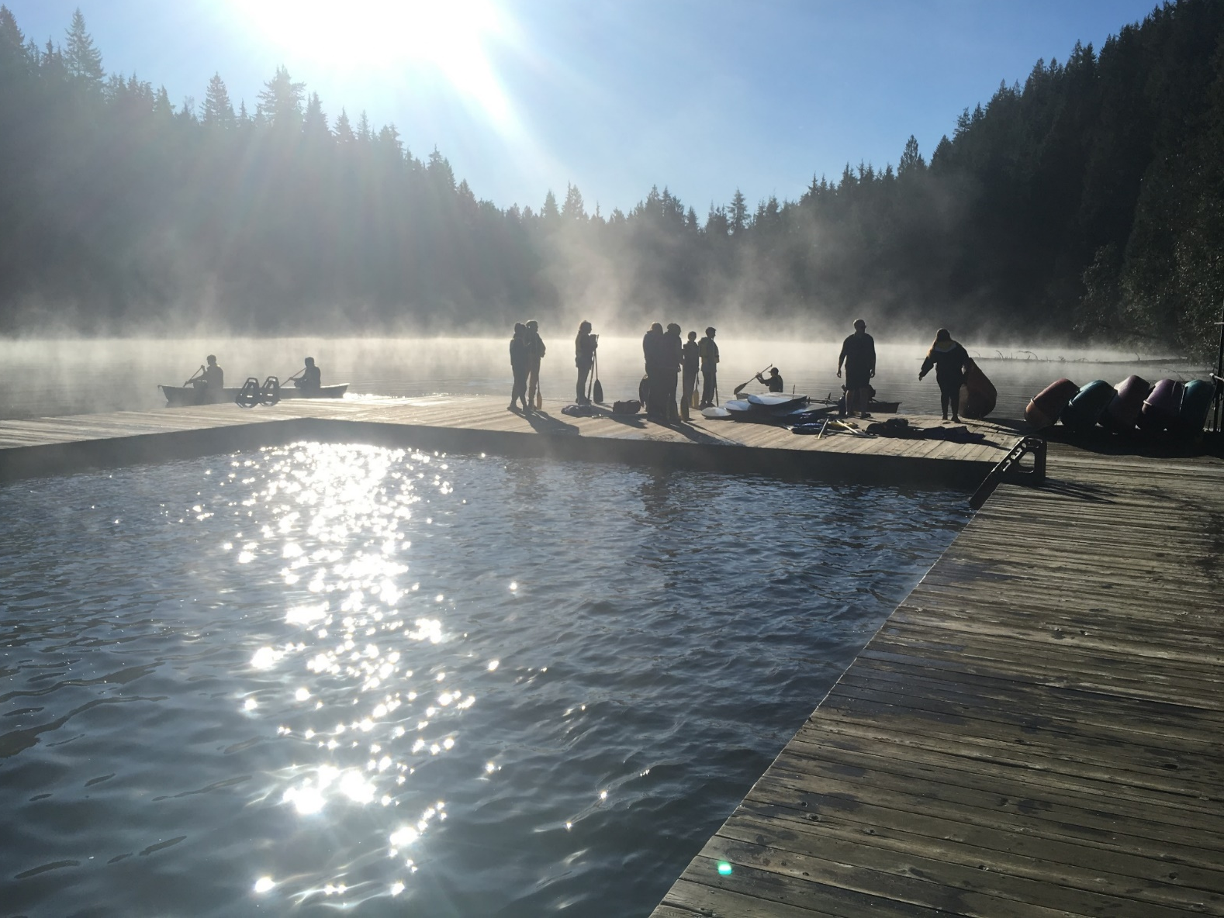
Flex Humanities Community-Building Camp
Notes:
Introduce the grade 9s

Slide 18
Flex Humanities Activities
Flex Humanities Camp
Early October
A three-day camp at UBC’s Loon lake ecology Center.
Focus: Community Building, and creating connections
Notes:
Grade 9s

Slide 19
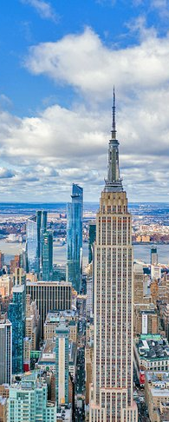
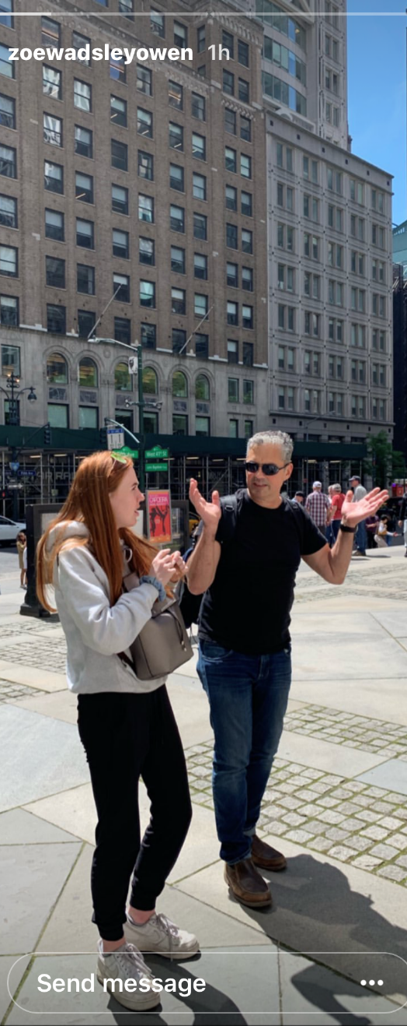
Flex Humanities
Graduation Trip
New York Trip:
-MET, Harlem Tours, Greenwich Village, Broadway Plays, Tenement Museum
-African Burial Ground, Brooklyn Graffiti and Gentrification Tour, Ellis Island
-MOMA, New York Library, Schomburg Centre for Research in Black Culture
*Other destinations include:
Victoria BC, Montreal, Spain
Depends on availability, interest & cost
Notes:
Grade 11s

Slide 20

Transitioning from Grade Seven to Flex Humanities
Notes:
Grade 8s

Slide 21
Program Application Process
VSB's Mini School programs provide enrichment opportunities for highly motivated individuals. Students must consistently work at an above average or Applying level and have excellent work habits (achieve B averages or higher). Students must be Vancouver residents.
Students must apply to each program separately by picking up an application package at the school where the program is offered.
All applications are posted on the host school website

Slide 22
Program Application Process
Each year over 1,400 students apply for approximately 600 grade 8 spaces in the District programs.
Acceptance is based on grade 6 and grade 7 report cards, applications and interviews.
FLEX SELECTION CRITERIA
DIFFER SOMEWHAT…

Slide 23
Program Application Process
Please remember that:
All VSB secondary schools have a variety of challenging and exciting programs and courses
Many students who take the regular programs graduate, receive scholarships and attend the university of their choice
Many schools have developed their own school-based enrichment program for a wide variety of interests and abilities.

Slide 24

Program Application Process: Step One
District Registry:
Interested students will submit a general application package to the District registry between.
November 10, 2025 - December 15, 2025, by 3:00pm
This will be similar to the process used in this past school year
https://govsb.ca/secondary-programs

Slide 25
Flex Intake Day: Step Three
All applicants will be invited to the intake day
Intake day will include an essay that will then be included in the application form
January 26th January 2026 from 8:30 am to 12pm. Small Gym.

Slide 26
Program Application Process: Step Four
Offer Procedures
First Offers: February 11th 2026
Second Offers: Second offers 18 February 2026
48-hour Acceptance Window
Final offers and acceptance: March 7th-10th
24-hour acceptance window

Slide 27
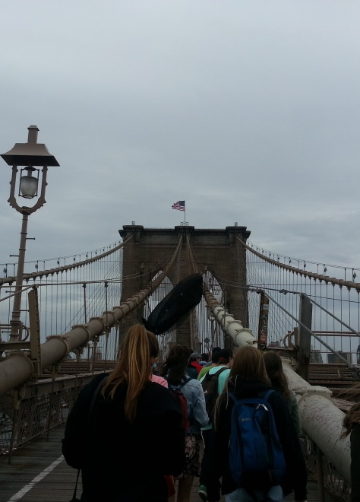

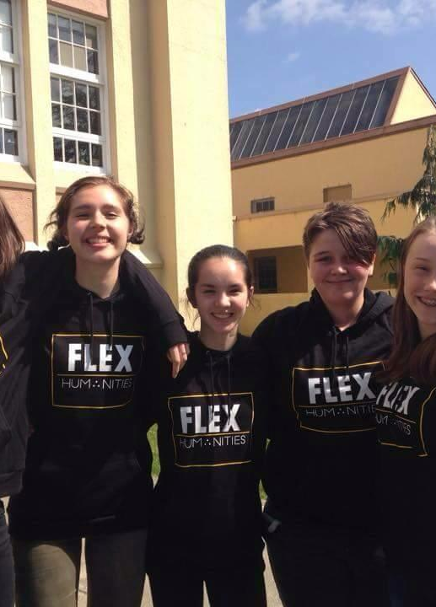
Questions ?
https://vantechflexhumanities.wordpress.com/

