Slide 1

Grads of 2028 Gr 10 to 11 Course Planning
With Ms. Wall – jbwall@vsb.bc.ca

Slide 2
Counsellors’ role in course planning
Counsellors help students with their course selections and make timetables, but we are neutral when it comes to recommending courses. It is better to talk to teachers, read the course planning book on our website, and make an informed choice by doing research
I will enter all the courses written in your MS Forms submission
Students will get all REQUIRED courses needed for graduation

Slide 3
Students’ role in course planning
Talk to caregivers, look at post-secondary websites, talk to the teachers who teach the course, and gather information from the course planning book to decide if the classes would be a good fit AND if they’re necessary for your post-secondary plans
In consultation with your caregivers, choose the 8 courses you would like to take in Grade 11 and your alternate choices for electives
Fill in your MS Form and SUBMIT it so your counsellor can enter your requests into MyEd

Slide 4
COURSE PLANNING 11
Feb. 3-10
Course Planning – will be done online on MS Forms. Will be available from Feb. 3-10
10 Feb. 2023
Due Date for completion of MS Teams Course Selection Form is February 10, 2026
Feb 3, 2026
Course Planning assembly at FIT time in the Auditorium. Course Planning PowerPoint available on school website

Slide 5
WHAT DO I NEED TO GRADUATE?
80 CREDITS TOTAL (most courses are 4 credits each)
Hint: You need to pass the course to get the credits!
52 CREDITS from required Grade 10-12 academic classes, as well as CLE 10, CLC 12, and PHE 10.
28 CREDITS from electives
At least 4 CREDITS must come from an ADST or Fine Arts 10, 11, or 12 course
16 CREDITS (or more) must be at the Grade 12 level (which includes your required English 12 class)
4 CREDITS (or more) must be from an Indigenous-focused course
Most of you satisfy this requirement this year by taking English First Peoples 10
If you didn’t pass OR didn’t take English First Peoples 10, please email me or come see me!

Slide 6
Graduation Requirements for Grade 11
An English (Language Arts) 11:
Literary Studies 11 OR New Media 11
A Math 11:
Pre-Calculus 11 OR Foundations of Math 11 OR Workplace Math 11
At least 1 senior Science course:
Life Sciences 11, Chem 11, Physics 11, Science for Citizens 11, Environmental Science 12
At least 1 senior Social Studies course
Exploration of Social Studies 11 (preferred for Grade 11 students), any of the Grade 12 level Socials courses

Slide 7
English
You MUST take one English 11 class. You have two choices (all are accepted for post-secondary). See course planning book for more information
Literary Studies 11
New Media 11
In Grade 12, students will take English Studies 12 or English First Peoples 12

Slide 8
What About Math?
Workplace Math 10 students will go into Workplace Math 11. This will be sufficient to graduate and enter SOME post –secondary programs
Workplace Math 10 → Workplace Math 11
Students in Foundations of Math and Pre-Calculus 10 can choose one of two pathways (see next slide)

Slide 9
Math Pathway Continued…
Found of Math/
Pre-Calc 10
Found of Math 11
Pre-Calc 11
Found of Math 12
Pre-Calc 12
Which one do you need to take?
Answer: It depends on where you are going, but… our Math department suggests that if you got a B or higher in Found of Math/Pre-Calc 10, then you could consider Pre-Calc 11. If you did not get a B or higher, you should consider Foundations of Math 11. Please see Course Planning Guide for more information!

Slide 10
Science
You must have at least ONE senior Science in order to graduate. Options include:
Life Sciences 11 (formerly Biology 11)
Chemistry 11
Physics 11
Environmental Science 12
Science for Citizens 11 (formerly Science and Technology 11)

Slide 11
Social Studies
Many Grade 11 students take Exploration of Social Studies 11 (formerly Social Studies 11)
Grade 12-level Social Studies courses also satisfy this requirement

Slide 12
CAREER PROGRAMS/ TRADES
If you think you may be interested in trying out a trade or career program, or simply want to learn more, you can:
Talk to Ms. Wall or any of the counsellors for general info
For more in-depth info:
FIRST Look at the VSB Career Programs website
Email Mark from VSB Career Programs [mreid@vsb.bc.ca]
Email Allison from VSB Career Programs [anewton@vsb.bc.ca]
*Application deadlines for next years’ programs are generally December 1st and March 1st of your Grade 11 year.

Slide 13
HOW SHOULD I DECIDE WHAT COURSES TO TAKE NOW TO GET INTO POST-SECONDARY LATER?
Look at the admissions requirements for the various post-secondary spots where you’re interested in going.
Hint: for popular BC university admissions, look at my Teams post!
See what courses they require you to have, and which ones are suggested, but optional.
If you’re confused, see me and, we can talk about where to find information
CUE (Canadian Universities Event) – usually the first week of October, brings over 50 of the best Canadian post-secondary schools together in one place (Ms. Wall will send a notice in the fall)

Slide 14
WHAT IF I FAIL SOMETHING OR MAKE THE WRONG CHOICE IN GRADE 11?
No problem. You have tons of options!
Summer school
Repeating the course next year
Going to college first before university
Choosing a different path, learning something about yourself you maybe didn’t know, getting life experience.
*PLEASE remember that your life isn’t ruined if your path to post-secondary, or even graduation, goes a little differently than you thought it would. You have support!

Slide 15
Grade 12 Courses Required for Direct Entry to University
English Studies 12/English First Peoples 12
3 other Grade 12-level academic electives (which 3 depend on the school and faculty)
Anatomy and Physiology (formerly known as Biology 12) or Chemistry or Physics 12
Geography 12
History 12
A Language 12
Pre-Calculus Math 12
Calculus 12
Law 12
BC First Peoples 12

Slide 16
What do I need to know about going to college instead of university after I graduate?
Apply early on in your Grade 12 year (October 1)
Basic high school graduation requirements (usually C average or higher)
Typically smaller classes
Tuition is less expensive
Can transfer in third year to university

Slide 17
What if I don’t know what I want to do ?!
Don’t worry, it’s ok if you don’t have it all figured out.
Think about the things you ‘don’t’ want to do and use that as a starting point.
People change their mind/ career path all the time---open yourself to new ideas/ opportunities, take some general classes to help you figure out a focus.

Slide 18
Electives
Think Career/ Think of your passions
What courses really interest you?
Make informed choices!!!!!
Read the Course Planner carefully
Are you planning to apply to post-secondary? You will need very specific courses, research it!

Slide 19
NEW(ish) Electives!!
Peer Counselling/Link Leadership:
Formerly Link Crew
If you’d like to be a Link Leader, choose this as one of your electives!
The counsellors conduct interviews for potential new Link Leaders in Spring
Peer Tutoring
Will function a bit like a CS
If you are an academically strong student and want to help younger students learn, this might be for you!

Slide 20
How do I make my final choices?? now?
Read the planners online
Talk to your caregivers
Make individual appts with your counsellor if necessary
Talk to your teachers--especially Youth Train in Trades hopefuls--research the courses and make informed choices.
If you have questions, I want to HEAR FROM YOU !!

Slide 21
Course Planning book 2026-2027
Course Planning Book
More info about Course Planning
If links didn’t work, go to Tupper Website → Guidance and Support (top tab) → Course Planning → Course Planning Book 2025-2026
Pages 4 and 5 will list ALL ELECTIVES AVAILABLE, then you can look each individual choice up on the following pages
REMEMBER that whether or not a course runs depends on how many people choose it during course selection. If not enough people choose a course, it won’t be offered even though it is in the Course Planning Book

Slide 22
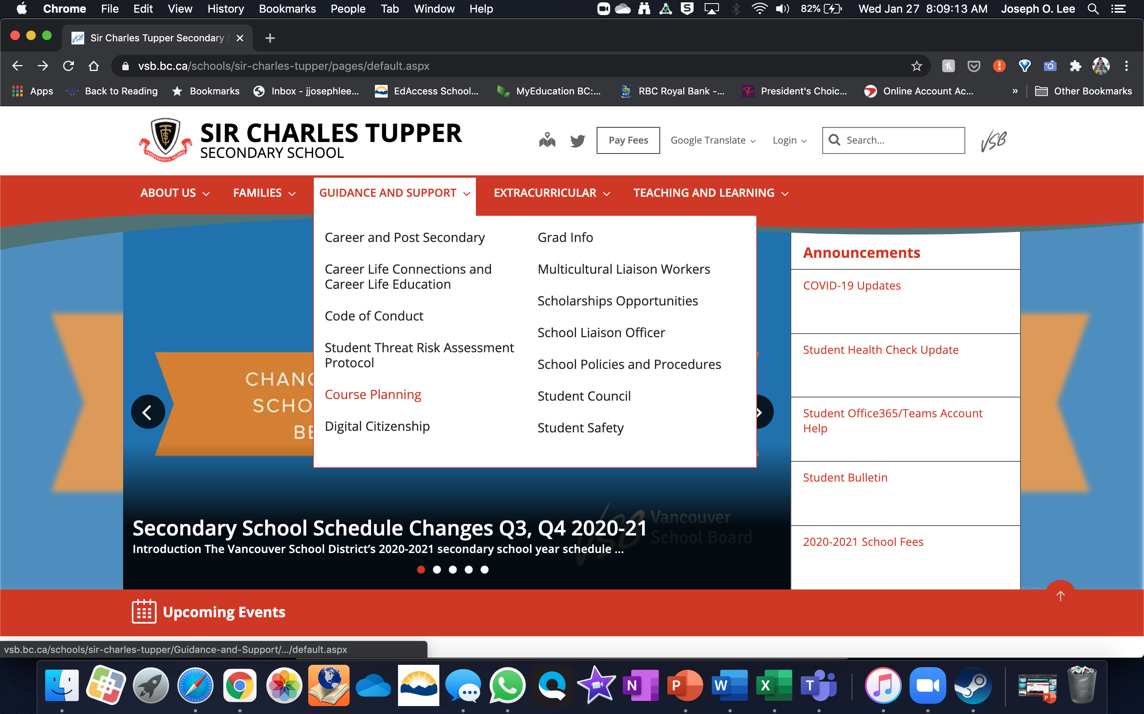


Slide 23
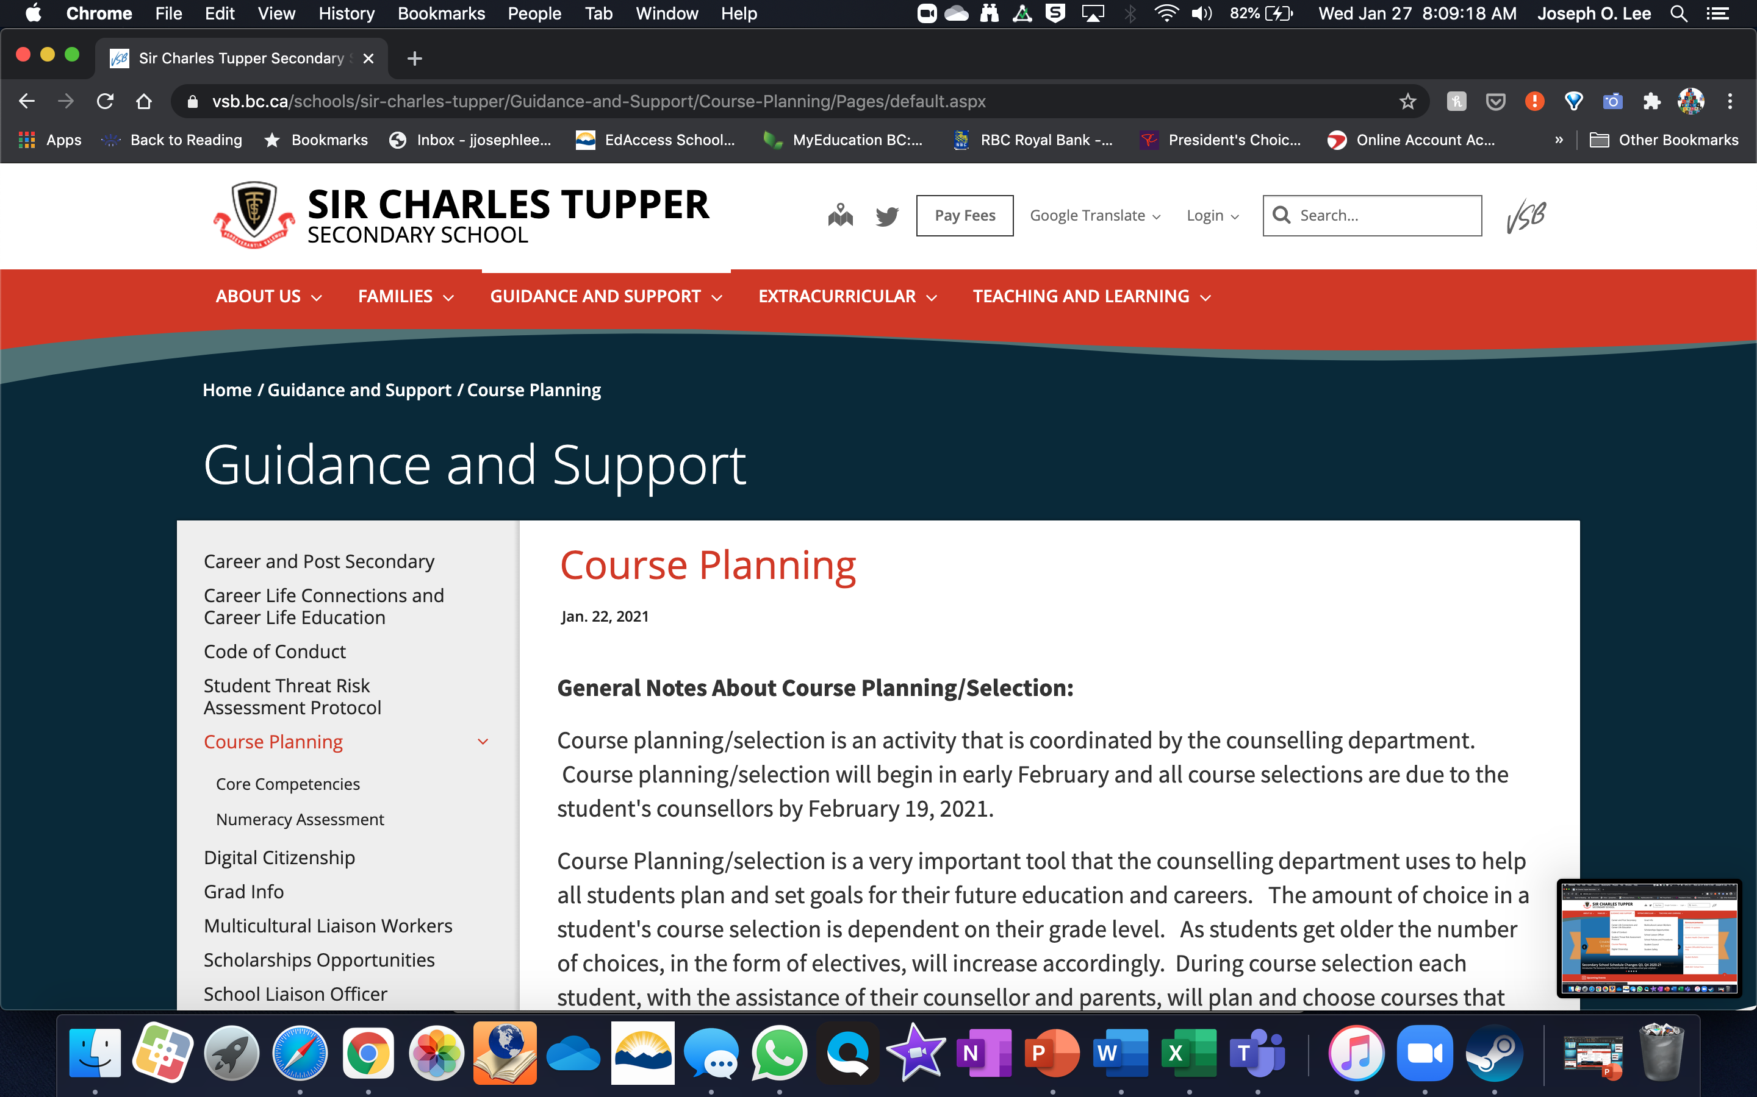

Slide 24
How do I submit my course Selections?
Once you’ve made your decisions and after consulting with your parents, you MUST complete the Course Selection Form on the Grade 10 MS Teams Channel

Slide 25
How Your Schedule is Made
Once everyone’s courses are requested, we spend months building the timetable
Factors that impact how the timetable is made:
number of people requesting a course
teacher’s work schedules
room availability
student support needs
overall operating budget/staffing.

Slide 26
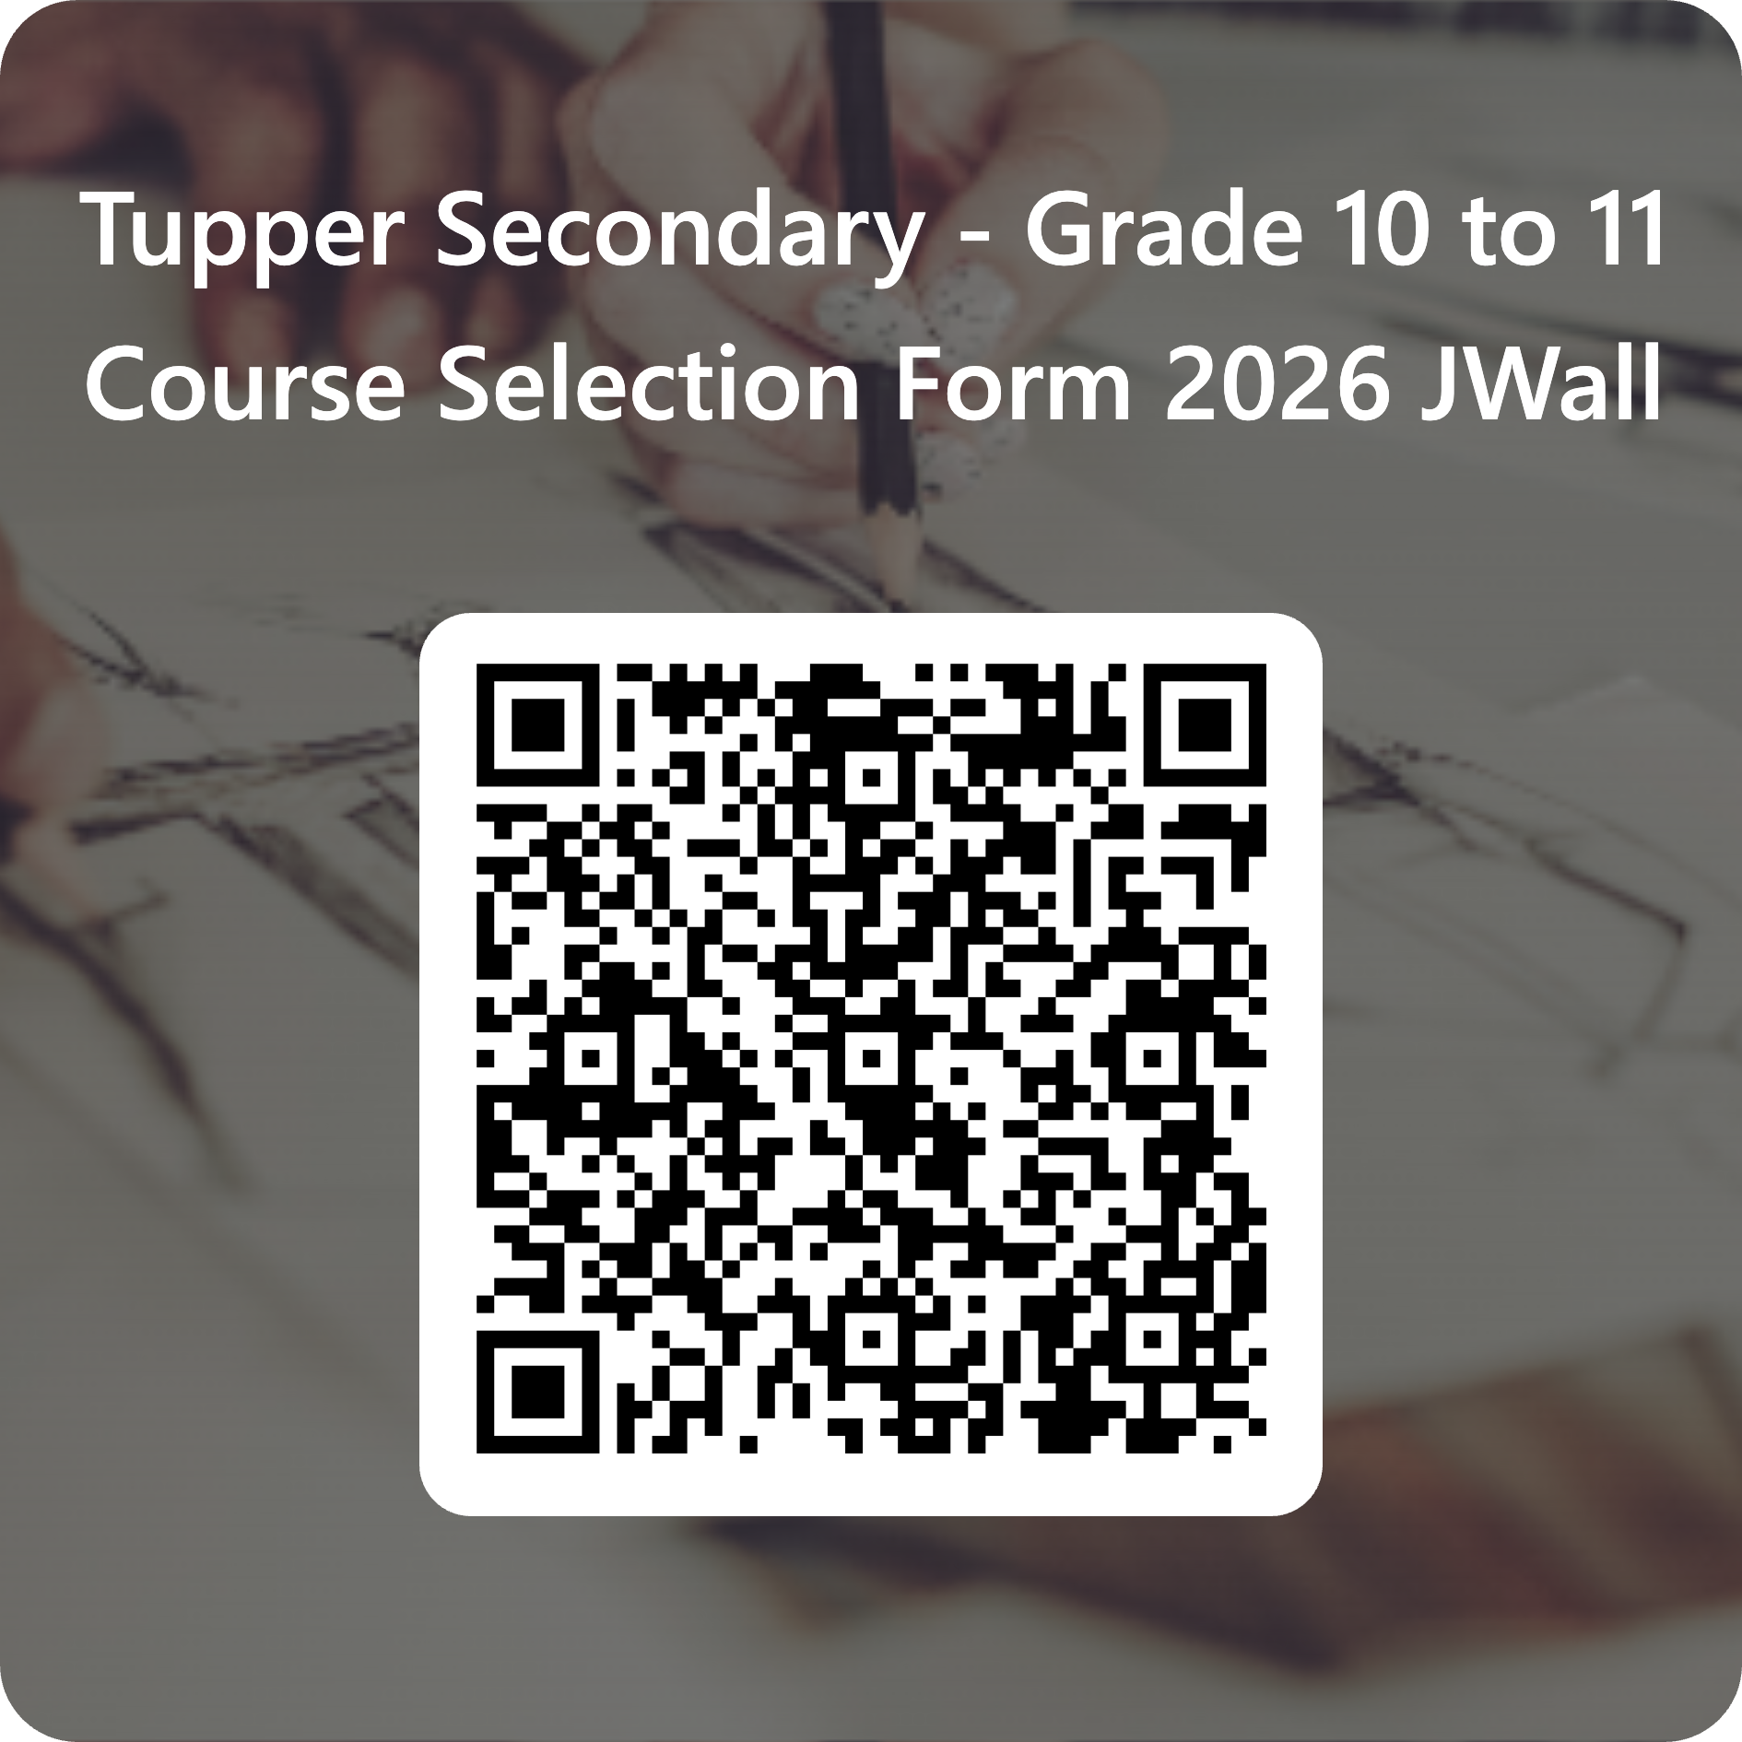
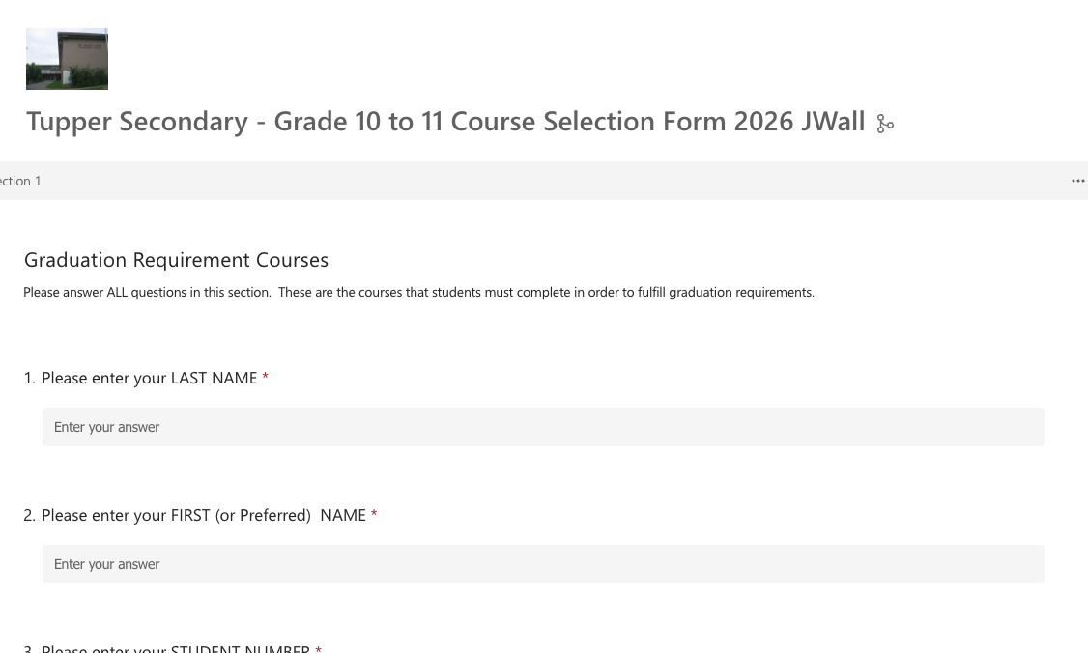
MS Forms – Course Selection
Click the link for your access to your Course Selection form or use the QR code.

