Slide 1

The Byng Arts Guide to Course Planning

Slide 2
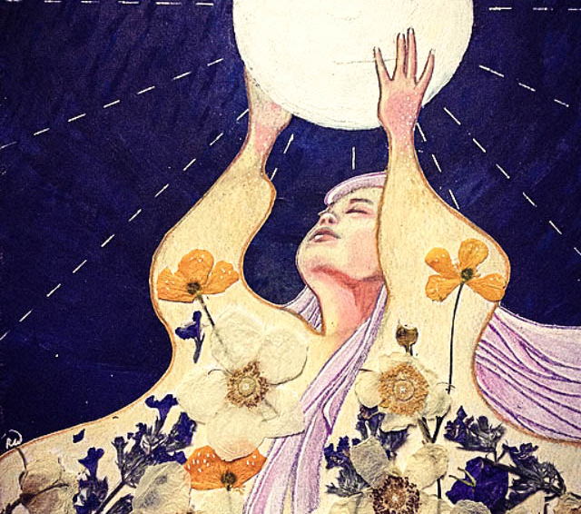
The Byng Arts Guide to Course Planning
Fine Art Targets
Academic Classes
Certification and
program expectations

Slide 3
Who Are We?
We are developing Film Makers, Actors, Artists, Musicians, Singers, and Writers.

Slide 4


A Community of Artists and Their Mentors

Slide 5
Program Design
Byng Arts offers an opportunity for students to embrace their creative selves and to:
Direct their energy and passion towards the fine arts,
Work within a community of students who share their interests, and
Challenge themselves academically.

Slide 6
Our values
Community and Connection
Fostering a sense of belonging
Building a safe environment where we can be our genuine selves

Slide 7
Our Challenge
To express our creative selves and seek out opportunities to come together even when faced with obstacles.
We are smart enough and creative enough to find a way to make the most of our high-school experience.

Slide 8

Course Selection
The pattern is
TWO CLASSES in your Fine Art Focus Area in Grade 11 and TWO CLASSES in your Fine Art Focus Area in Grade 12

Slide 9
Fine Art Focus Areas
Art
Band
Drama
Choir
Media
Strings
One or More

Slide 10

Art
All visual arts students must enroll in Honours Art
Visual Arts 9: Byng Arts Visual Arts 2-D 10: Byng Arts MVA—09DC1 MVAD-10DC1
Studio Arts 2-D 11: Byng Arts
MVAD-11DC1
Studio Arts 2-D 12: Byng Arts
MVAD-12DC1

Slide 11
Art
Then choose another Visual Art elective from the list below:
Animation 9/Media Design10-12 (Animation)
Art Studio 9-12: Year 1 - 5
Studio Arts 3-D Intro, Adv (Ceramics)
Yearbook/Annual Production
Jewelry 9-12
Photography 9-12: Beginner or Advanced
Textiles 9-12: Year 1 to 2
Fiber Arts 9-12 (YHEC-0A)

Slide 12

Band
First chose the appropriate level of Instrumental Music
(check with instructor if you are not sure)
Junior Band, Intermediate Band or
Concert Band: Senior Wind Ensemble
Then add where appropriate:
Symphony Junior or Senior
and/or
Jazz Band (Junior, Intermediate, or Senior)

Slide 13

Choir
First chose the appropriate level of Choral Music (check with instructor if you are not sure)
Concert Choir Junior, Concert Choir Intermediate, or
Concert Choir Senior
Then add where appropriate:
Chamber Choir (Junior, Senior)
and/or Contemporary Music: Treble Vocal Ensemble

Slide 14
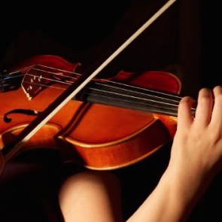
Strings
First chose the appropriate level of Orchestra
(check with instructor if you are not sure)
Orchestral Strings, Intermediate Strings or
Sinfonia (Senior Strings)
Then add where appropriate:
Honours Orchestra (Junior or Senior)
and/or
Symphony Junior or Senior

Slide 15

Media Arts 9 & 10
Students take
Media Arts 9 Advanced and Photography 9
Media Arts 10 Advanced plus one of the following:
Drama 10
Media Design 10 (Animation)

Slide 16
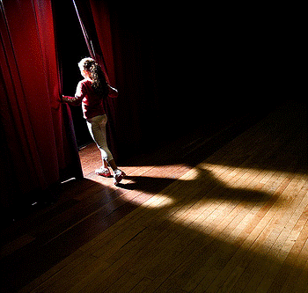
Drama 9 & 10
Grade 9 students take
Drama 9 and *Drama 9: Byng Arts Theatre Arts
MDR—09 MDR—09DC1
Grade 10 students take
Theatre Performance 10
MDRM-10DC1
plus one of the following:
 Theatre Production 10: Coaching (MDRD-10DC1)
 Drama 10 (MDRM-10)
 Media Arts 10 (MVAM-10SC1)

Slide 17
Drama 11 & 12
There are several ways to demonstrate your focus in senior Drama.
Below are the typical combinations for each area.
Drama – Stage/Theatre Performance Focus
Students take a double block of Theatre Company each year:
Theatre Company Senior 11 (Double Block)
MDRTC11 and MMUTH11
Theatre Company Senior 12 (Double Block)
MDRTC12 and MMUTH12

Slide 18
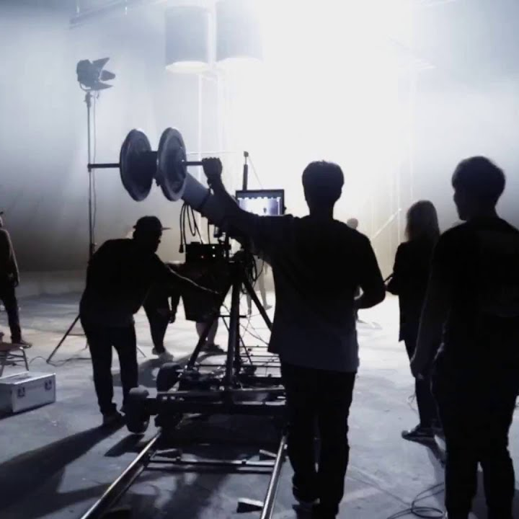
Drama/Media 11 & 12
There are several ways to demonstrate your focus in senior Drama.
Below are the typical combinations for each area.
Drama/Media - Film & Television Focus
Students enroll in a minimum of two classes per year:
Drama: Film Actors Process 11/12 (MDRM-11/12)
plus one or more of the following:
Media Arts 11/12 (MVAMT11/12) and/or
Film & Television Studies 11/12 (DFT-11/12)

Slide 19
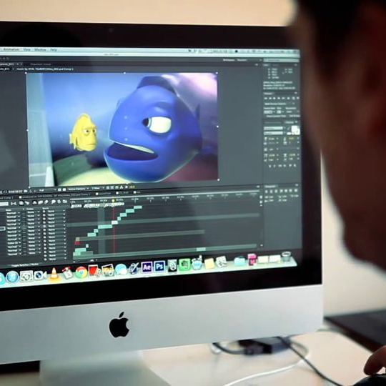
Drama/Media 11 & 12
There are several ways to demonstrate your focus in senior Drama.
Below are the typical combinations for each area.
Media Arts – Video/Animation
Students enroll in the Advanced Media class plus a minimum of one other class per year:
Media Arts 11/12: *Advanced (MVAMT11/12SC2)
plus a choice of the following:
Film & Television Studies 11/12 (DFT-11/12)
Media Design 11/12 (Animation) (MMEDD11/12)

Slide 20

Literary Arts
ANY FOUR (4) of the following courses will qualify for a
Literary Arts MAJOR or HONOURS.
ANY THREE (3) of the following courses will qualify
for a Literary Arts MINOR.
Literary Studies 11: AP Prep
English Studies 12: AP Prep
British Literature 12
Creative Writing 12

Slide 21
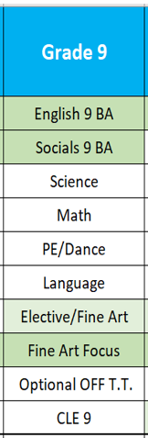
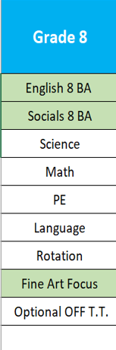
Grade 8 to Grade 9

Slide 22
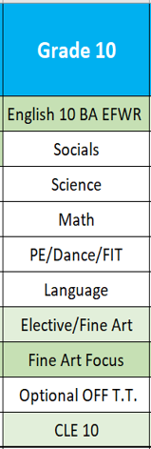
Grade 9 to 10

Slide 23
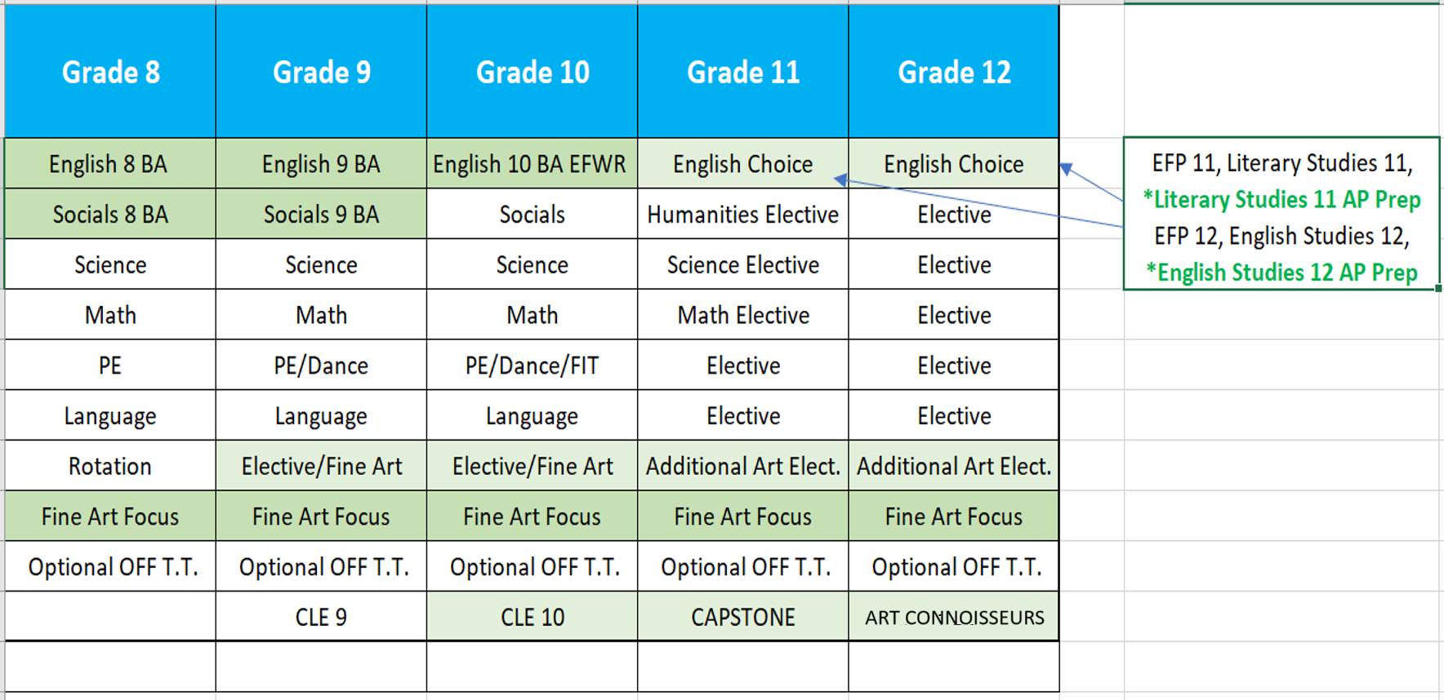

Slide 24
Who Are We?
We are developing Film Makers, Actors, Artists, Musicians, Singers, and Writers.

Slide 25
Our values
Community and Connection
Fostering a sense of belonging
Building a safe environment where we can be our genuine selves

Slide 26
Our Challenge
To express our creative selves and seek out opportunities to come together even when faced with obstacles.
We are smart enough and creative enough to find a way to make the most of our high-school experience.

Slide 27

Certification
Honours: Minimum of four senior courses in their chosen field, with an average of 86% or higher.
Major: Minimum of four with an average of 80% or higher.
Minor: Minimum of three courses with an average of 80% or higher.

Slide 28

Course Selection
Course Planning Booklet
booklets can be downloaded HERE
Talk to your teachers, speak with your parents, do your research.
I can be reached by email: jhartley@vsb.bc.ca

