Slide 1
Tennyson Elementary School
2018-19
[Enter Date]
Notes:
Came about as a result of redesigned K-9 curriculum and a change in Ministry reporting policy
– a different way of looking at learning means a different way of both assessing and communicating learning
Involved a year of conversations at many levels – CSL steering group, parent focus group, school level, individual classrooms

Slide 2
Ultimately, transforming reporting
to communicating student learning
shifts the ownership from teachers
to a collaboration between
students, parents and teachers.

Slide 3
BC Curriculum https://m.youtube.com/watch?v=lXyyZql2PZQ

Slide 4
Redesigned Curriculum
Core
Competencies
Big Ideas (Understand)
Curricular Competencies (Do)
Content (Know)
Notes:
Intention: Make explicit the location of the core competencies in the landscape of instruction and learning.
Speaking notes: Share that the core competencies are not isolated ideas, but run throughout the whole curriculum. They are an essential part of twenty-first century learning and key to helping students become productive and successful citizens. Core competencies are not a separate subject, part, or area of instruction.They are embedded in lessons, activities, and student interactions. From the Ministry, "Core competencies are sets of intellectual, personal, and emotional proficiencies that all students need to develop in order to engage in deep learning and life-long learning."
Overarching umbrella of skills that are all encompassing and also woven throughout the curricular competencies. When teaching the curricular competencies, you are implicitly teaching the core competencies.
See presentation #2 for their description of theirs.

Slide 5
Who do we want our students to become?
Notes:
Core Competencies ARE….

Slide 6
The Educated Citizen
Notes:
JANIS
Intention: The description of the Educated Citizen became part of BC's Education Policy in 1988
Speaking notes: The redesigned curriculum captures these qualities, implicitly and explicitly, through the Core and Curricular Competencies. The concept of the Educated Citizen continues to guide our practice ensuring meaningful educational experiences for students.
If presenters would like further information about 21st Century learning and the educated citizen, refer to this video link: http://www.bing.com/videos/search?q=21st+century+lEARNER+youtube&&view=detail&mid=51D62E776087714A04F251D62E776087714A04F2&rvsmid=AADBF004FB52D5F92ABFAADBF004FB52D5F92ABF&fsscr=0&FORM=VDQVAP

Slide 7
What are the Core Competencies?

Slide 9
Notice it - Name it - Nurture it
Teachers and Students will be able to:
Notice it
Name it
Nurture it
Notice evidence of Core Competencies in student learning
Name specific facets and profiles of the Core Competencies
Nurture Core Competencies by moving forward along the continuum with instructional intention
Notes:
Laura
Intention: After a re-cap of the Core competencies, introduce shape of session to participants and introduce Notice it, Name it, Nurture it protocol as the framework to making the core competencies explicit in our classrooms and then teaching students to name the core competencies and reflect on their skills for future growth.
Speaking notes: This notice, name, nurture protocol is an effective framework that supports student development of the core competencies. Our presentation will build your familiarity with each piece of the protocol and we will give you an opportunity to reflect on the three pieces.We will be providing opportunities to practice noticing when students are demonstrating core competencies, help you develop your ability to name the specific aspects of the core competencies students are demonstrating, and will provide a variety of suggestions for nurturing the development of the core competencies in our students .
---------------------------------------------
Notice it refers to being aware of when students demonstrate the core competencies. Teachers may notice students using specific competencies during lessons or classroom activities as well as when students are generally interacting with each other like at breaks or lunchtime.
Name it refers to using language from the core competencies to describe the competencies. Language can be found in the profiles and the sample I can statements on the ministry website. When teachers name it, they are pointing out to the student the specific skill they are demonstrating.
Nurture it refers to considering learning engagements and self-reflection opportunities for students to develop the competency. Planning is a key component of building student abilities related to the core competencies.

Slide 10
The Learning Process
Teachers create rich learning tasks based on student interests
Together teachers and students set criteria
Powerful questioning/learning conversations allow for ongoing, timely descriptive feedback to the student
Teachers and students intentionally gather evidence over time to inform teaching and learning
Metacognitive skills are developed through student reflection and self-assessment
Learning can be process, inquiry, and/or project based

Slide 11
What’s new? Communicating Learning
Then - Reporting | Now - Communicating Student Learning
Reporting on student achievement with parents at prescribed intervals throughout the year Letter grades for all students in Grades 4-9 with each written report | Ongoing communication of student learning Mid Year and End of June Letter grades for students in Grades 4-9 are not included unless specifically requested by parents
3 times/year for written reports 2 times/year for informal reports | Relevant, descriptive and timely feedback for learning is provided a minimum of 4 times each school year using a variety of methods
Identical items/tasks used to evaluate student learning for the whole class | Evidence of student learning can be demonstrated in a variety of ways. Students are actively involved in the assessment process.
Minimal student voice | Student voice included in the communication of learning

Slide 12
Growth vs Fixed Mind Sets – Carol Dweck

Slide 13
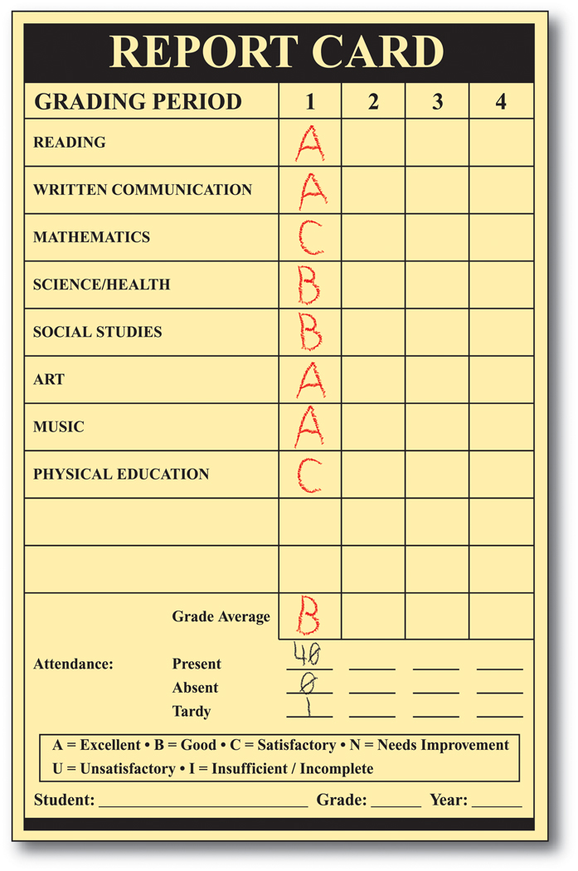
No letter grades?
Letter grades tend to foster a Fixed Mindset in students.
“I always get a C+ in Math.”
“I got a C in Science. I’m no good at it.”
A letter grade on a written composition or project
gives the student no information about how to improve.
Students with a Growth Mindset are much more likely to continue learning. They see themselves as learners with potential.
Feedback for learning promotes a Growth Mindset. Providing a student with feedback about what’s working and what to focus on next provides students with the tools they need to improve.

Slide 14
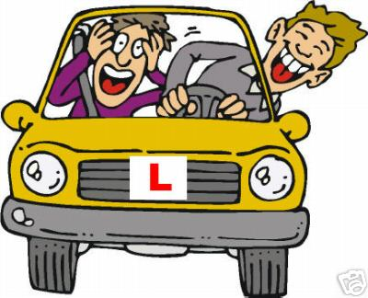
“Turn left at the corner.”
Feedback for Learning
Imagine that during a driving test you are asked to turn left. After you complete the turn the Examiner says, “You got a C- on that turn.” Do you know what you have to do to pass the driving test the next time?
If the Examiner tells you that you turned the steering wheel correctly but forgot to make a visual check in both directions before making the turn, will this help you next time you take the test?

Slide 16
Communicating Student Learning Reporting Minimum Expectations 2017-2018
Curriculum area Written Reports Ongoing Communications
 | January | June
English and French Language Arts |  |  | 2
Mathematics |  |  | 2
Science |  |  | 2
Social Studies |  |  | 2
Arts Education | (either Jan or June) |  | 1
Core French (Gr 5-7) | (either Jan or Jun) |  | 1
Physical and Health Education | (either Jan or Jun) |  | 1
Applied Design, Skills and Technology |  |  | (optional)
Career Education |  |  | (optional)
Student Self Assessment of Core Competencies |  |  | (optional)

Slide 17
Sarah Li Grade 4
STUDENT’S LEARNING STRENGTHS:
Sara shows that she cares for others by regularly inviting children who are alone on the playground to play with her.
Language Arts – After reading a passage Sara can draw conclusions and express her opinion in writing. She is able to find evidence from text to support her opinion. Her written reflections of the book, When I Was Eight, showed that Sara can make inferences about how the main character felt while living at a Residential School. She is an avid reader of non-fiction to learn more about animals and she enjoys reading fantasy novels.
Mathematics – Sara can represent, compare and order numbers to 10 000 using base ten blocks and is making connections to measurement and other real world contexts.
Social Studies – Sara can explain the impact of the Residential School system on Indigenous children and families.
Science – Sara’s excellent research project comparing human and animal senses demonstrated her understanding of the sensory differences between animals and humans.

Slide 19
Student Competency Scale
Beginning to acquire knowledge, skills, strategies and processes “ I am just get getting started and I learn best with help” | Developing the ability to apply knowledge, skills and processes “ I am getting there and I am beginning to do more and more on my own” | Applying knowledge, skills, strategies and processes consistently “I get it and I can do it on my own” | Extending knowledge, skills, strategies and processes creatively and strategically “I get it and go beyond what is expected of me”
Student is beginning to understand at grade level expectations. | Student is developing understanding at grade level expectations | Student is applying understanding at grade level expectations | Student is extending understanding at grade level expectations
Shows evidence that learner can demonstrate some progress toward the learning standards | Shows evidence that the learner can understand the learning standards in basic or familiar situations | Shows evidence that learner can transfer understanding of learning standards to both predictable and new situations | Shows evidence that learner can insightfully and creatively apply an in-depth understanding of learning standards in complex situations.

Slide 20
Ongoing Communications with Parents:
Based on authentic evidence of student learning from a variety of sources (examples of student work, audio, photos, video, portfolios)
Based on clear standards and expectations with the intention of making learning visible
Can occur in different ways (3 way conferences, electronic portfolio reviews, parent-teacher conferences, reflections on student work, Fresh Grade or other on-line platforms, telephone conversations, Individual Education Plan meetings)

Slide 21
Communications with Parents can include:
Descriptive information about the child’s learning
Learning goals the child is working towards
Ways to further support the child’s learning at school and at home
The child’s contributions to the classroom, school and community
How the child interacts with others

Slide 22
Opportunities for Feedback:
Parents and VSB staff will have opportunities to provide feedback in several ways including:
Meetings
On-line survey

