Slide 1
Course Selection for Current Grade 10 Students

Slide 3
Course planning timeline
January – February
Course planning presentations
Course Selections complete
March – May
Timetable built
June
Resolve conflicts
Changes if possible
August
Resolve course conflicts
Changes if possible
September
Changes if possible

Slide 4
Graduation Requirements
English 10/English First Peoples 10
Mathematics 10 Foundations and Pre-calculus 10 Workplace Math 10
Physical Education 10
Science 10
Social Studies 10
Career Life Education 10

Slide 5
Graduation Requirements
English 11
Mathematics 11 Workplace Math 11 Foundations of Math 11 Pre-calculus 11
Social Studies 11/Social Studies 12 Human Geography 12 20th Century World History 12 Economic Theory 12 Law 12 Indigenous Studies 12
Science 11 Life Sciences 11 Chemistry 11 Physics 11 Earth Sciences 11

Slide 6
Graduation Requirements
English 12/English 12 First Peoples
3 Grade 12 Electives
Fine Arts OR Applied Skills 10, 11, OR 12
Career Life Connections/Capstone Project
Indigenous studies course (En 10, En 12, Cont. Ind. Studies)
Minimum 80 credits (20 courses)
Literacy/Numeracy 10 exams
Literacy 12 exam

Slide 7
Electives
Business Education
Technical Education
Home Economics
Fine Arts
Music
Performing Arts
P.E.
Languages

Slide 8
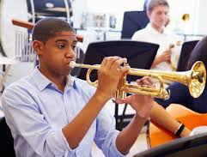
Off-timetable Electives
Consider taking an off-timetable elective
Specialized Studies in Foods 12
Fitness & Conditioning 11/12
Jazz Band 8 - 12
Strings Orchestra 8 - 12
CLE 10
Theatre Production (Stagecraft)
Theatre Company 9 – 12
Yearbook 11

Slide 9
VSB DISTRICT COURSES
2025-2026 OVERVIEW
What are District Courses? Special district-wide elective courses available to all VSB students.
Available Courses:
History of African Descent in BC 12
Queer & Trans History of BC 12
Why Take Them?
Unique curriculum with field trips, guest speakers, and project-based learning
Meet students from across the district
Focus on important cultural and historical topics
Who Can Enroll? Grades 11 & 12 students from all VSB high schools

Slide 10
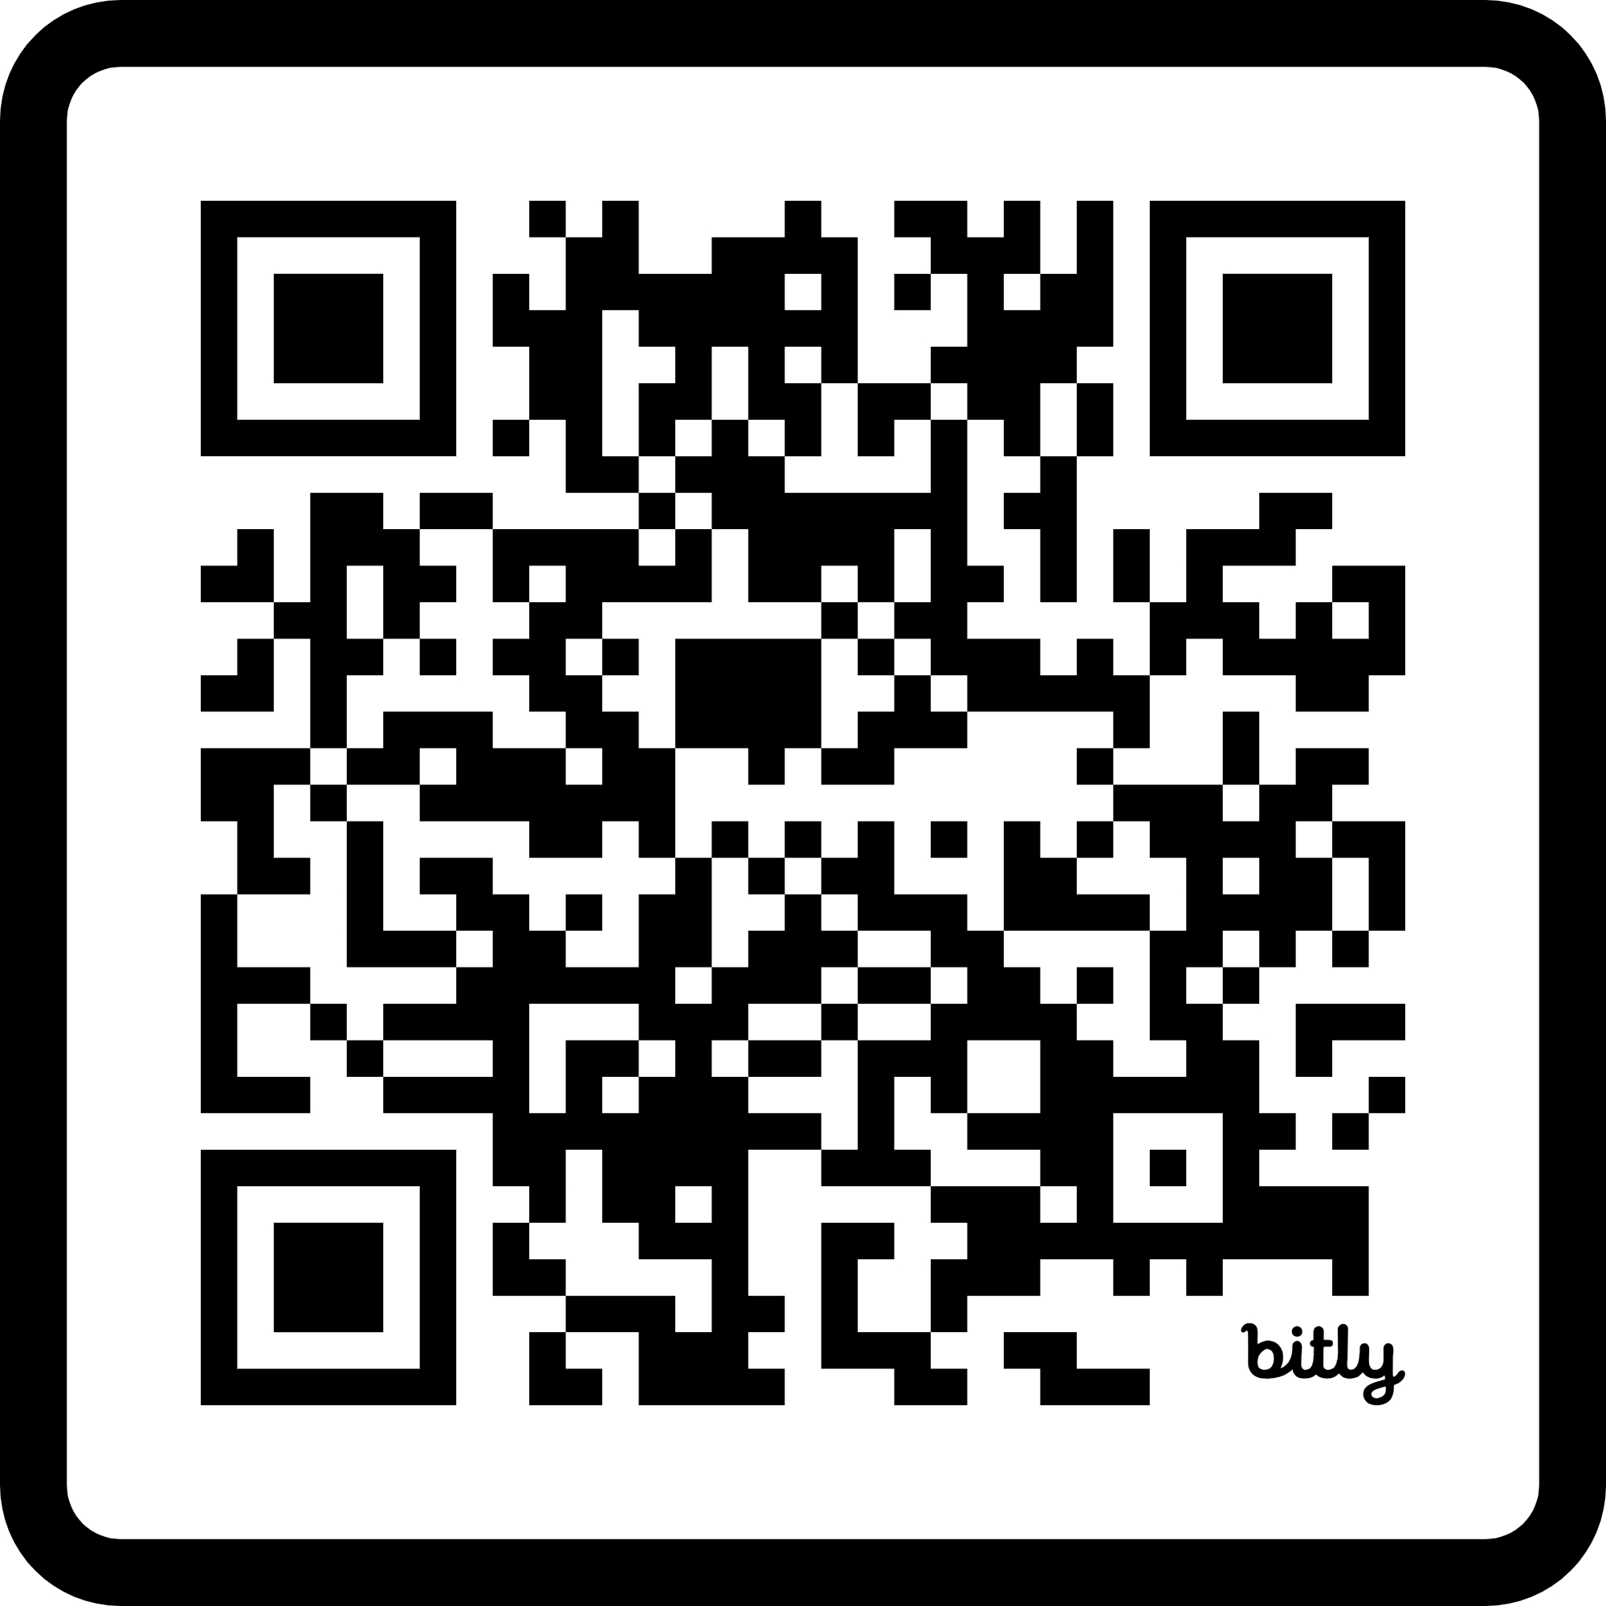
INFORMATIONAL SESSION
Register for the Informational Session on February 26, 2025 @ 5:30 PM (virtual) for more details!
bit.ly/3DoNNBo

Slide 11
Course Selection
Grade 11 students are expected to take 8 courses at PW
Timetable is built according to student choices
Do not pick a class assuming that a particular teacher will be teaching it
Pick classes based on interest, not student composition
If summer school is a plan, do not request the same class during course selection
Form required for CS blocks
Priority for courses will go to students in current course grade level

Slide 12
Course Selection
Elective tour was held during FIT last week
Course descriptions for each course offered at PW listed in Course Planning Guide
Please read course descriptions before making course selections
Course planning guide can be found at the link below:
https://www.vsb.bc.ca/prince-wales/page/11995/course-planning

Slide 13
Learning strategies/gold Classes
Learning Strategies (LS) 11 or GOLD 11 – for students who have taken these classes in previous years
Learning Strategies & GOLD students earn 4 credits for each LS class
Learning Strategies students can choose 2 LS classes if they want support in each semester

Slide 14
ELL beg/int
Sign up for the same level you are currently in.
ELL teachers advise counsellors on your required ELL classes in April/May.
Assessments in Spring will determine placement for next year.

Slide 15
Second language
Not required for high school graduation
Second language no longer required to apply to UBC or SFU
Still counts as an academic course for admissions purposes
Some students may qualify for language 10, 11 or 12 credits
Students who are fluent in a second language may write a Language Challenge exam or complete a language course online
Current second language offerings:
French 8-12
Spanish 9-12, Intro 11

Slide 16
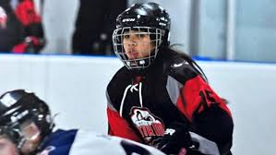
External credits
Some outside activities may qualify for extra credits
E.g. Royal Conservatory of Music, BC Athletics
Contact organization to see if they have certification
Proof of involvement/completion – letter, certificate, etc

Slide 17
Career programs
Number of different opportunities with the VSB
Train in Trades
Partnership with BCIT, VCC, Finishing Trades Institute, Piping Industry College of BC
Some programs run through summer, others during school year
Work in Trades
Currently already working in a trade
Credits for high school

Slide 18
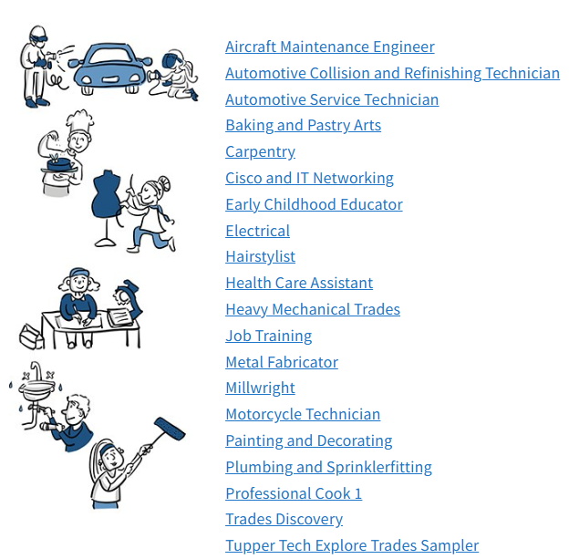
Youth train/work in trades

Slide 19
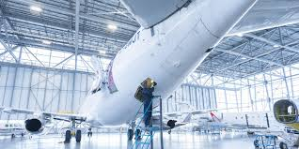
Youth train in trades
Start your apprenticeship training while in Grade 11 or 12
Earn up to 16 high school credits
Earn credits at the post-secondary level
Speak to Mr. Tse if interested
https://www.vsb.bc.ca/career-programs

Slide 20
Summer school
Registration typically starts in late April or early May
Inform counsellor of your plans to take a Summer School course (write down on course selection form)
Completion courses
5-6 weeks (3 hours/day)
July – August
Register day of/time of – spaces in completion courses fill up very quickly
Create account ahead of time

Slide 21
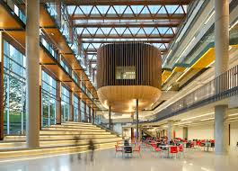
Post-secondary
All Canadian Universities look for completion of Grade 10 and 11 courses.
Many Canadian Universities are now using Grade 11 marks as part of the admissions process.
Canadian Universities calculate admission averages based on 4 - 6 Grade 12 courses and will use the Grade 11 equivalent when a Grade 12 mark isn’t available.
UBC requires a minimum of ‘3’ on the Literacy 12 exam

Slide 22
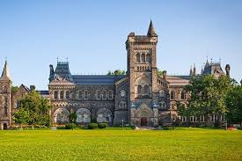
Post-secondary
Ontario Universities require/recommend Calculus 12 for most science, math, engineering and business programs.
In BC, Calculus 12 is recommended/required for some programs ie. Required for engineering, recommended for business
Science and Engineering programs typically require Chemistry 11, Physics 11 and 1-2 science 12 courses, as well as calculus.

Slide 23
Common misconceptions
I need to take all my Grade 12 courses in Grade 11
I need to take additional coursework outside of PW to be competitive for university applications (AP courses)
Doing well at PW is the most important factor
Get involved in extracurricular activities

Slide 24
Post-Secondary
Research each individual institution thoroughly
Be aware of application deadlines and admission requirements
Polytechnic universities work on a first-come first-served basis (aside from specialty programs)
High marks and graduation DO NOT guarantee entrance into the institution/program of your choice
Apply to multiple schools/programs

Slide 25
Post-secondary research
MyBlueprint - www.myblueprint.ca/sd39
Post-secondary planning
Scholarships
Grad portfolio
Click “login”
Click “School account login”
Select “SD39 Vancouver”
Use PW login and password
Education Planner - www.educationplannerbc.ca
Post-secondary requirements
Application portal

Slide 26
reminder
Parents and students are responsible for checking with colleges and universities for their specific entrance requirements

Slide 27
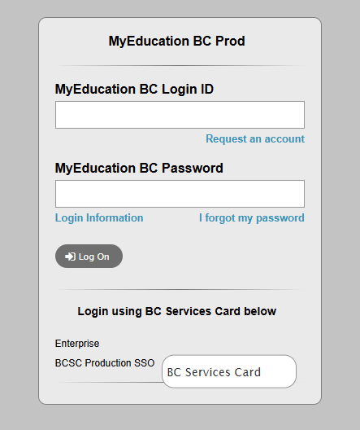
MYED INSTRUCTIONS
Go to PW website https://www.vsb.bc.ca/prince-wales
Click the ‘Family’ Tab and click “My Education BC Family Portal”
Log into MyEd
Click on top tab ‘Info’
Click on side tab ‘Requests’
Click on ‘Entry Mode’ if available – if not available, you are ready for selection
Portal will be open to put in requests on Jan. 31

Slide 28
Course selection schedule Computer Lab C106
Last Name | Date | Day | Fit
Adab-Chen | February 12 | Wednesday | Morning
Cheng-Hang | February 13 | Thursday | Afternoon
Harrison-Leung | February 18 | Tuesday | Afternoon
Li-Minami | February 19 | Wednesday | Morning
Moretta-Senbel | February 20 | Thursday | Afternoon
Shao-Vo | February 24 | Monday | Morning
Wang-Ye | February 25 | Tuesday | Afternoon
York-Zhu | February 26 | Wednesday | Morning

Slide 29
Questions
Come see Mr. Tse
ctse@vsb.bc.ca

