Slide 1

Prince of Wales Secondary
Grade 12
Course Selection
Presentation
Grads of 2026

Slide 2


Slide 3
Schools are staffed and time-tabled according to student course requests in January and February.
Only those courses with sufficient student requests will be available.
Please choose your courses carefully as there is little flexibility once the timetable is built!
Course Selection

Slide 4

Course Selection
Grade 12 students are expected to take 7 courses at PW + CLC
PW scholarship eligibility is based on taking 7 courses at PW

Slide 5

The B.C. Certificate of Graduation:
Dogwood Diploma
Complete a total of 80 credits - each course is 4 credits
52 credits are required from the following:
Physical and Health Education 10
Science 10 and a Science 11 or 12
Social Studies 10 and a Social Studies 11 or 12
A Math 10 and a Math 11 or 12 course
A Language Arts 10, 11, and 12 course
An Arts Education 10, 11, or 12 and/or an Applied Design, Skills, and Technologies 10, 11, or 12
Career-Life Education 10 and Career-Life Connections 12
Indigenous-focused course
At least 28 credits must be elective course credits
At least 16 credits must be at the Grade 12 level, including a required Language Arts 12 course and the Career-Life Connections course
Graduation Check List

Slide 6

New Graduation Requirement
Indigenous-Focused Course Requirement
2 options for Grade 12
  Contemporary Indigenous Studies 12
  English First Peoples 12
  Mini Students complete EFP Literary Studies & Writing 11
  Some students may have taken EFP 10 in Grade 10

Slide 7

The Road to Graduation
REQUIRED COURSES in Grade 10:
1. English 10
2. Social Studies 10
3. Science 10
4. Math 10
5. PE 10
6. CLE 10
7. 2 elective courses
REQUIRED COURSES in Grade 11:
1. English 11
2. Social Studies 11 or 12
3. A Science 11
4. A Math 11
5. 4 Elective courses

Slide 8

    Required Courses in Grade 12
English Studies 12 or
English First Peoples 12
2 other Grade 12 courses
Everything else is a choice
CLC 12 (completed off-timetable)

Slide 9

Course Choices
Dropping courses is problematic
If you don’t like your mark, ask for help
Remember breadth and rigour count
You need good marks to get into university but, you need the skills to stay there

Slide 10

Course Choices
Online courses
Repeated classes
Check post-secondary dates for online course completion
Cannot repeat at PW
Upgrade online or summer school, highest mark is reflected on transcript

Slide 11

Course Selection
Talk to your Teachers, Counsellor, parents and friends
Read the course descriptions in the Course Planning Guide on the website
Make sure to consider graduation requirements and your post-secondary plans

Slide 12
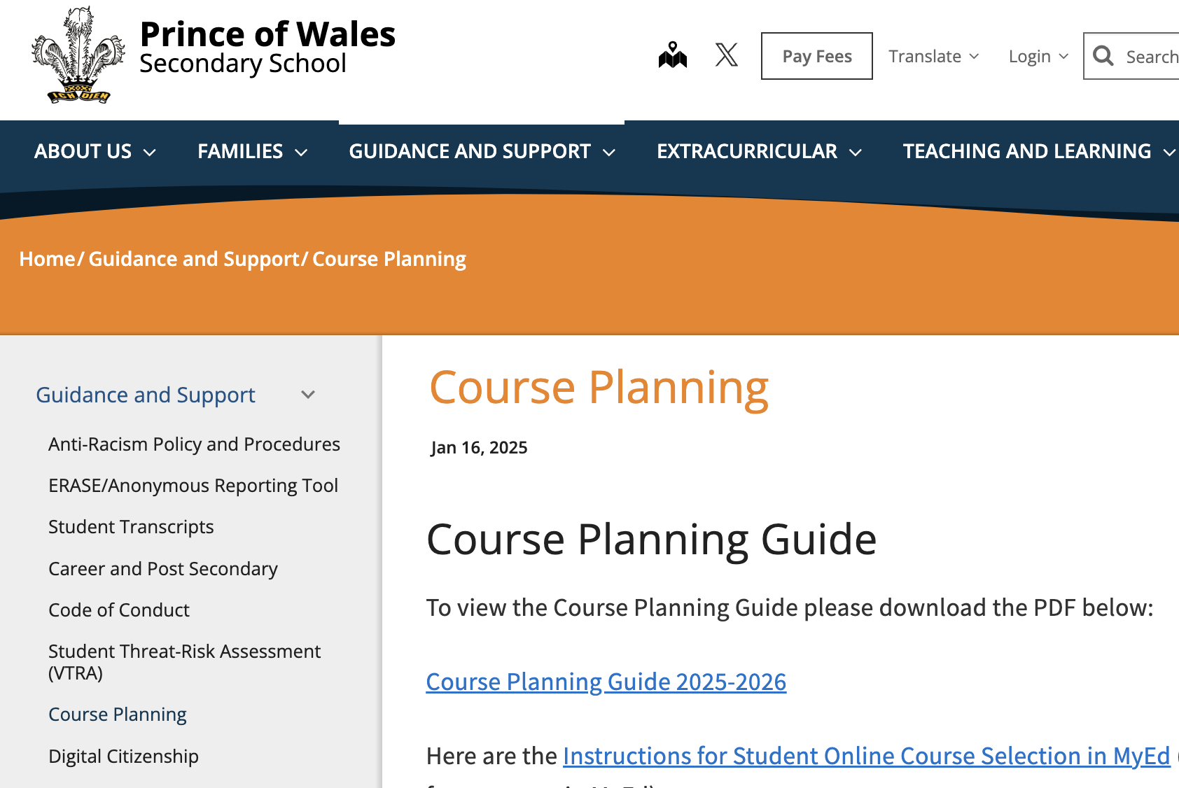
Course Planning Guide
Found on PW website under Guidance and Support tab
or download here
https://media.vsb.bc.ca/media/Default/medialib/pw-course-planning-guide-2025-2026.09e2e978488.pdf

Slide 13

Grade 12 English Choices
Graduation Requirement
English Studies 12
English First Peoples 12
English Studies 12 Mini
English Electives
Creative Writing 12

Slide 14

Grade 12 Social Studies Choices
20th Century World History 12
Contemporary Indigenous Studies 12
Economic Theory 12
Human Geography 12
Law Studies 12
Queer & Trans History of BC (District OT)
African Descent History In BC 12 (District OT)
Transitional Social Studies
ELL Social Studies

Slide 15
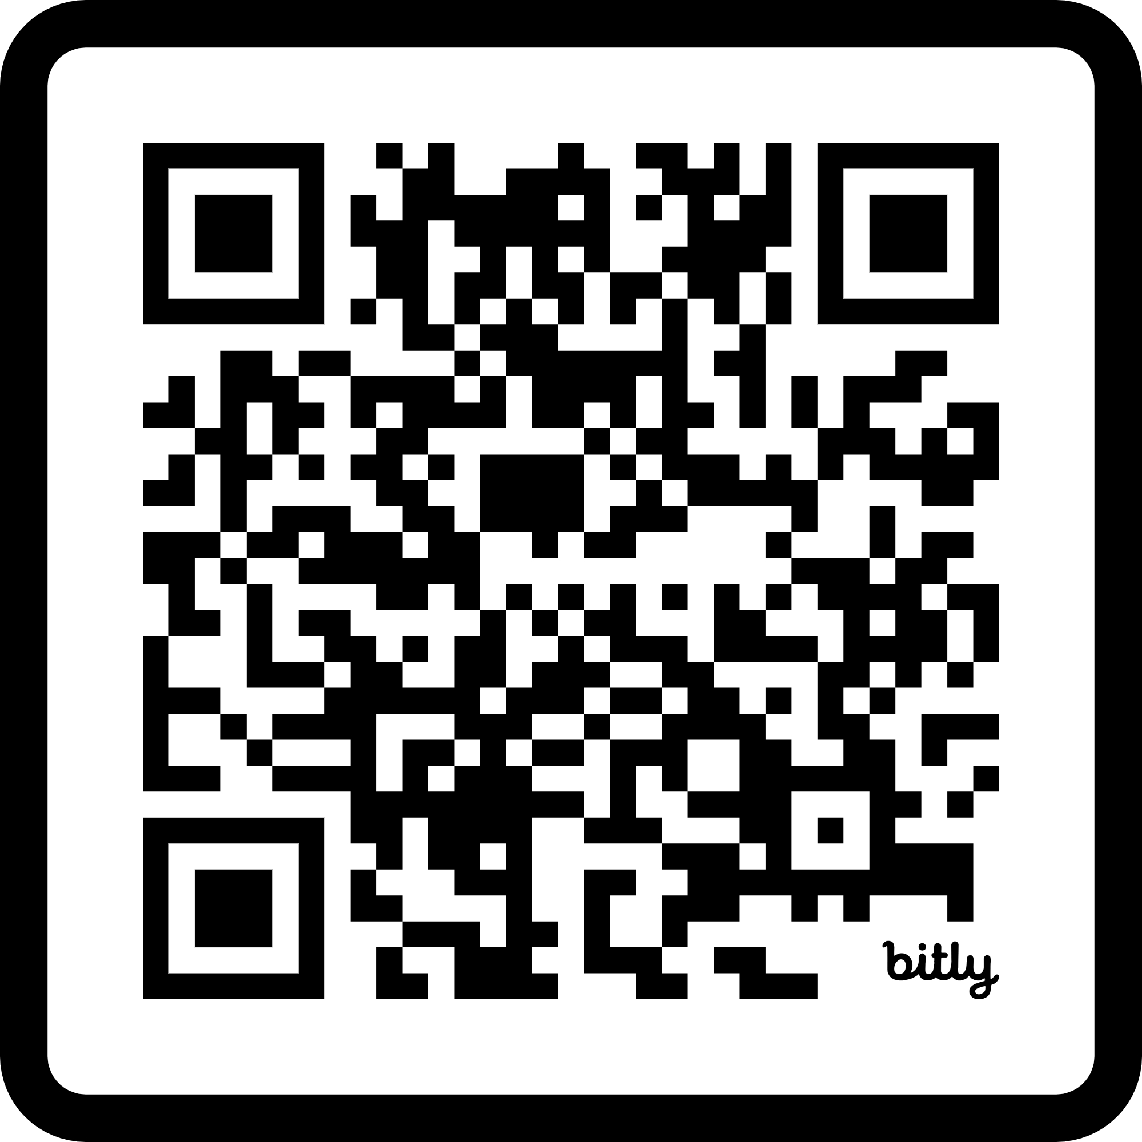

INFORMATION SESSION
For District OT Courses
Register for the Informational Session on February 26, 2025 @ 5:30 PM (virtual) for more details!
Please note these courses are Social Studies electives:
They do not fulfill the Social Studies requirement for graduation,
or the Social Studies requirement for university admission
bit.ly/3DoNNBo

Slide 16

Anatomy & Physiology 12
Chemistry 11/12
Earth Science 11
Life Science 11
Physics 11/12
ELL Science
Students may take more than 1 Science
Chemistry and Physics 11 + 1 or 2 Grade 12 Science classes are required for most Science or Engineering programs
Grade 12 Science Choices

Slide 17

Grade 12 Math Choices
Pre Calculus 12
Calculus 12
AP Calculus 12
Pre-Calculus 12 and Calculus 12 may be done concurrently
Pre-Calculus 12 must be done before AP Calculus
No Math

Slide 18
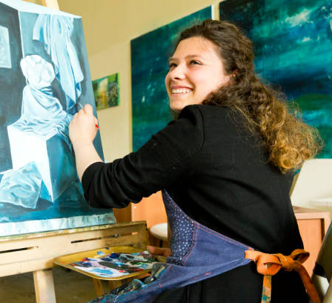

Grade 12 Electives
Round out your course schedule with electives
Choose courses that will meet the post-secondary requirements for your program of choice
Add in electives of interest

Slide 19



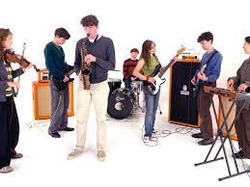
Electives
Business Education
Technical Education
Home Economics
Computers
Fine Arts
Music
Performing Arts
P.E.
Languages
Consider Off Timetable electives
Choose your electives carefully
Some electives considered “academic”
Notes:
Choose based on your likes not your friends!

Slide 20

Language Electives
French 11/12
Spanish 11/12
Beginner Spanish 11
A 2nd language is not required for graduation
A 2nd language is not required for university admission.
A 2nd language is considered “academic”
ELL students may be eligible for a Language 10, 11, or 12 credit.

Slide 21

Skills or
GOLD Support
Skills 12 or GOLD 12 – for students who have taken these classes in previous years
Skills 12 + GOLD 12 classes are each worth 4 credits

Slide 22

Sign up for ELL courses you are currently in
ELL teachers advise Counsellors on your required ELL classes
Assessments in May and September will determine placement
ELL Students
Beginner or Intermediate

Slide 23

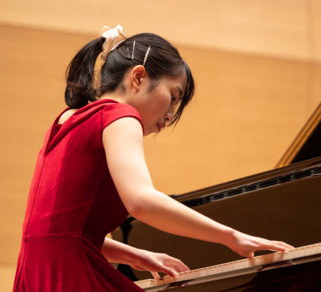
External Credits
Challenge exams (Languages)
Music / Dance
Youth Leadership
Sports
First Aid
ICBC Driver Training
Cadets

Slide 24


www.vsb.bc.ca/Career-Programs
VSB Career Education
Youth WORK in Trades Program
Youth TRAIN in Trades Program

Slide 25

Youth WORK
in Trades Program
Start your apprenticeship training while in Grade 10, 11 or 12.
Earn up to 16 high school credits

Slide 26

VSB Career Programs
For students who are passionate about working with their hands, seeing the results of their efforts, and are creative problem solvers
Provides students with career training in skilled trades, health care and technology sectors while attending high school
Why Choose a Career Program?
Get free tuition for the first level of a post secondary program
Earn dual credits – high school and post-secondary credits concurrently
Work experience in chosen career path
Explore career opportunities
Build skills that can transition into paid work

Slide 27
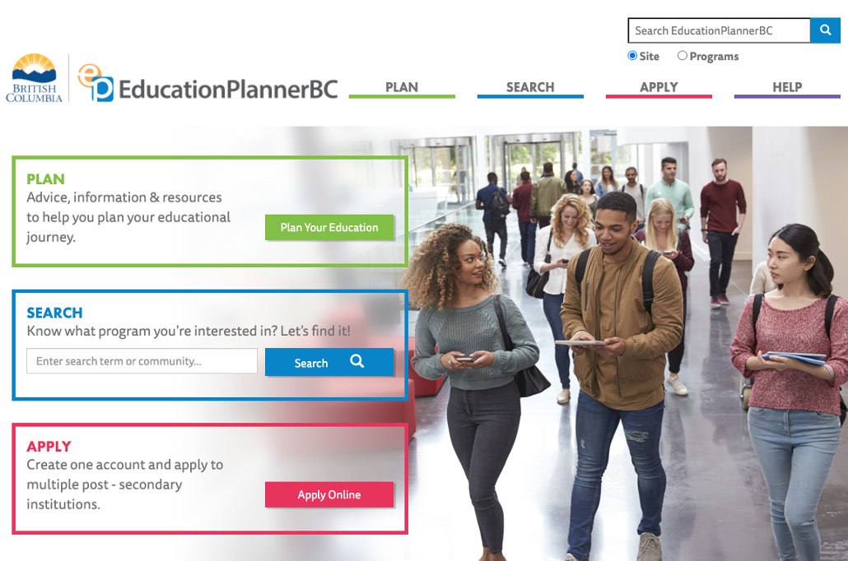
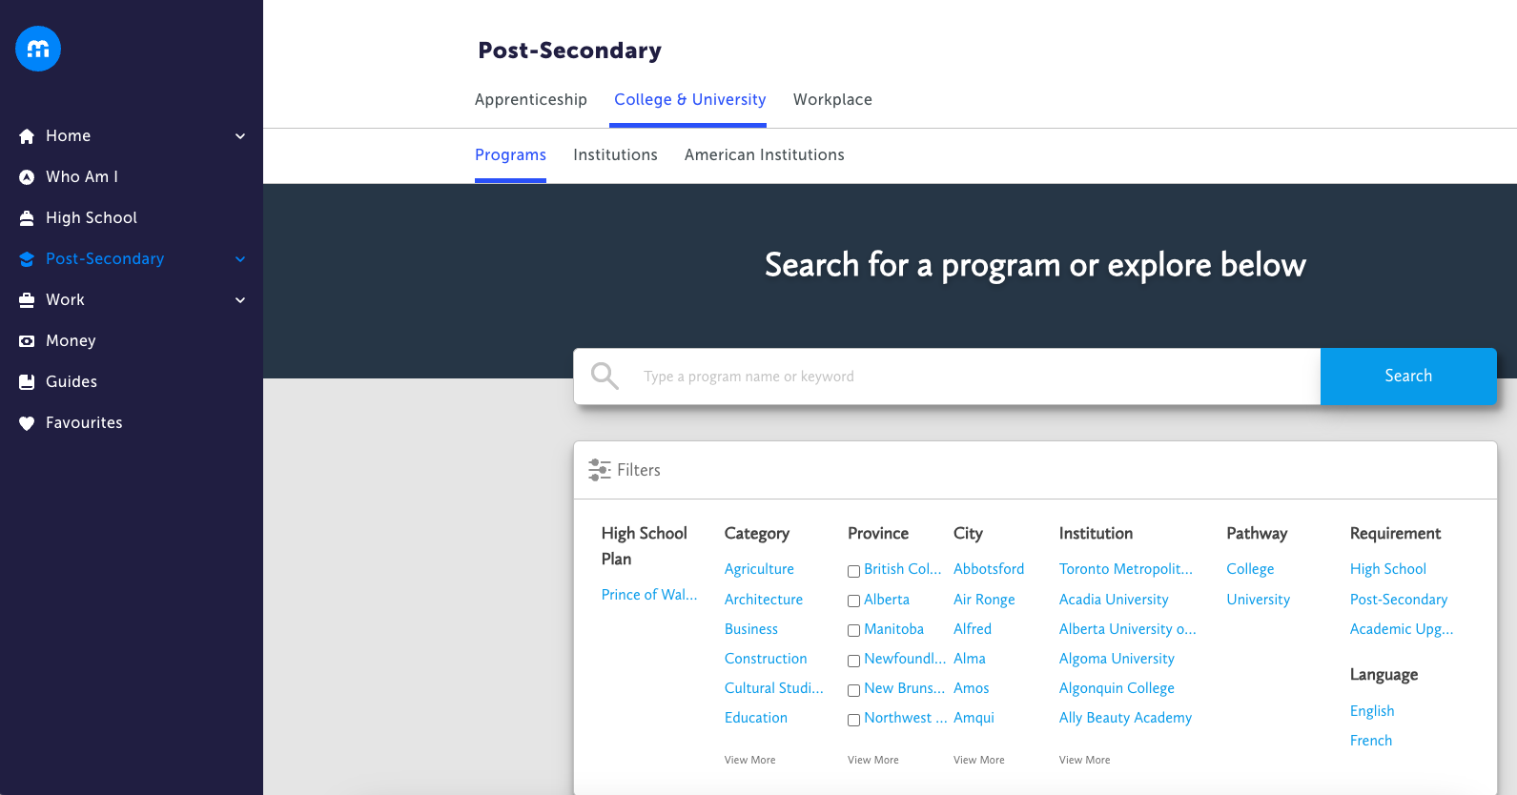
To research and explore post-secondary pathways and entrance requirements check out these websites.
myblueprint.ca
educationplannerbc.ca
Post-Secondary Research

Slide 28
As you approach graduation, the Students Transcript Service (STS) page becomes important.
It’s where you submit your marks for post-secondary and track your grad status.
It’s where you can check on your Numeracy and Literacy assessment results.
It shows COMPLETED courses that you have PASSED.
It only shows your BEST mark if you have taken a class more than once.
Student Transcript Service is now linked through a BCeID.
To create a Basic BCeID account click HERE
To log in to your BCeID account click HERE.
These are helpful because you’ll use a BCeID for other things after graduation.
You’ll need your PEN, which is on your report cards or on MyEd under My Info tab.
Click HERE for a YouTube video on getting set up.
Student Transcript Service

Slide 29
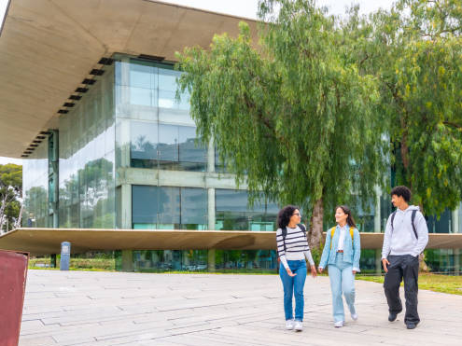
Post – Secondary
Information
Please check specific college & university requirements
Science and Engineering programs typically require Chemistry 11 and Physics 11
Many Business programs recommend Calculus 12

Slide 30



University Second Language Requirements
There is no longer a second language requirement for university admission in Canada

Slide 31
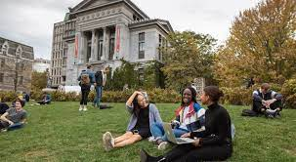
Required Grade 11 Courses:
English 11
Pre-Calculus 11
Science 11 – Biology, Chemistry, Physics or Earth Science
Social Studies 11 or 12
check university websites for program specifics
Universities use Grade 11 marks until Grade 12 marks are available
Post-Secondary Information

Slide 32
UBC – Vancouver
ubc.ca
Holistic approach to competitive academic assessment
Courses required for admission to specific programs
All courses in Grade 11 and 12 will be considered in admission
Particular attention paid to courses relevant to program of study

Slide 33
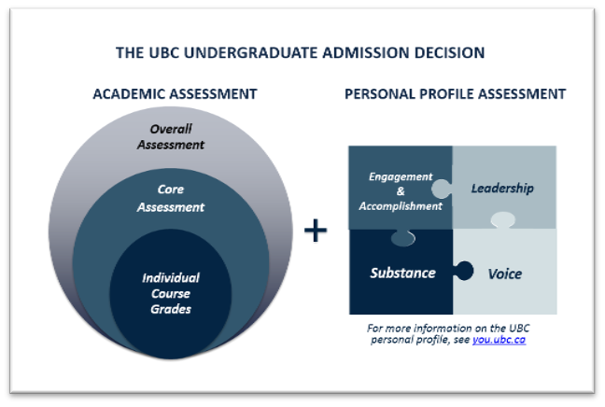
Factors for admission
Overall course assessment – all Grade 11 & 12 courses considered
Core academics – courses relevant to field of study
Marks for English 12 and Pre-Calculus 11
Personal Profile
At least 6 academic/non-academic Grade 12 courses
UBC – Vancouver
ubc.ca

Slide 34
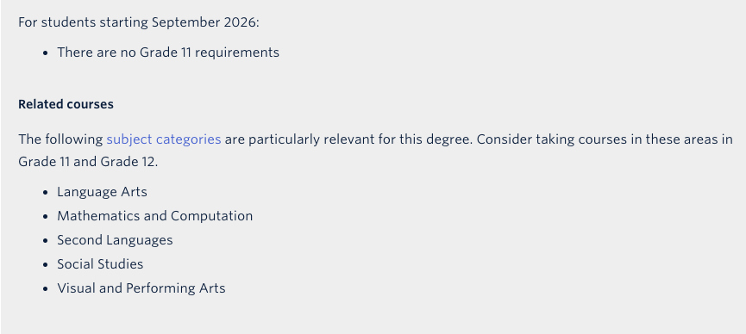
Faculty of Arts
UBC Admission Requirements

Slide 35
SFU Admission Requirements
High school graduation
Minimum 5 approved Grade 12 courses from lists
Quantitative & Analytical Skills
  Minimum 60% in Grade 11 or 12 Math
Competence in English language
  3 years of English instruction in Canada
  minimum 70% in English 12
  Please note Faculty of Arts requires a Math 12 or Science 12

Slide 36
UVIC Admission Requirements
uvic.ca
English 12 + 3 other approved Grade 12 courses
see programs for specific requirements

Slide 37


Langara Admissions
Graduate from high school
Acceptance is based on application date
Applications open on October 1. APPLY!!
Langara offers Career Programs and University Transfer programs
Many students attend Langara for 2 years and then transfer to university
Smaller class sizes and cheaper tuition

Slide 38

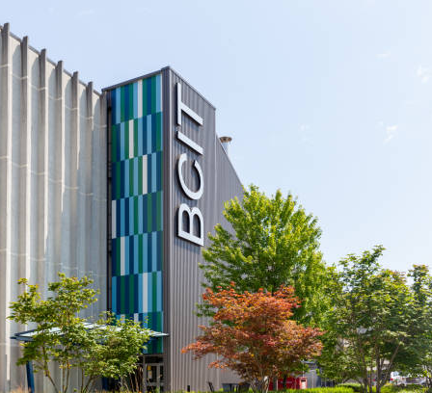
BCIT Programs
Applied & Natural Science
Business & Media
Computing & Info Technology
Engineering
Health Sciences
Trades & Apprenticeships
Admission
Requirements are program specific
Many programs require English 12 and a Math 11
Many students will consider BCIT upon completion of a degree program elsewhere

Slide 39

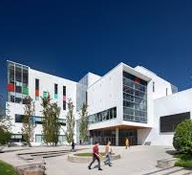
Emily Carr University of Art & Design
Admission Requirements
Portfolio
English 12
2 other Grade 12 academic courses
2 Grade 12 elective courses

Slide 40
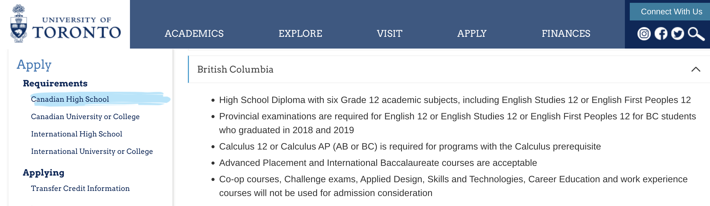
University of Toronto
6 Grade 12 courses with emphasis on courses related to field of study

Slide 41
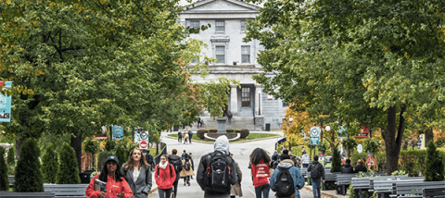
McGill Admissions
Top 5 academic Grade 12 courses based on program pre-requisites

Slide 42

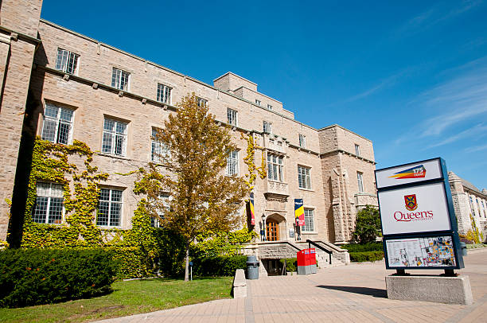
Queen’s University Admission
English 12 + 3 other academic Grade 12 courses based on program prerequisites

Slide 43
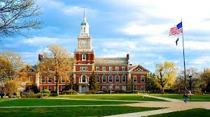
US Universities
Academic achievement in Grade 9 – 12
Rigor of academic study in grade 12
Extracurricular accomplishments
Common Application
SAT I and SAT II (optional?)
Student Personal Essay
Letters of Recommendation
College Board – collegeboard.org
Expensive

Slide 44

Reference Letters
3 weeks' notice
Complete a reference request form
Prove that you need one

Slide 45

Summer School
Information available in April
Registration in May
Inform Counsellor of your Summer School plans

Slide 46
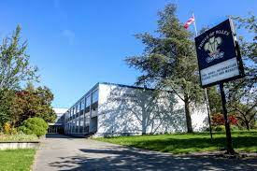
Course Planning Process
1. Review Powerpoint on TEAMS or PW website
2. Read course descriptions in Course Planning Guide on PW website
3. Research post-secondary requirements
4. Complete Course Selection Form with parent signature
5. Enter course choices into MyEd
6. Hand in your signed course form to Ms. Baerg in computer lab
7. Final day to complete is February 26

Slide 47
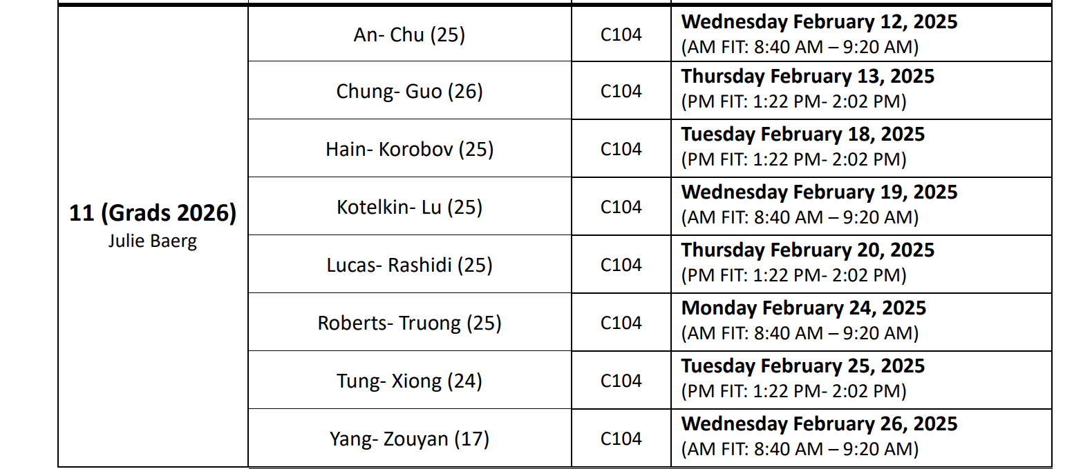
Lab Schedule

Slide 48
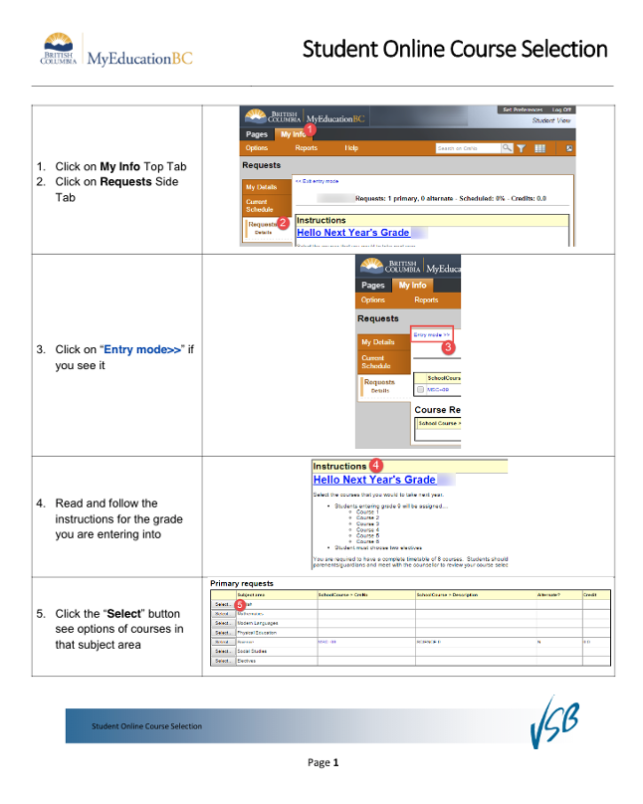
Entering Course Choices into MyEd
Students will enter their course
choices into MyEd at home or during
a computer lab sessions.
Window for course entry is
Feb. 12 to 26
Instructions posted on TEAMS
Hand in Course Selection Form to
Ms. Baerg in computer lab
Deadline February 26

Slide 49
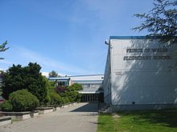
Final Words of Wisdom
Informed Choice
Make INFORMED decisions.
Talk to your teachers, counsellor, parents and friends.
Research
Research course options in the Course Planning Guide.
Research program requirements for university.
Submit
Submit your Grade 12 Course Selection Form in computer lab Submit final MyEd choices or changes by February 26.

Slide 50
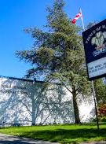
Questions regarding course planning for Grade 12:
Please come talk to me
Make an appointment
Send an email jbaerg@vsb.bc.ca

