Slide 1


Grade 8/9 Course Planning Information
Prince of Wales SEcondary

Slide 3
Course Selection
The course selection sheet is like a contract
Schools are staffed and time-tabled according to the information on these forms
Only those courses with a sufficient number of students registered will be available

Slide 4
Course Selection
Students are required to take 8 courses in Grade 9 and 10 (you may take additional courses off timetable)
Please consider your choices carefully now as there is little flexibility in September

Slide 5
Required Grade 9 Courses
1. English 9
2. Social Studies 9
3. Science 9
4. Math 9
5. PE 9
Plus 3 Elective courses

Slide 6
Required Grade 10 Courses
1. English 10
2. Social Studies 10
3. Science 10
4. Math 10
5. PE 10
6. Career and Life Education 10
Plus 2 Elective courses

Slide 7
Grade 10: The 3 Year Plan
Begin to earn credits for graduation
All marks show on graduation transcript
Begin to plan for life after graduation

Slide 8
Graduation Checklist
To graduate, students are required to have 80 credits in total, 4 of which must be in the Fine Arts/Applied Skills department, and 4 of which must be an Indigenous course.
At least 16 credits out of the 80 must be at the Grade 12 level, including the required Grade 12 English (Language Arts) course and Career Life Connections.

Slide 9
Graduation Requirements
Grade 10 Grade 11 Grade 12
Language Arts 10 Language Arts 11 Language Arts 12
Math 10 Math 11 Elective 12
PE 10 Science 11/12 Elective 12
Science 10 Socials 11 or 12 Elective
Socials 10 Elective Elective
Career Life Ed 10 Elective Elective
Elective Elective Elective
Elective Elective *CLC/Capstone (off
Elective (if CLC is taken off-timetable)

Slide 10
Graduation Assessments
Literacy 10
Numeracy 10
Literacy 12

Slide 11
Math Choices After Grade 8/9
*

Slide 12
Electives
Current grade 8s choose 3 electives from Course Code Sheet on the back of the course selection sheet
Current grade 9s choose 2 electives from Course Code Sheet on the back of the course selection sheet
Some electives have pre-requisite course requirements
Second language courses are electives

Slide 13
Electives
Applied Design, Skills and Technologies
Business Education
Fine Arts
Home Economics
Music
Performing Arts
PE/Leadership
Languages
Course Planning Guide 2026-2027

Slide 14
Off-Timetable Electives
Jazz Band 9-12
String Ensemble 9-12
Theatre Company 9-12
Stagecraft/Theatre Production 9-12
Foods 9-12

Slide 15
Language Electives
French 9, 10, 11, 12
Spanish 9
A 2nd language is not required for graduation or university
ELL Students may be eligible for a Language 10, 11 or 12 credit

Slide 16
How to Choose the Right Electives
Consult your teachers, counsellors, parents and friends
Read the course descriptions in the Course Planning Guide on the website
Complete your Grade 9 Course Planning Sheet
Utilize the Graduation Check List

Slide 17
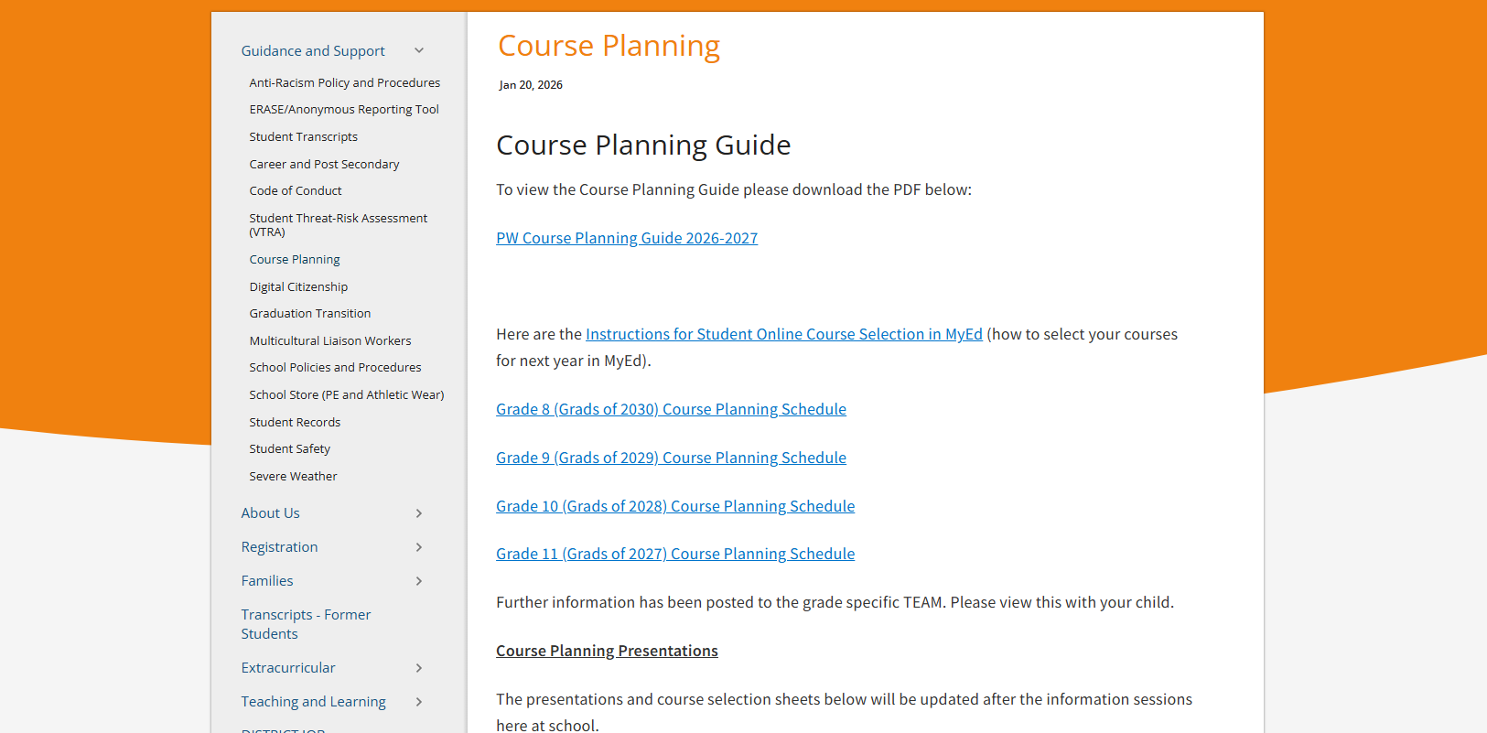
Course Planning Guide
Course Planning Guide 2026-2027

Slide 18
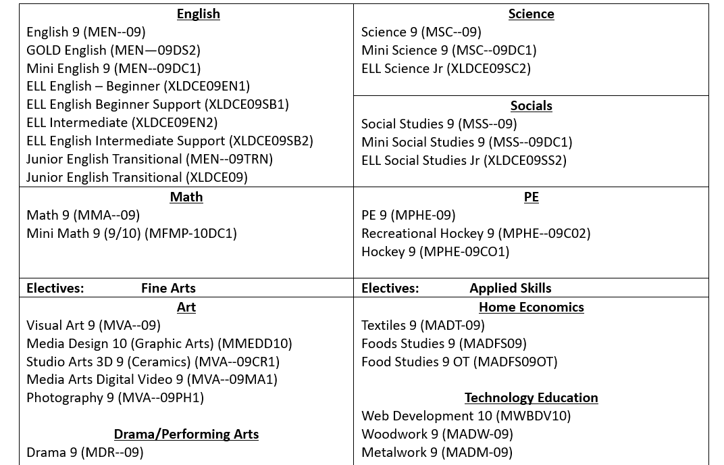
Course Code Sheet
Complete list IS ON THE BACKSIDE OF THE COURSE SELECTION SHEET – ALSO UPLOADED TO TEAMS

Slide 19
ELL Students
Sign up for the same ELL courses as this year
ELL teachers advise counsellors on your required ELL classes
Assessments in May and September will determine placement

Slide 20

VSB Career Programs
Apprenticeship Program - Youth work in Trades Program
Combine high school instruction with paid, part-time, on-the-job training and receive credit towards apprenticeship and high school graduation.
Start your apprenticeship training in Grade 10, 11 or 12 and earn up to 16 high school credits.
https://www.vsb.bc.ca/career-programs/page/11419/program-offerings

Slide 21
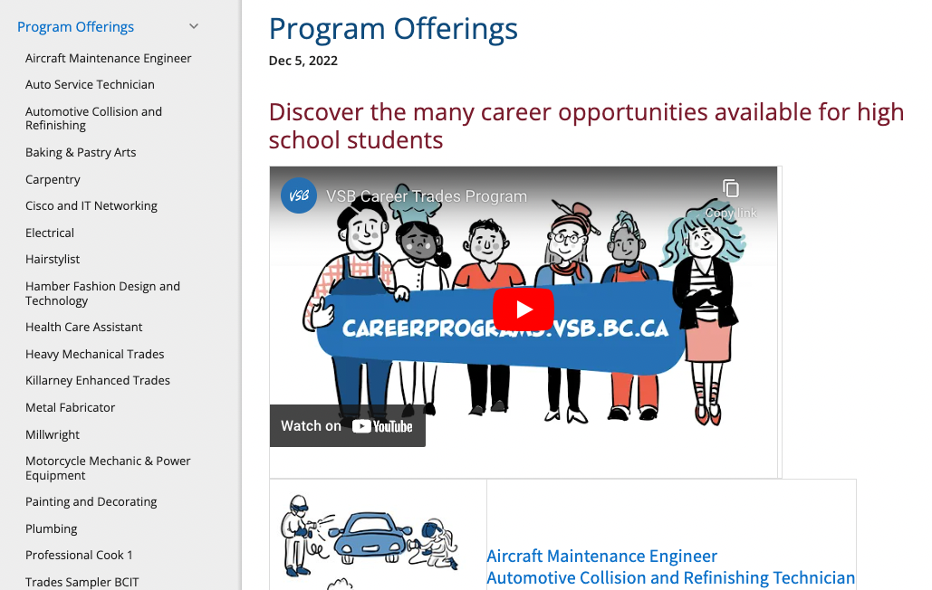
VSB Career Programs
For more information go to the VSB website and search career programs

Slide 22

External Credits
Language Challenge Exams
Music
Dance
Youth Leadership
Sports
Coaching
First Aid
ICBC Driver Training
Cadets

Slide 23

Summer School
Grade 8 & 9 preview & review courses are available
4 weeks in July
2.5 hrs/day
Registration opens at the beginning of May.

Slide 24
Online Courses
Self-paced
You are responsible for your own learning
You must be motivated to complete the course
You cannot take a course online and at PW at the same time
An online course does not replace taking a course at PW
Online might offer courses not offered at PW

Slide 25
Post-Secondary Information
Most universities consider Grade 11 and Grade 12 marks
Many universities require a personal profile
Many universities will admit on Grade 11 marks

Slide 26
Course Planning Sheet (Due at end of lab session)
Completed form must be signed by parent or guardian
Please include student cell phone number and email address
Course selection forms will be uploaded to the PW website

Slide 27
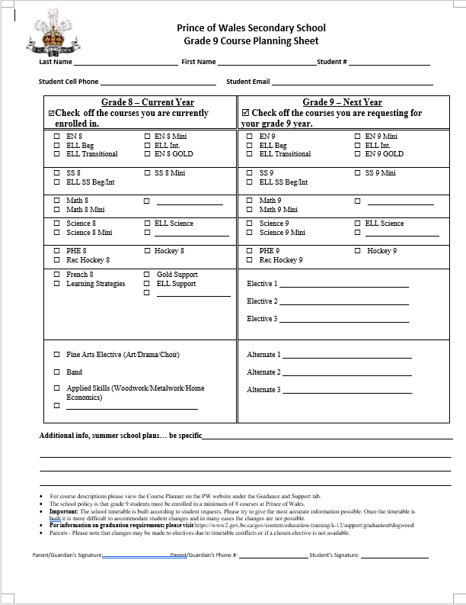
Course Planning Sheet

Slide 28
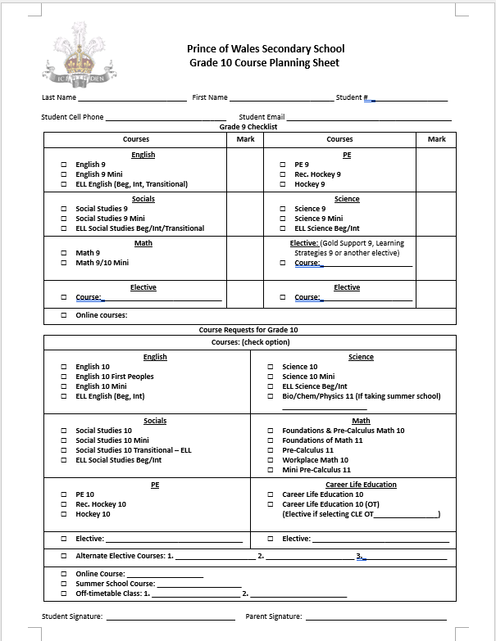
Course Planning Sheet

Slide 29
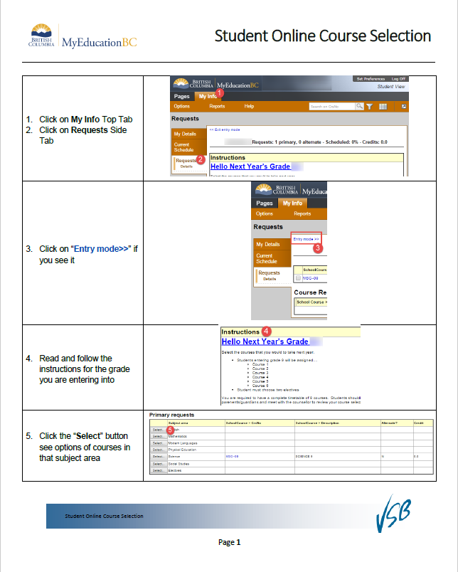
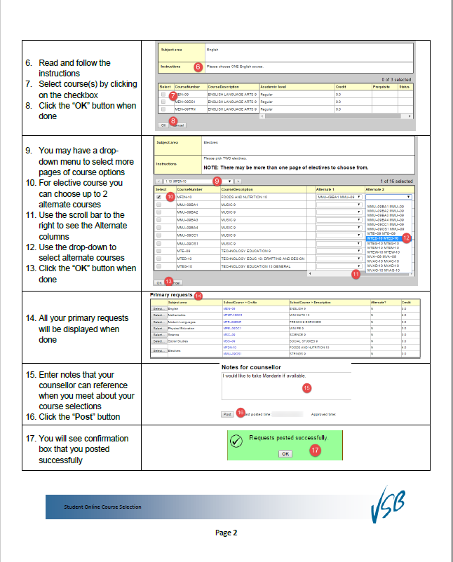
Course Selection
You will enter your course choices in the computer lab.
MyEd will be open for you to enter your course selection before your lab session

Slide 30

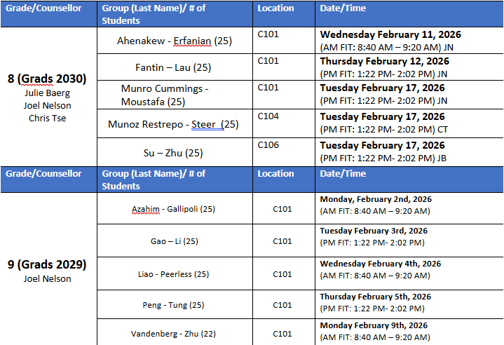
Next Steps
Course Request Input Feb. 2-17
LAB SESSIONS ARE MANDATORY

Slide 31
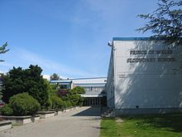
Questions? Concerns?
Feel free to see your counsellor in the counselling suite to ask any questions or discuss your course selections.

