Slide 1




Prince of Wales Secondary
Course Planning for Grade 11

Slide 3

Course Planning Timeline
January – February
Course Planning Presentations
Course Selections complete
March – May
Timetable Built
June
Resolve conflicts
Changes if possible
August
Resolve course conflicts
Changes if possible
September
Changes if possible

Slide 4
Course Selection
Schools are staffed and time-tabled according to student course requests in January and February.
Only those courses with a sufficient number of students registered will be available.
Please choose carefully as there is very little flexibility in September!

Slide 5

Course Selection
Grade 11 students are expected to take 8 courses at PW
Grade 12 students take minimum 7 courses at PW + CLC

Slide 6

Graduation Requirements
At least 4 credits must have an Indigenous-focus.
PW offers:
English First Peoples 10
English First Peoples 12
Contemporary Indigenous Studies 12 (SS)

Slide 7

Graduation Requirements
REQUIRED COURSES in Grade 11
English 11
A Social Studies 11 or 12
A Science 11 or 12
A Math 11
4 Elective courses
Total 8 courses at PW for Grade 11
1 course must have Indigenous focus in Grade 10 - 12

Slide 8

Graduation Requirements
REQUIRED COURSES in Grade 12
English 12 or English First Peoples 12
2 Grade 12 courses (minimum)
4 Electives
Career Life Connections + Capstone (off timetable)
Total 7 courses in Grade 12 at PW + CLC (minimum)
1 course must have Indigenous focus in Grade 10 - 12

Slide 9

Grade 11 English Choices
English 11:
    Literary Studies
    Spoken Language
English 11 Mini
ELL Beginner or ELL Intermediate or ELL Transitional (Double Block)

Slide 10

Grade 11/12 Social Studies Choices
    Human Geography 12
    Economic Theory 12
    Law Studies 12
    20th Century World History 12
    Contemporary Indigenous Studies 12
    African Descent History in BC 12 (District course taught OT)
    Queer and Trans History 12
    (District course taught OT)
    Social Studies 11 Mini (SJ)
    Transitional Social Studies 10

Slide 11

Science Choices
Grade 11 Sciences
(one required for graduation)
Life Science 11
Earth Science 11
Chemistry 11*
Physics 11*
*required for admission to
University sciences
Grade 12 Sciences
Anatomy & Physiology 12
Chemistry 12
Physics 12
One or two required for admission to Faculty of Science depending on the University
Students may take more than 1 Science in Grade 11 or 12

Slide 12

Math Choices
Grade 11 (one required for graduation)
Pre-Calculus 11
Pre-Calculus 12 Mini
Foundations of Math 11
Workplace Math 11
Grade 12
Pre-Calculus 12
Calculus 12
AP Calculus 12
No math

Slide 13

Learning Strategies or GOLD class
Learning Strategies 11 or GOLD 11 – for students who have taken these classes in previous years
Learning Strategies & GOLD students earn 4 credits
Students are recommended for Learning Strategies by their teacher

Slide 14

Electives
Grade 11 - 4 electives
Grade 12 – 6 electives
You can choose Grade 10, 11 or 12 electives
In Grade 11, a 2nd science, a socials or a language will take an elective space

Slide 15

2nd Language Requirements
A second language is NOT required for graduation or university admission.
Students who are fluent in a second language may write a Language Challenge exam or complete a language course online for credit.
ELL students may be eligible for a Language 10, 11, 12 credit.
2nd Language Course options:
  French 11/12
  Spanish 11/12
  Beginner Spanish 11
Notes:
Studied Grade 7, 8 or 9 in another language = grade 10, 11 or 12 external language credit

Slide 16



University 2nd Language
Universities in BC no longer require a 2nd language for admission
Universities in Canada do not require a 2nd language for admission
Notes:
LD with a ministry of Ed designatin you are exempt from the language requirement. ELL students and students that came from a different province/country may also be exempt

Slide 17



Electives
Business Education
Technical Education
Home Economics
Fine Arts
Music
Performing Arts
P.E.
Languages
Choose your electives carefully!
Notes:
Choose based on your likes not your friends!

Slide 18



Electives:
Off Timetable
Consider taking an off-timetable elective
Foods 10
Specialized Studies in Foods 12
Fitness & Conditioning 11/12
Jazz Band 8 - 12
Strings Orchestra 8 - 12
CLE 10
Theatre Production (Stagecraft)
Theatre Company 9 - 12

Slide 19

ELL Students
Sign up for the same level you are currently in.
ELL teachers advise counsellors on your required ELL classes in April/May.
Assessments in Spring will determine placement for next year.

Slide 20
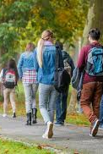
Post-Secondary
Different Universities have different entrance requirements
Check each University and program to ensure that you have the necessary courses
Some Universities require:
4 Gr. 12 academic courses (UVIC)
5 Gr. 12 academic courses (SFU)
6 Gr. 12 courses (UT/UBC)

Slide 21

Post-Secondary
Course Tips
Ontario Universities require Calculus 12 for most science, math and engineering programs.
In BC, Calculus 12 is recommended for some programs but not required.
Many Business programs recommend Calculus 12
Science and Engineering programs typically require Chemistry 11 and Physics 11 and 1-2 science 12 courses.

Slide 22
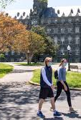
Post-Secondary
All Canadian Universities look for completion of Grade 10 and 11 courses.
Many Canadian Universities are now using Grade 11 marks as part of the admissions process.
Canadian Universities calculate admission averages based on 4 - 6 Grade 12 courses and will use the Grade 11 equivalent when a Grade 12 mark isn’t available.
Additional requirements - personal profile, interview, portfolio, etc.

Slide 23

Common Misconceptions
I need to take all my Grade 12 courses in Grade 11
I need to take additional coursework outside of PW to be competitive for university applications (AP courses)
TIP: doing well at PW is the most important factor

Slide 24
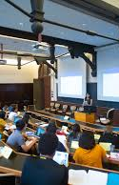
Post-Secondary
Most universities require a personal profile
Some universities will admit on Grade 11 marks
Most college’s require high school graduation for admissions.
Some college programs do have specific course requirements.

Slide 25


Parents and students are responsible for checking with colleges and universities for their specific entrance requirements.
Post-Secondary Requirements

Slide 26



Post-Secondary Research
To research post-secondary pathways and entrance requirements check out these websites.
myblueprint.ca
educationplannerbc.ca
chatterhigh.com
Post-Secondary Websites

Slide 27
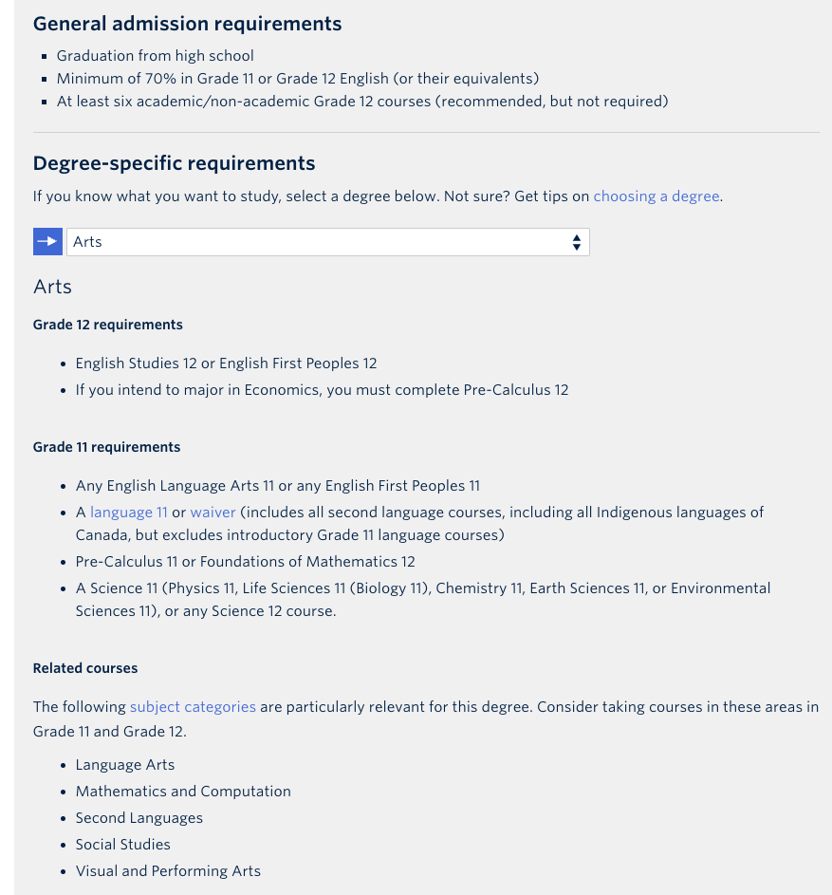


Slide 28
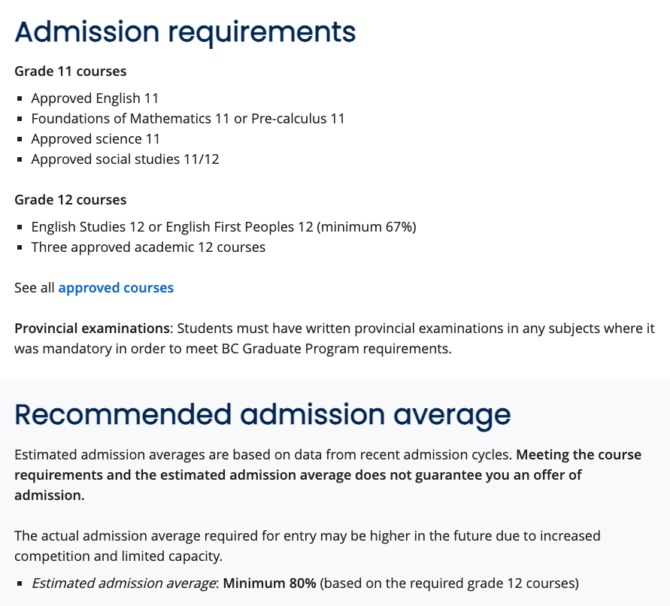


Slide 29
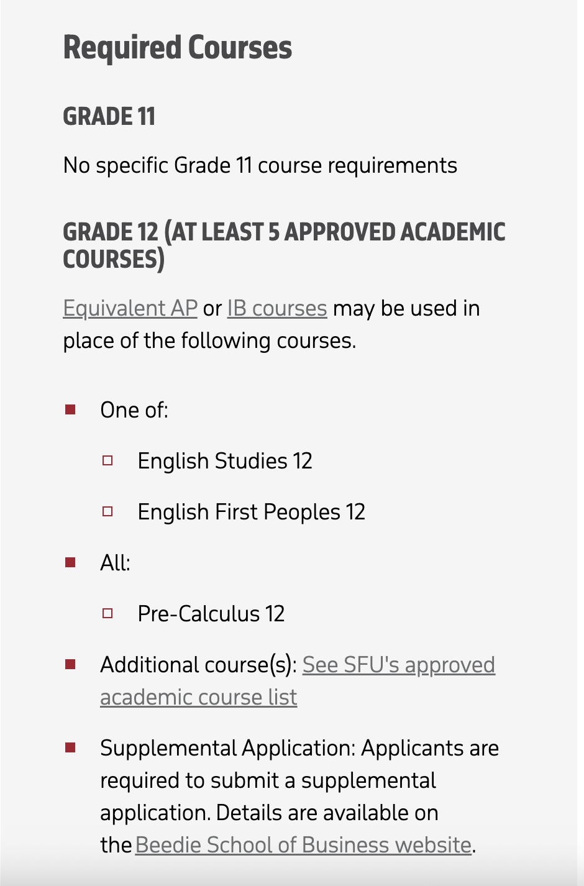
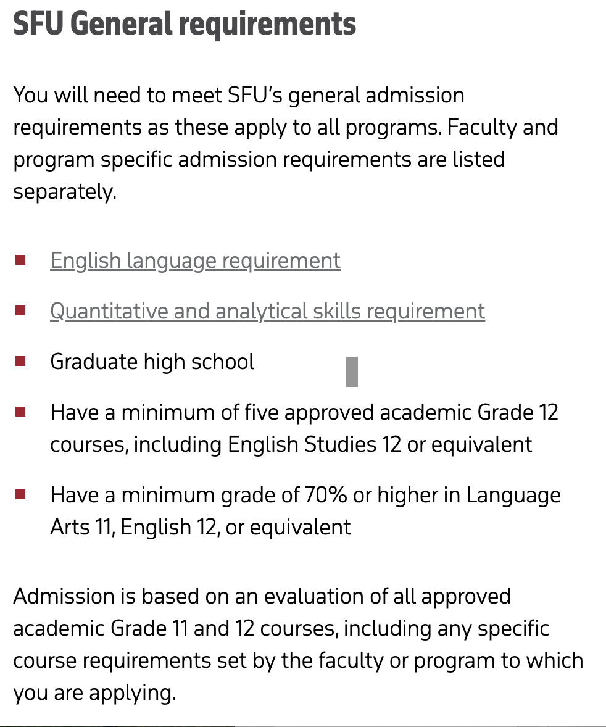

Beedie School
of Business

Slide 30

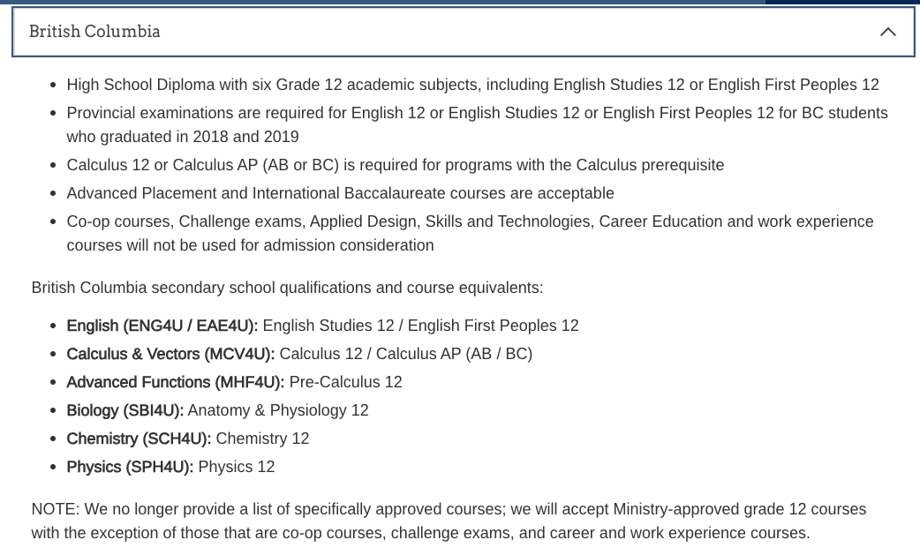

Slide 31

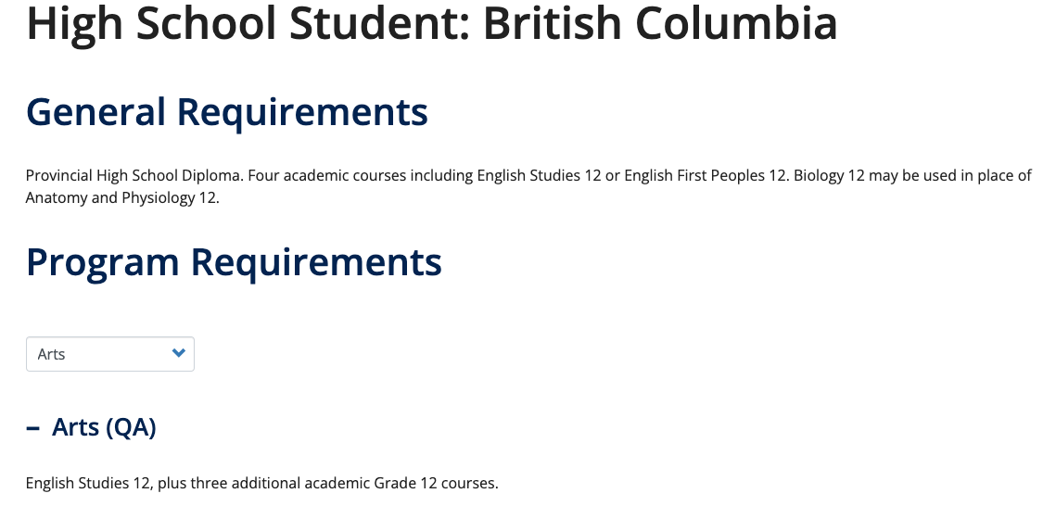

Slide 32
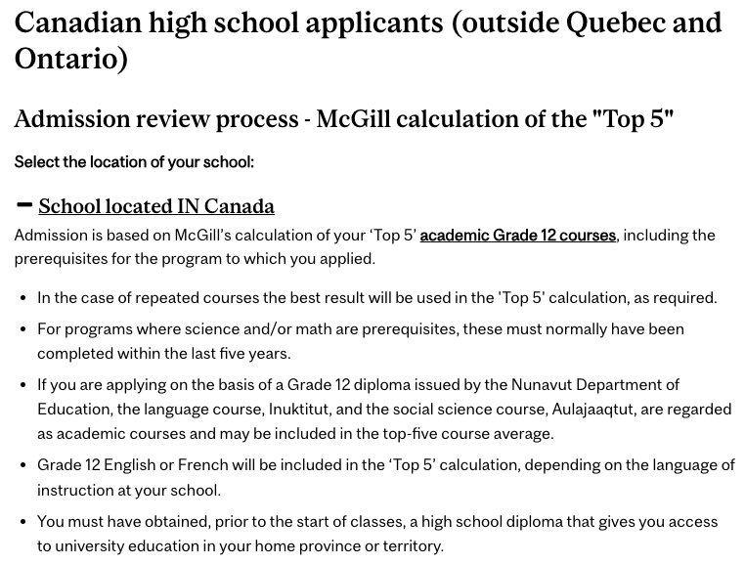


Slide 33


Youth WORK in Trades Program
Youth TRAIN in Trades Program
vsb.bc.ca/site/Career-Programs
VSB Career Education

Slide 34

Youth WORK in Trades Program
Start your apprenticeship training while in Grade 10, 11 or 12.
Earn up to 16 high school credits
Receive a Youth Work in Trades certificate upon ​graduation.

Slide 35

Youth TRAIN in Trades Program
Dual credit with a post secondary institution
Head start with foundation program training
Registration with the Industry Training Authority
May lead directly into an apprenticeship
Work experience in a trade

Slide 36
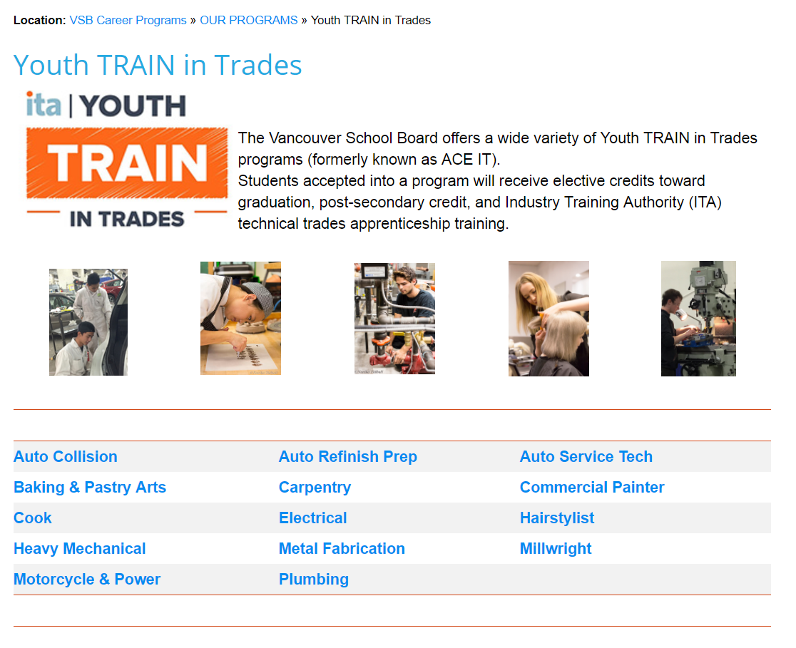
VSB Career Programs

Slide 37

Registration typically starts in late April or early May.
Inform counsellor of your plans to take a Summer School course
Completion courses:
5-6 weeks (3 hours/day)
July – August
Review/Preview courses:
4 weeks (1.5 hours/day)
July

Slide 38

Course Planning Schedule
Attend course planning presentation
Research course options for Grade 11 while thinking about post-secondary plans.
Complete course planning form, due in computer lab Feb. 3-11 .
Enter Grade 11 courses into MyEd Feb 3–11 in computer lab
Complete Grade 10 courses to the best of your ability.

Slide 39
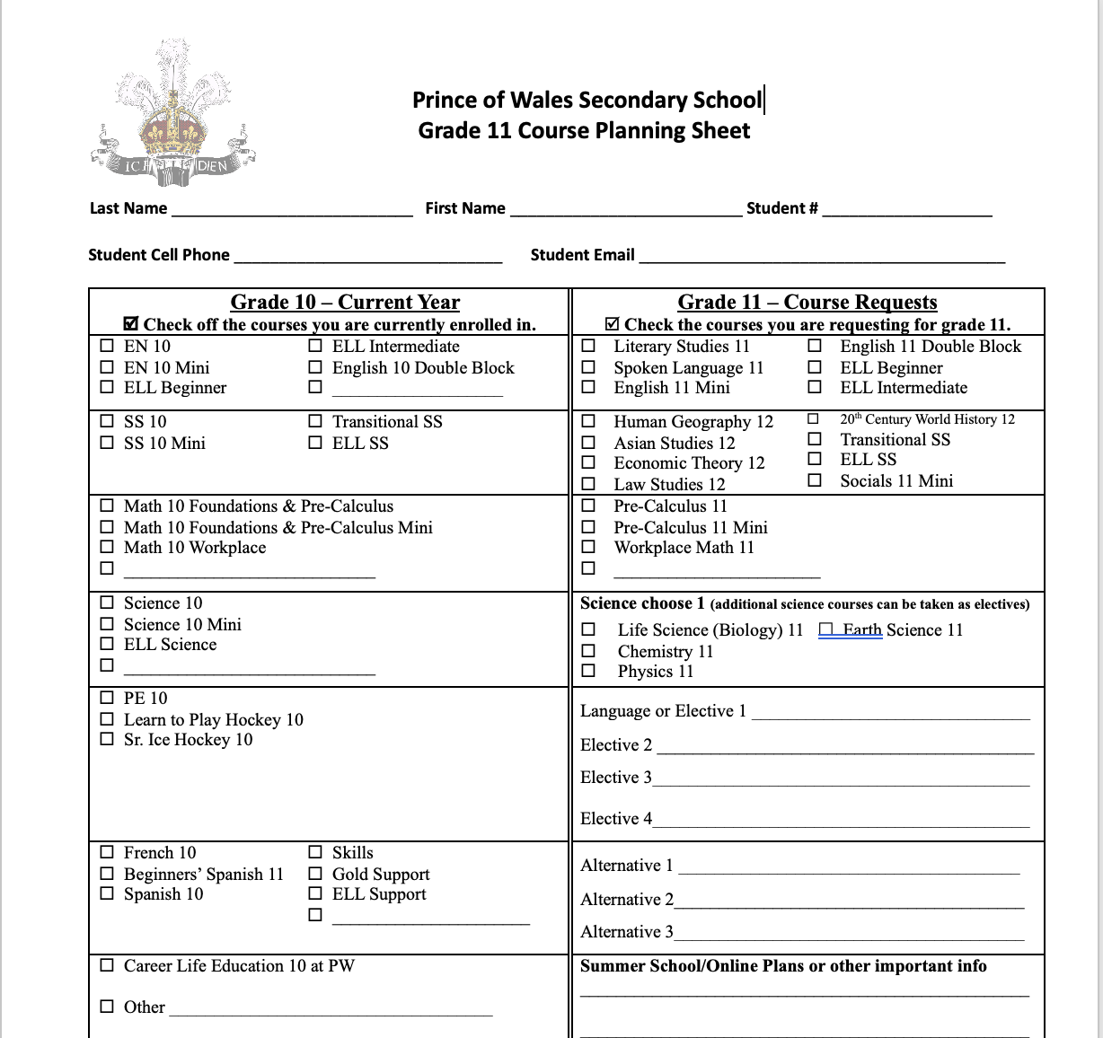
Course Selection
Course planning form will be posted to on the Grade 10 TEAMs channel
Course Planning Form to be filled out and reviewed by you and your parents
Please include student cell phone number and email address

Slide 40
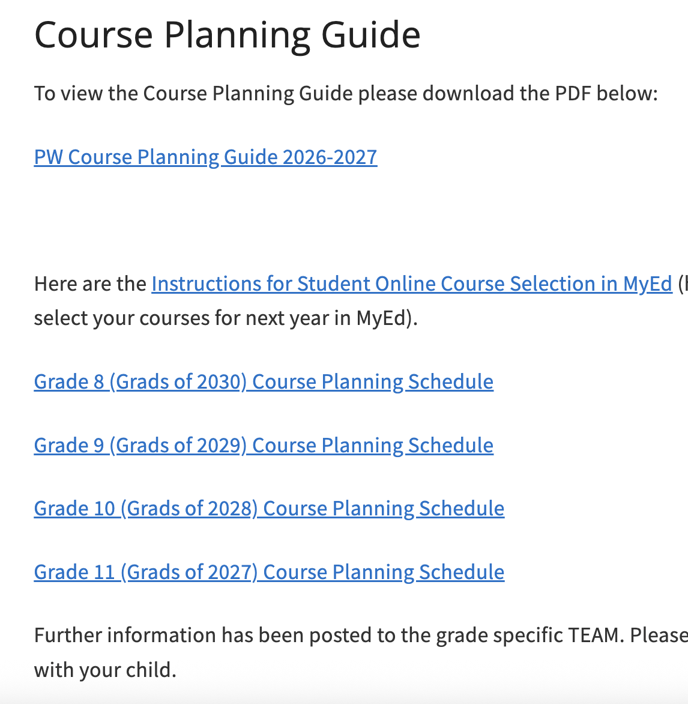
Course Selection
Course descriptions in the PW Course Planning Guide on PW website
Click Guidance and Support tab
Click PW Course Planning Guide 2026-2027
Powerpoint Grade presentations posted here

Slide 41
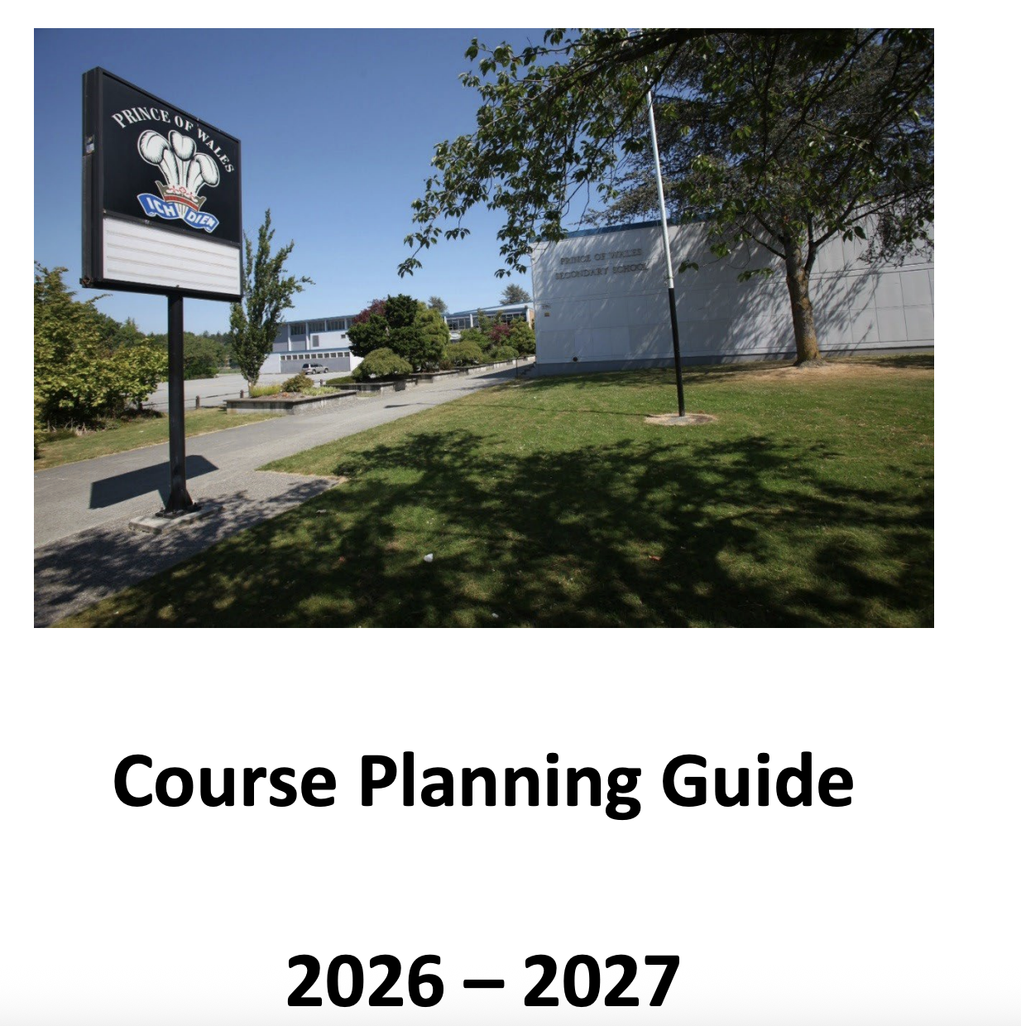
Course Selection
Course descriptions for each course offered at PW listed in Course Planning Guide
Please read course descriptions before making course selections
Don’t just ask your friends what they are taking, do your own research

Slide 42
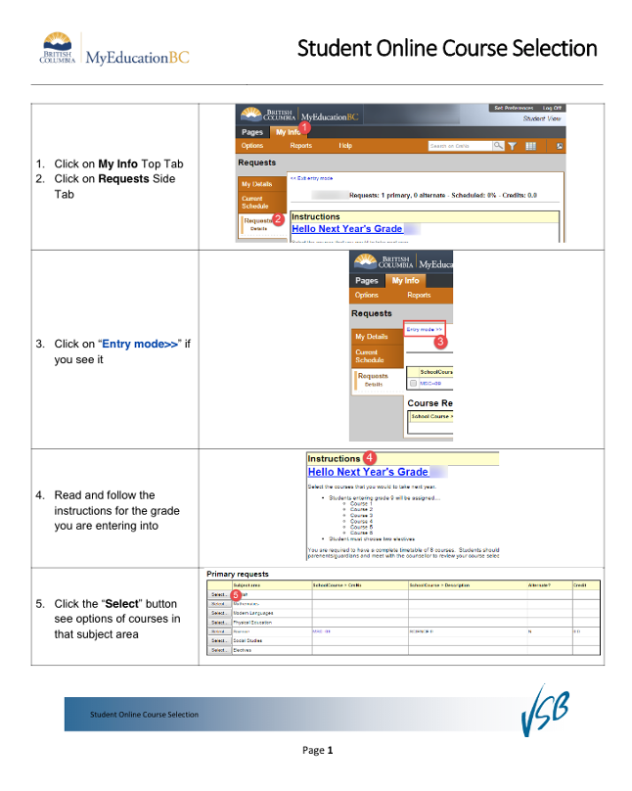
Entering Course Choices into MyEd
Course Planning – Second Session
please come prepared to enter your choices into MyEd.
You can enter them prior to your scheduled session below or you can enter them during your schedule session.
Either way Ms. Baerg will review them with you and answer questions you may have.

Slide 43
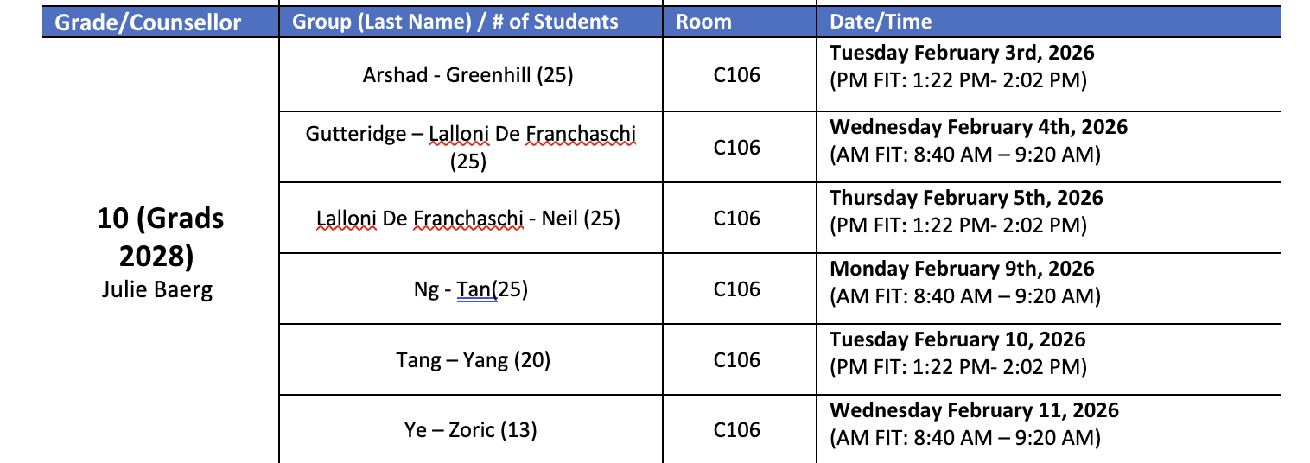
Grade 10 Course Planning
Computer Lab Schedule C106

Slide 44

Course Selection
Make INFORMED decisions. Talk to your Teachers, Counsellor, parents and friends.
Read the course descriptions in the Course Planning Guide on the website
See Ms. Baerg if you have questions.

Slide 45

Parent Information Night
Tuesday,
January 27
6:30 – 7:30
Auditorium

Slide 46

Questions?
Come see Ms. Baerg
jbaerg@vsb.bc.ca

