Slide 1

Prince of Wales
Secondary School
Grade 8 TO 9
Course Planning
Information
2024

Slide 2

Your School Career
Only 4 more years to go – Grade 9, 10, 11 & 12
And then:
  University
  College
  Trades training
  Take a gap year
  Travel
  Work

Slide 3

Grade 9 Required Courses
English 9
Social Studies 9
Science 9
Math 9
PE 9 or Hockey 9 or Recreational Hockey 9
Language or Elective
Elective
Elective

Slide 4
The Graduation Program Grade 10 - 12
Begin earning credits in Grade 10
Each course is worth 4 credits
Students need 80 credits to graduate
So, if you fail a Grade 10, 11 or 12 required course, it is important that you take it again during summer school, online or the next year.

Slide 5
Required Courses for Graduation
English 10, 11, 12
Math 10, 11
Science 10 and 11 or 12
Socials 10 and 11 or 12
PE 10
CLE 10
CLC 12 and Capstone
28 Elective credits
Each course is worth 4 credits
80 credits = Graduation

Slide 6
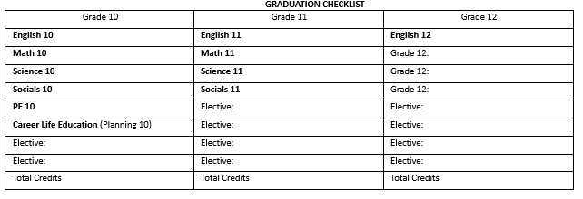
Planning for Graduation

Slide 7
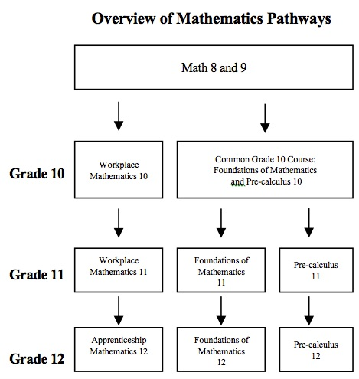
Math Choices After Grade 9

Slide 8

Grade 9 Language Options
French 9
Spanish 9
ELL Students may be eligible for a Language 10, 11 or 12 credit
You do not need a second language in order to graduate from high school, but...

Slide 9



University 2nd Language
General Entrance Requirement
UBC requires a Language 11
SFU requires a Beginner Language 11 or Language 11
UVIC does not require a 2nd Language

Slide 10



Fine Arts at PW
ART
  Visual Art 9
  Studio Arts 3D 9 (Ceramics)
  Media Design (Graphic Arts) 10
  Media Arts Digital Video 9
  Photography 9

Slide 11
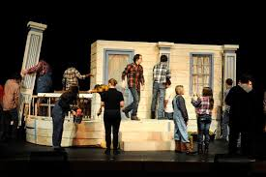
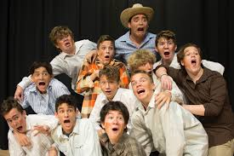
Fine Arts at PW
Performing Arts
  Drama 9
  Theatre Company OT
  Stagecraft OT

Slide 12
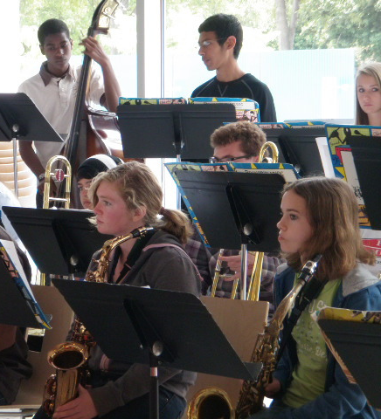

Fine Arts at PW
Music
  Beginning Band 9
  Intermediate Band 9
  Senior Band 9
  Choir 9
  Jazz Band (OT)
  Strings Orchestra (OT)

Slide 13
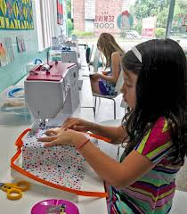


Applied Skills at PW
Home Economics
  Textiles 9
  Food Studies 9
  Food Studies 9/10 (OT Wed pm)

Slide 14

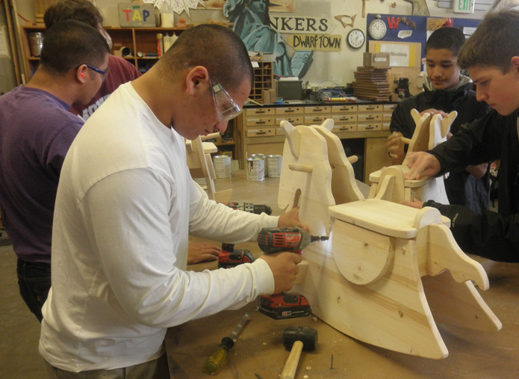

Applied Skills at PW
Technology Education
  Web Development 10
  Woodwork 9
  Metalwork 9
  Drafting 9

Slide 15


Applied Skills at PW
Business Education
  Entrepreneurship & Marketing 10

Slide 16



Other Elective Options
Leadership 10 (PE Department)
Learning Strategies (Skills) 9 – by permission only
GOLD Support 9 – for those in the GOLD program

Slide 17
Off-Timetable Electives
Other Elective Options
Consider taking an off-timetable class – this does not take the place of an on-timetable class
Jazz Band 8-12 (must also be registered in on-timetable band)
Theatre Company 9-12
Stagecraft 9-12
Strings Orchestra 8-12 (must also be registered in on-timetable band)
Foods 10 (Can only register if you have not completed Foods 9)

Slide 18
Course Selection
The course selection sheet is like a contract
Schools are staffed and timetabled according to the information on these forms
Only those courses with a sufficient number of students registered will be available

Slide 19
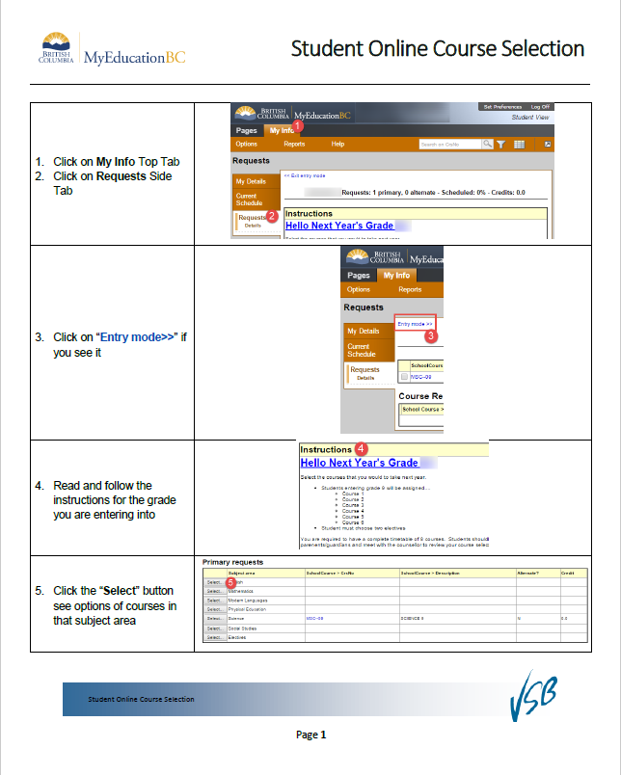
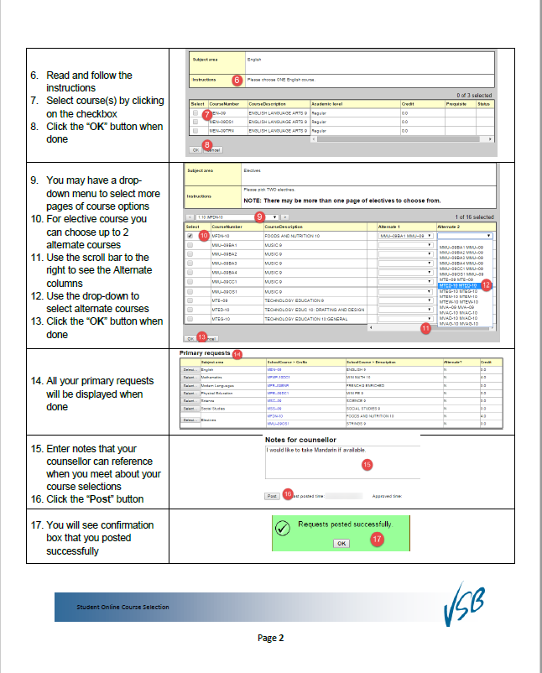
Course Selection
You will enter your course choices in the computer lab.

Slide 20
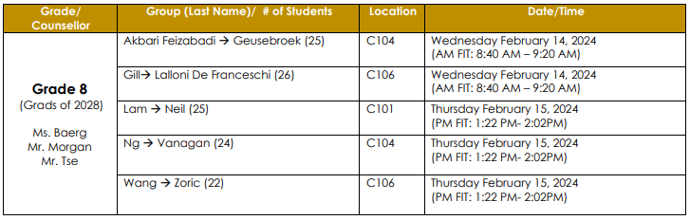
Computer Lab Schedule
You will enter your course choices on either
Feb. 14 or 15 during morning FIT

Slide 21
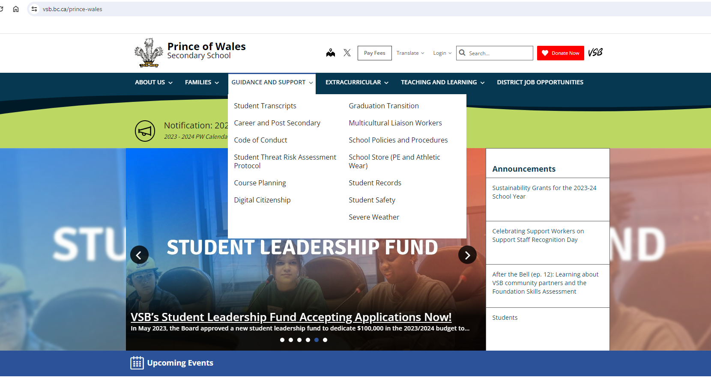
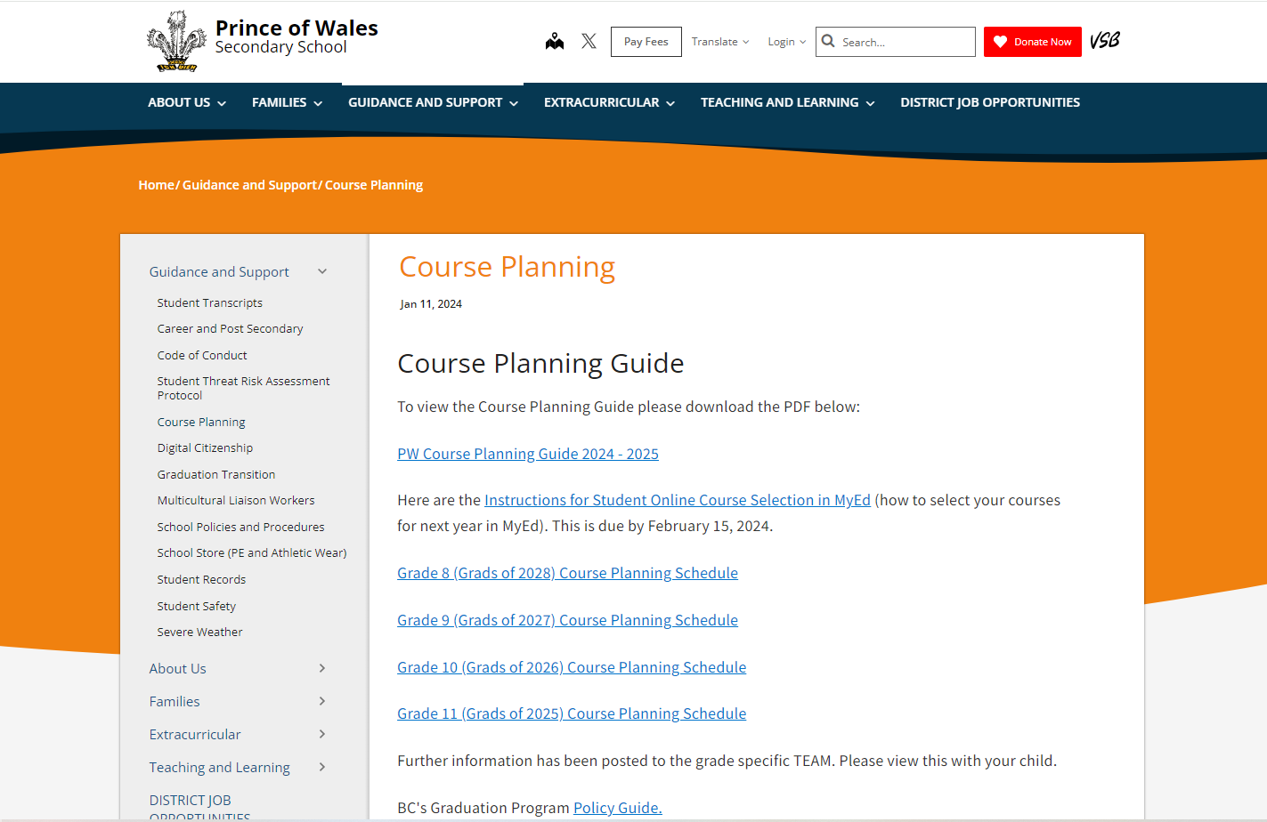
Course Planning Guide
https://www.vsb.bc.ca/prince-wales/page/11995/course-planning

Slide 22
Grade 9 Course Planning Sheet
If you lose your copy of the course planning sheet, it will be posted in the Grade 9 Teams channel.

Slide 23
Grade 9 Course Planning Sheet
The Course Planning Sheet is like a contract
Please consider your choices wisely as there is little flexibility for change in September
Please discuss your course options with your parents
Your parents must sign off on your course selections

Slide 24

ELL Students
Sign up for the same ELL level courses as this year
ELL teachers advise Counsellors on your ELL level in the Spring and Fall
Recommendations and assessments from teachers in May and September determine ELL level for next year

Slide 25
Tips for Course Selection
If you choose to take a Grade 10 level class, please know that your mark will show on your high school transcript forever.
Consult your Teachers, Counsellor, parents and friends
Read the course descriptions in the Course Planning Guide on the website
Follow your interests, not your friends.
Mini students, please select designated Mini courses

Slide 26
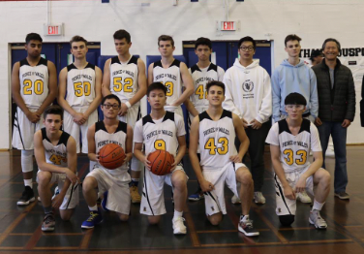
Tips for Grade 9
Take responsibility for your actions.
Keep organized: use agenda!
Attend and stay on track.
Be committed and set goals.
Engage in all your classes.
Be an active participant in school life by getting involved.

Slide 27
Next Steps
Research your elective options
Make your course choices
Talk with your parents
Talk with your counsellor to ask any questions

Slide 28
Final Steps
Go to computer lab Feb. 14 or 15 to input choices and hand in course selection sheet
Finish off your Grade 8 year strong

Slide 29
Questions
Please come see your Counsellor if you have any questions.

