Slide 1
Grade 10 Course Planning Information
Prince of Wales SEcondary

Slide 2
Grade 10: The 3 Year Plan
Begin to earn credits for graduation
All marks show on graduation transcript
Begin to plan for life after graduation

Slide 3
Course Selection
The course selection sheet is like a contract
Schools are staffed and time-tabled according to the information on these forms
Only those courses with a sufficient number of students registered will be available

Slide 4
Course Selection
Students are required to take 8 courses on timetable in Grade 10 (you may take additional courses off timetable)
Please consider your choices carefully now as there is little flexibility in September

Slide 5
Graduation Checklist
REQUIRED COURSES IN GRADE 10:
1. English 10
2. Social Studies 10
3. Science 10
4. Math 10
5. PE 10
6. Career Life Education 10 (Off-timetable available)
Plus 2 Elective courses

Slide 6
Graduation Checklist
Grade 10 Grade 11 Grade 12
Language Arts 10 Language Arts 11 Language Arts 12
Math 10 Math 11 Elective 12
PE 10 Science 11 Elective 12
Science 10 Socials 11 or 12 Elective
Socials 10 Elective Elective
Career Life Ed 10 Elective Elective
Elective Elective Elective
Elective Elective *CLC/Capstone (off timetable)

Slide 7
Graduation Checklist
To graduate, students are required to have 80 credits in total​
At least 16 credits must be at the Grade 12 level, including a required Grade 12 Language Arts course and the Career Life Connections course ​
You must complete at least 1 Fine Arts/Applied skills course between grade 10 and 12​
One Indigenous-focused class

Slide 8
Graduation Exams
Literacy 10
Numeracy 10
Literacy 12

Slide 9
Grade 10 Course Planning Sheet
Completed form must be signed by student and a parent
Please include student cell phone number and email address

Slide 10
Grade 10 Course Planning Sheet

Slide 11
Grade 10 Course Planning Sheet

Slide 12
Math Choices After Grade 9

Slide 13
Grade 10 Electives
You must choose 2 electives
Choose electives from Grade 10, or 11 but, only Grade 10 or 11 electives have course credit
Some electives have pre-requisite course requirements

Slide 14
Electives
Applied Design, Skills and Technologies
Business Education
Fine Arts
Home Economics
Music
Performing Arts
PE/Leadership
Languages

Slide 15
Off-Timetable Electives
Consider taking an off-timetable class – this does not take the place of an on-timetable class
Fitness and Conditioning 11 (this course is NOT a replacement for PE)
Jazz Band 8-12 (must also be registered in on-timetable band)
Theatre Company 9-12
Career Life Education10
Stagecraft 9-12
Specialized Studies in Foods 12 (must have completed either Foods 9 or 10)
Strings Orchestra 8-12 (must also be registered in on-timetable band)
Foods 10 (Can only register if you have not completed Foods 9)

Slide 16
Language Electives
French 10
Spanish 10/Intro Spanish 11
A 2nd language is not required for graduation
ELL Students may be eligible for a Language 10, 11 or 12 credit

Slide 17
University 2nd Language Requirements
UBC requires a Language 11
SFU requires a Beginner Language 11
UVIC does not require a 2nd Language

Slide 18
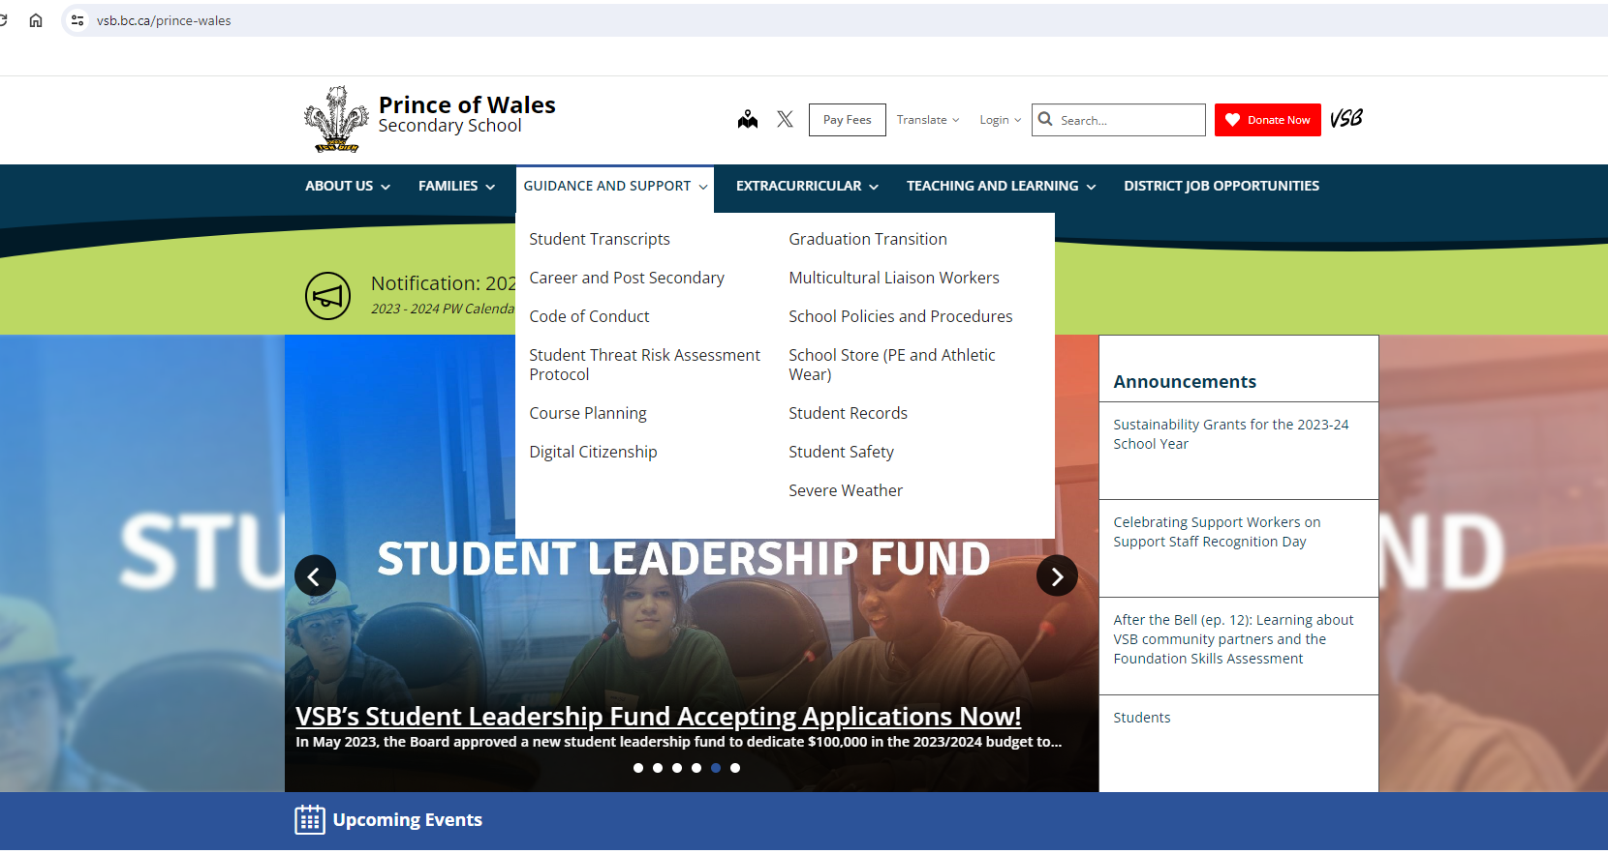
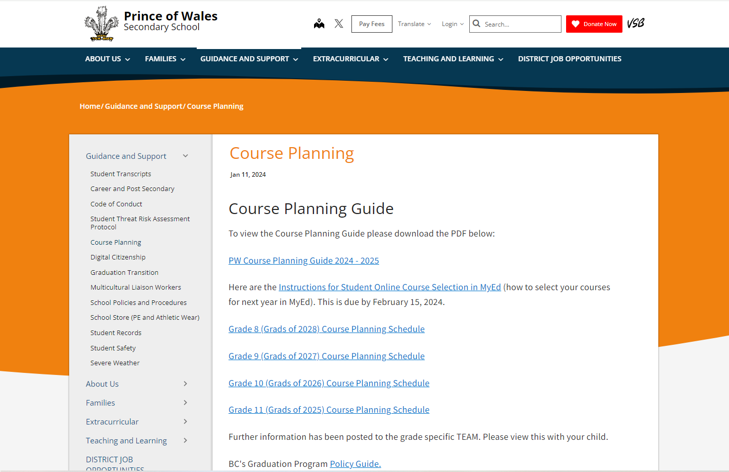
Course Planning Guide
https://www.vsb.bc.ca/prince-wales/page/11995/course-planning

Slide 19
How to Choose the Right Electives
Consult
Consult your Teachers, Counsellor, parents and friends
Read
Read the course descriptions in the Course Planning Guide on the website
Complete
Complete your Grade 10 Course Planning Sheet
Utilize
Utilize the Graduation Check List

Slide 20
ELL Students
Sign up for courses
ELL teachers advise Counsellors on your required ELL classes
Assessments in May and September will determine placement

Slide 21
VSB Career Programs
Apprenticeship Programs/WORK in Trades
Start your apprenticeship training in Grade 10, 11 or 12 and earn up to 16 high school credits.

Slide 22
External Credits
Language Challenge Exams
Music
Dance
Youth Leadership
Sports
Coaching
First Aid
ICBC Driver Training
Cadets

Slide 23
Summer School
Classes typically fill up within the first 24-48 hours of registration opening
Courses are 5 days a week for 3 hours with lots of homework
Miss 3 classes and you are withdrawn from the course
You cannot sign up for the same course at summer school and PW
You may not be able to retain all the information from summer school course in order to do well in the next level of that course
If you do not like your mark at summer school or withdraw before the end of the course, there may not be space for you to take the course at PW

Slide 24
Online Courses
Self-paced
You are responsible for your own learning
You must be motivated to complete the course
You cannot take a course online and at PW at the same time
An online course does not replace taking a course at PW
Online might offer courses not offered at PW

Slide 25
Post-Secondary Information
Most universities consider Grade 11 and Grade 12 marks
Most universities outside of BC don’t require a second language in Grade 11
Most universities require a personal profile
Some universities will admit on Grade 11 marks
AP exams

Slide 26
Post-Secondary Information
Always check specific university requirements for admission
Science and Engineering programs typically require Chemistry 11/12, Physics 11/12, Pre-Calculus 11/12 and Calculus 12 is recommended
Many Business programs recommend Calculus 12

Slide 27
Post-Secondary Information
Required Grade 11 courses:
English 11
Pre-Calculus 11
Science 11 – Biology, Chemistry, Physics or Earth Science
Social Studies 11 or 12
2nd Language 11 – UBC 2nd Language 11, SFU Beg. Language 11, UVIC no 2nd Language

Slide 28
Next Steps
Make sure your course planning sheets are complete as Mr. Tse will collect them in the computer lab
You will enter your course choices in the computer lab

Slide 29
Next Steps – Computer Lab (C101)

Slide 30
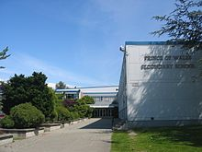
Questions? Concerns?
Feel free to see any of the counsellors in the Counselling Suite to ask any questions or discuss your course selections

