Slide 1
Science Options
What Should I Take?

Slide 2
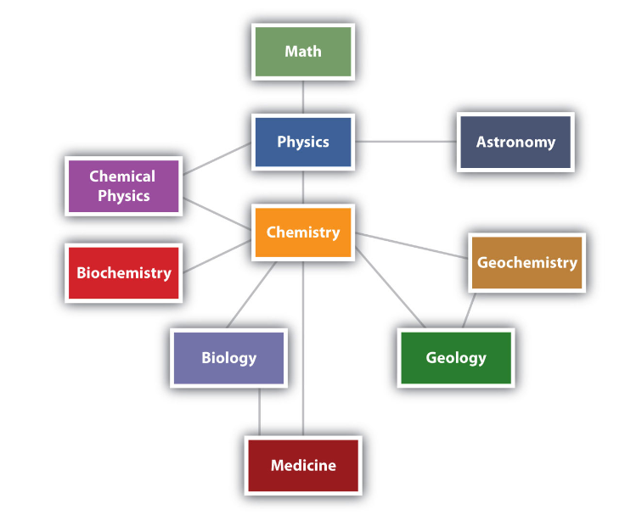
Science and Math are Interconnected

Slide 3
Questions to Ask Yourself
What do I need to graduate?
One grade 11 science
What am I interested in?
What do I need for my future studies?

Slide 4
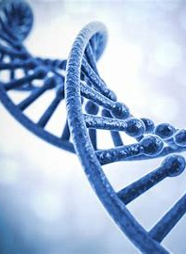
Biology
Life Sciences 11
Environmental Sciences 11
Anatomy and Physiology 12

Slide 5
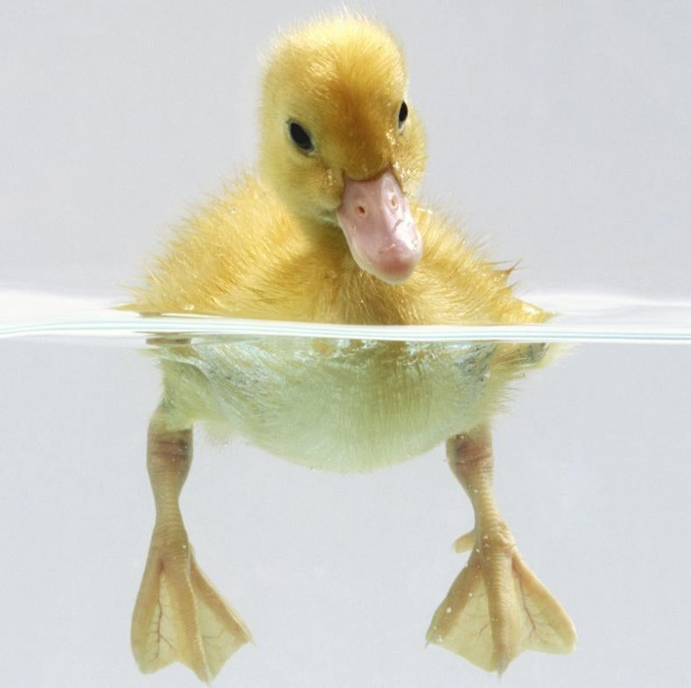
Life Sciences 11
Microbiology
Evolution
Invertebrates
Mammals
Plants
This is a survey course designed to expose you to many types of biology, some of which you may not have heard about.

Slide 6
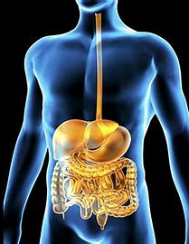
Human Anatomy and Physiology 12
Studies the human body from nutrients, to cells to the different organ systems.
If you are thinking about Health Sciences as a future career, this course will give insight into the field.
BUT: be prepared to take time to learn the material. The human body is an incredibly complex piece of machinery.

Slide 7
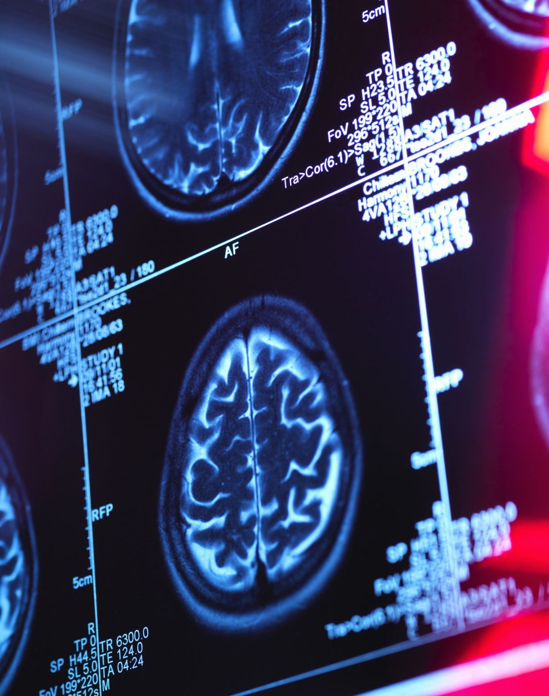
Frequently Asked Question
Do I have to take Life Sciences 11 to take Human Anatomy and Physiology 12?

Slide 8
Answer
There is no prerequisite for Human Anatomy and Phys. 12. However, students that have received less than an A in Science 10 often struggle with the material and do not achieve the marks that they are hoping for. Talk to your counselor or science teacher for guidance.
If you are planning to take first year Biology in University, one semester of the course relates to Life Sciences 11, so you will be at a disadvantage if you do not take this course in your first year.
It’s a fun course!

Slide 9
Environmental Science 11
The aim of this course is to cultivate a deeper understanding of the interconnectedness of our world.
The course is an extension of the ecology unit in grade 9 with a deeper dive into understanding the processes, diversity, sustainability, and stewardship of ecosystems.
Students should be willing to take the initiative for independent & group work, enjoy learning outside, and have a passion for the environment and sustainability issues.
Career opportunities in Enviro Sci. include green energy, conservation biology, physical geography, land-use planning, resource management, environmental law and more.

Slide 10
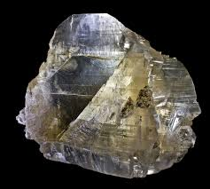
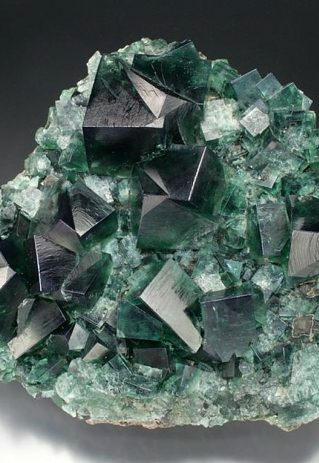
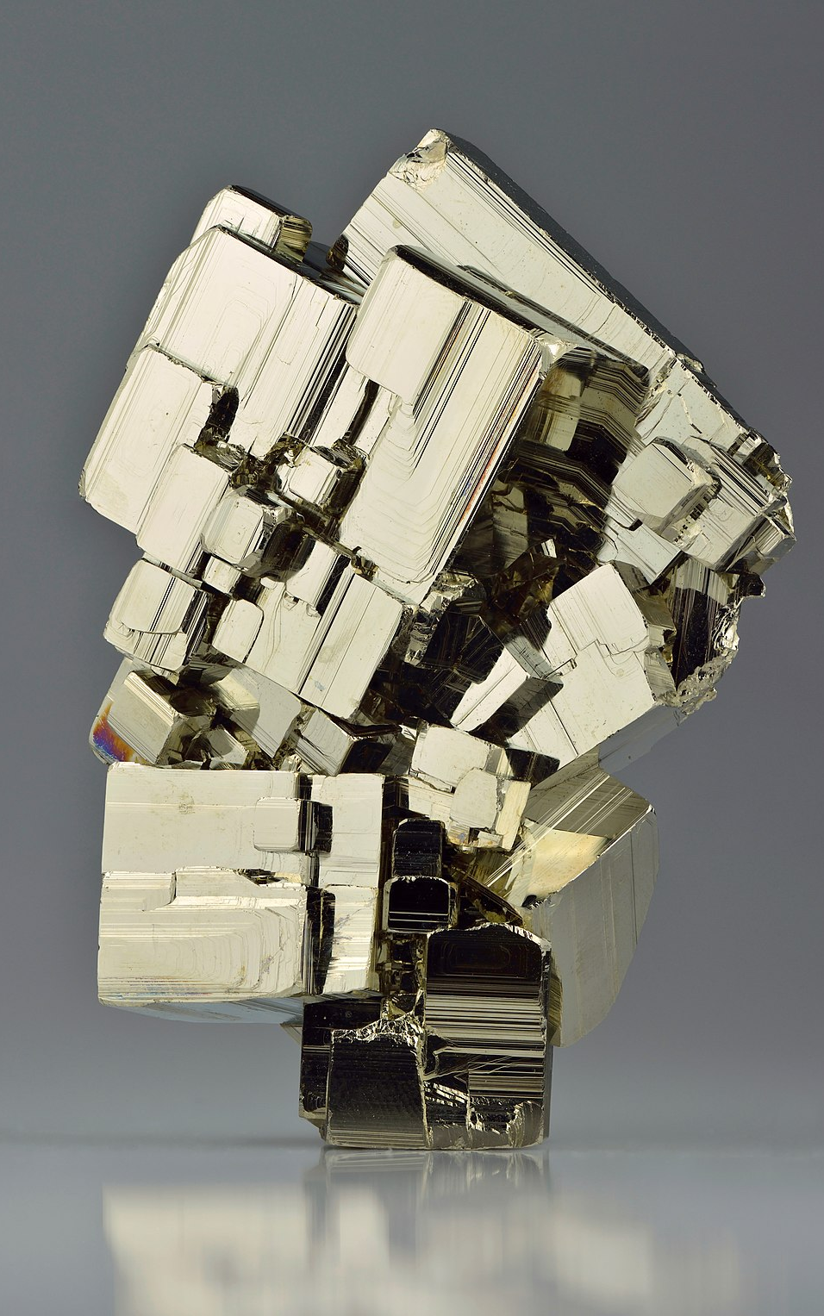
Earth Science 11
Have you ever wondered where the materials that make up your cell phone come from? Have you ever been interested in how the weather is predicted? Have you been interested in space and the celestial objects that make up our universe? Then earth science is the course for you!
Topics in earth science include:
Space
Rocks and Minerals
Plate Tectonics
Weather and the atmosphere
Climate Change
Oceanography
Geological Time

Slide 11
Chemistry 11
See the picture to the right?
Everyone thinks this is what you do. Beakers, Cauldrons, Bubbling flasks...
Sure...but first there is math. Lots of math. A good mark (70% better) in math 10 is a better indicator of success than a good mark in science 10. Keep that in mind!
If you work hard, you will learn a ton! Even if you don't go into science at postsecondary, this course is a necessary prereq. for a lot of programs! Here's a short list: science, applied biology, applied science (engineering), nursing, dental hygiene, food/nutrition/health, pharmaceutical sciences, urban forestry

Slide 12
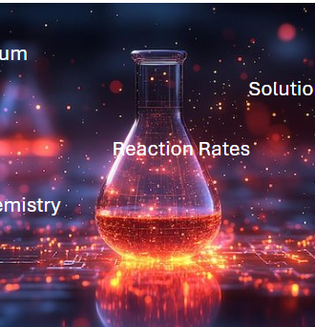
Chemistry 12
Is it harder than chemistry 11? Yes
Do I need chemistry 11? To do well, yes.
Are there lots of Labs? Yes. Loads
Be prepared to do a lot of practice, do lots of questions. Understanding concepts will be your goal instead of memorizing!

Slide 13
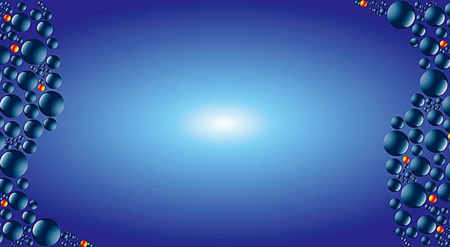
Physics
Physics is about understanding how the universe works,
from the biggest galaxies to the smallest particles.
Physics is a great way to build problem-solving skills,
and it’s super useful for anyone thinking about science,
engineering, health, or technology careers.
Ready to explore how the world works?

Slide 14
Physics 11
Things we will explore in Physics 11:
How things move (kinematics)
How forces make things move (dynamics)
Energy (heat, work)
Electricity (circuits)
Waves (sound, light)
To do well in Physics 11 you should have at least 70% in Science 10 and Math 10.

Slide 15
Do I need to take Physics 11 before Physics 12 to do well? Yes.
Physics 12 builds on your prior skills and knowledge so you’ll need good marks (> 70%) in Physics 11 and Pre-Calculus 11.

Slide 16
Physics 12
Dive deeper into how the universe works and apply physics to more advanced and complex problems.
Take Newton’s Laws to the next level, and go beyond with Einstein's Theory of Special Relativity.
Explore new physics topics including equilibrium, torque, momentum, and circular motion.
Understand electric charge and electric fields, and the link between electricity and magnetism.

Slide 17
To conclude…
Science is all around you and even if you are not planning to study science, any of these courses will help you understand the world around you. So…
Take one, two or three courses and explore the world!

