Slide 1
YOGA FOR LIFE 11/12
Ms. N. godwin
Killarney secondary

Slide 2
Yoga for life 11/12 – This slideshow will cover …
What is yoga?
Learning outcomes
A typical week
Assignments and assessment
Photos from one of our workshops: partner yoga
Student testimonials: what the 2024-2025 students have to say!
About Ms. Godwin

Slide 3
1. What is yoga?
Yoga 11/12 offers students a safe and accessible introduction to the ancient practice of yoga, exploring its diverse forms and styles. The course aims to foster a lifelong personal yoga practice that enhances physical health, mental clarity, and emotional balance. Through yoga, students can maintain excellent physical condition and cultivate positive relationships with themselves and others, making it a rewarding practice for life.
Students will engage in a variety of activities, including physical practice, personal reflection, partner exercises, group discussions, and classroom theory.
The physical practice of yoga helps students develop crucial skills such as strength, flexibility, cardiovascular endurance, balance, breath control, and mental focus. These skills contribute significantly to overall health and well-being and support other physical activities.
Yoga 11/12 is designed to accommodate all senior students, regardless of their abilities or fitness levels, and fulfills the requirements for a Physical and Health Education course credit.

Slide 4
2. Learning outcomes From the 2024-2025 course outline
Module 1: Proper Breathing and Asana Practice *note: Asana = yoga pose
Students will be expected to:
1.1 demonstrate foundational standing balance postures with proper alignment.
1.2 demonstrate foundational balance postures with proper alignment.
1.3 demonstrate the sun salutation sequence with proper alignment, integrating breath, postures, and movement.
1.4 demonstrate foundational seated postures with proper alignment
1.5 demonstrate backbends safely and with proper alignment.
1.6 demonstrate foundational restorative postures with proper alignment.
1.7 apply effective breathing techniques to their yoga practice.
1.8 demonstrate an understanding of anatomy and physiology as it applies to the intentional integration of breath, postures, and movement within the practice of yoga.
1.9 identify Asanas specific to their desired health benefits and create a yoga practice to use outside of class time.
Module 2: The Origins and Philosophy of Yoga
Students will be expected to:
2.1 demonstrate an understanding of the Eight Limbs of Ashtanga Yoga.
2.2 apply their understanding of yogic text and principles to their daily lives and yoga practice.
2.3 distinguish among the four paths of yoga to find the practice most suited to their personality.
Module 3: Integrating a Mindful Practice
Students will be expected to:
3.1 analyze their own eating patterns with respect to healthy and mindful eating practices.
3.2 explore relaxation techniques to observe thoughts and to manage emotions and stress and reflect on those techniques which are most effective to them.
3.3 apply the principles of yoga in a personal way outside of yoga practice.
Note: syllabus is subject to change, but this should give you a good idea of the content covered.

Slide 5
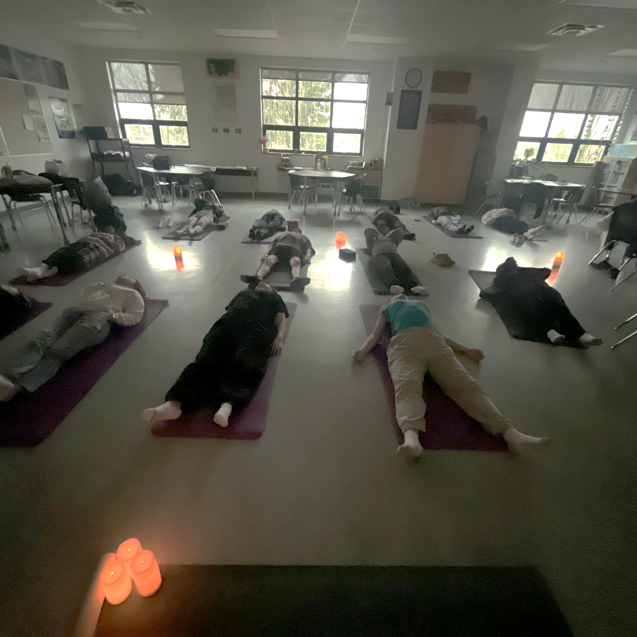
3. A typical week (during the 2024-2025 year)
*note this is subject to change from year to year. Email Ms. Godwin if you have questions!
“Mindful Mondays”: Journal entry, meditation, short yoga practice
Tuesdays: Hatha or Vinyasa yoga practice
“Workshop Wednesdays”: breaking down yoga postures, breathing techniques, philosophy, partner yoga, arm balances, etc.
Thursdays: Hatha or Vinyasa yoga practice
Fridays: Yin yoga practice

Slide 6
4. Assignments/assessment
2024-2025 sampling
Throughout the semester: Yoga journals collected weekly, marked on a 4-point scale for thought and completeness of the Mindful Monday prompts.
Yoga Habit – students chose an aspect of yoga theywanted to implement in their personal lives at home, which they tracked over 3 weeks and documented the benefits experienced.
Vision Board – students created a 2025 New Year vision board to “manifest” and visualize their ideal selves, including all aspects of wellness: physical, mental, emotional, social, etc.
Final: Teaching a yoga sequence – students chose a partner to teach a 30-min yoga sequence to the class. Each partner was responsible to cue breathwork and 5 postures (~15 min/each).

Slide 7
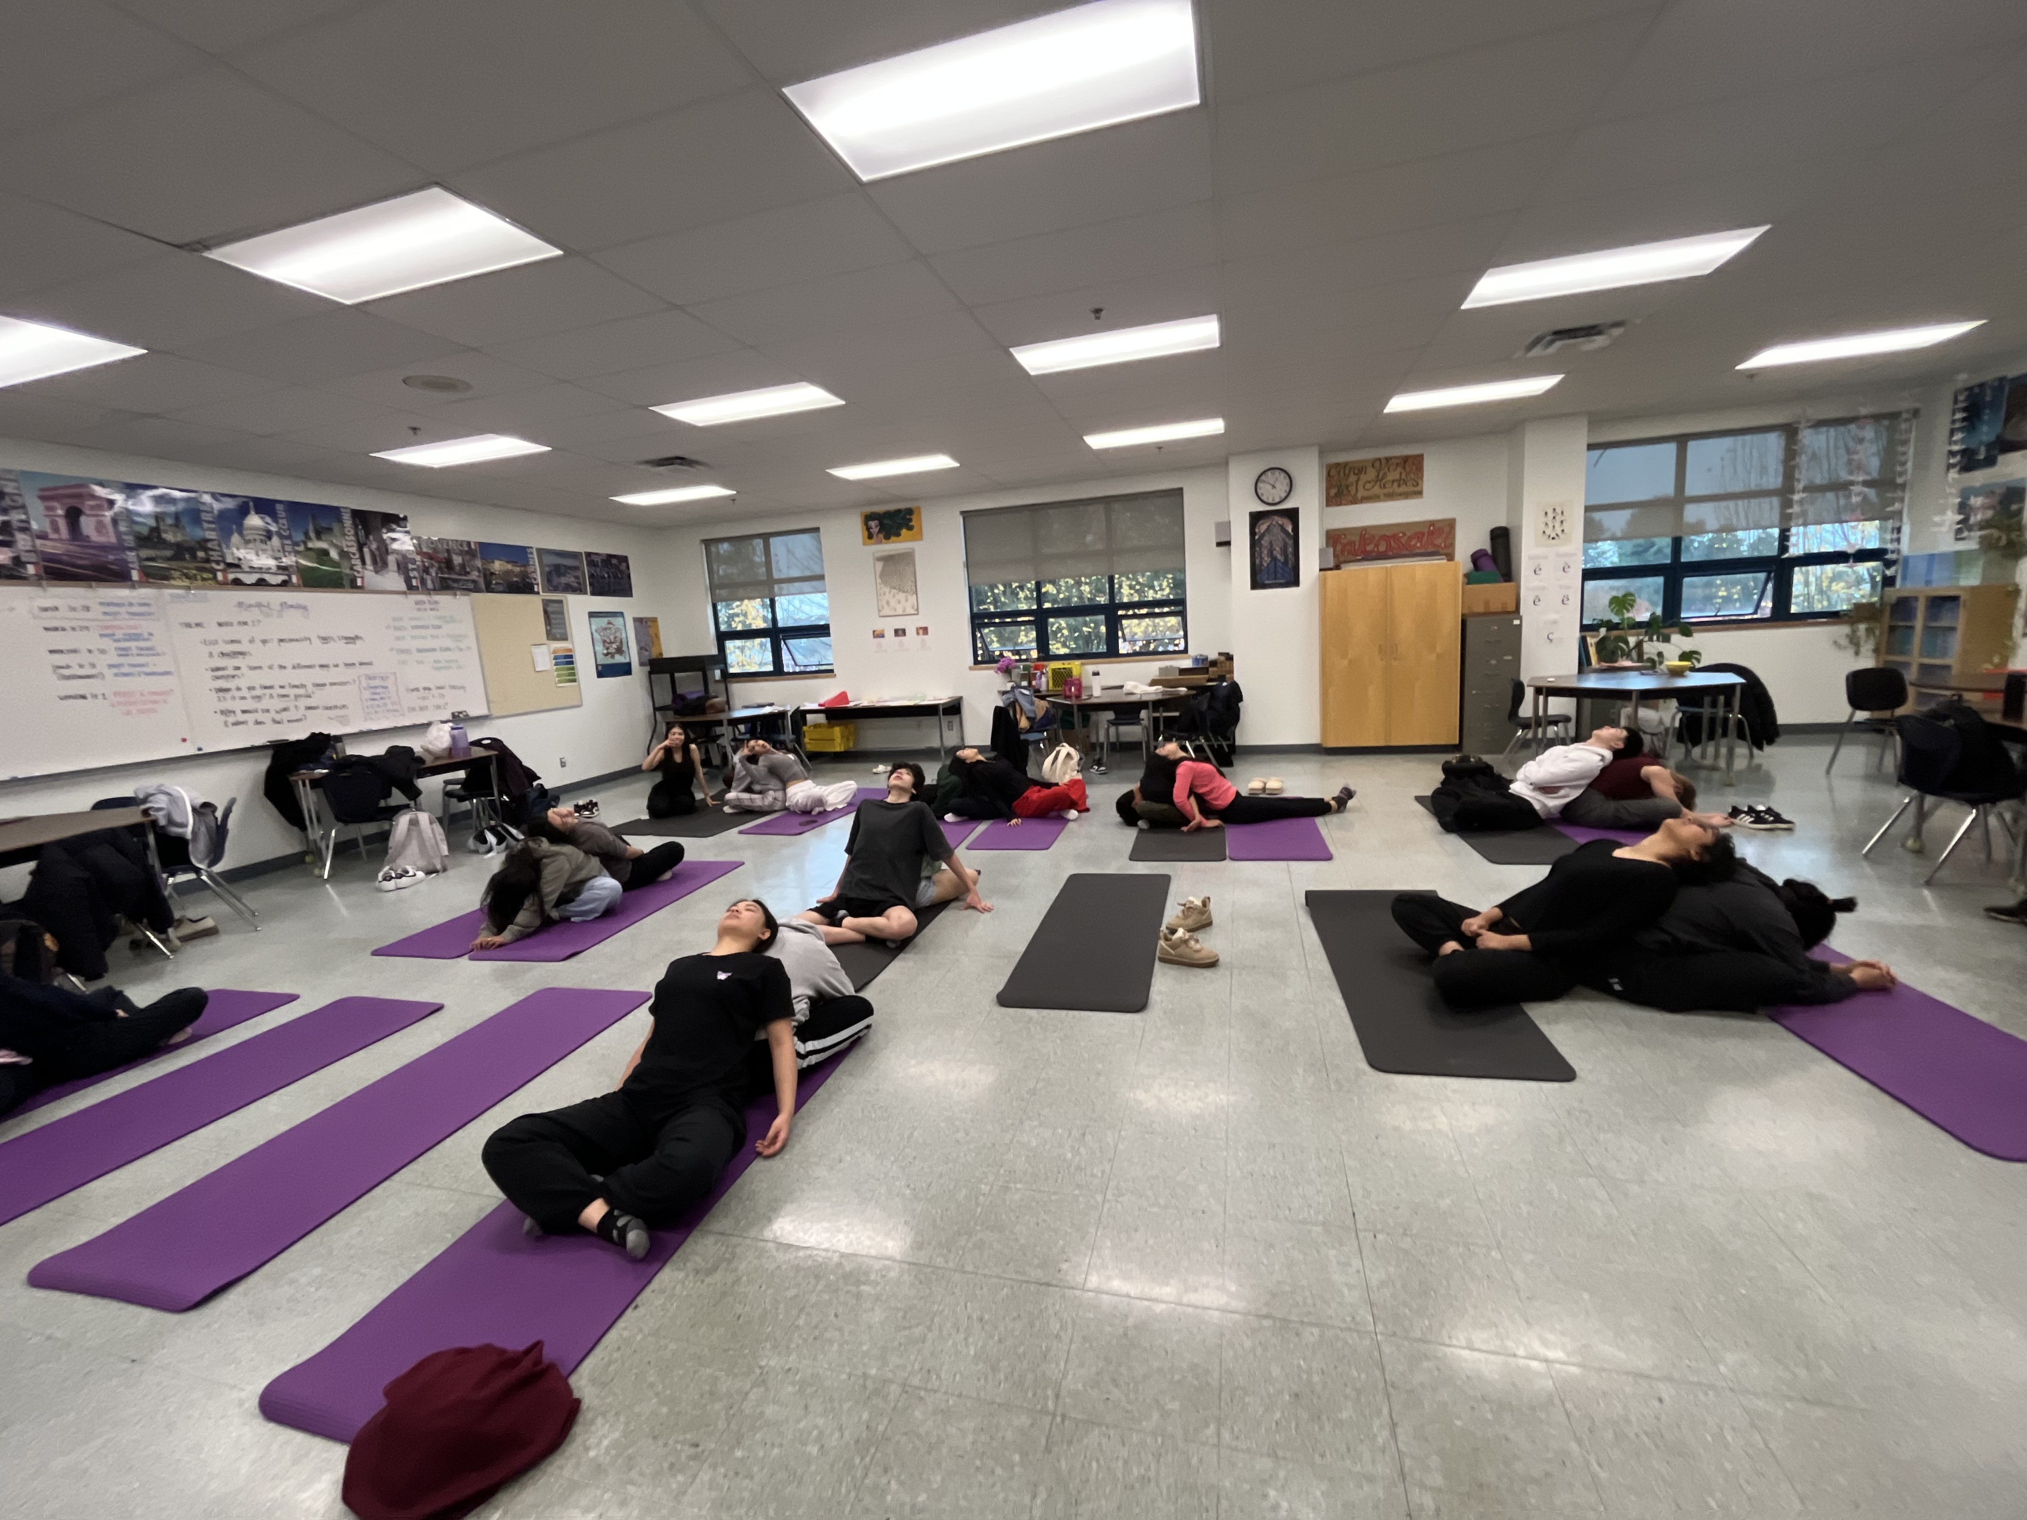
5. Partner yoga!

Slide 8
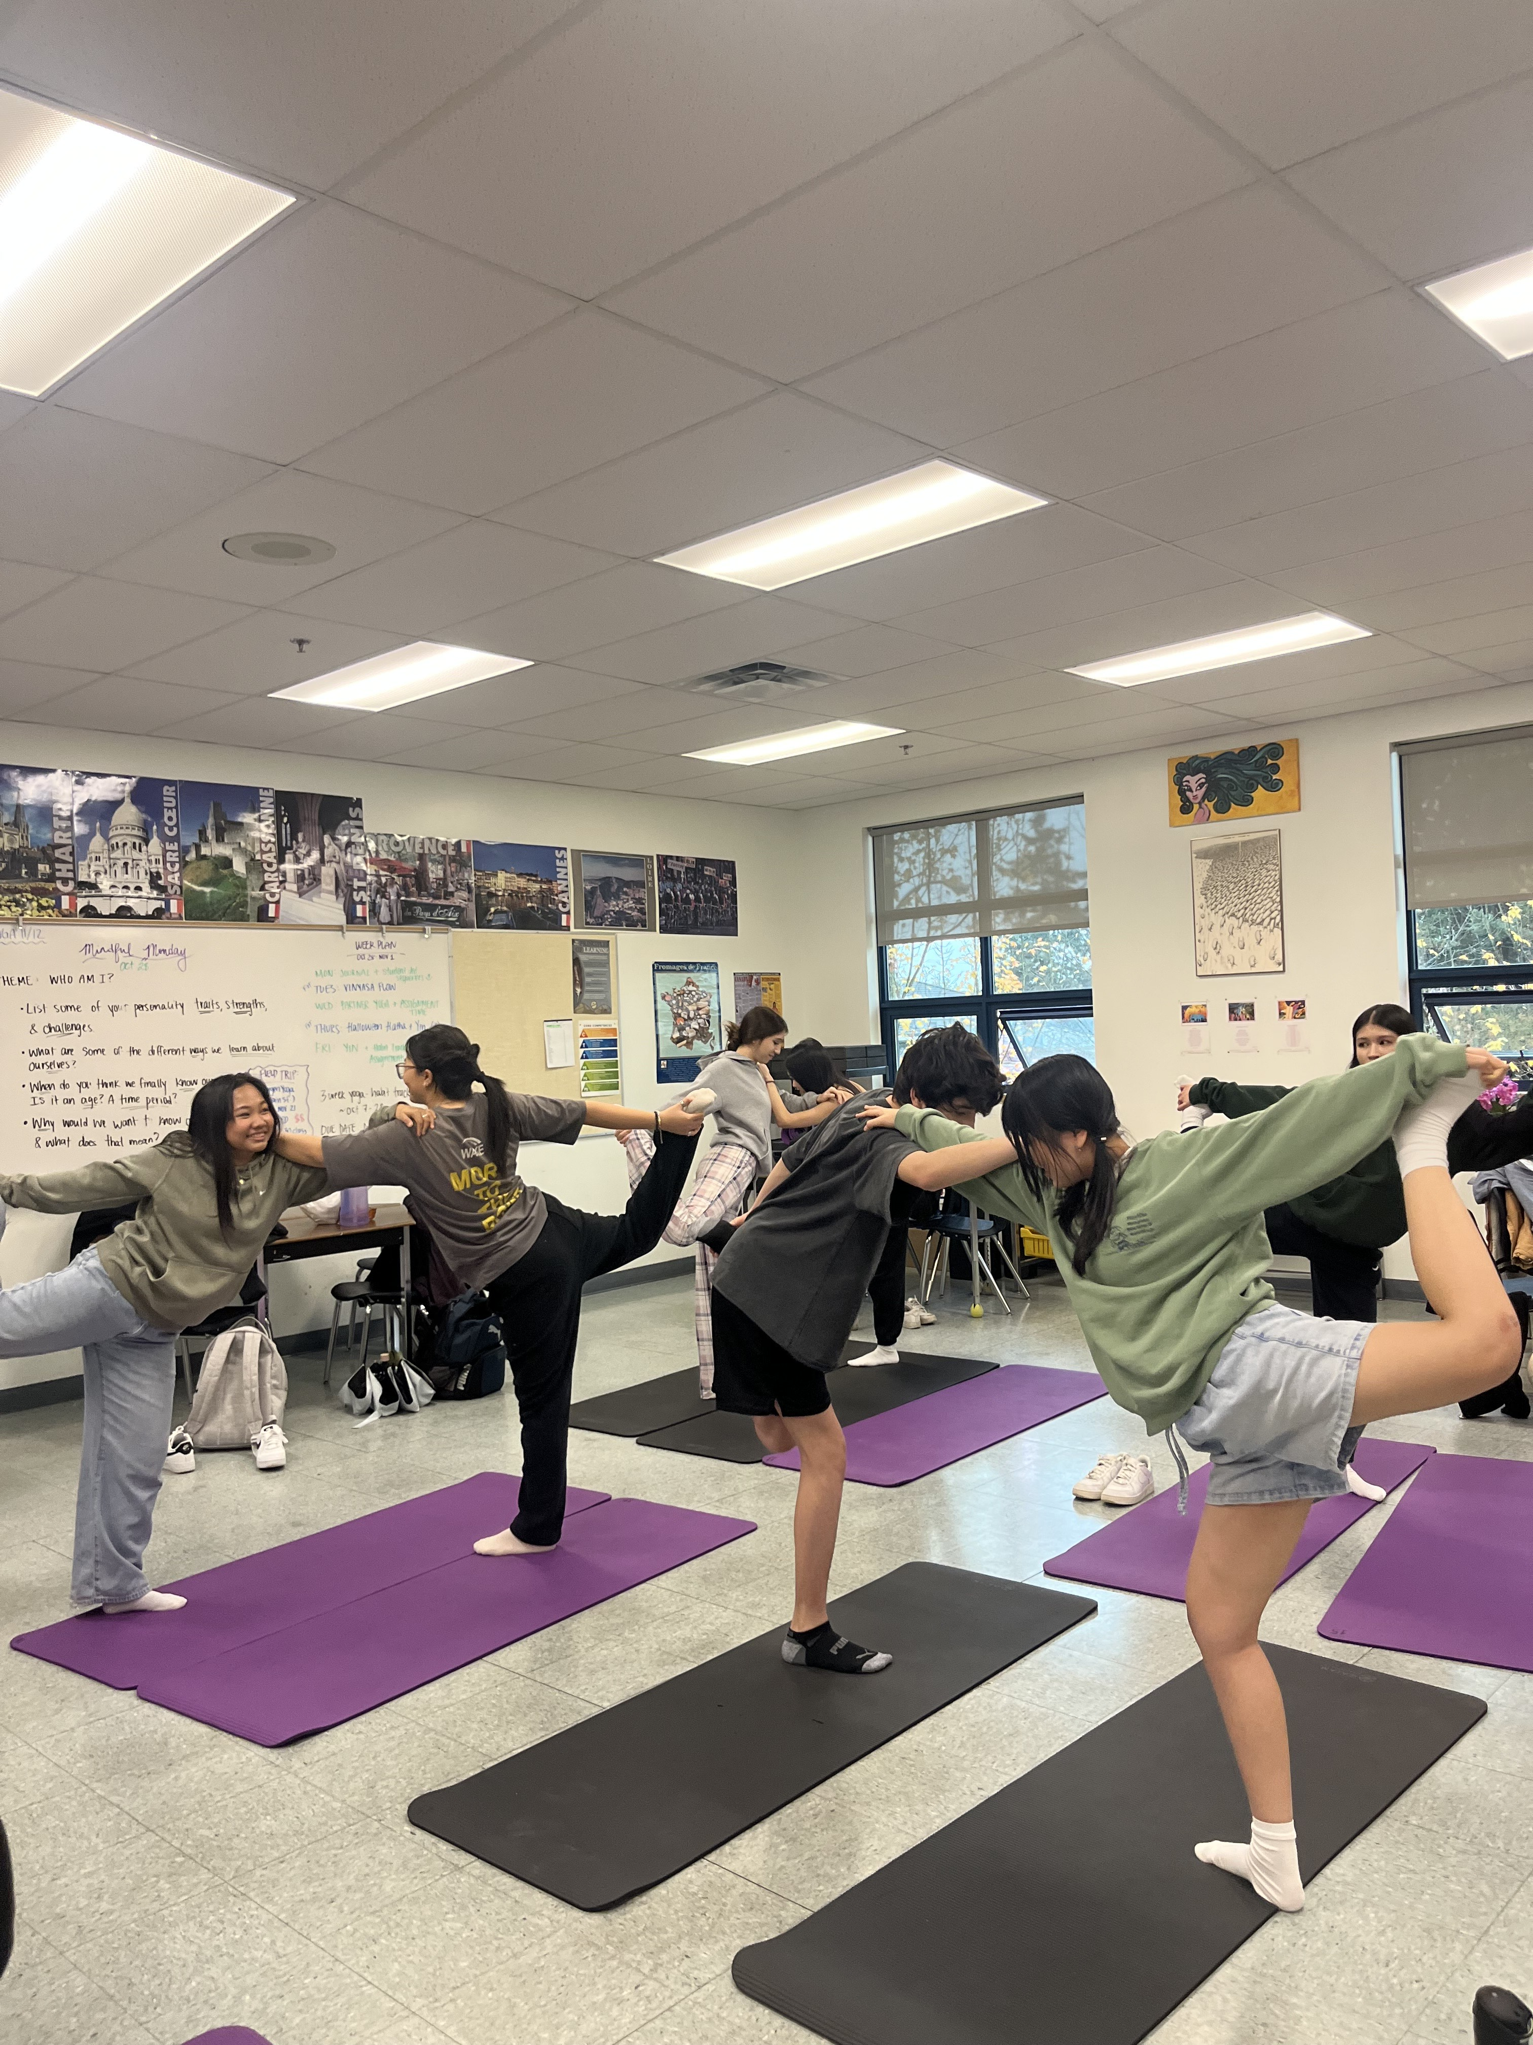
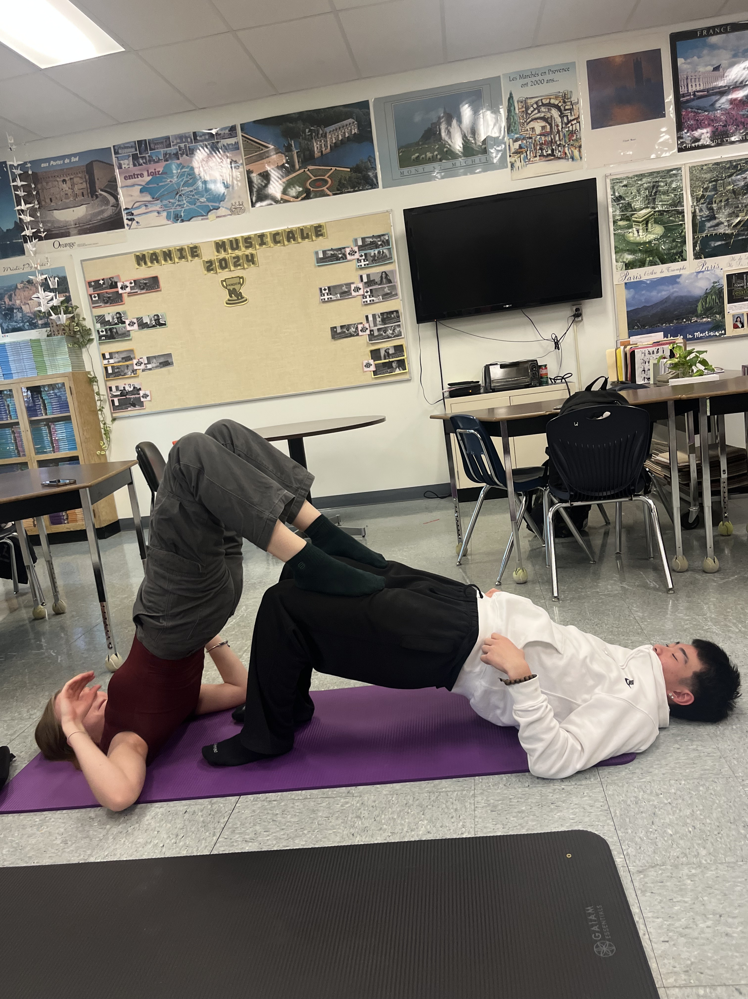
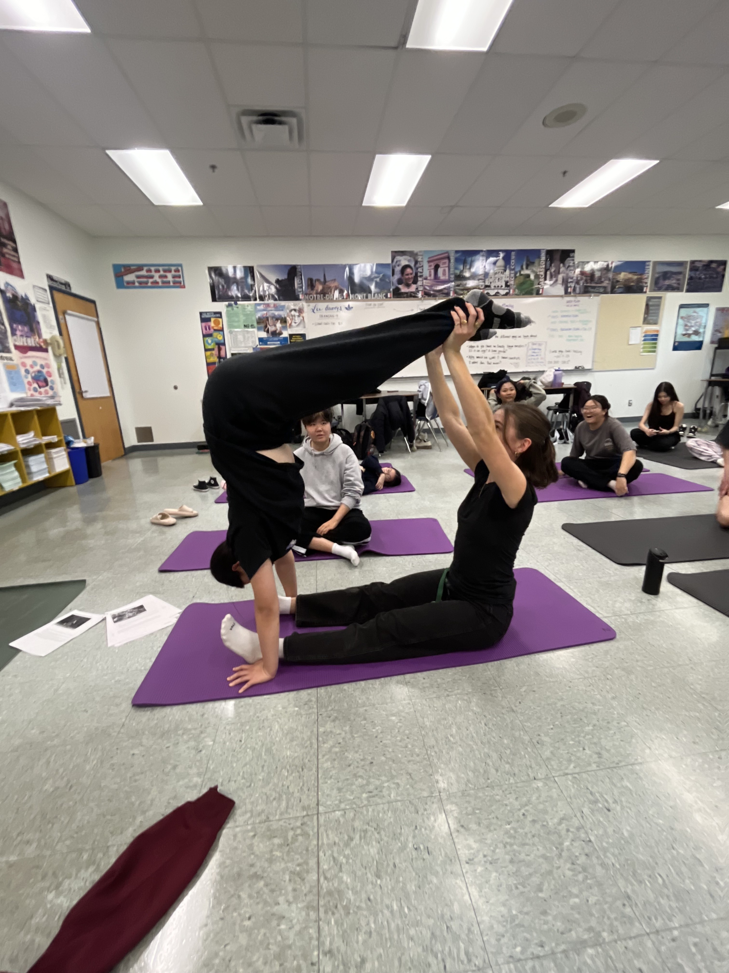
Partner yoga!

Slide 9
Partner yoga!

Slide 10
6. Student testimonials
I asked my yoga students “would you recommend this course to future students? What would you say to them if you wanted to give them a preview of what they will experience as a result of class?”
So don’t take it from me! Read what the first ever Killarney Yoga 11/12 (2024-2025 school year) students had to say over the next few slides.

Slide 11
Student testimonials
“Yoga class is a safe space to zen out, connect with people and channel your inner self. Live love laugh Ms. Godwin’s Yoga class. Become a yogi today!”
“Fun relaxing class. It’s very chill, and I bet you will ejoy following yoga sequences and learning new types of poses. In this calss I improved my flexibility, my mental and my physical health, and learned breathing techniques. I really recommend taking this course, everyone enjoys it.”
“Nice environment. Yoga really taught me that not all physical activities need to be vigorous.”
“I would tell people to join yoga if they want or need a relaxing class to clear their mind about anything. It’s not active in the same way as PE class. It still gets the body moving and makes you feel better. It’s a good course to take.”

Slide 12
Student testimonials
“I recommend yoga to any senior student because it really helps manage stress levels and teaches a type of movement that can be done after graduation.”
“Yoga is a great course to take if you wish to improve your mental health while being active in the process. Yoga is not just about stretching. There are many more aspects to it that opens your perspective within that realm while bringing it into reality. Recommended for senior students who have completed PE 10 and seek for a stress relieving course to have in their schedule”
“I really enjoyed yoga class so much ☺ If you want a chill class I recommend taking yoga class. Not just it was chill, fun, but also it will improve your mental well-being. Let’s go YOGA ☺ “
“Yoga teaches us about relaxing and balancing ourselves”

Slide 13
Student testimonials
“As a senior student, I would absolutely recommend yoga to fellow senior students. This course gives you the best mental break that any senior student needs. It makes you feel goodw ith your body. You can move easier and become physically stronger. It’s a casual gym course, that challenges you and makes you happy.”
“A great class to make friends and just chill. Friendly and cozy vibes is what this class is. This class is perfect if you need an academic break between a hectic schedule and if you just need to take your mind off things. Yoga really helps take your thoughts away from the outside world.”

Slide 14
Student testimonials
“This yoga 11/12 class 2024 is overall so awesome! Yoga helps me on improving my breathing, better posture, better mood, and improves with the physical factors too like flexibility, strength and stamina. It’s really chill and fun in this class. I absolutely love my classmates and teacher! They’re all so friendly and fun to be with! You get to make new friends and create good memories with the class. I totally recommend others to take this class!”
“Yoga 11/12 is a very amazing class. It’s calm, chill, and overall a good class to take. It helps build flexibility and strength. You get to meet new people and listen to calming music. The whole intention of this class is to be stress free and living in the moment. Join now!”

Slide 15
7. About ms. Godwin & yoga
While I teach French and have taught Art at Killarney, Yoga is a passion of mine. I have my 200hr Yoga Certification from Green Yoga International, for which I spent the summer of 2022 in Majorca, Spain, studying and practicing yoga.
Currently, I volunteer at a yoga studio and practice there regularly. My life would not be the same without it and I would be thrilled to impart the physical and mental benefits of yoga so that you have a calmer and more confident Grade 12 year of high school!

Slide 16
Thank you!
For any questions, email
negodwin@vsb.bc.ca
Killarney Secondary

